Slide 1

单片机课程应用设计 课程汇报

Slide 2

功能： 1、按下按键0，音乐长生诀开始，同时按照音乐节奏LED灯开始闪烁，LCD显示屏显示歌曲名“Mean of Immortality”。 2、按下按键1，音乐Flower Dance开始，同时LED灯开始闪烁，LCD显示屏显示歌曲名“Flower Dance”。 3、按下按键2，音乐Illusionary Daytime开始，同时LED灯开始闪烁，LCD显示屏显示歌曲名“Illusionary Daytime”。 4、按下按键3，中断正在运行的程序。

Slide 3
组员分工 任轶凡 负责编程歌曲3及Button部分 詹靖宇 负责编程歌曲1、2及Button部分 陈紫瑞 负责编程LCD部分 葛新楠 负责编程LED部分

Slide 4
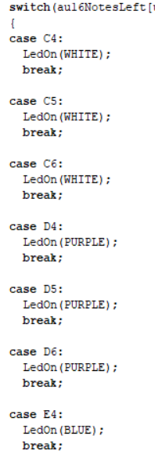
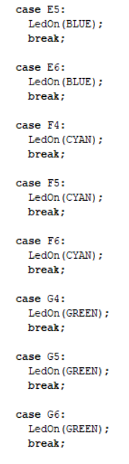
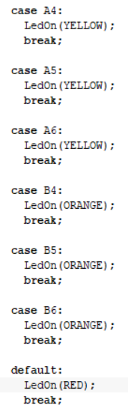
LED灯 闪烁 节奏

Slide 5
歌曲程序 static u16 au16NotesLeft[] = {E5, D5, A5, D5, E5, D5, A4, D5, E5, D5, A5, D5, E5, D5, A4, D5, E5, D5, A5, D5, E5, D5, A4, D5, E5, D5, A5, D5, E5, D5, A4, D5, E5, D5, A5, D5, E5, D5, A4, D5, E5, D5, A5, D5, E5, D5, A4, D5, E5, D5, A5, D5, E5, D5, A4, D5, E5, NONE, E5, A4, C5, E5, D5, G5, NONE ,D5, B5, A5, G5, A5, E6, NONE , A5, E6, D6, E6, D6, B5, G5, A5, NONE ,E5, E5, A4, C5, E5, D5, G5, NONE ,D5,G5,A5,B5,C6,B5,A5,E5 ,E5,C6,D5,B5,C5,A5,B5,G5 ,A5,E6,D6,E6 ,A5,E6,D6,E6 ,A5,E6,D6,E6,A5,E6,D6,E6 ,A5,E6,D6,E6 ,E5 ,C6,B5,C6,E6,B5,A5,G5 ,E5,G5,A5,G5,A5,C6,G5,F5,E5 ,E5,G5,F5,E5,D5,F5,E5,D5,C5,E5,D5,C5,B4,A4,G4S,A4,B4,NONE ,C5,B4,C5,E5,B4,A4,G4 ,E4,G4,A4,A4,G4,A4,B4,C5,A4,G4,F4,E4 ,E4,G4,F4 ,F5,E5,D5,C5,B4 ,E5,D5,E5,F5,E5,D5,C5,B4 ,A4,E5,A4,E5,A4 ,NONE }; static u16 au16DurationLeft[] = {EN, EN, EN, EN, EN, EN, EN, EN, EN, EN, EN, EN, EN, EN, EN, EN, EN, EN, EN, EN, EN, EN, EN, EN, EN, EN, EN, EN, EN, EN, EN, EN, EN, EN, EN, EN, EN, EN, EN, EN, EN, EN, EN, EN, EN, EN, EN, EN, EN, EN, EN, EN, EN, EN, EN, EN, QN, FN, QN, SN, EN, EN, QN, EN, EN ,QN, SN, EN, EN, QN, EN, EN , QN, QN, EN, SN, SN, EN, EN, QN, HN ,EN, QN, EN, SN, EN, QN, EN, EN , EN,EN,EN,EN,EN,EN,EN,EN ,SN,SN,SN,SN,SN,SN,SN,SN,SN,SN,SN,SN,SN,SN,SN,SN,SN,SN,SN,SN,SN,SN,SN,SN ,SN,SN,SN,SN ,QN ,EN,EN,EN,EN,EN,EN,EN ,SN,SN,EN,EN,EN,EN,EN,EN,EN ,SN,SN,EN,EN,EN,EN,EN,EN,EN,EN,EN,EN,EN,EN,EN,EN,EN ,EN ,EN,EN,EN,EN,EN,EN,EN ,SN,SN,EN,SN,SN,SN,SN,SN,SN,EN,EN,EN ,SN,SN,EN ,SN,SN,SN,SN,EN ,SN,SN,SN,SN,SN,SN,SN,SN ,EN,EN,EN,EN,QN ,FN }; static u16 au16NoteTypeLeft[] = {RT, RT, RT, RT, RT, RT, RT, RT, RT, RT, RT, RT, RT, RT, RT, RT, RT, RT, RT, RT, RT, RT, RT, RT, RT, RT, RT, RT, RT, RT, RT, RT, RT, RT, RT, RT, RT, RT, RT, RT, RT, RT, RT, RT, RT, RT, RT, RT, RT, RT, RT, RT, RT, RT, RT, RT, RT, RT, RT, RT, RT, RT, RT, RT, RT ,RT, RT,RT,RT,RT,RT,RT,RT,RT,RT,RT,RT,RT, ,RT,RT ,RT,RT,RT,RT,RT,RT,RT,RT ,RT,RT,RT,RT,RT,RT,RT,RT ,RT,RT,RT,RT,RT,RT,RT,RT,RT,RT,RT,RT,RT,RT,RT,RT,RT,RT,RT,RT,RT,RT,RT,RT ,RT,RT,RT,RT ,RT ,RT,RT,RT,RT,RT,RT,RT ,RT,RT,RT,RT,RT,RT,RT,RT,RT ,T,RT,RT,RT,RT,RT,RT,RT,RT,RT,RT,RT,RT,RT,RT,RT,RT ,RT ,RT,RT,RT,RT,RT,RT,RT ,RT,RT,RT,RT,RT,RT,RT,RT,RT,RT,RT,RT ,RT,RT,RT ,RT,RT,RT,RT,RT ,RT,RT,RT,RT,RT,RT,RT,RT ,RT,RT,RT,RT,RT ,RT };

Slide 7
//static u16 au16NotesLeft[] = {A5,B5,C6,D6,E6,NONE, D6,E6,G6,NONE ,F6,D6,E6,NONE ,D6,E6,G6,NONE ,F6,D6,E6,NONE,D6,C6,A5 ,G5,A5,B5,NONE,A5,G5,E5,NONE }; //static u16 au16DurationLeft[] = {EN,EN,EN,EN,QN,SN , EN,EN,HN,SN ,EN,EN,QN,SN ,EN,EN,HN,SN ,EN,EN,EN,SN, EN,EN,QN ,EN,EN,EN,SN, EN,EN,QN,HN }; //static u16 au16NoteTypeLeft[] = {RT,RT,RT,RT,RT,RT , RT,RT,RT,RT ,RT,RT,RT,RT ,RT,RT,RT,RT ,RT,RT,RT,RT, RT,RT,RT ,RT,RT,RT,RT, RT,RT,RT,RT }; static u16 au16NotesRight[] = {E5,G5,D5,D5,C5,B4,G5,D5,D5,D5,C5,B4,E5,C5,C5,B4,A4,E4,E4,C5,C5,B4,B4,G4,G5,D5,D5,C5,B4,G5,D5,D5,D5,C5,B4,E5,C5,C5,B4,A4,E4,E4,C5,C5,B4,B4,G4,E4,NO,NO}; static u16 au16DurationRight[] = {QN,QN,QN,QN,QN,EN,EN,QN,EN,QN,QN,EN,QN,QN,QN,QN,QN,EN,EN,EN,EN,EN,EN,EN,EN,QN,EN,QN,EN,EN,QN,QN,QN,QN,EN,EN,QN,QN,QN,QN,EN,EN,EN,EN,EN,EN,EN,EN,FN,FN}; static u16 au16NoteTypeRight[] = {RT,RT,RT,RT,RT,RT,RT,RT,RT,RT,RT,RT,RT,RT,RT,RT,RT,RT,RT,RT,RT,RT,RT,RT,RT,RT,RT,RT,RT,RT,RT,RT,RT,RT,RT,RT,RT,RT,RT,RT,RT,RT,RT,RT,RT,RT,RT,RT,RT,RT};

Slide 8
//static u16 au16NotesLeft[] = {G5, A5, D6, C6, D6, D6, D6, C6, D6, D6, D6, D6, C6, D6 ,D6, D6, D6, C6, D6, A5, NONE , A5, C6, D6, D6, D6, C6, D6, D6, D6, D6, C6, D6 ,D6, D6, D6, C6, G6, E6, NONE , A5, C6, D6, D6, D6, C6, D6, D6, D6, D6, C6, D6 ,D6, D6, D6, C6, D6, A5, NONE , A5, G5, A5, A5, A5, G5, A5, B5, B5, B5, A5, G5, A5, NONE, NONE }; //static u16 au16DurationLeft[] = {EN, EN, EN, EN, EN, SN, SN, EN, EN, EN, SN, SN, EN, EN, EN, SN, SN, EN, EN, EN, EN , EN, EN, EN, SN, SN, EN, EN, EN, SN, SN, EN, EN, EN, SN, SN, EN, EN, EN, EN , EN, EN, EN, SN, SN, EN, EN, EN, SN, SN, EN, EN, EN, SN, SN, EN, EN, EN, EN , EN, EN, EN, SN, SN, EN, EN, EN, SN, SN, EN, EN, EN, HN, QN }; //static u16 au16NoteTypeLeft[] = {RT, RT, RT, RT, RT, RT, RT, RT, RT, RT, RT, RT, RT, RT, RT, RT, RT, RT, RT, RT, RT , RT, RT, RT, RT, RT, RT, RT, RT, RT, RT, RT, RT, RT, RT, RT, RT ,RT, RT, RT , RT, RT, RT, RT, RT, RT, RT, RT, RT, RT, RT, RT, RT, RT, RT, RT ,RT, RT, RT , RT, RT, RT, RT, RT, RT, RT, RT, RT, RT, RT, RT, RT ,RT, RT }; // static u16 au16NotesLeft[] = { E5, C6, B5, A5, G5, E5, D5, E5, A5, G5, NONE , E5, C6, B5, A5, G5, E5, D5, E5, D5, E5, NONE , E5, G5, A5, G5, A5, E6, NONE, D6, B5, B5, G5, E5, NONE , E5, C6, B5, A5, G5, E5, D5, E5, A5, G5, NONE , E5, C6, B5, A5, G5, E5, D5, E5, E6, D6, C6, NONE , A5, B5, C6, B5, C6, E6, D6, D6, B5, G5, E5, A5, NONE }; // static u16 au16DurationLeft[] = { EN, EN, EN, EN, EN, QN, EN, QN, QN, QN, EN , EN, EN, EN, EN, EN, QN, EN, QN, QN, HN, EN , EN, EN, QN, EN, QN, QN, EN, QN, QN, EN, QN, HN, HN , EN, EN, EN, EN, EN, QN, EN, QN, QN, QN, EN , EN, EN, EN, EN, EN, QN, EN, QN, QN, EN, QN, QN , EN, EN, QN, EN, QN, QN, EN, QN, QN, QN, QN, HN, QN }; //static u16 au16NoteTypeLeft[] = { RT, RT, RT, RT, RT, RT, RT, RT, RT, RT, RT , RT, RT, RT, RT, RT, RT, RT, RT, RT, RT, RT , RT, RT, RT, RT, RT, RT, RT, RT, RT, RT, RT, RT, RT , RT, RT, RT, RT, RT, RT, RT, RT, RT, RT, RT , RT, RT, RT, RT, RT, RT, RT, RT, RT, RT, RT, RT , RT, RT, RT, RT, RT, RT, RT, RT, RT, RT, RT, RT, RT };

Slide 9
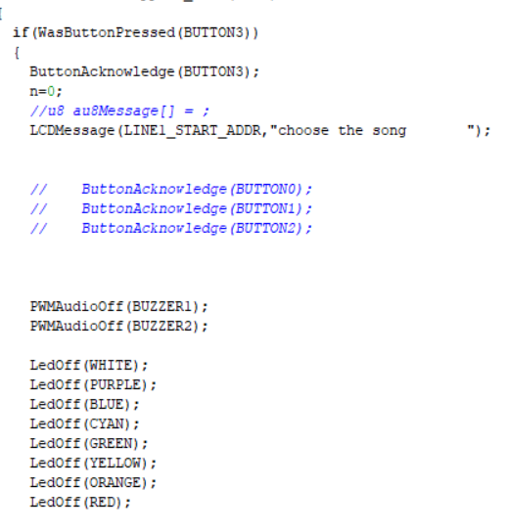
BUTTON3的程序

Slide 10
设计展示

Slide 11
Thank You

