Slide 1


University Travel Assistant
COMP7940 - Cloud Computing
Team Members:
He Yifan, Gou Jiajie, Wang Huayu

Slide 2
Content
Project Overview & Core Value
Core Features Showcase
System Architecture & Design
DevOps & Automation
Summary

Slide 3
01. Project Overview & Core Value

Slide 4
Project Overview & Objectives
Vision: Transforming a local telegram bot prototype into a production-grade, highly available travel assistant.
Core Value: Providing intelligent, traveling-advice services for HKBU students.
Key Challenges Addressed:
Scalability via containerization.
High Availability through load balancing.
Observability using structured logging and monitoring.

Slide 5
02. Core Feature Showcase

Slide 6
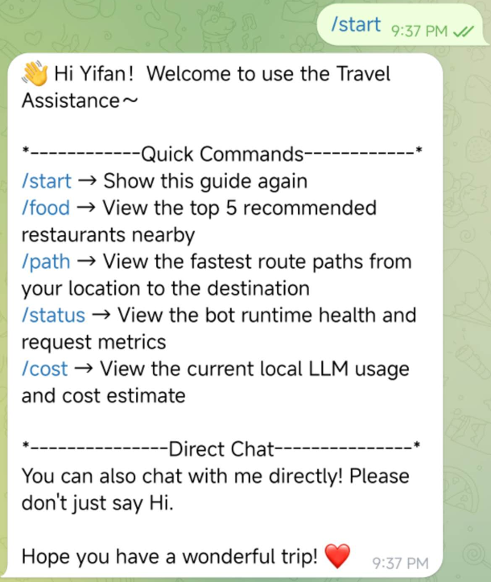
/start
the /start command is a user-friendly interactive menu which lists all available shortcut commands.

Slide 7
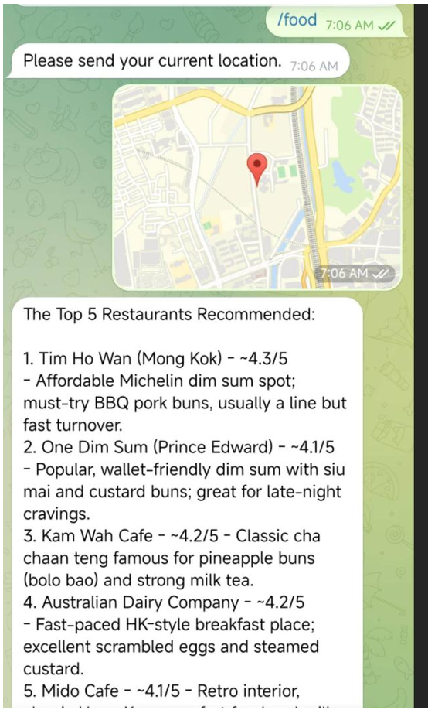
/food
the /food command curates the top 5 highest-rated restaurants based on the user’s current location.

Slide 8
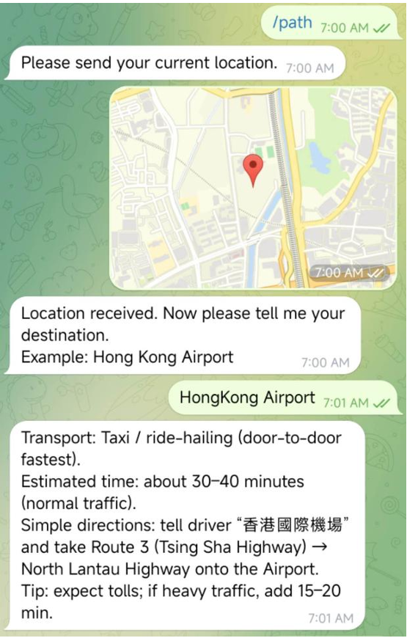
/path
the /path provides intelligent route planning between the destination and the current location.

Slide 9
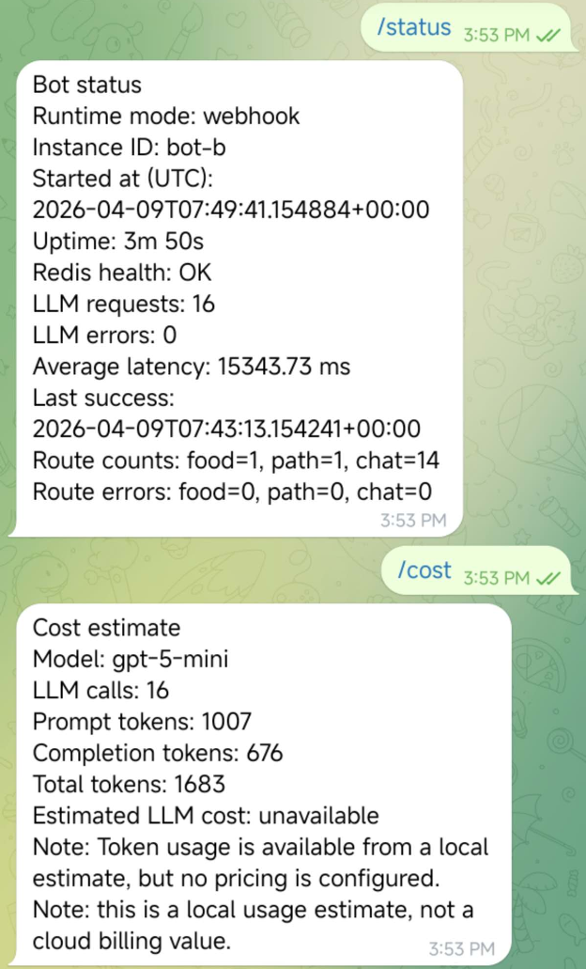

/status & /cost
/status: Displays the bot’s real-time operational status.
/cost: Provides a detailed estimate of LLM token usage and associated costs.
Note: The last two commands are for administrators only.

Slide 10
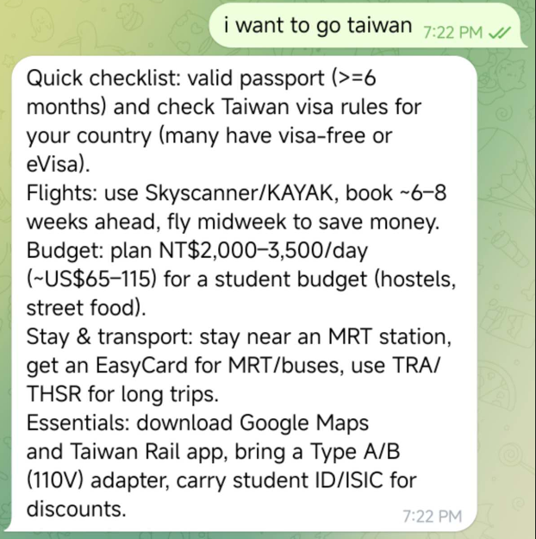
Chat directly
You can also chat directly with our chatbot for a personalized travel plan.

Slide 11
03. System Architecture & Design

Slide 12
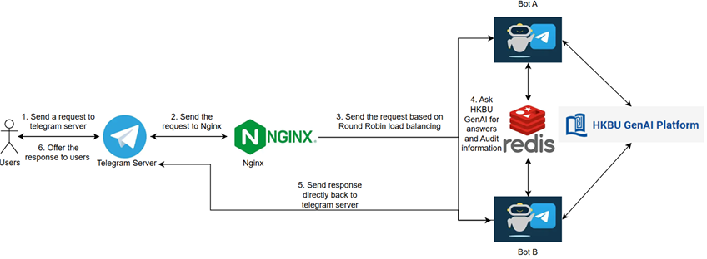
System Design Diagram
Stateless Design: All session data is externalized to Redis, allowing any bot instance to handle any request.
Hot Data (Redis): Real-time chat logs and metrics for the /status command.
Cold Data (EC2): JSONL archiving with a 7-day auto-rotation policy.
Webhook Architecture:
Efficient event-driven communication with Telegram API.
Uses Nginx as a Reverse Proxy/Load Balancer.
Redundancy & Load Balance: Dual-instance deployment (bot-a and bot-b) to eliminate single points of failure.

Slide 13
04. DevOps & Automation

Slide 14
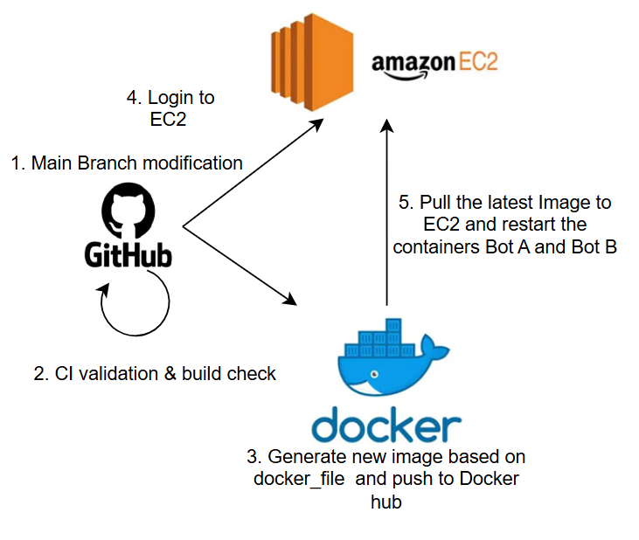
DevOps Workflow
CI/CD Pipeline: GitHub Actions automates the entire lifecycle (Validation -> Build -> Push -> Deploy).
Secrets Management: GitHub Secrets used for secure storage of API Keys and server credentials.

Slide 15
05. Summary

Slide 16
Conclusions
01
Success: Delivered a robust, secure, and cost-effective cloud solution.
02
Learnings: Mastery of Docker orchestration, Nginx load balancing, and automated DevOps workflows.
03
Future Work: Integration of campus event scraping and real-time shuttle bus tracking.

Slide 17
Thank You!

