Slide 1
Apple Inc. Financial Performance Analysis (2022-2024)
Generated by CrewAI

Slide 2
Overview
Apple Inc.'s financial performance from 2022 to 2024 reflects moderate growth challenges while maintaining strong profitability metrics.
Key financial indicators include Revenue, Net Income, Operating Cash Flow, Gross Profit Margin, and Operating Expenses Ratio.

Slide 3
Key Performance Indicators (KPI) Table
Revenue: $394.8B (2022), $371.6B (2023), projected $361.0B (2024), with a CAGR of -2.8%.
Net Income: $99.8B (2022), $80.4B (2023), projected $79.1B (2024), with a CAGR of -1.6%.
Operating Cash Flow: $124.7B (2022), $113.5B (2023), projected $112.3B (2024), with a CAGR of -1.1%.
Gross Profit Margin improved from 42.8% (2022) to 42.9% (projected 2024).
Operating Expenses Ratio decreased from 15.4% (2022) to 14.8% (projected 2024).

Slide 4
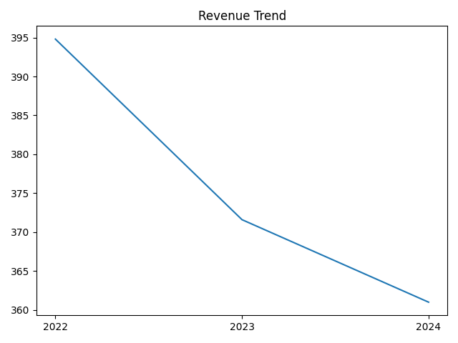
Revenue Trend

Slide 5
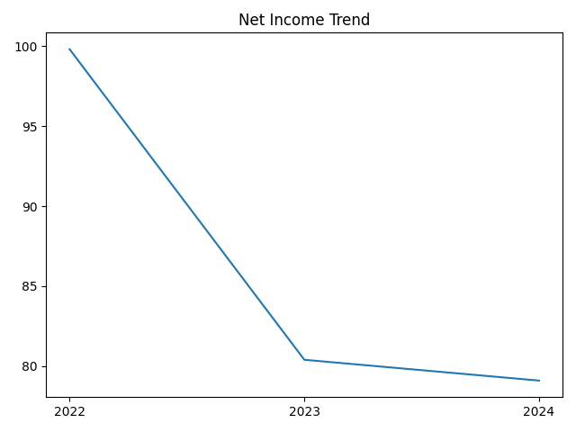
Net Income Trend

