Slide 1
A lightweight task submission and management infrastructure
Xiaomei Zhang
CHEP2016

Slide 2



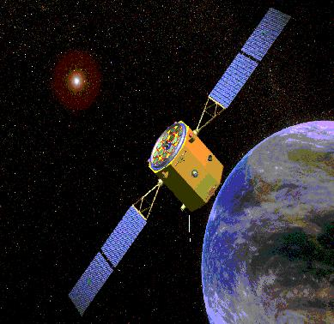
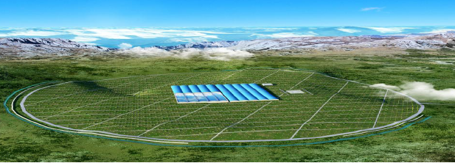
Experiments n IHEP
Current experiments
BESIII
DYB
YBJ
New experiments
JUNO
LHAASO
HXMT
CEPC
DYB (Daya Bay Reactor
Neutrino Experiment)
BESIII (Beijing Spectrometer III at BEPCII)
e+
IP1
e-
LTB
CEPC
BTC
BTC
e+ e- Linac
(240m)
JUNO (Jiangmen Underground
Neutrino Observatory)
Booster(50Km)
CEPC Collider Ring(50Km)
IP2
HXMT
LHAASO
Large High Altitude Air Shower Observatory
Hard X-Ray Moderate Telescope

Slide 3
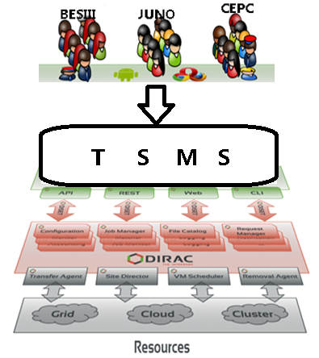
Multi-VO distributed computing
More than one experiments express interests on using or evaluating distributed computing resources
DIRAC was adopted to build distributed computing system for BESIII in 2012
Multi-VO supports has been extended in one set-up to run JUNO and CEPC jobs
Task Submission and Management System (TSMS) is one of the necessary steps for new experiments to have a try and use in their early stages

Slide 4
JSUB
Goals:
Ease the procedure to use heterogeneous resources
Automatically manage massive jobs
Highly Extensible for other experiments
Life cycle of a task (a batch of jobs in one submission)
split->submit->run->status monitor->output retrieval -> reschedule
reschedule
submit
split
Job1
.
.
.
run
output
Dirac
Task
worknode
SE
jobn
Batch
Monitor

Slide 5





Architecture
Functions:
User interface
Job submission
Job management
Data management
Backend supports
UI
CLI
Profile
web
Job submission
Job monitoring
Data operation
split
monitoring status
dataset
generate
register
reschedule
workflow
down/up-load
task statistics
submit
query

Slide 6
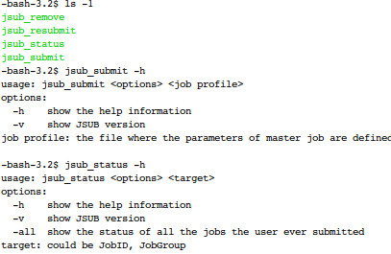
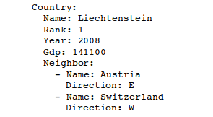
User Interface
YAML used to describe tasks
Job, Splitter, Backend
simple, clear, friendly with python
Data transformed into tree-like dictionary
Shell commands are provided

Slide 7
Job Split and Submit
YAMLParser
Splitter
JobFactory -- Generate Job submission scripts, Dictionary JobPara to collect Job related parameters
ExpParser -- Get runtime card or options for applications
Workflow
JobDB -- Record job info
jobStatus DB
core components
job
profile
splitter
dbService
WMS
profileParser
backend
JobFactory
jobParam
submit
RT
script
jobSteps
Workflow
script
save
OptsParser
option
files
workspace

Slide 8
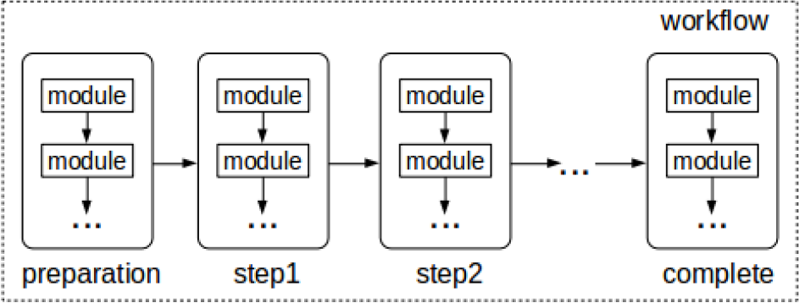
Workflow control
Adopt ideas from “DIRAC workflow”
Highly extensible and reusable
Runtime workflow
Workflow – Group of step
Step
Group of modules to complete a process, eg. preparation, simulation, reconstruction, complete
Module
Basic units for one operation or command, eg. checkenv

Slide 9
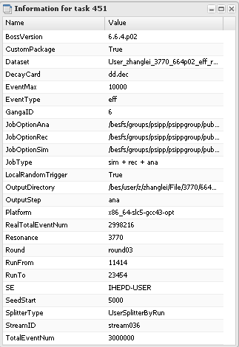
Task monitor and management(1)
TaskId uniquely identify the task, created after submitted
Tasks can be monitored and controlled both trough commands and web portal (next slide)
Jsub_list, list all the tasks and the status
Jsub_status <taskId>, show task progress and information
Jsub_resubmit <taskId>, rescheule all or failed jobs
Jsub_remove <taskId>, delete the whole task
Detailed task info collected from each stage of task processing
Physicists can easily track down specific task

Slide 10
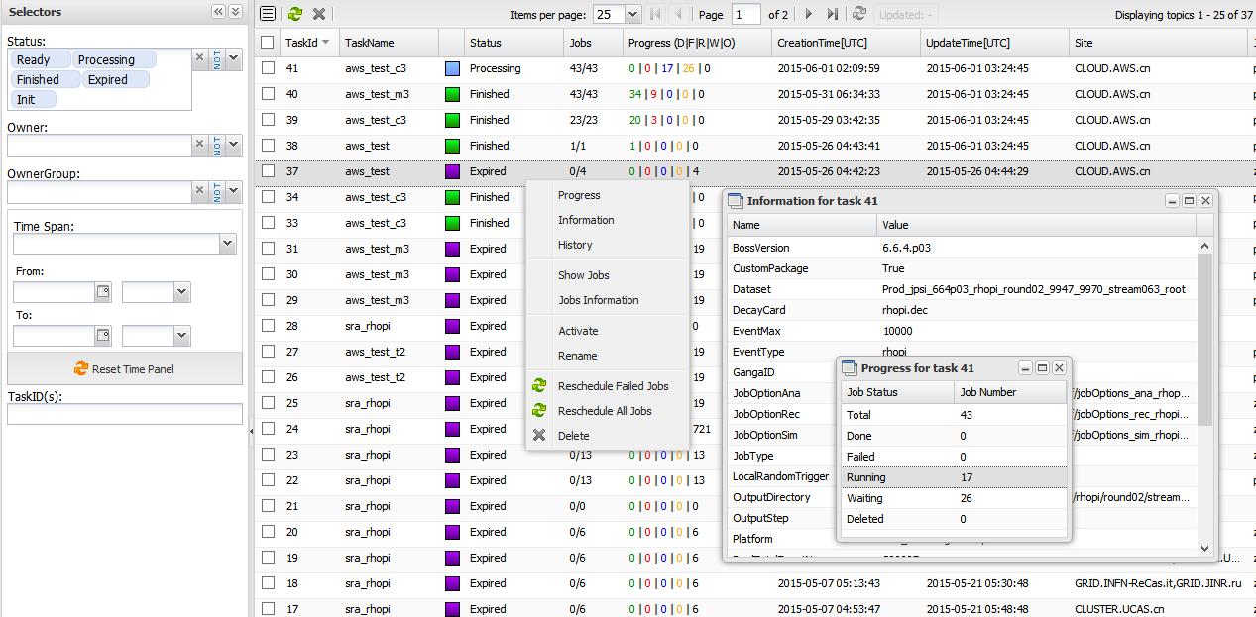
Task monitor and management(2)

Slide 11
Dataset management
Dirac File Catalog(DFC) used to build metadata and replica catalog
Dataset class is built to contact with DFC
Query dataset with conditions or name
Register dataset for output of jobs
Users can simply use Dataset as input data of task, move bulks of data by dataset

Slide 12
Backend supports
Dirac is mainly supported
Dirac API called for job submission and status retrieval
from DIRAC.Interfaces.API.Job import Job
from DIRAC.Interfaces.API.Dirac import Dirac as GridDirac
dirac = GridDirac()
j = Job()
j.setExecutablle('job.py')
j.setJobName('job_test')
dirac.submit(j)

Slide 13
Implementation and Extensions
Develop in python
Object-oriented programing are used
Inheritance, Polymorphism, reflection
Main Code Architecture
Framework
Common services
Plug-in
CLI
Profile
Web
Interface
Framework
Plug-in
Experiment
Back-end
BESIII
DIRAC
JUNO
Condor
workspace
jobStatus DB
CEPC
PBS

Slide 14


CEPC and JUNO case (1)
CEPC
JUNO
JobFactory
properties
createJobSet(){}
setSubParam(){}
setSpecialParam();
CepcJobFactory
JunoJobFactory
setSpecialParam(){}
setSpecialParam(){}
Step
executable
description
number
returnData
CEPC/JUNO
OptionsParser
Step
OptParser
JobFactory
WorkFlow
modules
opts
cepc.Step.Sim
juno.Step.Sim
parser();
generateOpts();
backend
optionsParser
args
Dirac/Condor
modules
CepcSimParser
CepcSimParser
CepcRecParser
…
…
simu_macro
event_macro
JSUB Core
(parse,split,generate,submit,getStatus…)
simu_macro
event_macro
reco_xml
_prepare(){}
parser(){}
generateOpts(){}
_prepare(){}
parser(){}
generateOpts(){}

Slide 15
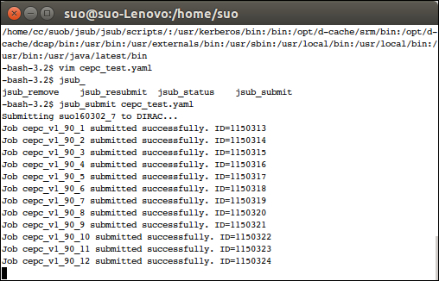
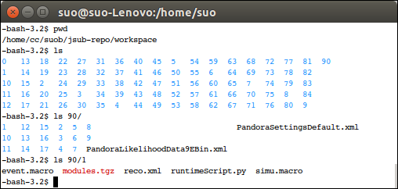
CEPC and JUNO case (2)
CEPC_test.yaml
Experiment:
Name: cepc
JobSteps:
- Type: Sim
Executable: Mokka
JobOption: /home/cc/suob/jsub/workfiles/sim
ReturnData: true
- Type: Rec
Executable: Marlin
JobOption: /home/cc/suob/jsub/workfiles/rec
ReturnData: true
Splitter:
Type: ByFile
EventMaxPerJob: 20
SeedStart: auto
InputData: ./stdhep.list
Backend:
Name: dirac
Site:
- CLOUD.IHEP.cn
- GRID.JINR.ru
JobGroup: suob160302_7
OutputSe: WHU-USER
OutputDir: /test/cepc/0302_7

Slide 16
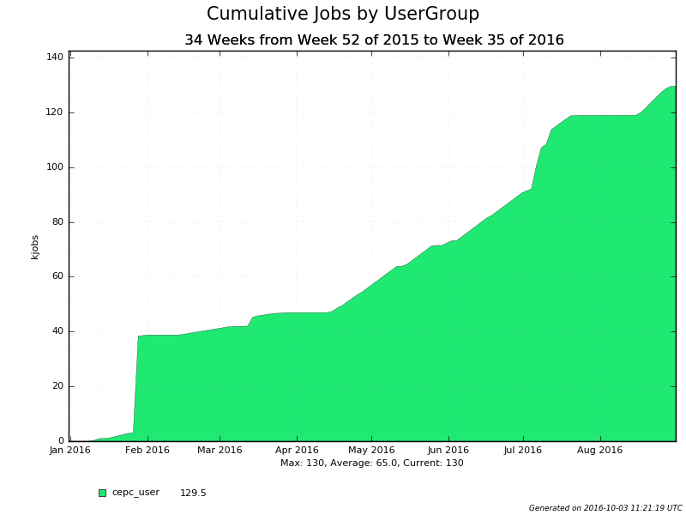
CEPC and JUNO case (3)
In 2016, about 130K jobs have been successfully submitted through JSUB

Slide 17
Summary
JSub is a lightweight and extensible task submission and management tool
Small experiments or experiments in early stage can extend it for quickly access of distributed resources for massive production
JSub has been implemented in Python
Dirac and Condor supported
Real cases of CEPC and JUNO experiments have shown its flexibility and simplicity
CEPC usage in 2016 has proved its stability

