Slide 1
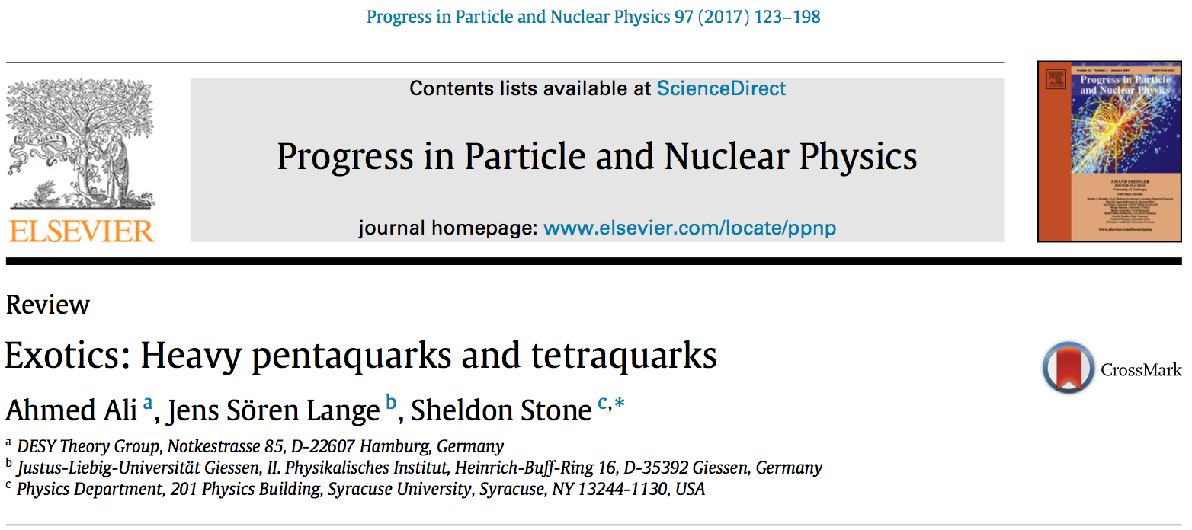
Yifan Yang, Longke Li
Oct. 24, Round Table Meeting

Slide 2
Contents
Introduction (Jiaojiao Song, Liming Yuan)
Theoretical techniques for quarkonia and exotic hadrons spectroscopy (Yifan Yang, Longke Li)
Experimental evidence for pentaquarks
Experimental evidence for tetraquarks
Theoretical models for tetraquarks
Theoretical models for pentaquarks
Summary

Slide 3
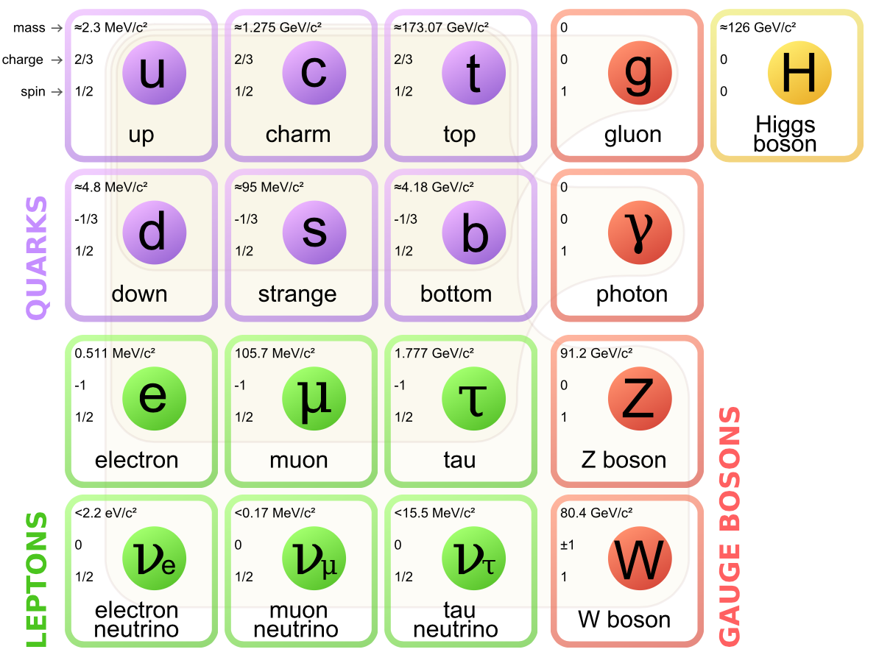
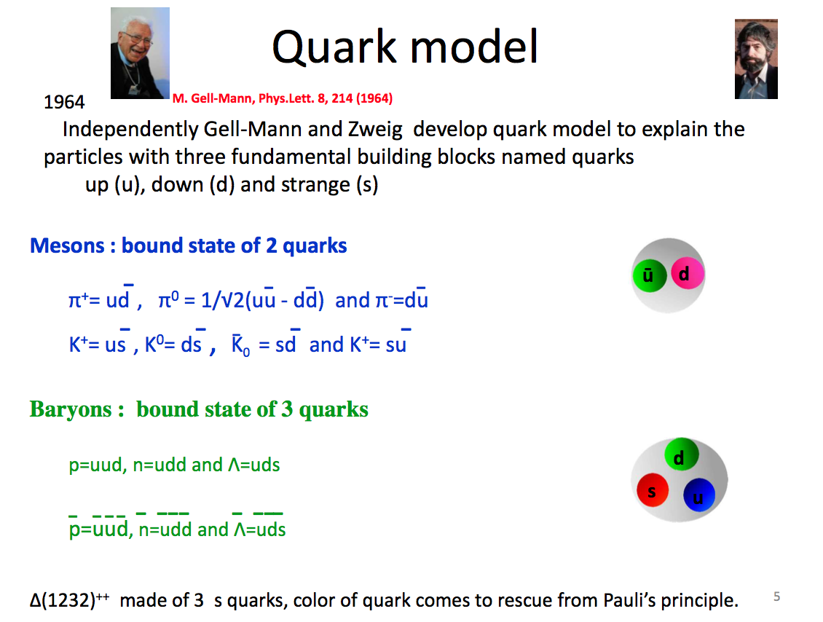

Slide 4
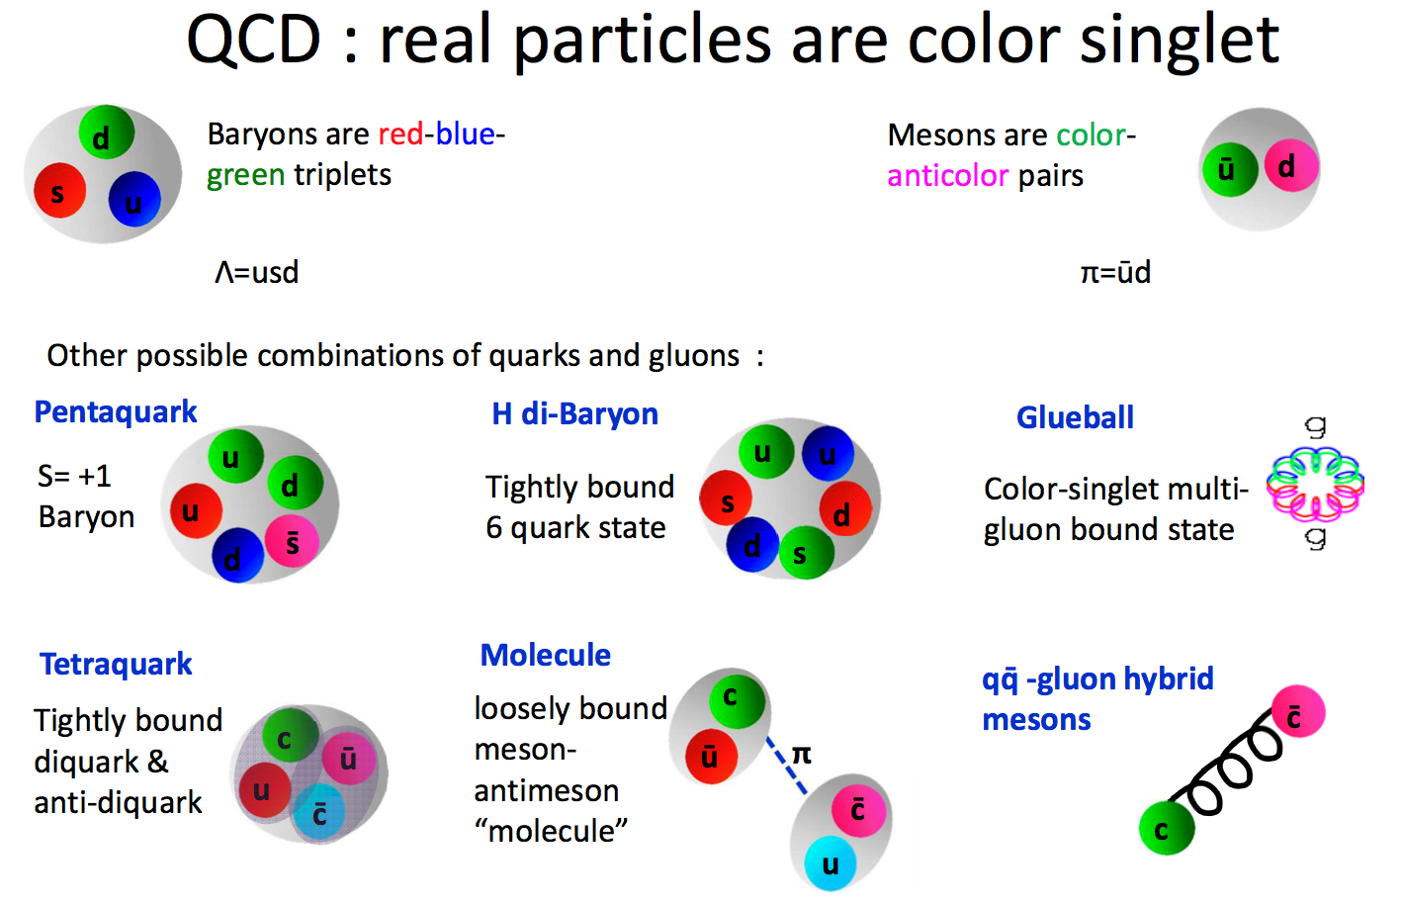

Slide 5
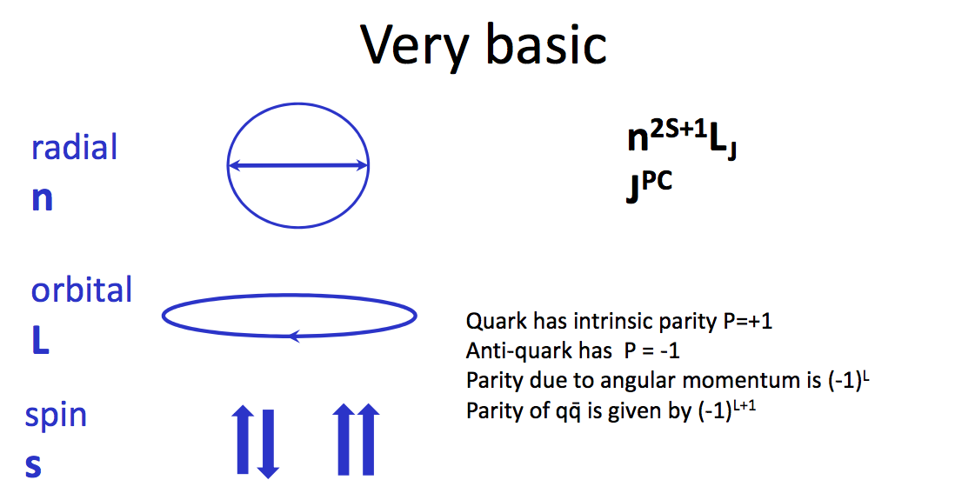

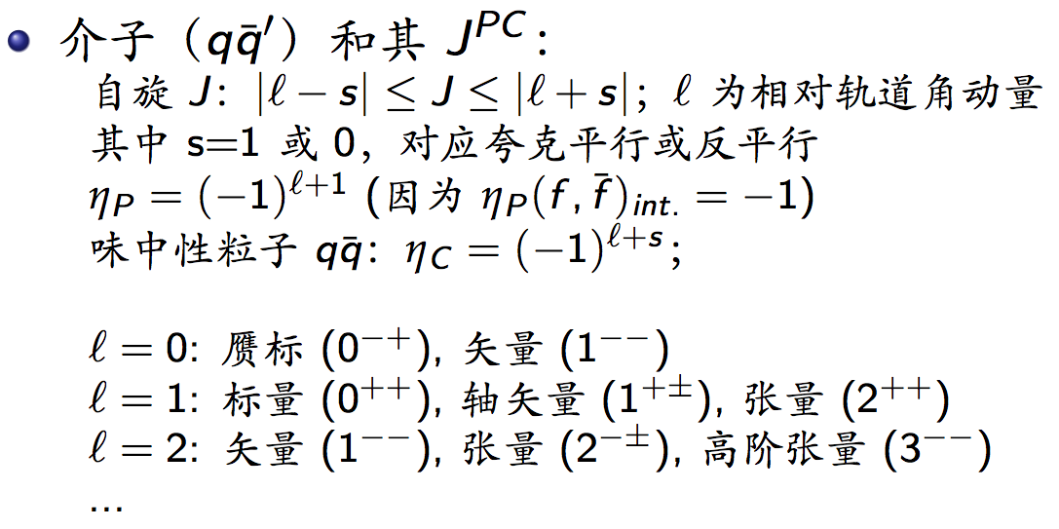


Slide 6
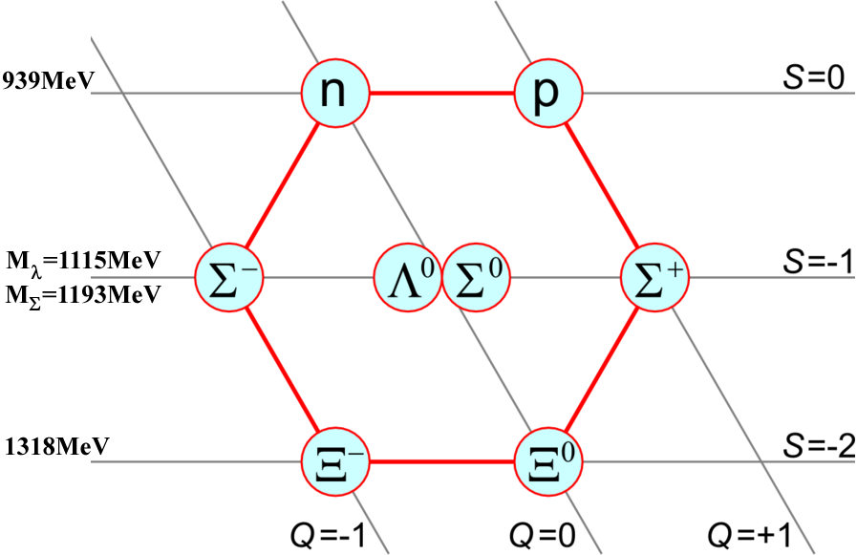
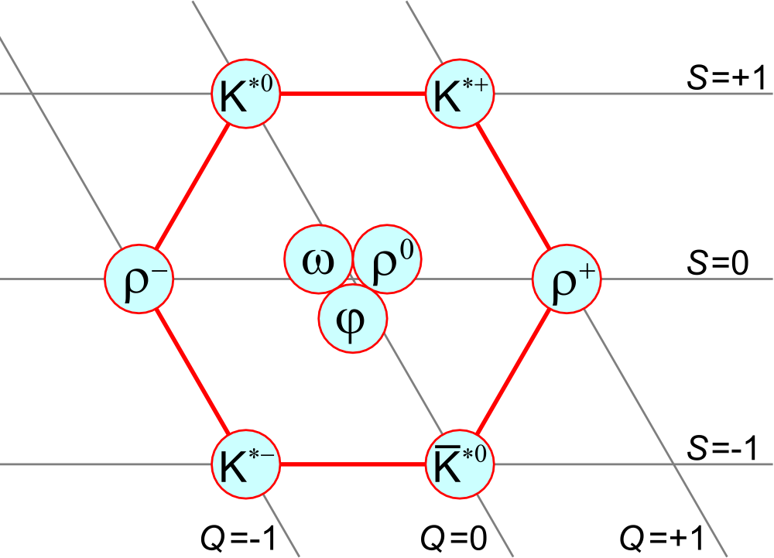
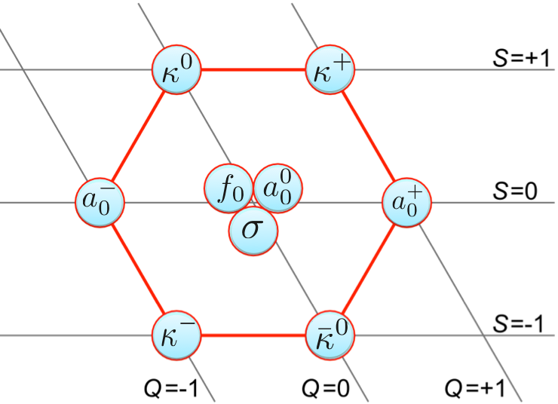
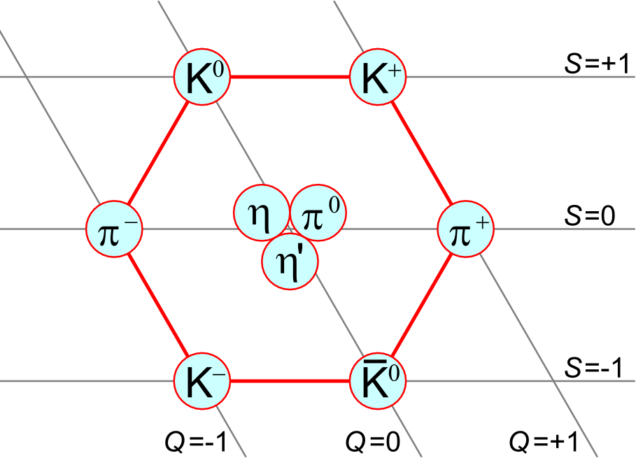
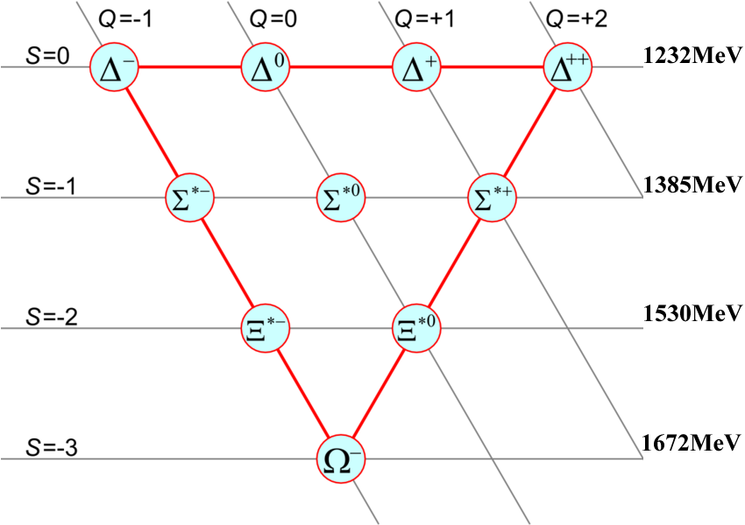
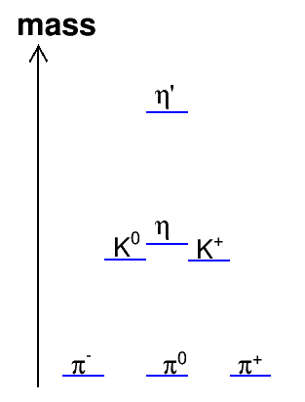
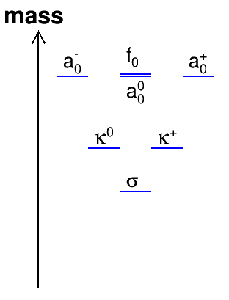

Slide 7

举个栗子

