Slide 1
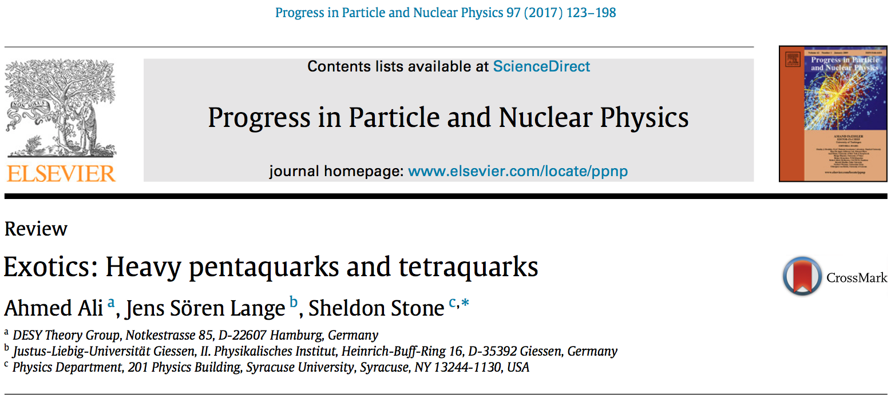
Yifan Yang, Longke Li
Oct. 24, Round Table Meeting

Slide 2
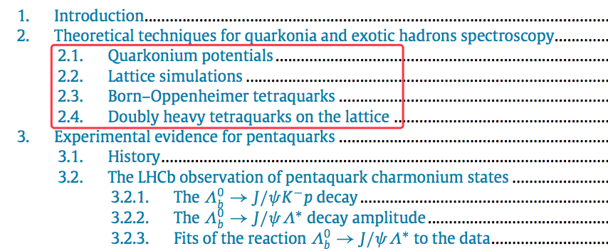
Outline

Slide 3
2.0 Introduction to this section
excited states in the Quarkonium spectroscopy
gluonic and light mesonic degrees of freedom in the Fock space description of a hadron
discovery of P_{c}(4380)± and P_{c}(4450)± by LHCb:
states and complete SU(3)_{F} multiplets
next frontier: spectrum of in QCD and the underlying dynamics
review briefly the various theoretical techniques to calculate the spectroscopy of the excited quarkonia and exotic states:
potential models:
general features of QCD at short and long-distances
include spin-spin interactions among the quarks
lattice QCD: in terms of Born-Oppenheimer approximation
QCD simulations: using current correlators with mesonic and diquark degrees of freedom
QCD sum rules: understanding the properties of light and heavy mesons and applied to exotic hadrons (extensively in reviews, so no included in this paper)

Slide 4

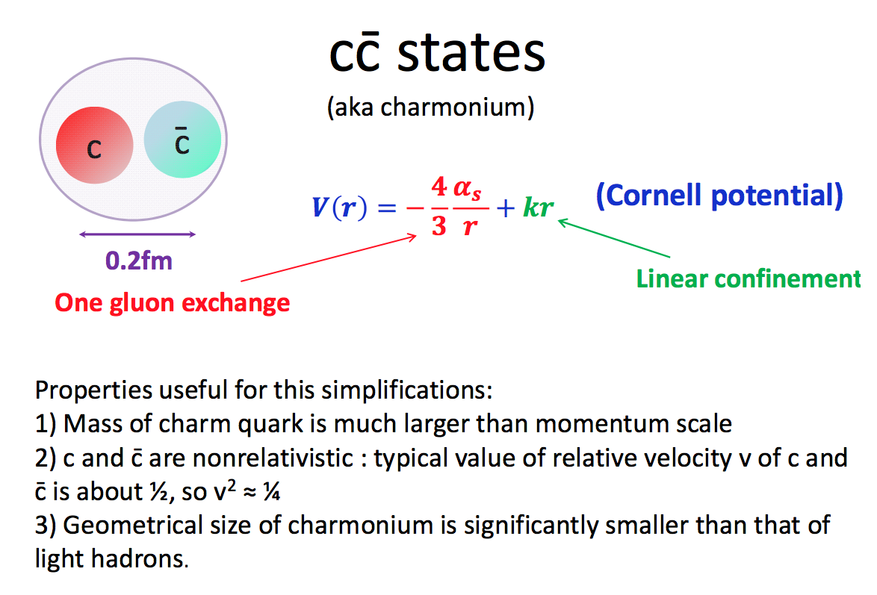
2.1 quarkonium potentials
Cornell potential
α_{s}: effective strong coupling; k: string tension
Notes:
In perturbative QCD, the essential interaction at small distances is instantaneous coulombic one-gluon exchange (OGE); in QCD, it is 𝑞𝑞, 𝑞𝑔, or 𝑔𝑔 Coulomb scattering [14]. erefore, one expects from OGE a Coulomb-like contribution to the potential: 𝑉𝑆(𝑟) ∝ −𝛼𝑠/𝑟 at 𝑟 → 0. For large distances, from lattice-gauge-theory computations [15], it follows that this rise is an approximately linear; that is, 𝑉𝐿(𝑟) ≃ 𝜎𝑟 + const, where 𝜎 ≃ 0.15 GeV2 is the string tension. ese two contributions by simple summation lead to the famous Cornell 𝑞𝑞 potential

Slide 5
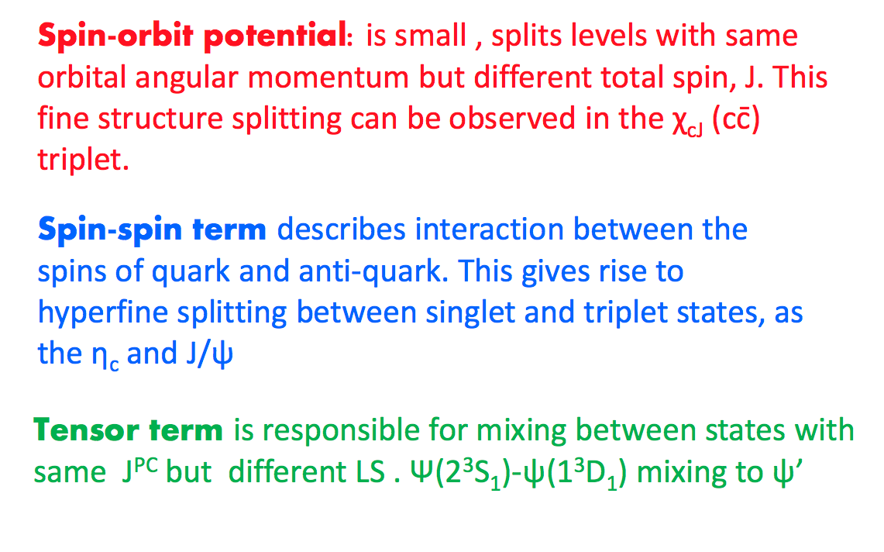



2.1 quarkonium potentials
modify the potential
a hyperfine interaction
defined in the configuration space(位形空间)

Slide 6
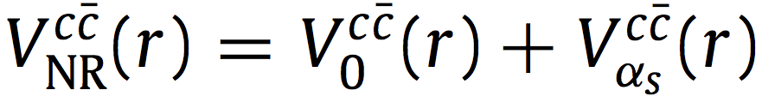
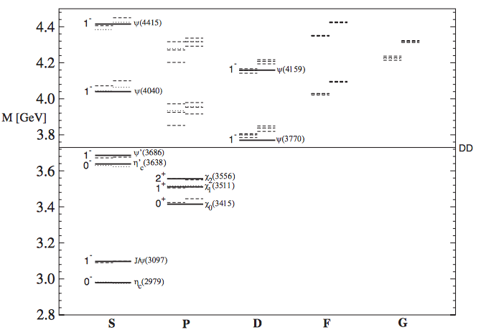
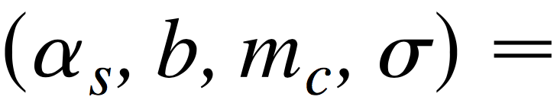
2.1 quarkonium potentials
the quarkonium potential-model studies were updated to incorporate the data from CLEO and Belle/BABAR
Phys. Rev. D 72 (2005) 054026
parameters of this potential are fitted from well-established charmonium states 1S-4S, 1P and two D-states psi(3770) and psi(4159).
predict charmonium spectrum above the DD threshold, which including 2P, 3P, 1D, 2D, 1F, 2F and 1G states.

Slide 7
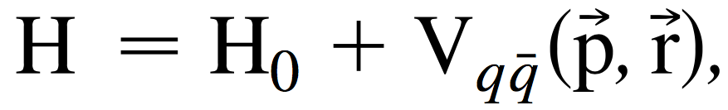
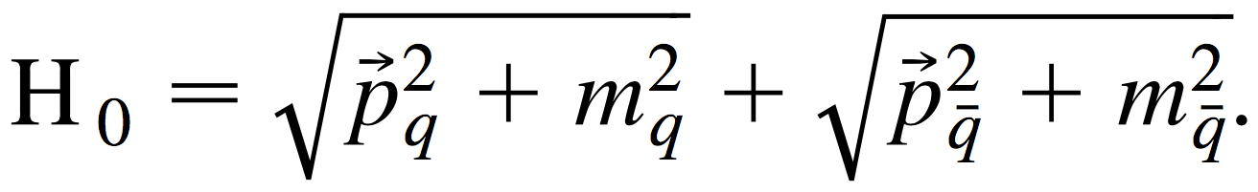
2.1 quarkonium potentials
Godfrey-Isgur model:
a relativistic dispersion relation for the quark kinetic energy and an effective potential of the ccbar system
Both models predicted the charmonium spectroscopy quite accurately, including some states lying above the open charm threshold.

Slide 8
2.1 quarkonium potentials
Unperfect or failure of potentials:
several 2P states are still missing or not identified unambiguously.
such as 0⁺⁺ χ_{c0}(2P), 1⁺⁺ χ_{c1}(2P) and 1⁺⁻ h_{c}(2P)
Not cover the excited charmonia (and bottomonia) and exotica, which have extra light d.o.f in their Fock space.
such as hybrids and tetraquark states
Their role: provide benchmarks to map out the normal quarkonia, and hence are very valuable in the search for the excited quarkounium states and exotica.

Slide 9
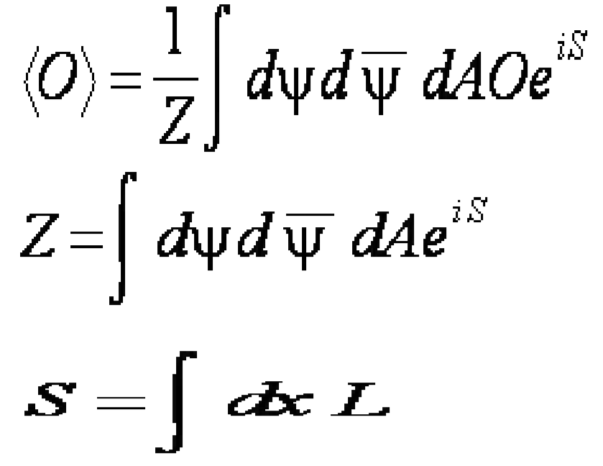

2.2 Lattice Simulation
How is lattice simulation done:
The calculation is based on path integral formulation of QCD.
From continuum to discrete space-time grid.

Slide 10
2.1 Lattice Simulation
The progress of lattice studies:
Impressive precisionfor the calculations of lowest-lying states well below the strong decay threshold.
A recent lattice work on the excited and exotic charmonium states is carried out.
Techniques have been being developed for the energy region near or above strong decay thresholds, e.g., Luescher's formulation, finite volume Hamilton EFT, and HALQCD approach.
Several lattice results on the near-threshold bound states, scattering and resonances in the charm sector have been reported, albeit reliable results are not quantative.

Slide 11
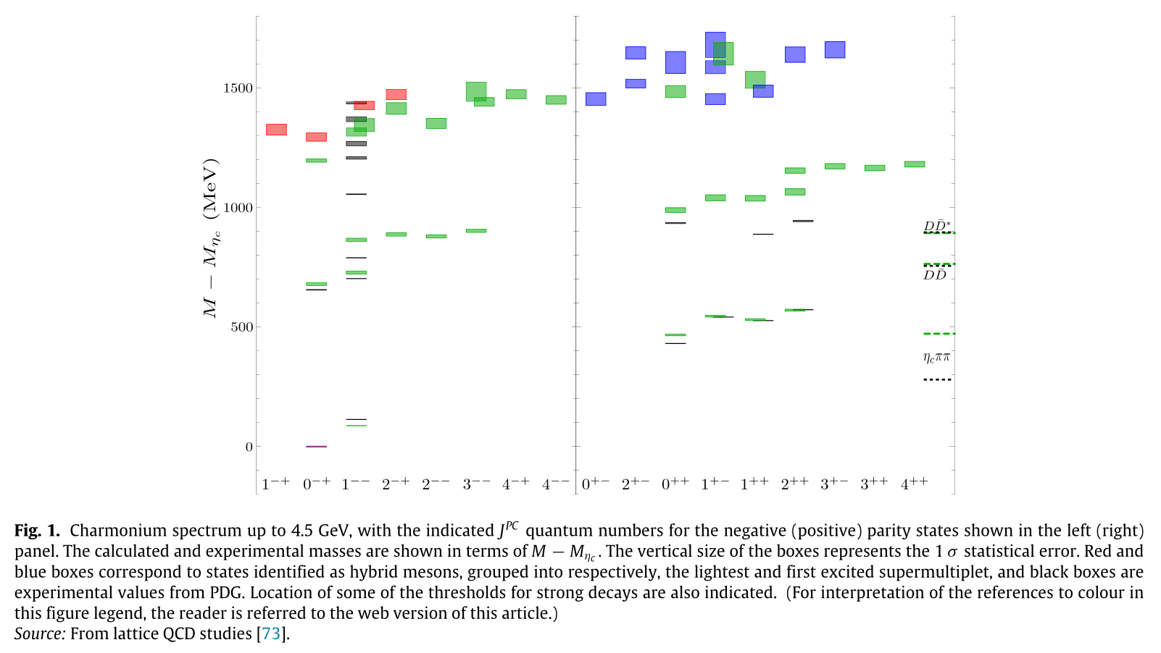
2.2 Lattice Simulation
The LQCD result of Charmonium spectrum(2016):

Slide 12
2.1 Lattice Simulation
Examples of current states of LQCD:
X(3872):
First simulation of close-threshold effect, found a pole in the scattering matrix: arXiv:1307.5172
Confirmed by Fermilab: , arXiv:1411.1389
Reinvestigated the topic and suggest that both ccbar and the D⁰D^{*0}bar threshold are required for the X(3872): arXiv:1503.03257
Z_{c}⁺(3900):
lattice simullation as tetraquark, result suggesting the state possibly a rescattering effect: arXiv:1602.03465
But the result is argued to be tentative: arXiv:1609.03052

Slide 13
2.1 Lattice Simulation
Examples of current states of LQCD:
Pentaquarks:
The first evidence for a η_{c}N bound state 20 MeV below the η_{c}N threshold: arXiv:1410.7069

