Slide 1


Ad Hoc Routing:
The AODV and DSR Protocols
Jonathan Sevy
Geometric and Intelligent Computing Lab
Drexel University
http://gicl.mcs.drexel.edu

Slide 2
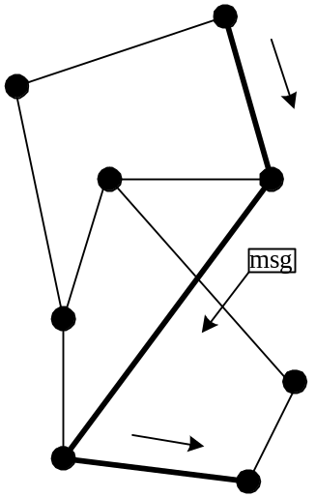
Routing Overview
Network with nodes, edges
Goal: Devise scheme for transferring message from one node to another
  Which path?
  Who decides – source or intermediate nodes?

Slide 3
Which path?
Generally try to optimize something:
  Shortest path (fewest hops)
  Shortest time (lowest latency)
  Shortest weighted path (utilize available bandwidth)
  Etc…

Slide 4
Who determines route?
Two general approaches:
Source (“path”) routing
  Source specifies entire route: places complete path to destination in message header: A – D – F – G
  Intermediate nodes just forward to specified next hop: D would look at path in header, forward to F
  Like airline travel – get complete set of tickets to final destination before departing…

Slide 5
Destination (“hop-by-hop”) routing
  Source specifies only destination in message header: G
  Intermediate nodes look at destination in header, consult internal tables to determine appropriate next hop
  Like postal service – specify only the final destination on an envelope, and intermediate post offices select where to forward next…

Slide 6
Comparison
Source routing
  Moderate source storage (entire route for each desired dest.)
  No intermediate node storage
  Higher routing overhead (entire path in message header, route discovery messages)
Destination routing
  No source storage
  High intermediate node storage (table w/ routing instructions for all possible dests.)
  Lower routing overhead (just dest in header, only routers need deal w/ route discovery)

Slide 7
Ad Hoc Routing
Every node participates in routing: no distinction between “routers” and “end nodes”
No external network setup: “self-configuring”
Especially useful when network topology is dynamic (frequent network changes – links break, nodes come and go)

Slide 8
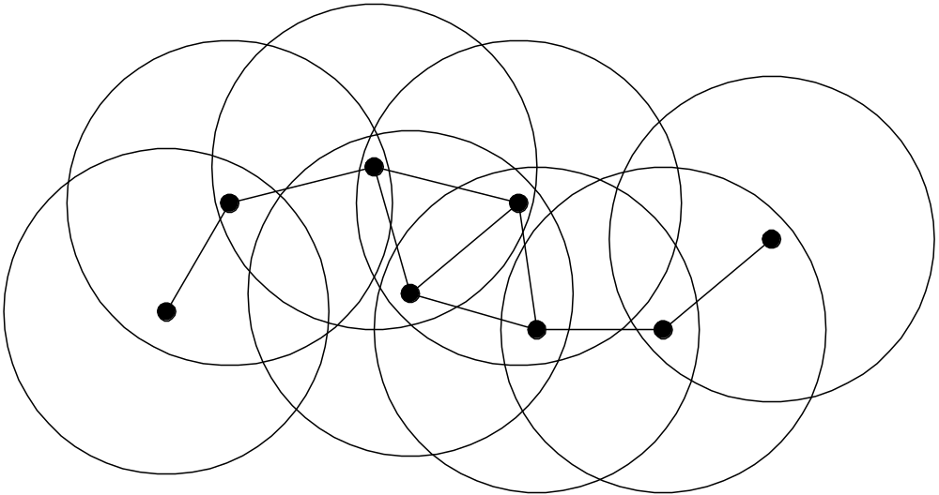
Common application
Mobile wireless hosts
  Only subset within range at given time
  Want to communicate with any other node

Slide 9
Ad Hoc Routing Protocols
Standardization effort led by IETF Mobile Ad-hoc Networks (MANET) task group
  http://www.ietf.org/html.charters/manet-charter.html
  9 routing protocols in draft stage, 4 drafts dealing with broadcast / multicast / flow issues
Other protocols being researched
  utilize geographic / GPS info, ant-based techniques, etc.

Slide 10
Leading MANET Contenders
DSR: Dynamic Source Routing
  Source routing protocol
AODV: Ad-hoc On-demand Distance Vector Routing
  “Hop-by-hop” protocol
Both are “on demand” protocols: route information discovered only as needed

Slide 11
Dynamic Source Routing
Draft RFC at http://www.ietf.org/internet-drafts/draft-ietf-manet-dsr-07.txt
Source routing: entire path to destination supplied by source in packet header
  Utilizes extension header following standard IP header to carry protocol information (route to destination, etc.)

Slide 12
DSR Protocol Activities
Route discovery
  Undertaken when source needs a route to a destination
Route maintenance
  Used when link breaks, rendering specified path unusable
Routing (easy!)

Slide 13
Route Discovery
Route Request:
  Source broadcasts Route Request message for specified destination
  Intermediate node:
    Adds itself to path in message
    Forwards (broadcasts) message toward destination
Route Reply
  Destination unicasts Route Reply message to source
    will contain complete path built by intermediate nodes

Slide 14
Details, details…
Intermediate nodes cache overheard routes
  “Eavesdrop” on routes contained in headers
  Reduces need for route discovery
Intermediate node may return Route Reply to source if it already has a path stored
  Encourages “expanding ring” search for route
Destination may need to discover route to source to deliver Route Reply
  piggyback Route Reply onto new Route Request to prevent “infinite loop”
Route Request duplicate rejection:
  Source includes identification number in Route Request
  Partial path inspected for “loop”

Slide 15
Route Maintenance
Used when link breakage occurs
  Link breakage may be detected using link-layer ACKs, “passive ACKs”, DSR ACK request
  Route Error message sent to source of message being forwarded when break detected
  Intermediate nodes “eavesdrop”, adjust cached routes
  Source deletes route; tries another if one cached, or issues new Route Request
    Piggybacks Route Error on new Route Request to clear intermediate nodes’ route caches, prevent return of invalid route

Slide 16
Issues
Scalability
  Discovery messages broadcast throughout network
Broadcast / Multicast
  Use Route Request packets with data included
    Duplicate rejection mechanisms prevent “storms”
  Multicast treated as broadcast; no multicast-tree operation defined
    Scalability issues
  http://www.ietf.org/internet-drafts/draft-ietf-manet-simple-mbcast-01.txt

Slide 17
Ad-hoc On-demand Distance Vector Routing
Draft RFC at http://www.ietf.org/internet-drafts/draft-ietf-manet-aodv-10.txt
“Hop-by-hop” protocol: intermediate nodes use lookup table to determine next hop based on destination
Utilizes only standard IP header

Slide 18
AODV Protocol Activities
Route discovery
  Undertaken whenever a node needs a “next hop” to forward a packet to a destination
Route maintenance
  Used when link breaks, rendering next hop unusable
Routing (easy!)

Slide 19
Route Discovery
Route Request:
  Source broadcasts Route Request (RREQ) message for specified destination
  Intermediate node:
    Forwards (broadcasts) message toward destination
    Creates next-hop entry for reverse path to source, to use when sending reply (assumes bidirectional link…)

Slide 20
Route Reply
  Destination unicasts Route Reply (RREP) message to source
    RREP contains sequence number, hop-count field (initialized to 0)
    Will be sent along “reverse” path hops created by intermediate nodes which forwarded RREQ
  Intermediate node:
    Create next-hop entry for destination as RREP is received, forward along “reverse path” hop
    Increment hop-count field in RREP and forward
  Source:
    If multiple replies, uses one with lowest hop count

Slide 21
Details again…
Each node maintains nondecreasing sequence number
  Sent in RREQ, RREP messages; incremented with each new message
  Used to “timestamp” routing table entries for “freshness” comparison
Intermediate node may return RREP if it has routing table entry for destination which is “fresher” than source’s (or equal with lower hop count)
Routing table entries assigned “lifetime”, deleted on expiration
Unique ID included in RREQ for duplicate rejection

Slide 22
Route Maintenance
Used when link breakage occurs
  Link breakage detected by link-layer ACK, “passive ACK”, AODV “Hello” messages
Detecting node may attempt “local repair”
  Send RREQ for destination from intermediate node
Route Error (RERR) message generated
  Contains list of unreachable destinations
  Sent to “precursors”: neighbors who recently sent packet which was forwarded over broken link
    Propagated recursively

Slide 23
Issues
Scalability
  No inherent “subnetting” provision in routing tables – one entry per destination
Directionality
  Assumes there is at least one bidirectional path between any two nodes

Slide 24
Issues (cont.)
Multicast
  True multicast-tree generation and maintenance
  Detailed in supplementary (expired…) draft: http://www.watersprings.org/pub/id/draft-ietf-manet-maodv-00.txt
Broadcast
  Suggested use of IP Ident field for duplicate detection
  http://www.ietf.org/internet-drafts/draft-ietf-manet-bcast-00.txt

Slide 25
Protocol Performance Tests
“A Performance Comparison of Multi-Hop Wireless Ad Hoc Network Rotuing Protocols”, D. Johnson et al., MobiCom ’98 Proceedings.
  By the creators of DSR
“Performance Comparison of Two On-Demand Routing Protocols for Ad Hoc Networks”, C. Perkins et al., IEEE Personal Communications, February 2001.
  By the creators of AODV
Both used ns-2 simulator, simulated 802.11 link layer

Slide 26
Johnson et al
Compared DSR, AODV, DSDV, TORA
  Varied number of sources, node mobility, traffic load
    50 nodes total, 64-byte data packets
  Looked at packet delivery ratio, routing overhead
Conclusions:
  DSR, AODV similar on packet delivery ratio
  DSR much lower routing traffic overhead (excluding DSR’s routing header extension in each data packet)
  TORA, DSDV performed very poorly in certain situations (low packet delivery ratio)

Slide 27
Perkins et al
Compared DSR and AODV
  Varied number of sources, node mobility, traffic load
    50 and 100 nodes, 512-byte data packets
  Looked at packet delivery ratio, packet delay, routing overhead, total network throughput
Conclusions:
  DSR outperforms with fewer nodes, lower traffic load, less node mobility
  AODV outperforms when have more nodes, higher traffic load, greater node mobility
    DSR always lower routing overhead (excluding routing header)
    DSR poor delivery ratio when many nodes, many sources, high mobility

Slide 28
Linux Implementations
DSR
  Sourceforge “PicoNet” project (bad name choice… ☹), Alex Song:
  http://sourceforge.net/projects/piconet/
AODV
  NIST “Kernel AODV” implementation, Luke Klein-Berndt:
  http://w3.antd.nist.gov/wctg/aodv_kernel/

