Slide 1
SUMMER INTERN REPORT
YIFAN WU
08/25/2018

Slide 2
TRAFFIC LIGHT GUI DEIGN IN QT
YIFAN WU

Slide 3
TRAFFIC LIGHT GUI DEIGN IN QT
STATE MACHINE
Start
Red2Yellow
Yellow2Green
Red2Yellow.done
Yellow2Red.done
Yellow2Green.done
Yellow2Red
Green2Yellow
Green2Yellow.done

Slide 4
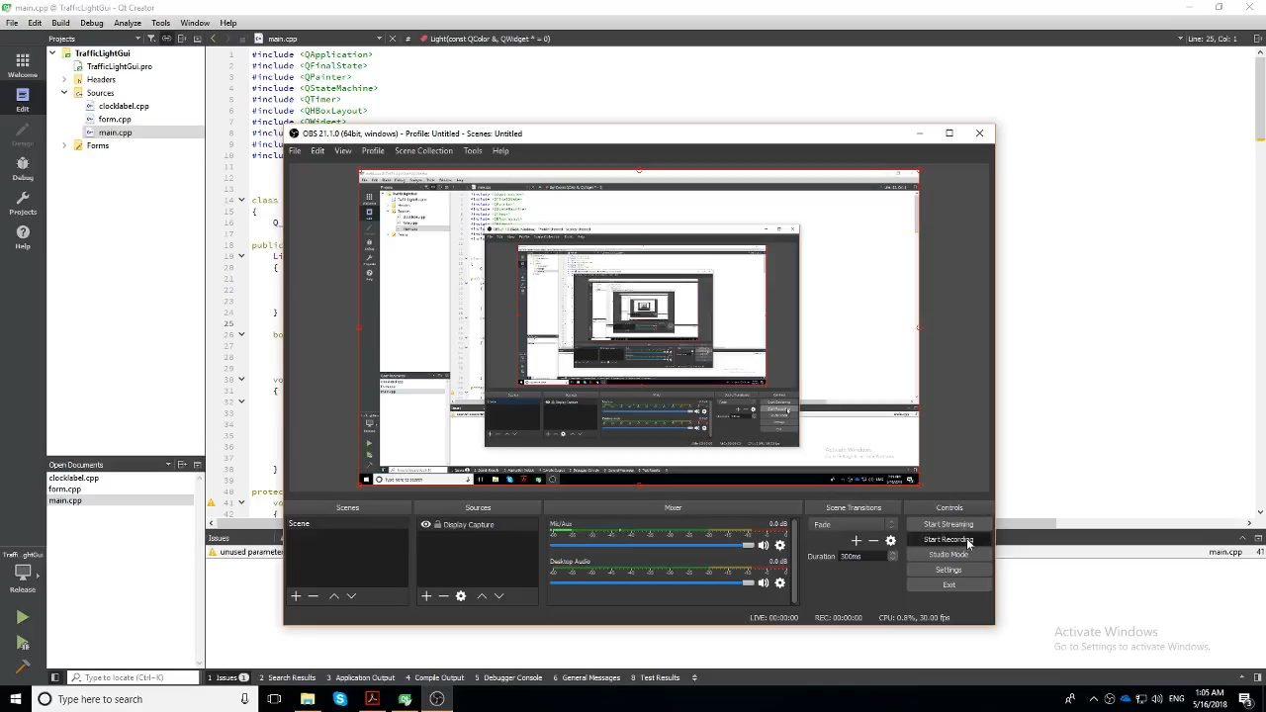
DEMONSTRATION

Slide 5
DEMONSTRATION
For demonstration, I only use 3 state to show different transition between red, yellow and green light.
Time, GPS location, speed info can be added when data is obtained.
The original idea is to use the Qt model in Rtmaps and create a GUI inside the Rtmaps components. However, Qt model in Rtmaps only supports the Window system.

Slide 6
RTMAPS
YIFAN WU

Slide 7
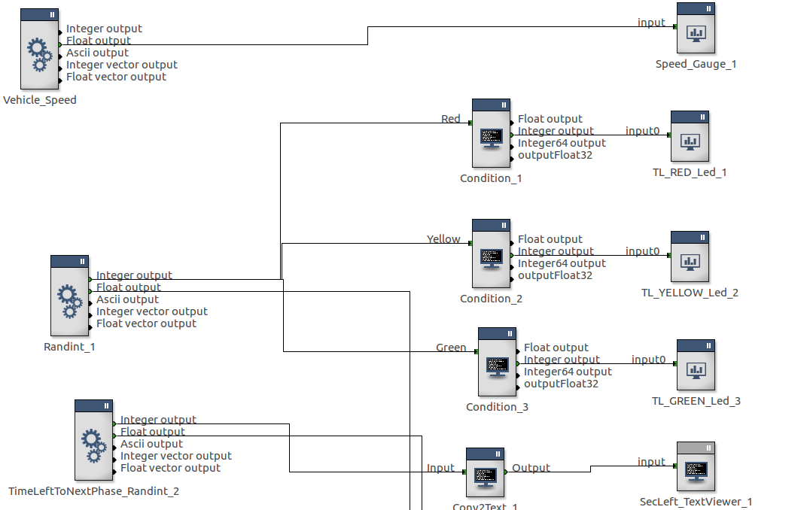
TRAFFIC LIGHT GUI DEIGN IN RTMAPS
MODEL DESIGN

Slide 8
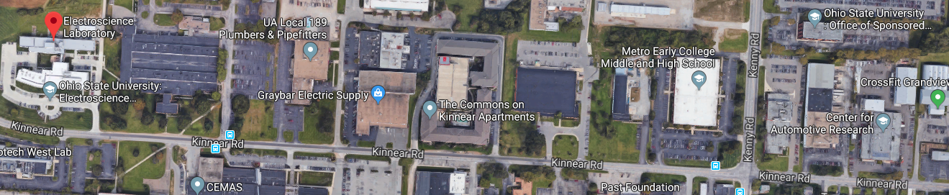
MODEL DESIGN
Since there are some data missing and waiting for further recording, I use random block as input
A speed gauge model is added
Three traffic lights model is added and there are 3 condition to control the light
A textual wall is added in the XYZ cloud with web camera feed as input
A rough map is added
During the testing, we figured out the GPS data is not accurately recorded
The drawing on the map is fluctuating

Slide 9
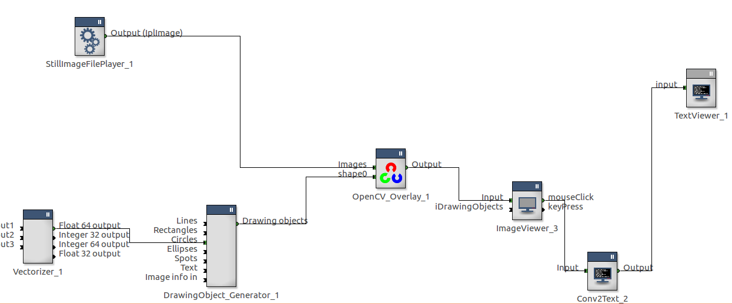
PIXEL MAP DESIGN
Using the GPS location and convert it into pixels in the still image which is a screenshot of map
The location is approach by using the pixel location shown in Text viewer.
Creating a drawing object, and make it shift according to the longitude and latitude.
This is a very rough approach to map and route. A better approach is shown in later slides.

Slide 10
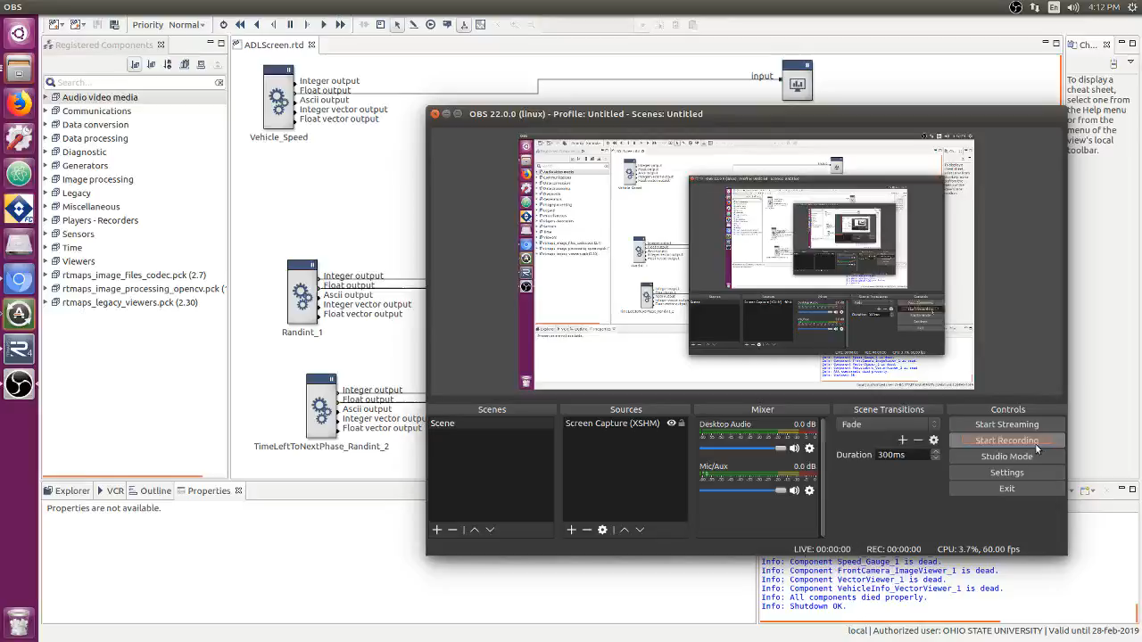
DEMONSTRATION

Slide 11
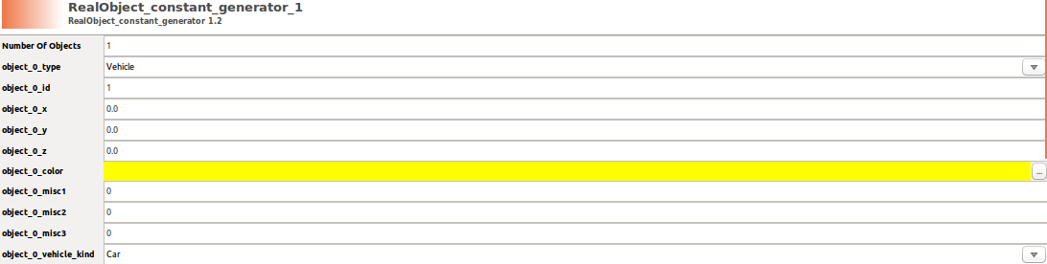
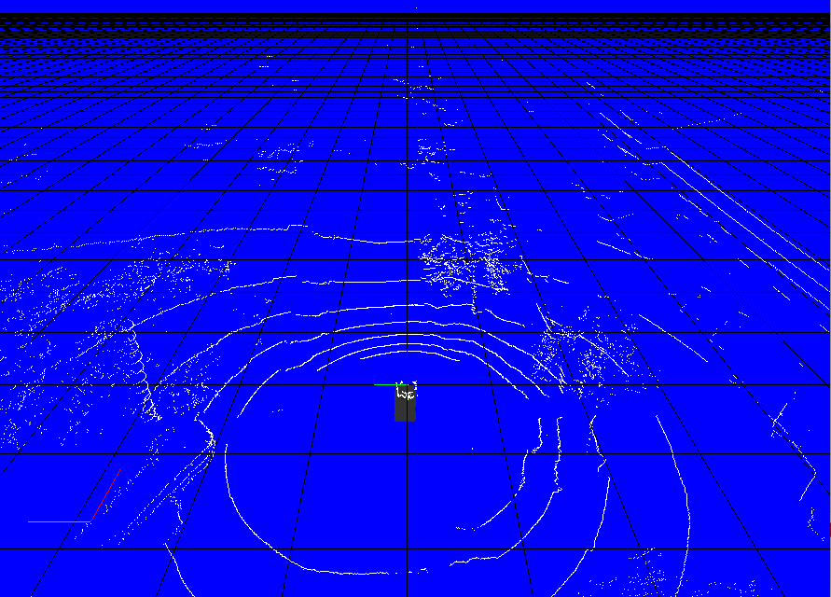
GOOGLE MAP APPROACH
A 3D model is insert in the XYZ Cloud and the orientation is adjust by a 4X4 matrix (rotation and translation)
Fill the 3D viewer with grid on X-Y plane
A real object is created and design as a vehicle object and vehicle kind as car

Slide 12
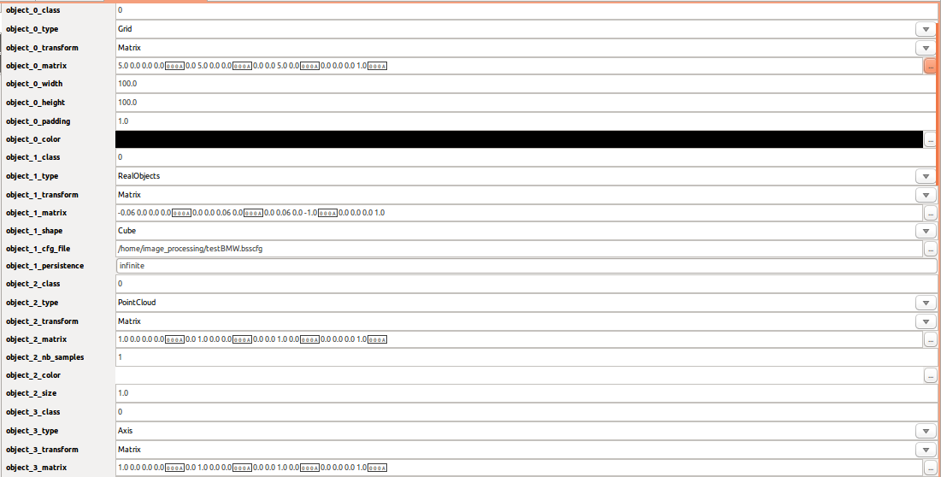
3D VIEWER CONFIGURATION
Each matrix is calculated by hand

Slide 13
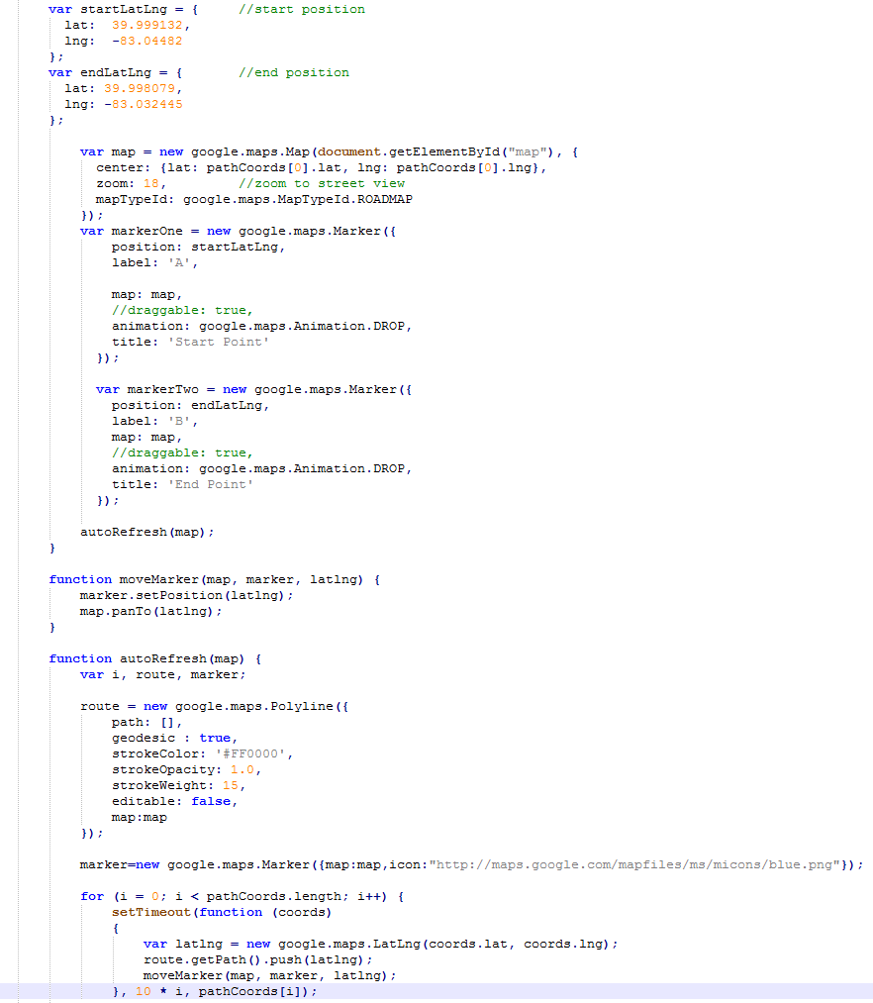
MAP CODING ACCORDING TO
GOOGLE MAP JAVASCRIPT API
The “autoRefresh” functioncreates an empty polyline. Then, it loops over the global pathCoords array. For each set of coordinates, it creates a call to this function, at 10 millisecond intervals. (1000 Hz refreshing rate)

Slide 14
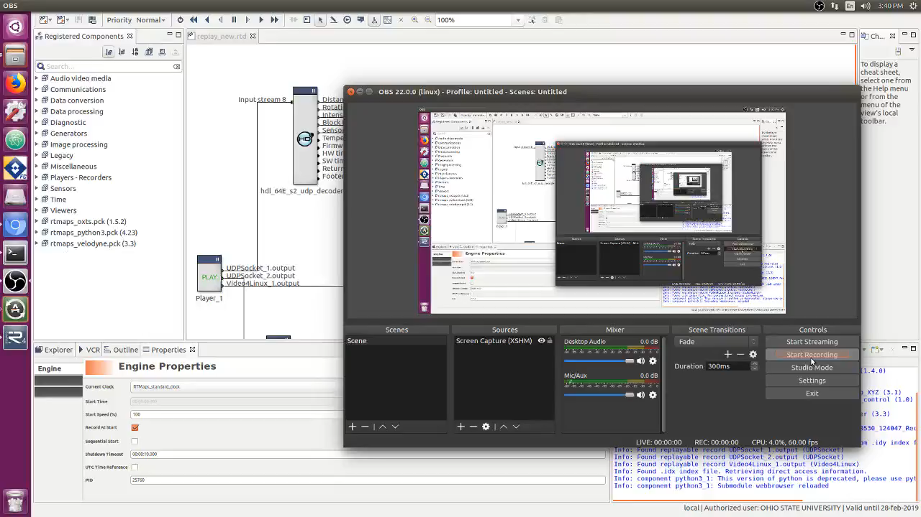
DEMOSTRATION

Slide 15
CONCLUSION
The model of traffic light status is set up
Vehicle mode in 3D XYZ cloud point is achieved
The path or the trajectory of the vehicle is not possible to create since the location of the car in 3D viewer is fixed
GPS map is created through Google Map. More features can be add through the Google Map JavaScript API
I'm trying to turn the map into real-time map by using UDP or Python reading and writing.

Slide 16
SUBMISSION INFO
YIFAN WU

