Slide 1
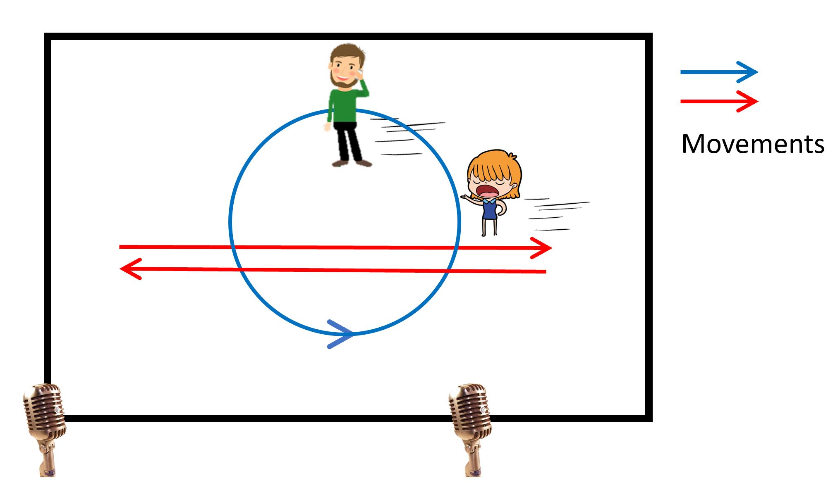
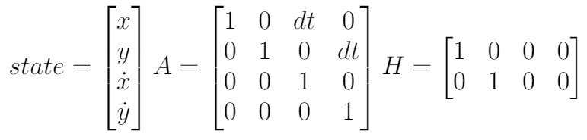
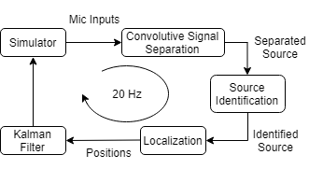
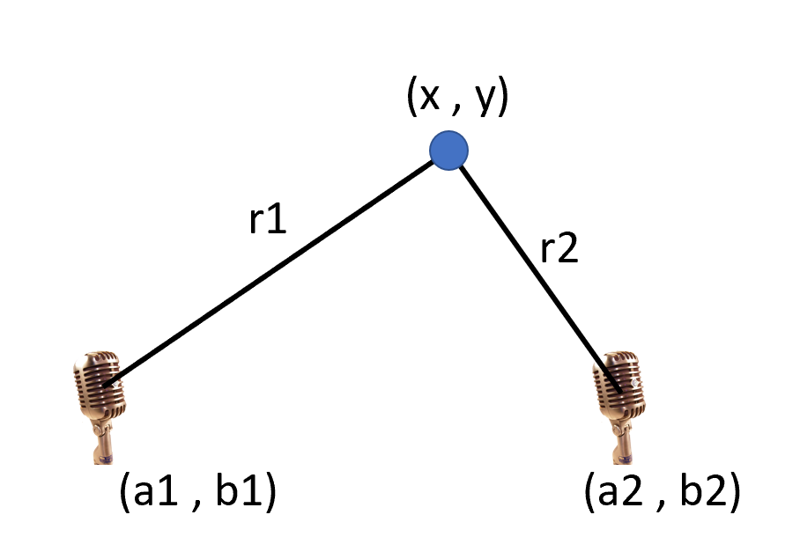

Sound Source Separation, Localization, and Tracking of Two Moving Agents with Two Microphones
Xinhang Song and Yifan Zhu Final Project for CS 598 PS, 2019 Fall, University of Illinois at Urbana-Champaign
Problem Statement
We would like to track the position of two moving- and talking- people using a pair of microphones in an indoor environment.
Methods – continued
Kalman Filter
Two independent Kalman filters are used for the two agents.
The state includes the position and velocity of the agent. The system dynamics matrix and observation matrix are listed below, the measurement noise matrix is diag(0.1).
Figure 1. A male and a female talking and walking in a room, with a pair of microphones recording sound. This is also the setup of our simulator which generates delayed and mixed sounds with reflections.
RESULTS
Method
The overview of our method is shown in Figure 2. The localization is performed at 20Hz, using the last 0.05s of data.
Simulator
The setup of our simulator resembles that in Figure 1.
Agents move at periodic patterns continuously and pre-recorded sounds are used.
Sound magnitude diminishing and delay are simulated. (Reverberation not implemented yet.)
Convolutive Signal Separation
The algorithm is based on [1], introduced in class lecture notes.
TODO: Add equation
Source Identification
We use a pre-trained classifier for male and female voice based on data we collected.
Frame-wise classifier in the frequency domain + voting.
Localization
Sound signals from 2 mics are aligned to give the difference in time-of-arrival and magnitude.
Triangulation is performed to compute the x-y location of the agent.
Figure 4. Ground truth, mixed and separated signals.
Figure 2. Overview of our method.
Figure 5. The tracking error overtime.
Conclusions and Future Work
While the tracking performance is decent, our algorithm is still not fast enough to perform real-time tracking
Arbitrary M source N input
3D instead of 2D
Reference
Figure 3. Localization of an agent. The difference in time-of-arrival is r1-r2, while the magnitude ratio is r1/r2, which together gives the value of r1 and r2. With the locations of the mics known, the x,y positions can be triangulated.
[1] Smaragdis, Paris. "Blind separation of convolved mixtures in the frequency domain." Neurocomputing 22.1-3 (1998): 21-34.

