Slide 1
第8章 输入输出系统
万继光
jgwan@mail.hust.edu.cn
华中科技大学计算机学院，武汉光电研究中心存储部

Slide 2
8.1 I/O系统的性能
8.2 I/O系统的可靠性、可用性和可信性
8.3 廉价磁盘冗余阵列RAID
8.4 总线
8.5 通道处理机
8.6 I/O与操作系统

Slide 3
8.1 I/O系统的性能
输入/输出系统简称I/O系统
  它包括：
    I/O设备
    I/O设备与处理机的连接
I/O系统是计算机系统中的一个重要组成部分
  完成计算机与外界的信息交换
  给计算机提供大容量的外部存储器
按照主要完成的工作进行分类：
    存储I/O系统（本章内容）
    通信I/O系统

Slide 4
8.1 I/O系统的性能
4. I/O系统的性能对CPU的性能有很大的影响，若两者的性能不匹配，I/O系统就有可能成为整个系统的瓶颈。
5. 系统的响应时间(衡量计算机系统的一个更好的指标)
  从用户输入命令开始，到得到结果所花费的时间。
  由两部分构成：
    I/O系统的响应时间
    CPU的处理时间
6.多进程技术只能够提高系统吞吐率，并不能够减少系统响应时间。

Slide 5
8.1 I/O系统的性能
7.评价I/O系统性能的参数主要有：
  连接特性
    （哪些I/O设备可以和计算机系统相连接）
  I/O系统的容量
    （I/O系统可以容纳的I/O设备数）
  响应时间和吞吐率等
8.另一种衡量I/O系统性能的方法：
  考虑I/O操作对CPU的打扰情况。
    即考查某个进程在执行时，由于进程的I/O操
    作，使得该进程的执行时间增加了多少。

Slide 6
8.2 I/O系统的可靠性、可用性和可信性
反映外设可靠性能的参数有：
  可靠性（Reliability）
  可用性（Availability）
  可信性（Dependability）
系统的可靠性：系统从某个初始参考点开始一直连续提供服务的能力。
  用平均无故障时间MTTF来衡量。
  系统中断服务的时间用平均修复时间MTTR来衡量。

Slide 7
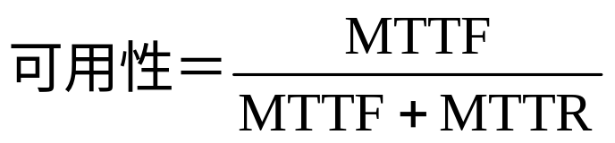
8.2 I/O系统的可靠性、可用性和可信性
  MTTF的倒数就是系统的失效率。
  如果系统中每个模块的生存期服从指数分布，则系统整体的失效率是各部件的失效率之和。
3.系统的可用性：系统正常工作的时间在连续两次正常服务间隔时间中所占的比率。
  MTTF+MTTR：平均失效间隔时间MTBF
    （Mean Time Between Failure）
4. 系统的可信性：服务的质量。即在多大程度上可以合理地认为服务是可靠的。（不可以度量）

Slide 8
8.2 I/O系统的可靠性、可用性和可信性
例8.1 假设磁盘子系统的组成部件和它们的MTTF如下：
（1）磁盘子系统由10个磁盘构成，每个磁盘的MTTF为1000000小时；
（2）1个SCSI控制器，其MTTF为500000小时；
（3）1个不间断电源，其MTTF为200000小时；
（4）1个风扇，其MTTF为200000小时；
（5）1根SCSI连线，其MTTF为1000000小时。
假定每个部件的生存期服从指数分布，同时假定各部件的故障是相互独立的，求整个系统的MTTF。

Slide 9
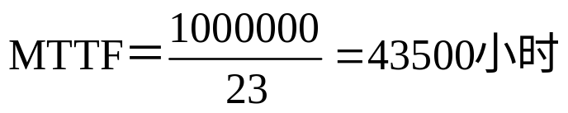
8.2 I/O系统的可靠性、可用性和可信性
解 整个系统的失效率为：
系统的MTTF为系统失效率的倒数，即：
即将近5年。

Slide 10
8.2 I/O系统的可靠性、可用性和可信性
5.提高系统组成部件可靠性的方法
  有效构建方法（valid construction）
    在构建系统的过程中消除故障隐患，这样建立起来
    的系统就不会出现故障。
  纠错方法（error correction）
    在系统构建中采用容错的方法。这样即使出现故障，
    也可以通过容错信息保证系统正常工作。

Slide 11
8.3 廉价磁盘冗余阵列RAID
磁盘阵列DA（Disk Array）：使用多个磁盘（包括驱动器）的组合来代替一个大容量的磁盘。
  多个磁盘并行工作。
  以条带为单位把数据均匀地分布到多个磁盘上。
    （交叉存放）
  条带存放可以使多个数据读/写请求并行地被处理，从而提高总的I/O性能。

Slide 12


RAID - Redundant Array of Independent Disks
RAID
Controller
Host
RAID Array
Disk Arrays
Notes:
Copyright © 2006 EMC Corporation. Do not Copy - All Rights Reserved.
RAID (Redundant Arrays of Independent Disks) combines two or more disk drives into an array (RAID set). Under the control of a RAID Controller, the RAID set can be made to appear to the host as a single logical disk drive. Properly implemented RAID sets provide:
Higher data availability
Improved I/O performance
Streamlined management of storage devices
Historical Note: In 1987, Patterson, Gibson and Katz at the University of California Berkeley, published a paper entitled, "A Case for Redundant Arrays of Inexpensive Disks (RAID)." This paper described various types of disk arrays, referred to by the acronym RAID. At the time, data was stored largely on large, expensive disk drives (called SLED, or Single Large Expensive Disk). The term inexpensive was used in contrast to that disk implementation. The term RAID has been redefined to refer to independent disks, to reflect the advances in the storage technology.
RAID storage has now grown from an academic concept to an industry standard.

Slide 13
RAID Components
Physical Array
Logical Array
RAID
Controller
Logical Array
Host
RAID Array
Disk Arrays
Notes:
Copyright © 2006 EMC Corporation. Do not Copy - All Rights Reserved.
Physical disks inside a RAID array are usually contained in smaller sub-enclosures. These sub-enclosures, or physical arrays, hold a fixed number of physical disks, and may also include other supporting hardware, such as power supplies.
A subset of disks within a RAID array can be grouped to form logical associations called logical arrays, also known as a RAID set. The operating system may see these disk groups as if they were regular disk volumes. Logical arrays facilitate the management of a potentially huge number of disks. For example:
Several physical disks can be concatenated to make large logical volumes (e.g., for databases)
A single physical disk can be divided up to create smaller areas (e.g., for logging)
Note: The number of logical arrays defined depends entirely on the RAID level(s) and the specific vendor implementation. Often, there is a 1:1 ratio of physical arrays to logical arrays. However, you could have a logical array with multiple physical arrays. Or, a physical array with multiple logical arrays.
Generally, the array management software implemented in RAID systems handles:
Management and control of disk aggregations (e.g. volume management)
Translation of I/O requests between the logical and the physical
Error correction if disk failures occur

Slide 14
Data Organization: Strips and Stripes
Stripe 1
Stripe 2
Stripe 3
Strips
Disk Arrays
Notes:
Copyright © 2006 EMC Corporation. Do not Copy - All Rights Reserved.
RAID sets are made up of disks. Within each disk, there are groups of contiguously addressed blocks, called strips. The set of aligned strips that spans across all the disks within the RAID set is called a stripe.
Strip size (also called stripe depth) describes the number of blocks in a strip, and is the maximum amount of data that will be written to or read from a single disk in the set before the next disk is accessed (assuming that the accessed data starts at the beginning of the strip).
All strips in a stripe have the same number of blocks.
Decreasing strip size means that data is broken into smaller pieces when spread across the disks.
Stripe size describes the number of data blocks in a stripe.
To calculate the stripe size, multiply the strip size by the number of data disks.
Stripe width refers to the number of data strips in a stripe (or, put differently, the number of data disks in a stripe).

Slide 15
RAID Performance: Striping
RAID
Controller
LUN
Host
Disk Arrays
Logical Array
Notes:
Copyright © 2006 EMC Corporation. Do not Copy - All Rights Reserved.
Striping improves performance by distributing data across the disks in the array. This use of multiple independent disks allows multiple reads and writes to take place concurrently.
When a large amount of data is written, the first piece is sent to the first drive, the second piece to the second drive, and so on.
The pieces are put back together again when the data is read.
Striping can occur at the block (or block multiple) level or the byte level. This is determined by the RAID level and the vendor-specific implementation.
Notes on striping:
Increasing the number of drives in the array increases performance because more data can be read or written simultaneously.
A higher stripe width indicates a higher number of drives and therefore better performance.
Striping is generally handled by the controller and is transparent to the host operating system.

Slide 16
RAID Redundancy: Mirroring
RAID
Controller
Mirrored Disk
Host
RAID Array
Disk Arrays
Notes:
Copyright © 2006 EMC Corporation. Do not Copy - All Rights Reserved.
A key element in RAID arrays is redundancy to improve fault tolerance. Mirroring uses multiple drives that hold identical copies of the data (usually 2 drives). Every write to a data disk is also a write to the mirror disk(s), meaning that all drives contain the same data. This is transparent to the attached host. If a disk fails, the RAID controller uses the mirror drive for data recovery and continuous operation. Data on a replaced drive is rebuilt from the mirrored drive.
Benefits - fast recovery from a failure and improved read performance
Drawbacks:
Degrades write performance because each block of host data is written to multiple disks
High cost of data protection due to the need for multiple disks

Slide 17
RAID Redundancy: Parity
0
4
8
1
5
9
RAID
Controller
2
6
10
3
Host
7
11
0 1 2 3
4 5 6 7
8 9 10 11
Disk Arrays
Parity Disk
Notes:
Copyright © 2006 EMC Corporation. Do not Copy - All Rights Reserved.
Parity is a redundancy check that ensures that the data is protected without having to have a full set of duplicate drives.
If a single disk in the array fails, the other disks have enough redundant data so that the data from the failed disk can be recovered
Like striping, parity is generally a function of the RAID controller and is transparent to the host .
Parity information can either be:
Stored on a separate, dedicated drive
Distributed with the data across all the drives in the array

Slide 18
8.3 廉价磁盘冗余阵列RAID
  这里并行性有两方面的含义：
  请求间并行：多个独立的请求可以由多个盘来并行地处理。 减少了I/O请求的排队等待时间
  请求内并行：如果一个请求访问多个块，就可以由多个盘合作来并行处理。
    提高了单个请求的数据传输率
3.问题：阵列中磁盘数量的增加会导致磁盘阵列可靠性的下降。
    如果使用了N个磁盘构成磁盘阵列，那么整个阵列
    的可靠性将降低为单个磁盘的1/N。
  解决方法：在磁盘阵列中设置冗余信息盘
    当单个磁盘失效时，丢失的信息可以通过冗余盘中
    的信息重新构建。

Slide 19
8.3 廉价磁盘冗余阵列RAID
4. 廉价磁盘冗余阵列RAID
    Redundant Arrays of Inexpensive Disks
  独立磁盘冗余阵列
    Redundant Arrays of Independent Disks
5. 大多数磁盘阵列的组成可以由以下两个特征来区分：
  数据交叉存放的粒度
    （可以是细粒度的，也可以是粗粒度的）
    细粒度磁盘阵列是在概念上把数据分割成相对较小
    的单位交叉存放。

Slide 20
8.3 廉价磁盘冗余阵列RAID
      优点：所有I/O请求都能够获得很高的数据传输率。
      缺点：在任何时间，都只有一个逻辑上的I/O在处
      理当中，而且所有的磁盘都会因为为每个请求进行
      定位而浪费时间。
    粗粒度磁盘阵列是把数据以相对较大的单位交叉存放。
      多个较小规模的请求可以同时得到处理。
      对于较大规模的请求又能获得较高的传输率。
  冗余数据的计算方法以及在磁盘阵列中的存放方式

Slide 21
8.3 廉价磁盘冗余阵列RAID
6. 在磁盘阵列中设置冗余需要解决以下两个问题：
  如何计算冗余信息?
    大多都是采用奇偶校验码；
    也有采用汉明码（Hamming code）码的。
  如何把冗余信息分布到磁盘阵列中的各个盘?
    有两种方法：
      把冗余信息集中存放在少数的几个盘中。
      把冗余信息均匀地存放到所有的盘中。
      （能避免出现热点问题）

Slide 22
RAID的分级及其特性
RAID级别 | 当数据盘为8个时，可容忍的故障个数及所需要的检测盘的个数 | 优 点 | 缺 点
0 非冗余，条带存放 | 0个故障； 0个检测盘 | 没有空间开销 | 没有纠错能力
1 镜像 | 1个故障； 8个检测盘 | 不需要计算奇偶校验，数据恢复快，读数据快。而且其小规模写操作比更高级别的RAID快 | 检测空间开销最大 （即需要的检测盘最多）
2 存储器式ECC | 1个故障； 4个检测盘 | 不依靠故障盘进行自诊断 | 检测空间开销的级别是log₂m级（m为数据盘的个数）
3 位交叉奇偶校验 | 1个故障； 1个检测盘 | 检测空间开销小（即需要的检测盘少），大规模读写操作的带宽高 | 对小规模、随机的读写操作没有提供特别的支持

Slide 23
RAID级别 | 可以容忍的故障个数以及当数据盘为8个时，所需要的检测盘的个数 | 优 点 | 缺 点
4 块交叉奇偶校验 | 1个故障； 1个检测盘 | 检测空间开销小，小规模的读操作带宽更高 | 校验盘是小规模写的瓶颈
5 块交叉分布 奇偶校验 | 1个故障； 1个检测盘 | 检测空间开销小，小规模的读写操作带宽更高 | 小规模写操作需要访问磁盘4次
6 P＋Q双奇偶校验 | 2个故障； 2个检测盘 | 具有容忍2个故障的能力 | 小规模写操作需要访问磁盘6次，检测空间开销加倍（与RAID3、4、5比较）

Slide 24
8.3 廉价磁盘冗余阵列RAID
8. 有关RAID的几个问题
  关键问题：如何发现磁盘的故障
    在磁盘扇区中除了保存数据信息外，还保存有用于发现该扇区错误的检测信息。
  设计的另一个问题
    如何减少平均修复时间MTTR
    典型的做法：在系统中增加热备份盘
  热交换技术
    与热备份盘相关的一种技术

Slide 25
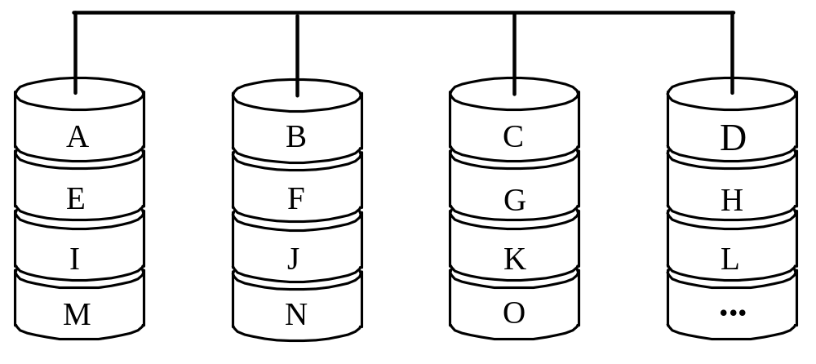
8.3 廉价磁盘冗余阵列RAID
8.3.1 RAID0
非冗余磁盘阵列，无冗余信息。
严格地说，它不属于RAID系列。
把数据切分成条带，以条带为单位交叉地分布存放到多个磁盘中。

Slide 26
RAID 0 – Striped Array with no Fault Tolerance
Block 4
RAID
Controller
Block 3
Block 2
Block 1
Block 0
Block 4
Block 3
Block 2
Block 1
Block 0
Host
Disk Arrays
Notes:
Copyright © 2006 EMC Corporation. Do not Copy - All Rights Reserved.
RAID 0 stripes the data across the drives in the array without generating redundant data.
Performance - better than JBOD because it uses striping. The I/O rate, called throughput, can be very high when I/O sizes are small. Large I/Os will produce high bandwidth (data moved per second) with this RAID type. Performance is further improved when data is striped across multiple controllers with only one drive per controller.
Data Protection – no parity or mirroring means that there is no fault tolerance. Therefore, it is extremely difficult to recover data.
Applications – those that need high bandwidth or high throughput, but where the data is not critical, or can easily be recreated. Temporary storage or spool areas can make use of RAID 0 .

Slide 27
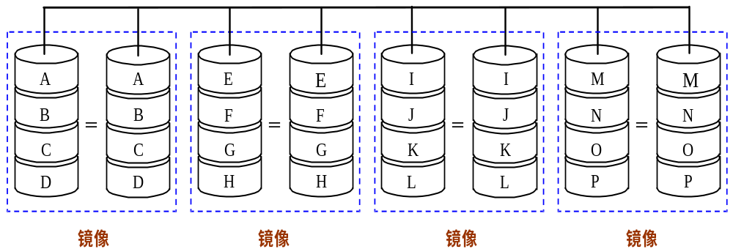
8.3 廉价磁盘冗余阵列RAID
8.3.2 RAID1
镜像磁盘，对所有的磁盘数据提供一份冗余的备份。
  每当把数据写入磁盘时，将该数据也写入其镜像盘。在系统中所有的数据都有两份。

Slide 28
RAID 1 – Disk Mirroring
Block 1
RAID
Controller
Block 0
Block 1
Block 1
Block 0
Block 0
Host
Disk Arrays
Notes:
Copyright © 2006 EMC Corporation. Do not Copy - All Rights Reserved.
RAID 1 uses mirroring to improve fault tolerance. A RAID 1 group consists of 2 (typically) or more disk modules. Every write to a data disk is also a write to the mirror disk(s). This is transparent to the host. If a disk fails, the disk array controller uses the mirror drive for data recovery and continuous operation. Data on the replaced drive is rebuilt from the mirror drive.
Benefits - high data availability and high I/O rate (small block size).
Drawbacks - total number of disks in the array equaling 2 times the data (useable) disks. This means that the overhead cost equals 100%, while usable storage capacity is 50%.
Performance – improves read performance, but degrades write performance
Data Protection - improved fault tolerance over RAID 0
Disks – at least two disks
Cost – expensive due to the extra capacity required to duplicate data
Maintenance - low complexity
Applications - accounting, payroll, finance, and applications requiring high availability

Slide 29
8.3 廉价磁盘冗余阵列RAID
2.RAID1的特点
  能实现快速的读取操作。
  对于写入操作，镜像的两个磁盘都要写入。但可并行进行，而且不需要计算校验信息，所以其速度比级别更高的RAID都快。
  可靠性很高，数据的恢复很简单。
  实现成本最高。

Slide 30
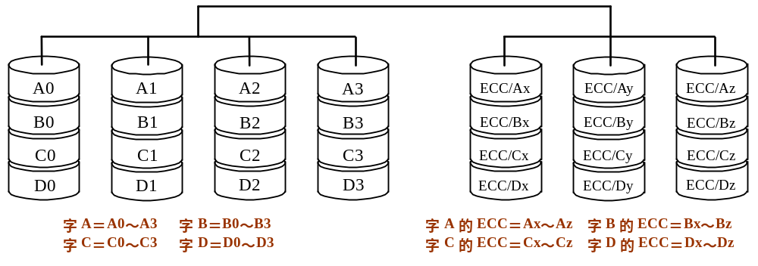
8.3 廉价磁盘冗余阵列RAID
8.3.3 RAID2
存储器式的磁盘阵列（按汉明纠错码的思路构建）
  含4个数据盘的RAID2

Slide 31
8.3 廉价磁盘冗余阵列RAID
2. RAID2的特点
  每个数据盘存放所有数据字的一位
    （位交叉存放）
  各个数据盘上的相应位计算汉明校验码，编码位被存放在多个校验（ECC）磁盘的对应位上。
  冗余盘是用来存放汉明码的，其个数为log₂m级。
    m：数据盘的个数（也就是数据字的位数）
  并未被广泛应用，目前还没有商业化产品。

Slide 32
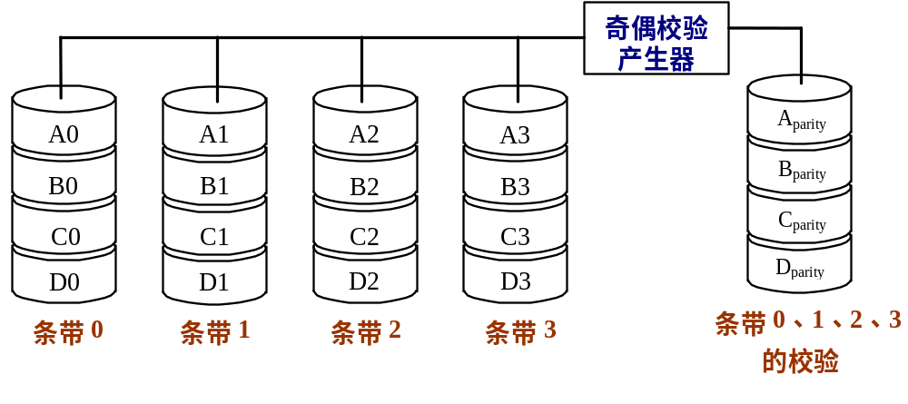
8.3 廉价磁盘冗余阵列RAID
8.3.4 RAID3
位交叉奇偶校验磁盘阵列

Slide 33
RAID 3 - Parallel Transfer with Dedicated Parity Disk
Block 3
RAID
Controller
Block 2
Block 1
Block 0
Block 0
Block 1
Parity
Generated
Block 2
Host
Block 3
P 0 1 2 3
Disk Arrays
Notes:
Copyright © 2006 EMC Corporation. Do not Copy - All Rights Reserved.
RAID Level 3 stripes data for high performance and uses parity for improved fault tolerance. Data is striped across all the disks but one in the array. Parity information is stored on a dedicated drive, so that data can be reconstructed if a drive fails.
RAID 3 always reads and writes complete stripes of data across all the disks. There are no partial writes that update one out of many strips in a stripe.
Benefits - the total number of disks is less than in a mirrored solution (e.g. 1.25 times the data disks for group of 5), good bandwidth on large data transfers
Drawbacks - poor efficiency in handling small data blocks. This makes it not well suited to transaction processing applications. Data is lost if multiple drives fail within the same RAID 3 Group.
Performance - high data read/write transfer rate. Disk failure has a significant impact on throughput. Rebuilds are slow.
Data Protection - uses parity for improved fault tolerance
Striping – byte level to multiple block level, depending on vendor implementation.
Applications - applications where large sequential data accesses are used such as medical and geographic imaging

Slide 34
8.3 廉价磁盘冗余阵列RAID
2. RAID3的特点
  采用奇偶校验
    写数据时：为每行数据形成奇偶校验位并写入校验盘
    读出数据时：如果控制器发现某个磁盘出故障，就可以根据故障盘以外的所有其他盘中的正确信息恢复故障盘中的数据。（通过异或运算实现）
  细粒度的磁盘阵列，即采用的条带宽度较小。
    （可以是1个字节或1位）
    能够获得很高的数据传输率，这种磁盘阵列对大数据量的读写具有很大的优越性。
    不能同时进行多个I/O请求的处理 。
  只需要一个校验盘，校验空间开销比较小。

Slide 35
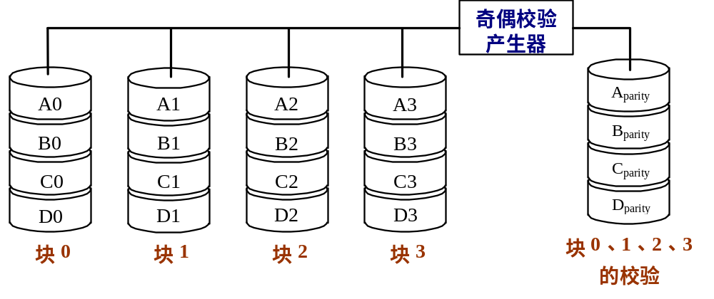
8.3 廉价磁盘冗余阵列RAID
8.3.5 RAID4
块交叉奇偶校验磁盘阵列
采用比较大的条带，以块为单位进行交叉存放和计算奇偶校验。
  实现目标：能同时处理多个小规模访问请求

Slide 36
RAID 4 - Striping with Dedicated Parity Disk
Block 0
Block 0
Block 4
Block 1
Block 5
Parity
Generated
Block 2
Block 0
RAID
Controller
Block 0
Block 6
P 0 1 2 3
Block 3
Host
Block 7
P 0 1 2 3
P 0 1 2 3
P 4 5 6 7
Disk Arrays
Notes:
Copyright © 2006 EMC Corporation. Do not Copy - All Rights Reserved.
RAID Level 4 stripes data for high performance and uses parity for improved fault tolerance. Data is striped across all the disks but one in the array. Parity information is stored on a dedicated disk so that data can be reconstructed if a drive fails.
The data disks are independently accessible, and multiple reads and writes can occur simultaneously.
Benefits - the total number of disks is less than in a mirrored solution (e.g., 1.25 times the data disks for group of 5), good read throughput, and reasonable write throughput.
Drawbacks – the dedicated parity drive can be a bottleneck when handling small data writes. This RAID level is not well suited to transaction processing applications. Data loss if multiple drives fail within the same RAID 4 Group.
Performance - high data read transfer rate. Poor to medium write transfer rate. Disk failure has a significant impact on throughput
Data Protection - uses parity for improved fault tolerance.
Striping – usually at the block (or block multiple) level
Applications – general purpose file storage
RAID 4 is much less commonly used than RAID 5, discussed next. The dedicated parity drive is a bottleneck, especially when a disk failure has occurred.

Slide 37
8.3 廉价磁盘冗余阵列RAID
3. RAID4读写特点
  读取操作
    每次只需访问数据所在的磁盘。
    仅在该磁盘出现故障时，才会去读校验盘，并进行数据的重建。
  写入操作
    假定:有4个数据盘和一个冗余盘。
    写数据需要2次磁盘读和2次磁盘写操作。

Slide 38
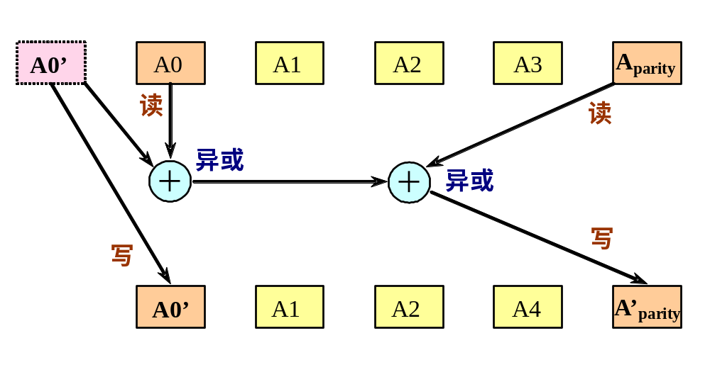
8.3 廉价磁盘冗余阵列RAID
  RAID4能有效地处理小规模访问，快速处理大规模访问，校验空间开销比较小。但其控制比较复杂。

Slide 39
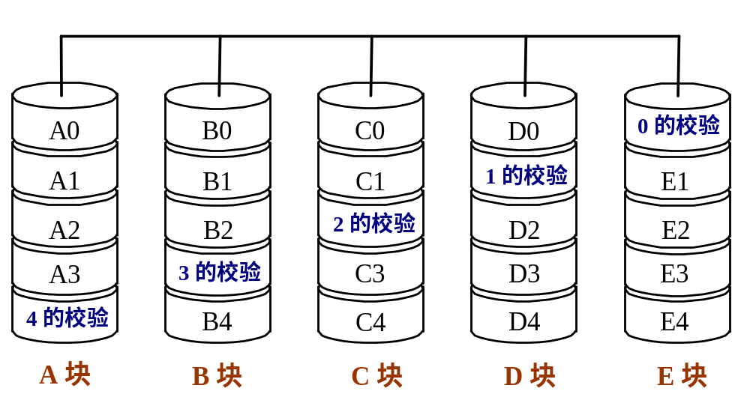
8.3 廉价磁盘冗余阵列RAID
8.3.6 RAID5
块交叉分布奇偶校验磁盘阵列
数据以块交叉的方式存于各盘，无专用冗余盘，奇偶校验信息均匀分布在所有磁盘上。

Slide 40
RAID 5 - Independent Disks with Distributed Parity
Block 0
Block 0
Block 4
Block 4
Block 1
Block 5
Parity
Generated
Block 2
Parity
Generated
Block 4
RAID
Controller
Block 0
Block 0
Block 4
Block 6
P 0 1 2 3
P 4 5 6 7
Block 3
Host
P 4 5 6 7
P 4 5 6 7
P 0 1 2 3
P 0 1 2 3
Block 7
Disk Arrays
Notes:
Copyright © 2006 EMC Corporation. Do not Copy - All Rights Reserved.
RAID 5 does not read and write data to all disks in parallel like RAID 3. Instead, it performs independent read and write operations. There is no dedicated parity drive; data and parity information is distributed across all drives in the group.
Benefits - the most versatile RAID level. A transfer rate greater than that of a single drive but with a high overall I/O rate. Good for parallel processing (multi-tasking) applications/environments. Cost savings due to the use of parity over mirroring.
Drawbacks - slower transfer rate than RAID 3. Small writes are slow, because they require a read-modify-write (RMW) operation. There is degradation in performance in recovery and reconstruction modes and data loss if multiple drives within the same group are lost.
Performance - high read data transaction rate, medium write data transaction rate. Low ratio of parity disks to data disks. Good aggregate transfer rate
Data Protection - single disk failure puts volume in degraded mode. Difficult to rebuild (as compared to RAID level 1).
Disks - 5-disk and 9-disk groups are popular. Most implementations allow other RAID set sizes.
Striping – block level, or multiple block level
Applications - file and application servers, database servers, WWW, email, and News servers

Slide 41
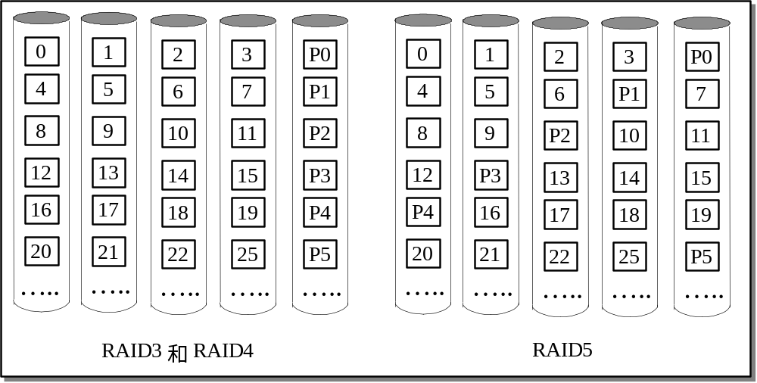
8.3 廉价磁盘冗余阵列RAID
RAID3/4和RAID5中的信息分布

Slide 42
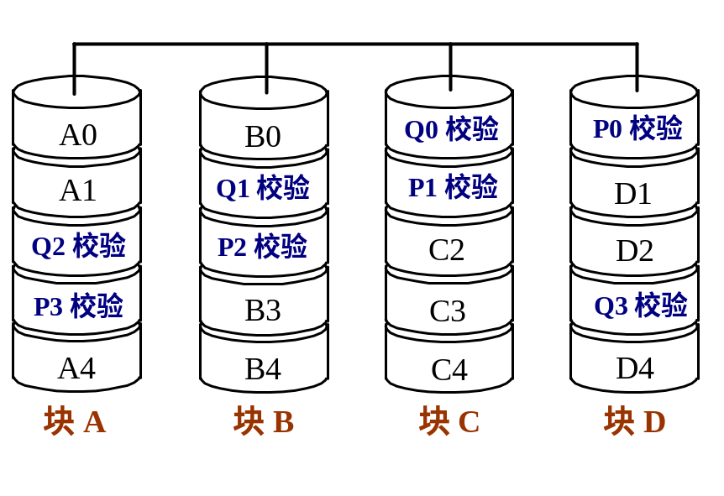
8.3 廉价磁盘冗余阵列RAID
8.3.7 RAID6
P＋Q双校验磁盘阵列
特点
  校验空间开销是RAID5的两倍
  容忍两个磁盘出错

Slide 43
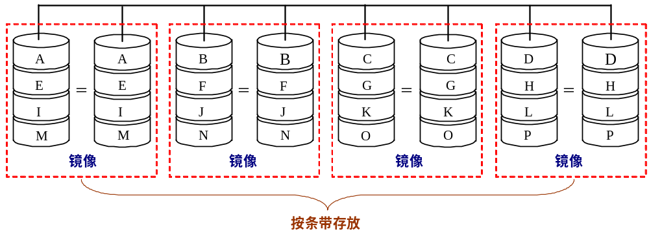
8.3 廉价磁盘冗余阵列RAID
8.3.8 RAID10与RAID01
RAID10又称为RAID1+0
    先进行镜像（RAID1），再进行条带存放（RAID0）

Slide 44
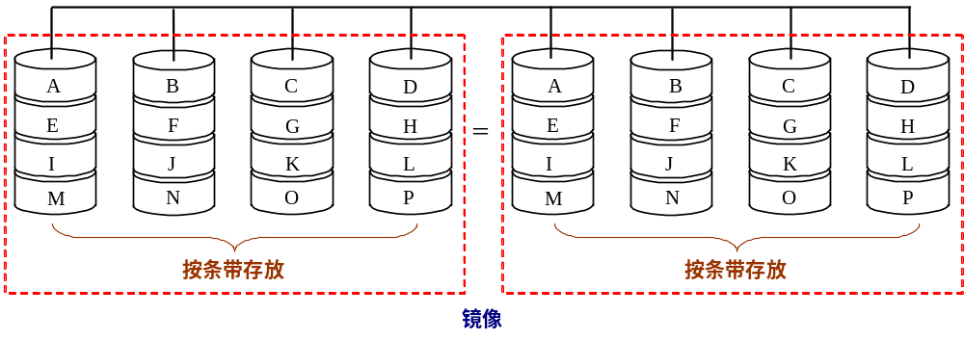
8.3 廉价磁盘冗余阵列RAID
2. RAID01又称为RAID0+1
    先进行条带存放（RAID0），再进行镜像（RAID1）

Slide 45
RAID 1+0 – Mirroring and Striping
Block 3
RAID
Controller
Block 2
Block 1
Block 0
Block 3
Block 3
Block 2
Block 2
Block 1
Block 1
Block 0
Block 0
Host
Disk Arrays
Notes:
Copyright © 2006 EMC Corporation. Do not Copy - All Rights Reserved.
RAID 1+0 (or RAID 10, RAID 1/0, or RAID A) also combines the speed of RAID 0 with the redundancy of RAID 1, but it is implemented a different manner than RAID 0+1. RAID 1+0 is a striped array whose individual elements are RAID 1 arrays - mirrors.
Benefits - high data availability, high I/O rate (small block size), and the ability to withstand multiple drive failures as long as they occur on different mirrors.
Drawbacks - total number of disks equal two times the data disks, with overhead cost equaling 100%
Data Protection - high reliability.
Disks - even number of disks (4 disk minimum, to allow striping)
Cost - very expensive, because of the high overhead
Performance: High I/O rates achieved using multiple stripe segments. Writes are slower than reads, because they are mirrored
Applications – databases requiring high I/O rates with random data, and applications requiring maximum data availability

Slide 46

Hot Spares
RAID
Controller
Disk Arrays
Notes:
Copyright © 2006 EMC Corporation. Do not Copy - All Rights Reserved.
A hot spare is an idle component (often a drive) in a RAID array that becomes a temporary replacement for a failed component. For example:
The hot spare takes the failed drive’s identity in the array.
Data recovery takes place. How this happens is based on the RAID implementation:
If parity was used, data will be rebuilt onto the hot spare from the parity and data on the surviving drives.
If mirroring was used, data will be rebuilt using the data from the surviving mirrored drive.
The failed drive is replaced with a new drive at some time later.
One of the following occurs:
The hot spare replaces the new drive permanently—meaning that it is no longer a hot spare and a new hot spare must be configured on the system.
When the new drive is added to the system, data from the hot spare is copied to the new drive. The hot spare returns to its idle state, ready to replace the next failed drive.
Note: The hot spare drive needs to be large enough to accommodate the data from the failed drive
Hot spare replacement can be:
Automatic - when a disk’s recoverable error rates exceed a predetermined threshold, the disk subsystem tries to copy data from the failing disk to a spare one. If this task completes before the damaged disk fails, the subsystem switches to the spare and marks the failing disk unusable. (If not it uses parity or the mirrored disk to recover the data, as appropriate).
User initiated - the administrator tells the system when to do the rebuild. This gives the administrator control (e.g., rebuild overnight so as not to degrade system performance), however, the system is vulnerable to another failure because the hot spare is now unavailable. Some systems implement multiple hot spares to improve availability.

Slide 47

Hot Swap
RAID
Controller
RAID
Controller
RAID
Controller
Disk Arrays
Notes:
Copyright © 2006 EMC Corporation. Do not Copy - All Rights Reserved.
Like hot spares, hot swaps enable a system to recover quickly in the event of a failure. With a hot swap the user can replace the failed hardware (such as a controller) without having to shut down the system.
Note: A warm swap occurs when the system needs to be shut down, but power does not need to be removed in order to replace the failed component. A cold swap occurs when the power must be removed as well. Some systems have the ability to auto-swap without user intervention.

Slide 48
8.3 廉价磁盘冗余阵列RAID
8.3.9 RAID的实现与发展
实现盘阵列的方式主要有三种：
  软件方式：阵列管理软件由主机来实现。
    优点：成本低
    缺点：过多地占用主机时间，且带宽指标上不去。
  阵列卡方式：把RAID管理软件固化在I/O控制卡上，从而可不占用主机时间，一般用于工作站和PC机。
  子系统方式：一种基于通用接口总线的开放式平台，可用于各种主机平台和网络系统。

Slide 49
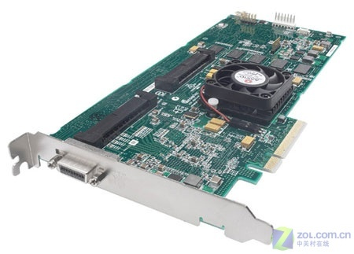
RAID阵列卡
Adaptec公司 的SAS RAID适配器：
SCSI RAID 4800SAS
提供标准的RAID 0、1、5、10和50功能

Slide 50
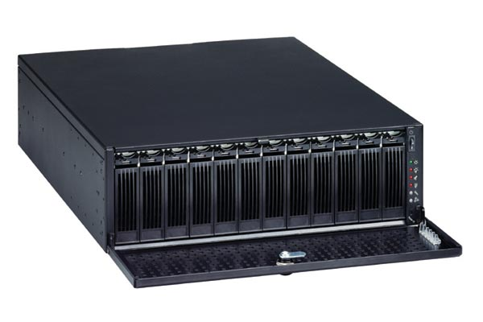
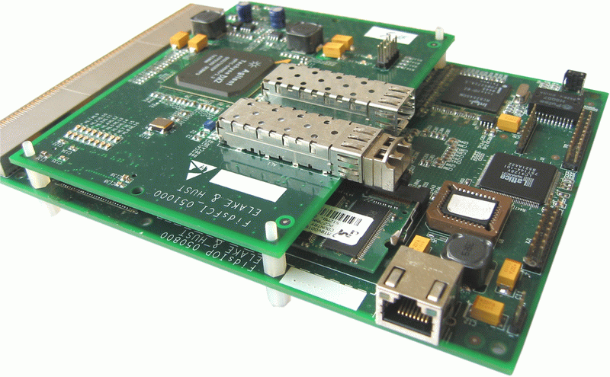
子系统方式

Slide 51
8.4 总 线
  在计算机系统中，各子系统之间可以通过总线互相连接。
  优点：成本低、简单
  主要缺点：它是由不同的外设分时共享的，形成了信息交换的瓶颈，从而限制了系统中总的I/O吞吐量。

Slide 52
8.4 总 线
8.4.1 总线的设计
总线设计存在很多技术难点
  一个重要原因：总线上信息传送的速度极大地受限于各种物理因素。
    如总线的长度、设备的数目等，这些物理因素限制了总线性能的提高。
  另外，我们一方面要求I/O操作响应快，另一方面又要求高吞吐量，这可能造成设计需求上的冲突。

Slide 53
8.4 总 线
2。设计总线时需要考虑的一些问题
特性 | 高性能 | 低价格
总线宽度 | 独立的地址和数据总线 | 数据和地址分时 共用同一套总线
数据总线宽度 | 越宽越快（例如：64位） | 越窄越便宜（例如：8位）
传输块大小 | 块越大总线开销越小 | 单字传送更简单
总线主设备 | 多个（需要仲裁） | 单个（无需仲裁）
分离事务 | 采用——分离的请求包和回答包能提高总线带宽 | 不采用——持续连接成本 更低，而且延迟更小
定时方式 | 同步 | 异步

Slide 54
8.4 总 线
3.分离事务总线
    （又称：流水总线、悬挂总线、包交换总线）
  在有多个主设备时，可以通过包交换来提高总线带宽。
  基本思想
    将总线事务分成请求和应答两部分。
    在请求和应答之间的空闲时间内，总线可以供其他的I/O使用，这样就不必在整个I/O过程中都独占总线。
  分离事务总线有较高的带宽，但是它的数据传送延迟通常比独占总线方法大。

Slide 55
8.4 总 线
4. 同步总线
  同步总线的控制线中包含一个时钟，总线上所有设备的所有的通信操作都以该时钟为基准。
  优点：速度快、成本低。
  缺点
    由于时钟通过长距离传输后会扭曲，因而同步总线不能用于长距离的连接。特别是对于高速同步总线来说，更是如此。
    总线上的所有设备都必须以同样的时钟频率工作。
  CPU-存储器总线通常是采用同步总线。

Slide 56
8.4 总 线
5. 异步总线
  没有统一的参考时钟，每个设备都有各自的定时方法。
  采用握手协议。
  不存在时钟扭曲和同步的问题，传输距离可以比较长。
  很多I/O总线都采用异步总线。
  同步总线通常比异步总线快。

Slide 57
8.4 总 线
8.4.3 与CPU的连接
I/O总线的物理连接方式有两种选择
  连接到存储器上
    更常见
  连接到Cache上
I/O总线连接到存储器总线上的方式
  一种典型的组织结构

Slide 58
CPU
－主存总线
Cache
总线适配器
总线适配器
主存
CPU
AGP总线
PCI总线
I/O
控制器
总线适配器
I/O
控制器
图形输出
网络
I/O
总线
I/O
控制器
I/O
控制器
磁盘
磁盘
CD

Slide 59
8.4 总 线
3.CPU对I/O设备的编址有两种方式
  存储器映射I/O（也称为I/O设备统一编址）
    将一部分存储器地址空间分配给I/O设备，用load指令和store指令对这些地址进行读写将引起I/O设备的数据传输。
    将一部分存储空间留出用于设备控制，对这一部分地址空间进行读写就是向设备发出控制命令。
  给I/O设备独立编址
    需要在CPU中设置专用的I/O指令来访问I/O设备。
    CPU需要发出一个标志信号来表示所访问的地址是I/O设备的地址。

Slide 60
8.4 总 线
4. CPU与外部设备进行输入/输出的方式可分为4种
  程序查询
  中断
  DMA
  通道

Slide 61
8.5 通道处理机
8.5.1 通道的作用和功能
程序控制、中断和DMA方式管理外围设备会引起两个问题：
  所有外设的输入/输出工作均由CPU承担，CPU的计算工作经常被打断而去处理输入/输出的事务，不能充分发挥CPU的计算能力。
  大型计算机系统的外设虽然很多，但同时工作的机会不是很多。
  解决上述问题的方法：采用通道处理机（简称通道）

Slide 62
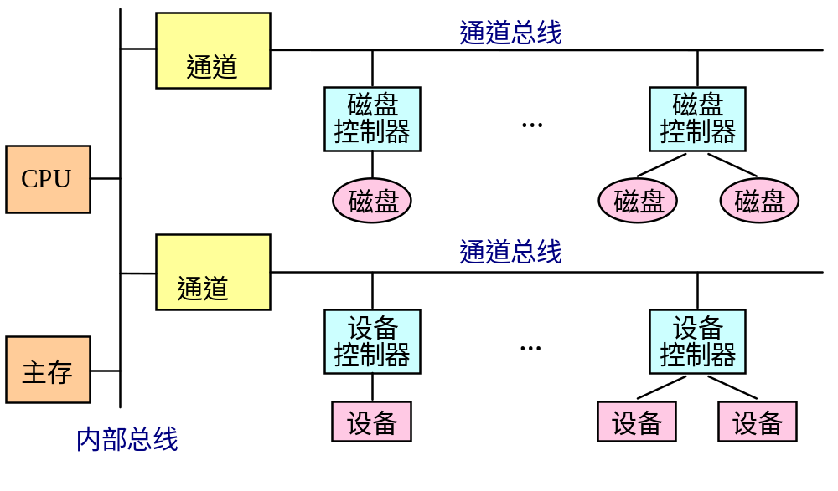
8.5 通道处理机
  通道负责外围设备的大部分I/O工作。
  通道只能执行有限的一组I/O指令。
2. 一个典型的由CPU、通道、设备控制器、外设构成的4级层次结构的输入/输出系统。

Slide 63
8.5 通道处理机
3. 通道的功能
  接收CPU发来的I/O指令，并根据指令要求选择指定的外设与通道相连接。
  执行通道程序
    从主存中逐条取出通道指令，对通道指令进行译码，并根据需要向被选中的设备控制器发出各种操作命令。
  给出外设中要进行读/写操作的数据所在的地址
    如磁盘存储器的柱面号、磁头号、扇区号等。

Slide 64
8.5 通道处理机
  给出主存缓冲区的首地址
    该缓冲区存放从外设输入的数据或者将要输出到外设中去的数据。
  控制外设与主存缓冲区之间的数据传送的长度
    对传送的数据个数进行计数，并判断数据传送是否结束。
  指定传送工作结束时要进行的操作
    例如：将外设的中断请求及通道的中断请求送往CPU等。
  检查外设的工作状态是否正常，并将该状态信息送往主存指定单元保存。
  在数据传输过程中完成必要的格式变换
    例如：把字拆分为字节，或者把字节装配成字等。

Slide 65
8.5 通道处理机
4. 通道对外设的控制通过输入/输出接口和设备控制器进行
  通道与设备控制器之间一般采用标准的输入/输出接口来连接。
  通道通过标准接口把操作命令送到设备控制器，设备控制器解释并执行这些通道命令，完成命令指定的操作。
  设备控制器能够记录外设的状态，并把状态信息送往通道和CPU。

Slide 66
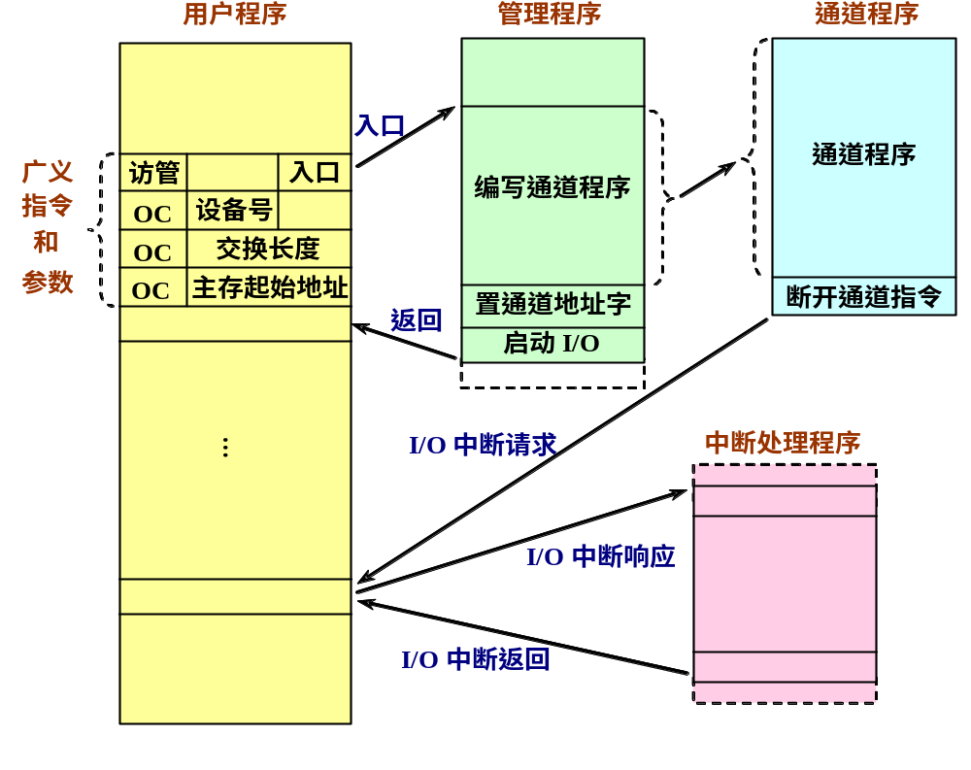
8.5 通道处理机
8.5.2 通道的工作过程

Slide 67
8.5 通道处理机
通道完成一次数据输入/输出的工作过程
  在用户程序中使用访管指令进入管理程序，由管理程序生成一个通道程序，并启动通道。
    用户在目标程序中设置一条广义指令，通过调用操作系统的管理程序来实现。
    管理程序根据广义指令提供的参数来编制通道程序。
    启动输入/输出设备指令是一条主要的输入/输出指令，属于特权指令。
  通道处理机执行通道程序，完成指定的数据I/O工作。
    通道处理机执行通道程序与CPU执行用户程序是并行的。
  通道程序结束后向CPU发中断请求。

Slide 68
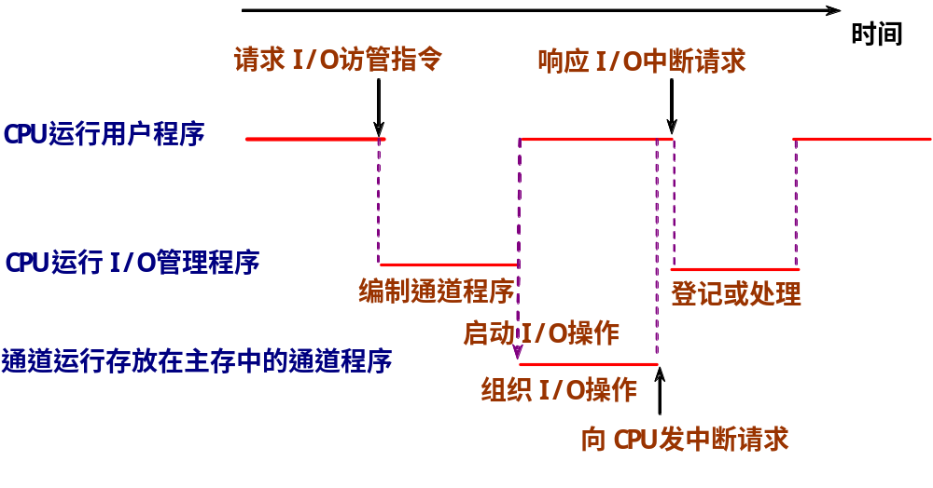
8.5 通道处理机
CPU执行程序和通道执行通道程序的时间关系

Slide 69
8.5 通道处理机
8.5.3 通道的种类
  根据信息传送方式的不同，将通道分为三种类型
    字节多路通道
    选择通道
    数组多路通道
  三种类型的通道与CPU、设备控制器和外设的连接关系

Slide 70
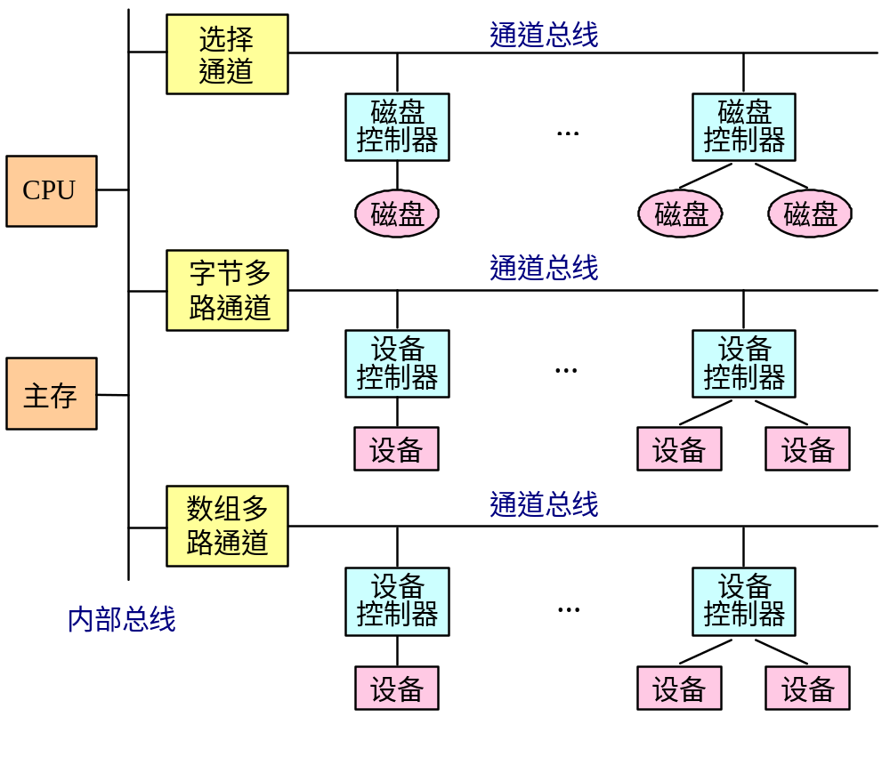
8.5 通道处理机

Slide 71
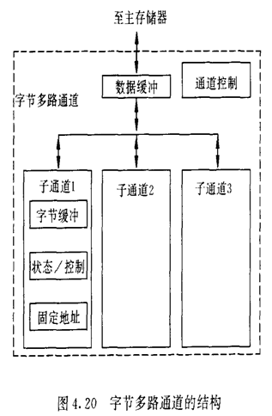
8.5 通道处理机
字节多路通道
  为多台低速或中速的外设服务。
  以字节交叉的方式分时轮流地为它们服务。
  字节多路通道可以包含多个子通道，每个子通道连接一台设备控制器。

Slide 72
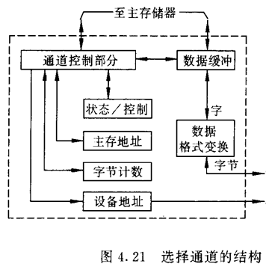
8.5 通道处理机
2. 选择通道
  为多台高速外围设备服务。
  在一段时间内只为一台高速外设独占使用。
  选择通道的硬件
5个寄存器
  数据缓冲寄存器、设备地址寄存器、主存地址计数器、交换字节数计数器、设备状态/控制寄存器
格式变换部件
  用于在主存和设备之间进行字与字节的拆分和装配
通道控制部件

Slide 73
8.5 通道处理机
3. 数组多路通道
  适用于高速设备。
  每次选择一个高速设备后传送一个数据块，轮流为多台外围设备服务。
  数组多路通道之所以能够并行地为多台高速设备服务，是因为虽然其所连设备的传输速率很高，但寻址等辅助操作时间很长。
  以从磁盘存储器读出一个文件的过程为例：
    数据读出过程可以分为3个步骤：磁头定位，找扇区和读出数据。
    磁盘的寻址时间 ：磁头定位和找扇区的时间加起来
    磁盘存储器的寻址时间要比数据传输时间长两个数量级以上。

Slide 74
8.5 通道处理机
8.5.4 通道流量分析
通道流量
  一个通道在数据传送期间，单位时间内能够传送的数据量。所用单位一般为B/s。
  又称为通道吞吐率、通道数据传输率等。
  通道最大流量
    一个通道在满负荷工作状态下的流量 。

Slide 75
8.5 通道处理机
  参数的定义
    T_{S}：设备选择时间。从通道响应设备发出的数据传送请求开始，到通道实际为这台设备传送数据所需要的时间。
    T_{D}：传送一个字节所用的时间。
    p：在一个通道上连接的设备台数，且这些设备同时都在工作。
    n：每台设备传送的字节数，这里假设每台设备传送的字节数都相同。
    k：数组多路通道传输的一个数据块中包含的字节数。在一般情况下，k<n。对于磁盘、磁带等磁表面存储器，通常k=512。
    T：通道完成全部数据传送工作所需要的时间。

Slide 76
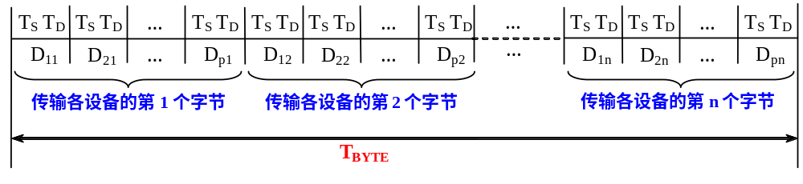

8.5 通道处理机
字节多路通道
  数据传送过程
  通道每连接一台个外设，只传送一个字节，然后又与另一台设备连接，并传送一个字节。
  p台设备每台传送n个数据总共所需的时间为

Slide 77
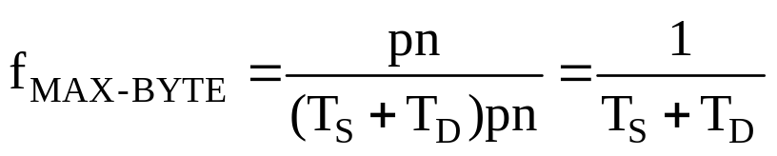
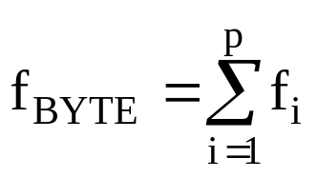
8.5 通道处理机
  最大流量
  实际流量是连接在这个通道上的所有设备的数据传输率之和。
    f_{i}：第i台设备的实际数据传输率

Slide 78
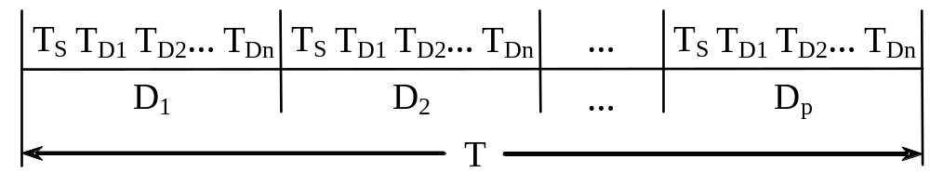
8.5 通道处理机
2. 选择通道
  在一段时间内只能单独为一台高速外设服务，当这台设备的数据传送工作全部完成后，通道才能为另一台设备服务。
  工作过程
    其中：D_{i}表示通道正在为第i台设备服务
    T_{D1} = T_{D2} = … = T_{Dn} = T_{D}

Slide 79
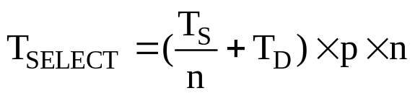
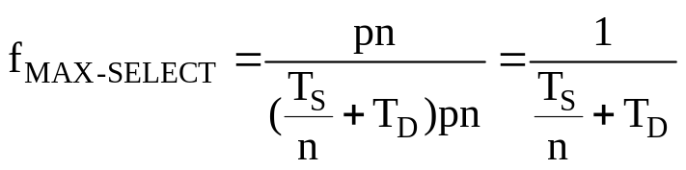
8.5 通道处理机
  p台设备每台传送n个数据总共所需的时间
  最大流量

Slide 80
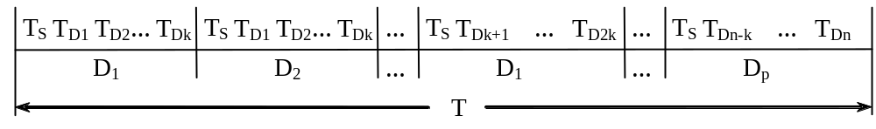
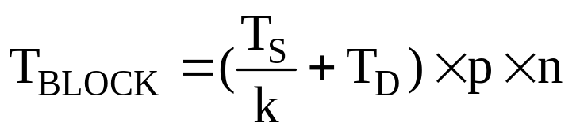
8.5 通道处理机
3. 数组多路通道
  工作过程
  p台设备每台传送n个数据总共所需的时间为：

Slide 81
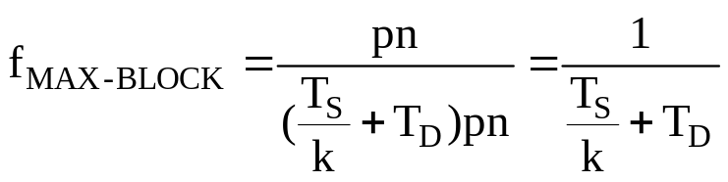
8.5 通道处理机
  最大流量
  选择通道和数组多路通道的实际流量就是连接在这个通道上的所有设备中数据流量最大的那一个 。

Slide 82
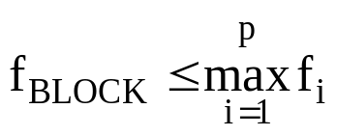
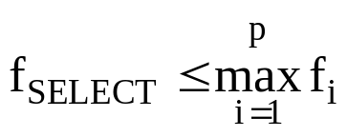



8.5 通道处理机
  各种通道的实际流量应该不大于通道的最大流量
    两边的差值越小，通道的利用率就越高。
    当两边相等时，通道处于满负荷工作状态。

Slide 83
8.6 I/O与操作系统
  操作系统的作用之一是在多进程之间进行进程保护，这种保护包括存储器访问和I/O操作两个方面。
  I/O操作主要是在外设和存储器之间进行，所以操作系统必须保证这些I/O操作的安全性。

Slide 84
8.6 I/O与操作系统
8.6.1 DMA和虚拟存储器
  DMA是使用虚拟地址还是物理地址？
使用物理地址进行DMA传输，存在以下两个问题：
  对于超过一页的数据缓冲区，由于缓冲区使用的页面在物理存储器中不一定是连续的，所以传输可能会发生问题。
  如果DMA正在存储器和缓冲区之间传输数据时，操作系统从存储器中移出（或重定位）一些页面，那么，DMA将会在存储器中错误的物理页面上进行数据传输。

Slide 85
6.6 I/O与操作系统
2. 解决这些问题的方法
  使操作系统在I/O的传输过程中确保DMA设备所访问的页面都位于物理存储器中，这些页面被称为是钉在了主存中。
  “虚拟DMA”技术
    允许DMA设备直接使用虚拟地址，并在DMA期间由硬件将虚拟地址转换为物理地址。
    在采用虚拟DMA的情况下，如果进程在内存中被移动，操作系统应该能够及时地修改相应的DMA地址表。

Slide 86
虚拟DMA的I/O连接
CPU
－主存总线
Cache
地址转换寄存器
主存
TLB
DMA
控制器
CPU
I/O
总线
I/O
控制器
I/O
控制器
I/O
控制器
磁盘
磁盘
图形输出
网络

Slide 87
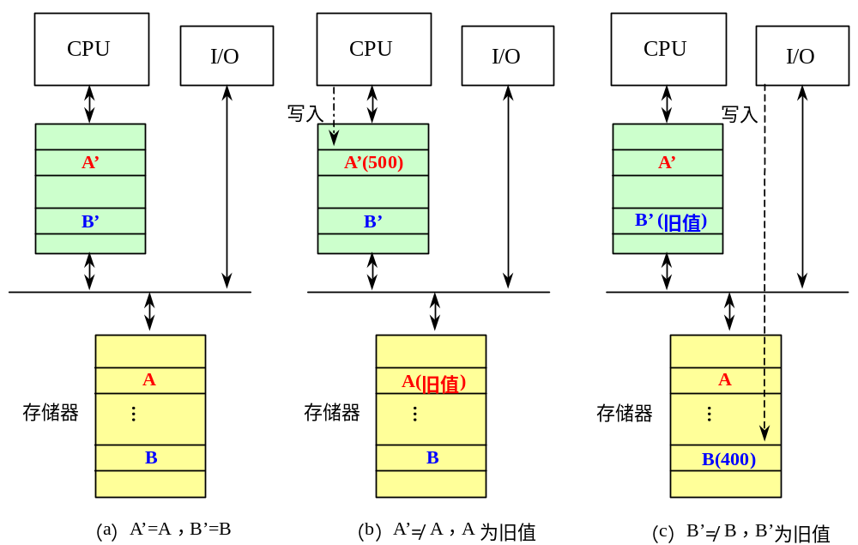
8.6 I/O与操作系统
8.6.2 I/O和Cache数据一致性
举例：假设Cache采用写回法，并且A’B ’是AB的副本。写直达Cache？

Slide 88
8.6 I/O与操作系统
Cache会使一个数据出现两个副本：
  一个在Cache中，另一个在主存中。
I/O设备可以修改存储器中的内容
  把I/O连接到存储器上
    会出现以下情况：
    CPU修改了Cache的内容后，由于存储器的内容跟不上Cache内容的变化，I/O系统进行输出操作时所看到的数据是旧值。（写直达Cache没有这样的问题）
    I/O系统进行输入操作后，存储器的内容发生了变化，但CPU在Cache中所看到的内容依然是旧值。

Slide 89
8.6 I/O与操作系统
  把I/O直接连接到Cache上
    不会产生由I/O导致的数据不一致的问题。
      所有I/O设备和CPU都能在Cache中看到最新的数据。
    I/O会跟CPU竞争访问Cache，在进行I/O时，会造成CPU的停顿。
    I/O还可能会破坏Cache中CPU访问的内容，因为I/O操作可能导致一些新数据被加入Cache，而这些新数据可能在近期内并不会被CPU访问。

Slide 90
8.6 I/O与操作系统
3.解决内容一致性问题的方法
    （不管Cache是采用写直达法还是写回法）
  软件的方法
    设法保证I/O缓冲器中的所有各块都不在Cache中。
    具体做法有两种
      把I/O缓冲器的页面设置为不可进入Cache的，在进行输入操作时，操作系统总是把输入的数据放到该页面上。
      在进行输入操作之前，操作系统先把Cache中与I/O缓冲器相关的数据“赶出”Cache，即把相应的数据块设置为“无效”状态。

Slide 91
8.6 I/O与操作系统
  硬件的方法
    在进行输入操作时，检查相应的I/O地址（I/O缓冲器中的单元）是否在Cache中（即是否有数据副本）。
    如果发现I/O地址在Cache中有匹配的项，就把相应的Cache块设置为“无效”。

Slide 92
作业
8.2

