Slide 1

Quantifying User influence
In retweet cascade
March 29th, 2017
Yifei Zhang
Marian-Andrei Rizoiu

Slide 2
Content of this presentation
Presentation outline
Motivation of quantifying user influence
Why cascade
Problem definition
Approach to estimate use influence
Test and Conclusion

Slide 3
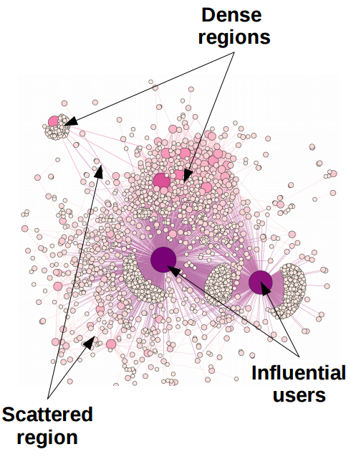
Motivation of Quantifying user influence
If a piece of information or event release from a user, can we predict whether it may infect to one million user ?
Applications:
advertisers and marketers to design more effective campaigns
Control virus

Slide 4
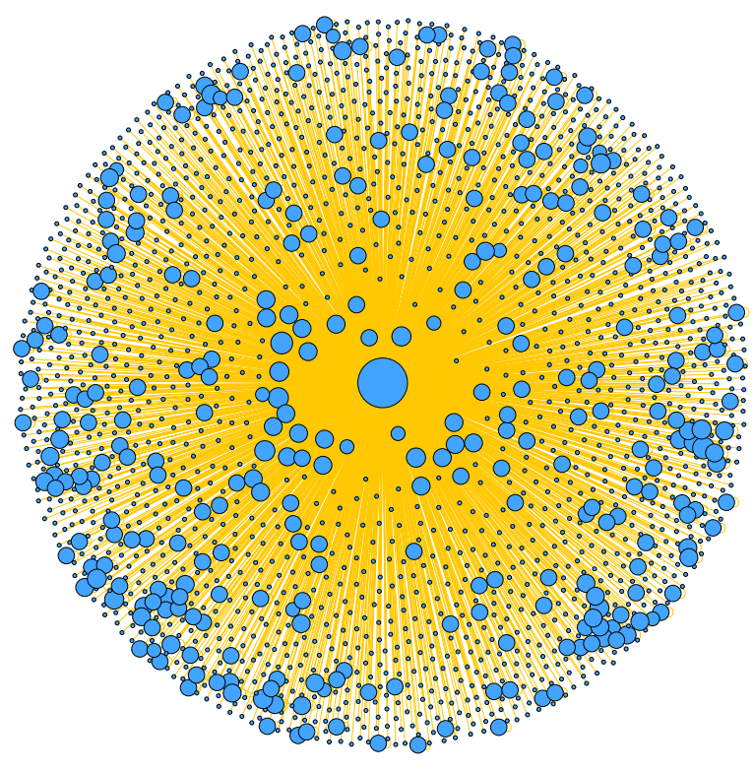
Why cascade?
In many case it is Impossible to get intermediary path of information diffusion
we only observe final traces of information spread (be it in the form of a message, a decision, or a virus) but we do not know the paths over which information propagates
Rewteet is a cascade

Slide 5
The problem
How to define a user influence
How do we detect the most influential
user through a cascade?
Can estimate user influence in losing
intermediary path
Network

Slide 6

Approach to estimate use influence
t5
t2
P2
P5
t0
P1
t1
P4
t4
p1
P3
t3
P6
t6
t6
t5
Path(t1) = P1
Path(t2) = P1*P2
Path(t3) = P1*P3
Path(t4) = P1*P4
Path(t5) = P1*P4*P5
Path(t6) = P1*P3*P6
t4
t1
t0
Influence(t0) = Path(t1)+Path(t2)+Path(t3)+Path(t4)+Path(t5)
t2
t3

Slide 7

Approach to estimate use influence
t1
t2
t3
t0
t1
t0
t1
t0
t1
t0
t1
t3
t2
t3
t2
t2
t0
t1
t2
t0
t1
t0
t1
t2
t2
t3
t3
t1
t0
t1
t2
t0
t1
t2
t3
t0
t3
t2
t3

Slide 8
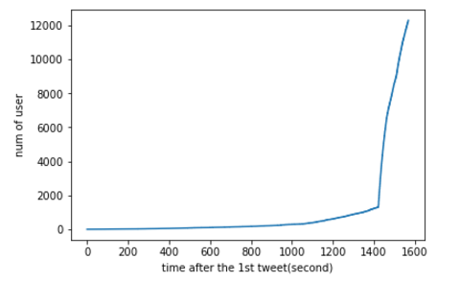
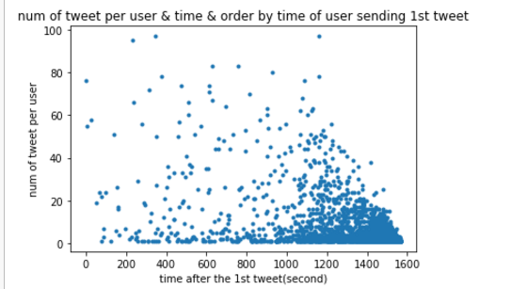
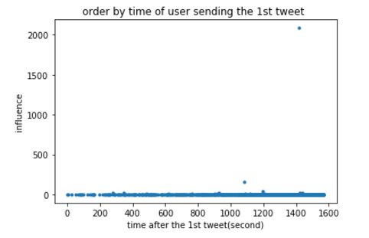
Simple test

Slide 9
Summary
We build models for measuring localised time-dependent user influence, by accounting for social factors such as the number of followers, the length of social memory and timing of interactions in an unobserved information diffusion cascade
develop time-efficient prototypes of the proposed algorithm, by exploiting linear algebra libraries and matrix operations
perform the experimental validation

