Slide 1

Machine Learning Regression Challenge
Spring 2026
Yifei Li

Slide 2
Main Idea & Results
Core Architecture
Data Preprocessing
Result
Mean Imputation to processing
missing values
Z-score standard for all 15 values
Points of 0.06245
Ridge Regression Model
L2-Lasso for preventing overfitting

Slide 3
Exploratory Data Analysis (EDA)
Feature Set: 15 continuous values (x0-x14)
Missing values: Train sets and test sets including missing values
Variance: Significant scale difference.

Slide 4

Handling missing values
Simple Imputer strategy
To preserve data integrity without dropping samples, I applied Mean Imputation.
Strict fit() on training and transform() on test sets was used to prevent "data leakage" from the unseen test set into the training phase.

Slide 5
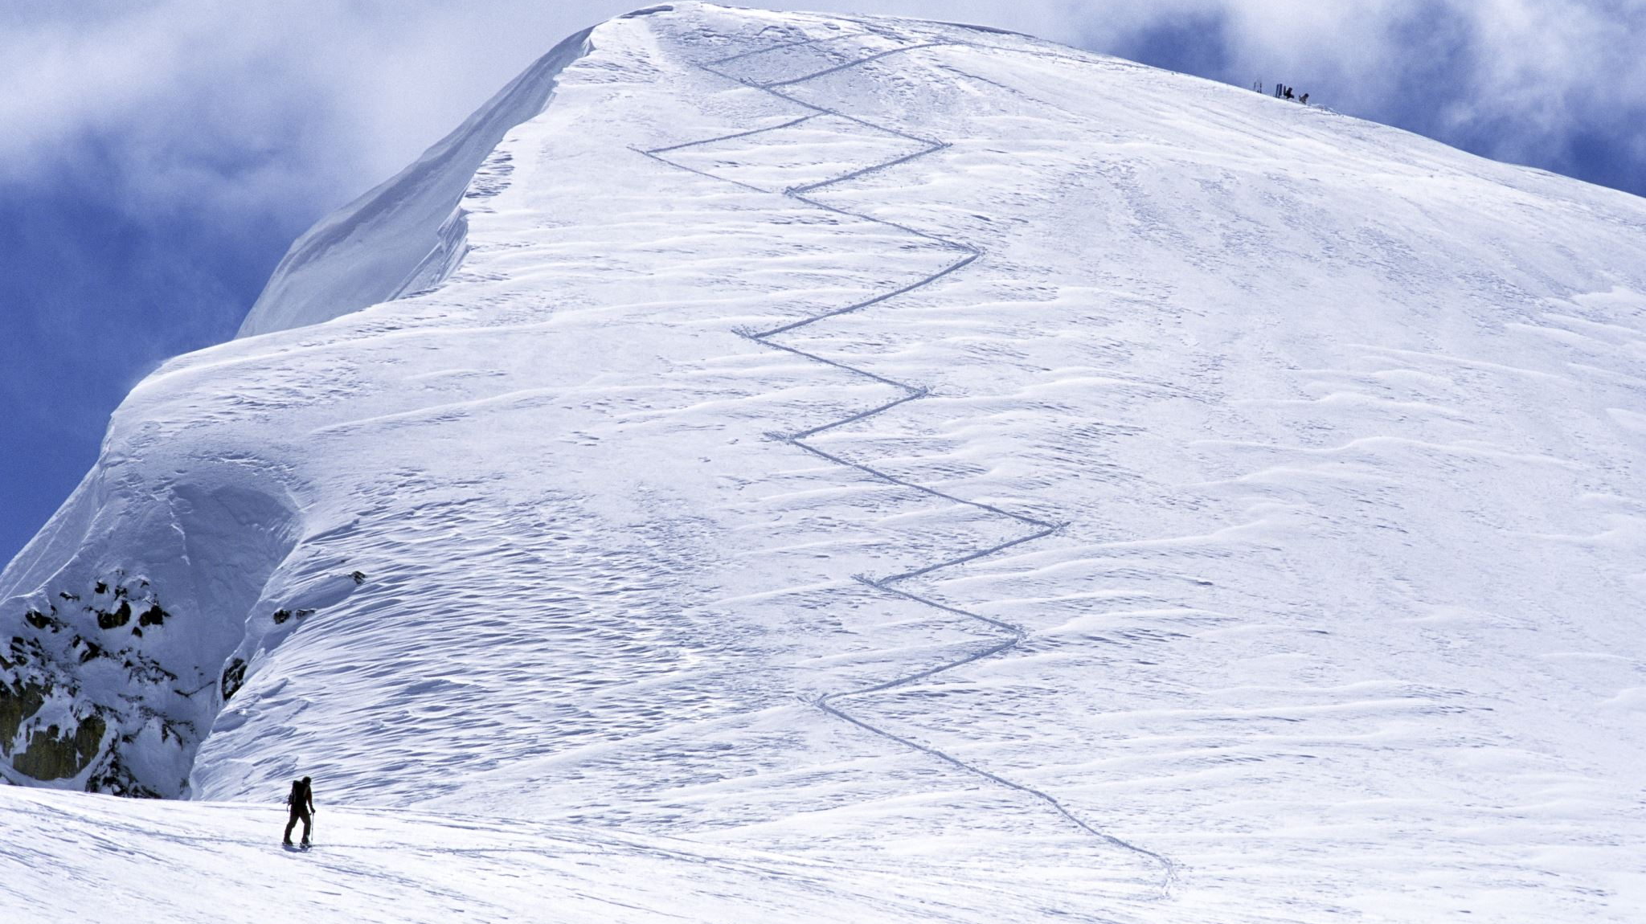
Ridge Regression
Motivation: Ordinary Least Squares (OLS) tends to overfit when features are correlated. Ridge adds a L2 penalty
Through tuning, Alpha=1.0 was selected to balance the bias-variance trade-off.

Slide 6

Validation Strategy
80/20
Train/split
This ensured the model remained generalized and performed well on the hidden Kaggle private set.

Slide 7
Final Performance

Slide 8

Thank you

