Slide 1
Predict the success of bank telemarketing
Reporter: Yifeng (Frank) Xie
Partner: Qiaozhi (Chelsea) Song
June 28, 2017

Slide 2
What does the data look like?
Input variables: # bank client data: 1 - age (numeric) 2 - job : type of job (categorical: 'admin.','blue-collar','entrepreneur','housemaid','management','retired','self-employed','services','student','technician','unemployed','unknown') 3 - marital : marital status (categorical: 'divorced','married','single','unknown'; note: 'divorced' means divorced or widowed) 4 - education (categorical: 'basic.4y','basic.6y','basic.9y','high.school','illiterate','professional.course','university.degree','unknown') 5 - default: has credit in default? (categorical: 'no','yes','unknown') 6 - housing: has housing loan? (categorical: 'no','yes','unknown') 7 - loan: has personal loan? (categorical: 'no','yes','unknown') # related with the last contact of the current campaign: 8 - contact: contact communication type (categorical: 'cellular','telephone') 9 - month: last contact month of year (categorical: 'jan', 'feb', 'mar', ..., 'nov', 'dec') 10 - day_of_week: last contact day of the week (categorical: 'mon','tue','wed','thu','fri') 11 - duration: last contact duration, in seconds (numeric). Important note: this attribute highly affects the output target (e.g., if duration=0 then y='no'). Yet, the duration is not known before a call is performed. Also, after the end of the call y is obviously known. Thus, this input should only be included for benchmark purposes and should be discarded if the intention is to have a realistic predictive model. # other attributes: 12 - campaign: number of contacts performed during this campaign and for this client (numeric, includes last contact) 13 - pdays: number of days that passed by after the client was last contacted from a previous campaign (numeric; 999 means client was not previously contacted) 14 - previous: number of contacts performed before this campaign and for this client (numeric) 15 - poutcome: outcome of the previous marketing campaign (categorical: 'failure','nonexistent','success') # social and economic context attributes 16 - emp.var.rate: employment variation rate - quarterly indicator (numeric) 17 - cons.price.idx: consumer price index - monthly indicator (numeric) 18 - cons.conf.idx: consumer confidence index - monthly indicator (numeric) 19 - euribor3m: euribor 3 month rate - daily indicator (numeric) 20 - nr.employed: number of employees - quarterly indicator (numeric)
Output variable (desired target): 21 - y - has the client subscribed a term deposit? (binary: 'yes','no')

Slide 3
What does the data look like?
 | 21 of 150 features (41188 instances from 2008 to 2013)
Categorical Feature | 'job', 'marital', 'education', 'default', 'housing', 'loan', 'contact', 'month', 'day_of_week', 'poutcome', 'y'
Numerical Feature | 'age', 'duration', 'campaign', 'pdays', 'previous', 'emp.var.rate', 'cons.price.idx', 'cons.conf.idx', 'euribor3m', 'nr.employed'
Which is relatively important to y ?

Slide 4
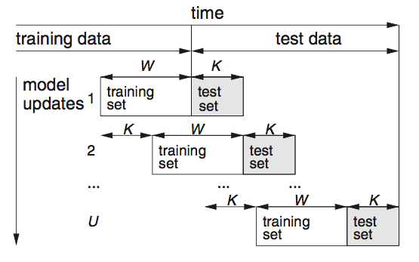
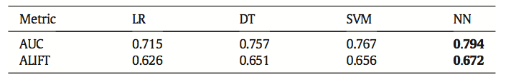
What is previous work?
Randomly split with 2/3 and 1/3 of the contacts at fisrt
Regularly update the data
Use logistic regression, decision trees (DTs), neural network (NN) and support vector machine (SVM) models
Compare the prediction results using above models

Slide 5
What is my work?
Why python ?
Randomly split with 4/5 of all the data for training, and remaining 1/5 for testing.
Preprocess the data above
Use decision trees (DTs) and support vector machine (SVM) models.
Compare the prediction results using above models.

Slide 6
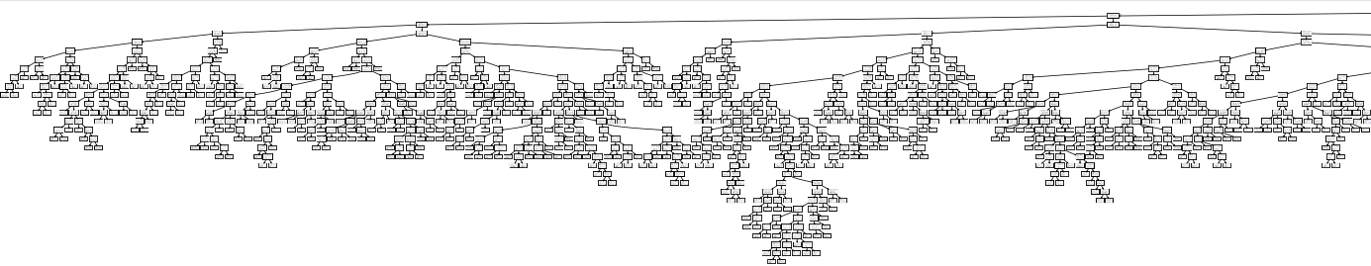
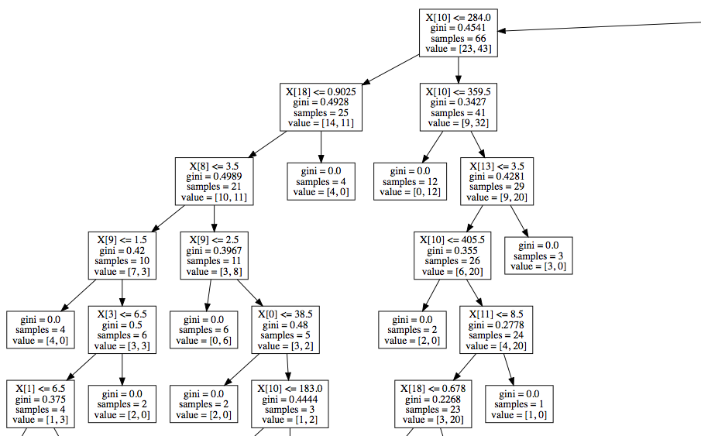
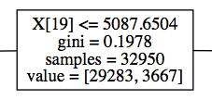
What is the result?
The most top one:
19 - euribor3m: euribor 3 month rate - daily indicator (numeric)

Slide 7
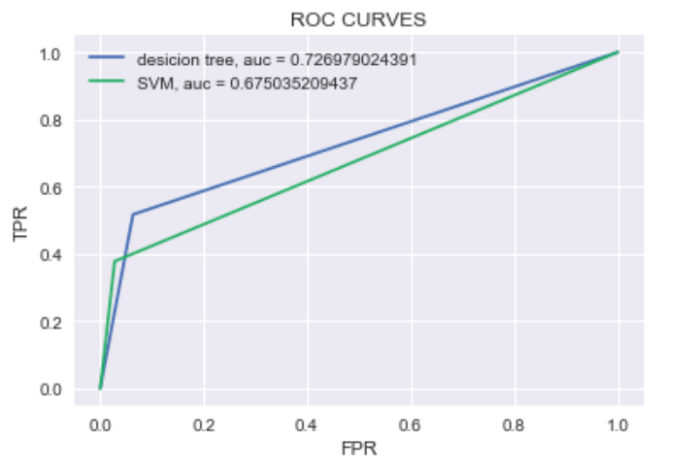
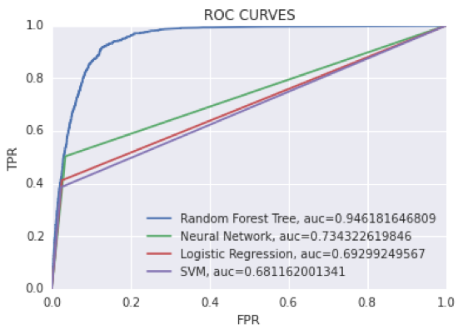
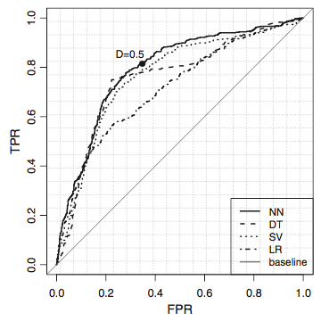
What is the result?
My work
Chelsea’s work
Previous work
 | SVM | DT | LR | NN | RFT
Previous work | AUC = 0.767 | AUC = 0.757 | AUC = 0.757 | AUC = 0.794 | N/A
My work | AUC = 0.675 | AUC = 0.727 | N/A | N/A | N/A
Chelsea’s work | AUC = 0.681 | N/A | AUC = 0.693 | AUC = 0.734 | AUC = 0.946

Slide 8
What is conclusion and future direction?
The output is very close to the output of previous work.
There might be some overfitting problems with random forest tree model.
Try to reduce overfitting effects.
Try to tune and modify parameters of machine learning models.
Try to modify decision tree graph.

Slide 9
Thank you!
Reference:
S. Moro, P. Cortez and P. Rita. A Data-Driven Approach to Predict the Success of Bank Telemarketing. Decision Support Systems, Elsevier, 62:22-31, June 2014
http://scikit-learn.org/stable/modules/tree.html
http://scikit-learn.org/stable/modules/svm.html
http://scikit-learn.org/stable/modules/preprocessing.html
UCI dataset is from http://archive.ics.uci.edu/ml/datasets/Bank+Marketing
All the code are in https://github.com/yifengxie/INF552.git

