Slide 1
Adult Income Prediction
Yifeng (Frank) Xie
July 17, 2017

Slide 2
Introduction
1. Where the data comes from and what the data looks like
It is from UCI data set
Inputs (totally 14): age, workplace, education, education-num, marital-status, race, sex, hours-per-week …
Prediction task is to determine whether a person makes over 50K a year (<=50K or >50K)
2. What size the data set has
32561 instances from training set and 16281 instances from testing set
3. How to evaluate SVM algorithm
Error rate – training data size diagram
4. What the paper did
Set Bias (ex: age <= 30)
Compare results with bias and without bias

Slide 3
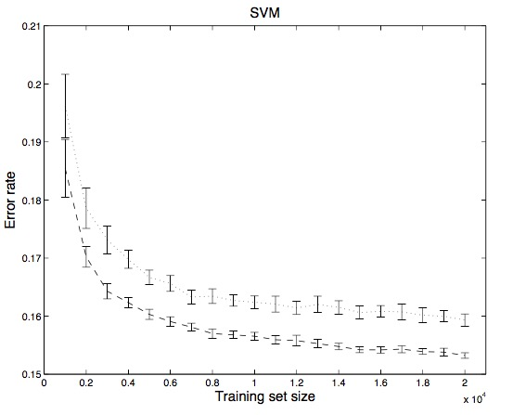
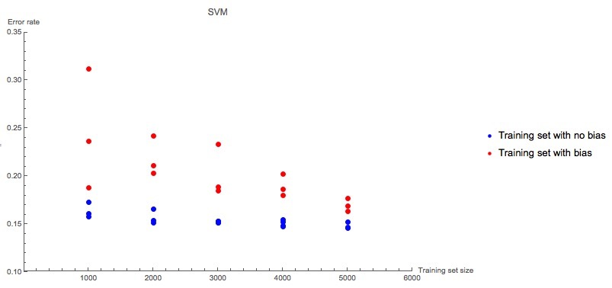
Comparison
Results from the paper
Results from my work

Slide 4
Conclusion
Con
Mathematica is a heavy-weight tool.
Running SVM algorithm in Mathematica is slow.
Pro
GUI of Mathematica is pretty good.
Mathematica has many functionalities.
Bias in ML
Some bias may affect algorithm accuracy.
My income
Unfortunately it is <=50K.

Slide 5
Thank you
Reference:
1. https://mathematica.stackexchange.com/questions/63181/transform-dataset-so-it-can-be-used-as-training-set-for-classify
2. http://archive.ics.uci.edu/ml/datasets/Adult
3. Bianca Zadrozny. Learning and evaluating classifiers under sample selection bias. ICML. 2004.

