Slide 1
LA City Health Prediction
Yifeng (Frank) Xie
2017.08.02

Slide 2
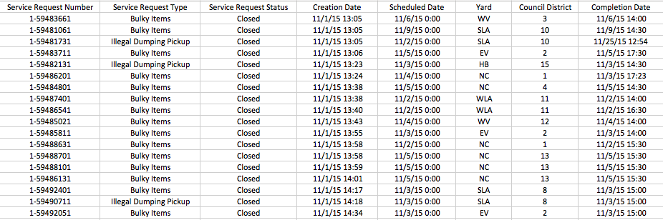
Raw Data Description
Title: LASAN: Solid Resources Abandoned Waste Collection Activity
16614 Instances
8 Attributes: Service Request Number, Service Request Type, Service Request Status, Creation Date, Scheduled Date, Yard, Council District and Completion Date
Time span: the whole November of 2015
Data Source: https://data.lacity.org/A-Livable-and-Sustainable-City/LASAN-Solid-Resources-Abandoned-Waste-Collection-A/97ra-aqza/data

Slide 3
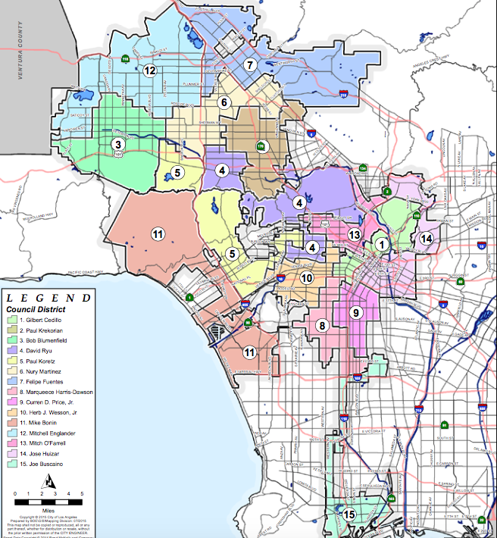
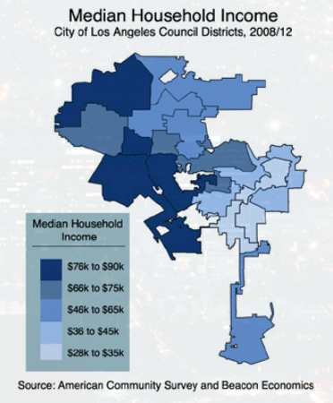
Health Status
Health Status data is based on LOS ANGELES CITY COUNCIL DISTRICTS ECONOMIC REPORT

Slide 4
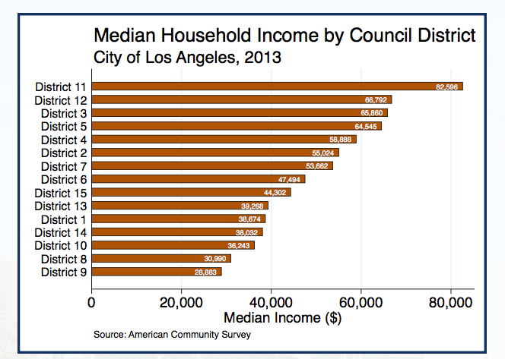
Health Status
Choose Median Household Income to represent Health Status.

Slide 5
My Hypothesis
Waste Collection Duration is the most important variable towards health status

Slide 6
Thinking in Method
Data Preprocessing tool: NodeJS
Data preprocessing and data aggregation
Generate .geojson file to be used for map visualization
Map Visualization tool: Mapbox
Import tilesets
Set up style
Output map layers
Implementation tool of map visualization: HTML, CSS, JavaScript…
Machine Learning lib: Scikit Learn
Machine Learning tools: Jupyter Notebook, Python
Machine Learning method: Decision Tree

Slide 7
Thinking in Method
3 –level Health Status to make things simple
Use t-test for statistics use
Use decision tree diagram to decide whether the hypothesis is correct
Use decision tree model to predict health status
Use cross validation to avoid deviation

Slide 8
Data Preprocessing
Choose attributes: Service Request Type and the Duration of a request
Duration = Completion Date – Creation Date
Make up for Completion Date if there is no Completion Date
The unit is day
Aggregate data by council district
Aggregate quantities of Bulky Items, Electronic Waste, Illegal Dumping pickup, and Metal/Household Appliances
All duration of each council district
Two dependent variables: quantity of all types of waste, average duration of each council district
Some data visualization
See attached file named mapbox.html

Slide 9
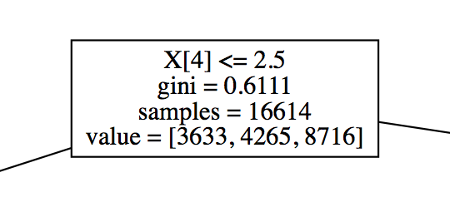
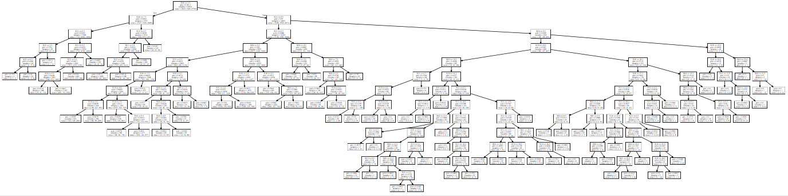
Machine Learning -- Decision Tree
For non aggregated data
Prediction Accuracy: 0.52
P-value | X[0] Bulky Items | X[1] Electronic Waste | X[2] Illegal Dumping Pickup | X[3] Metal/Household Appliances | X[4] duration
Health Area 1 vs Health Area 2 | 0.863897139 | 2.05E-06 | 0.777530701 | 3.28E-06 | 0.002378095
Health Area 2 vs Health Area 3 | 0.172292712 | 0.000268404 | 0.571759113 | 0.642751576 | 8.37E-22
Health Area 1 vs Health Area 3 | 0.273174323 | 0.055348648 | 0.832505132 | 2.14E-06 | 3.47E-08

Slide 10
Machine Learning -- Decision Tree
Bulky Items | Electronic Waste | Illegal Dumping Pickup | Metal/Household Appliances | All Collections | All Duration | Average Duration | Health
729 | 104 | 217 | 52 | 1102 | 4819 | 4.37 | 3
960 | 108 | 278 | 51 | 1397 | 5204 | 3.73 | 2
487 | 39 | 178 | 31 | 735 | 2723 | 3.7 | 1
625 | 58 | 168 | 50 | 901 | 3567 | 3.96 | 1
481 | 32 | 175 | 54 | 742 | 2922 | 3.94 | 1
753 | 106 | 256 | 36 | 1151 | 4198 | 3.65 | 2
482 | 82 | 185 | 27 | 776 | 3531 | 4.55 | 2
1161 | 79 | 486 | 57 | 1783 | 7800 | 4.37 | 3
790 | 70 | 361 | 26 | 1247 | 5420 | 4.35 | 3
1063 | 89 | 315 | 63 | 1530 | 6839 | 4.47 | 3
491 | 27 | 191 | 41 | 750 | 3398 | 4.53 | 1
293 | 48 | 123 | 38 | 502 | 2303 | 4.59 | 1
1373 | 132 | 365 | 106 | 1976 | 8777 | 4.44 | 3
677 | 93 | 277 | 27 | 1074 | 5690 | 5.3 | 3
587 | 59 | 251 | 41 | 938 | 3553 | 3.79 | 2

Slide 11
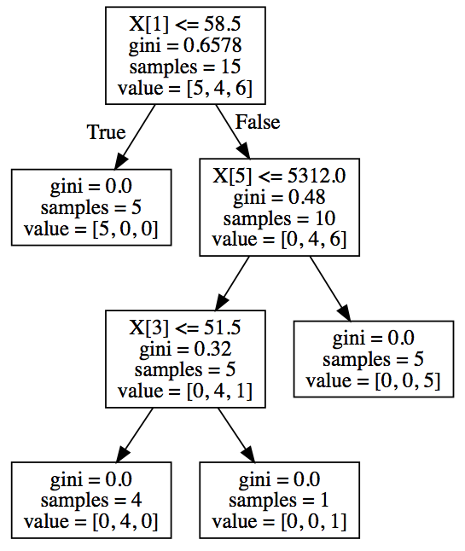
Machine Learning -- Decision Tree
For aggregated data
Prediction Accuracy: 0.63
X[0] | Bulky Items
X[1] | Electronic Waste
X[2] | Illegal Dumping Pickup
X[3] | Metal/Household Appliances
X[4] | All Collections
X[5] | All Duration
X[6] | Average Duration

Slide 12
Conclusion
Waste Collection Duration and Quantity of Electronic Waste are the most important variables towards health status
Council districts who have less Waste Collection Duration or Quantity of Electronic Waste are healthier
More variables are needed to predict health status
Mapbox is a very useful tool to implement map related visualization (JavaScript)

Slide 13
Thank Professor Tejada and Sneha ! Thank you all !

