Slide 1
MySQL Administration
主讲：马永亮(马哥)
QQ群:169777636
客服QQ：2813150558, 1661815153
http://www.magedu.com
http://mageedu.blog.51cto.com

Slide 2
MySQL Storage Engine
Transaction
User Management
Backup and Recovery
Caching and MySQL

Slide 3
MySQL Architacture and
Storage Engines
主讲：马永亮(马哥)
QQ群:169777636
客服QQ：2813150558, 1661815153
http://www.magedu.com
http://mageedu.blog.51cto.com

Slide 7
ACID

Slide 8
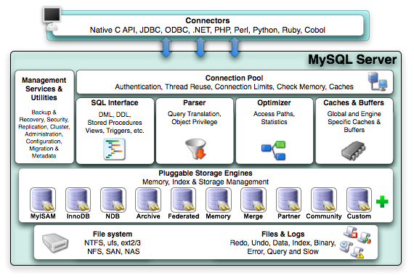
MySQL Arch

Slide 10
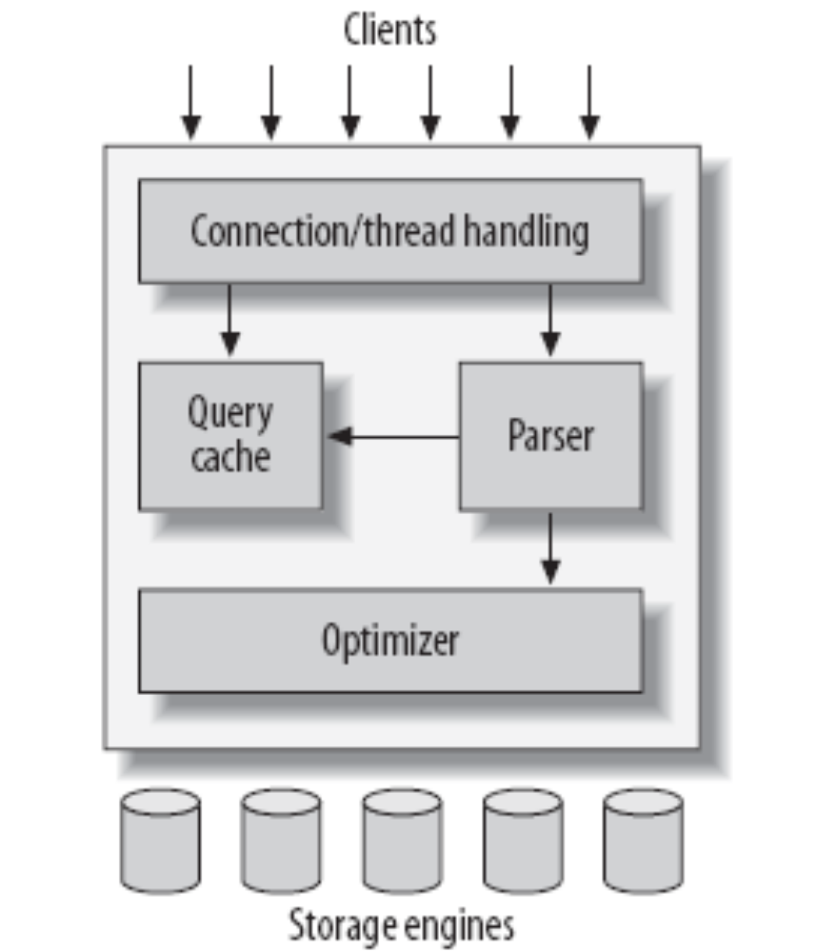
MySQL’s Logical Architecture

Slide 11
MySQL’s Logical Architecture
The topmost layer contains the services that aren’t unique to MySQL
  Services most network-based client/server tools or servers need: connection handling, authentication, security, and so forth
The second layer
  Much of MySQL’s brains are here, including the code for query parsing, analysis, optimization, caching, and all the built-in functions (e.g., dates, times, math, and encryption)
  Any functionality provided across storage engines lives at this level: stored procedures, triggers, and views, for example
The third layer contains the storage engines
  They are responsible for storing and retrieving all data stored “in” MySQL
  The server communicates with them through the storage engine API
Notes:
This interface hides differences between storage engines and makes them largely transparent at the query layer. The API contains a couple of dozen low-level functions that perform operations such
as “begin a transaction” or “fetch the row that has this primary key.” The storage
engines don’t parse SQL* or communicate with each other; they simply respond to
requests from the server.

Slide 12
Connection Management and Security
Each client connection gets its own thread within the server process
  The connection’s queries execute within that single thread, which in turn resides on one core or CPU
  The server caches threads, so they don’t need to be created and destroyed for each new connection
When clients (applications) connect to the MySQL server, the server needs to authenticate them
  Authentication is based on username, originating host, and password
  X.509 certificates can also be used across an Secure Sockets Layer (SSL) connection
  Once a client has connected, the server verifies whether the client has privileges for each query it issues

Slide 13
Optimization and Execution
MySQL parses queries to create an internal structure (the parse tree), and then applies a variety of optimizations, such as
  rewriting the query
  determining the order in which it will read tables
  choosing which indexes to use
You can pass hints to the optimizer through special keywords in the query, affecting its decision-making process
You can also ask the server to explain various aspects of optimization

Slide 14
Before even parsing the query, though, the server consults the query cache, which can store only SELECT statements, along with their result sets
  If anyone issues a query that’s identical to one already in the cache, the server doesn’t need to parse, optimize, or execute the query at all—it can simply pass back the stored result set
The optimizer does not really care what storage engine a particular table uses, but the storage engine does affect how the server optimizes query

Slide 15
Concurrency Control
Anytime more than one query needs to change data at the same time, the problem of concurrency control arises
  MySQL has to do this at two levels: the server level and the storage engine level
  Like email box on Unix system

Slide 16
Read/Write Locks
The solution to this classic problem of concurrency control is rather simple
  Systems that deal with concurrent read/write access typically implement a locking system that consists of two lock types
  These locks are usually known as shared locks and exclusive locks, or read locks and write locks

Slide 17
Lock Granularity
One way to improve the concurrency of a shared resource is to be more selective about what you lock
  Rather than locking the entire resource, lock only the part that contains the data you need to change
The problem is locks consume resources
  Every lock operation—getting a lock, checking to see whether a lock is free, releasing a lock, and so on—has overhead
A locking strategy is a compromise between lock overhead and data safety, and that compromise affects performance
  Lock management is a very important decision in storage engine design; fixing the granularity at a certain level can give better performance for certain uses, yet make that engine less suited for other purposes

Slide 18
Table locks
The most basic locking strategy available in MySQL, and the one with the lowest overhead, is table locks
Table locks have variations for good performance in specific situations
  For example, READ LOCAL table locks allow some types of concurrent write operations
  Write locks also have a higher priority than read locks

Slide 19
Row locks
The locking style that offers the greatest concurrency (and carries the greatest overhead) is the use of row locks
  Row-level locking, as this strategy is commonly known, is available in the InnoDB and Falcon storage engines, among others
Row locks are implemented in the storage engine, not the server

Slide 20
Transactions
A transaction is a group of SQL queries that are treated atomically, as a single unit of work
Transactions aren’t enough unless the system passes the ACID test
  Atomicity
    A transaction must function as a single indivisible unit of work so that the entire transaction is either applied or rolled back
  Consistency
    The database should always move from one consistent state to the next
  Isolation
    The results of a transaction are usually invisible to other transactions until the transaction is complete
  Durability
    Once committed, a transaction’s changes are permanent

Slide 21
Isolation Levels
The SQL standard defines four isolation levels, with specific rules for which changes are and aren’t visible inside and outside a transaction
  READ UNCOMMITTED
    Transactions can view the results of uncommitted transactions
  READ COMMITTED
    A transaction will see only those changes made by transactions that were already committed when it began, and its changes won’t be visible to others until it has committed
  REPEATABLE READ
    It guarantees that any rows a transaction reads will “look the same” in subsequent reads within the same transaction, but in theory it still allows another tricky problem: phantom reads
  SERIALIZABLE
    Solves the phantom read problem by forcing transactions to be ordered so that they can’t possibly conflict

Slide 22
部分
提交
提交
活动
失败
终止

Slide 23
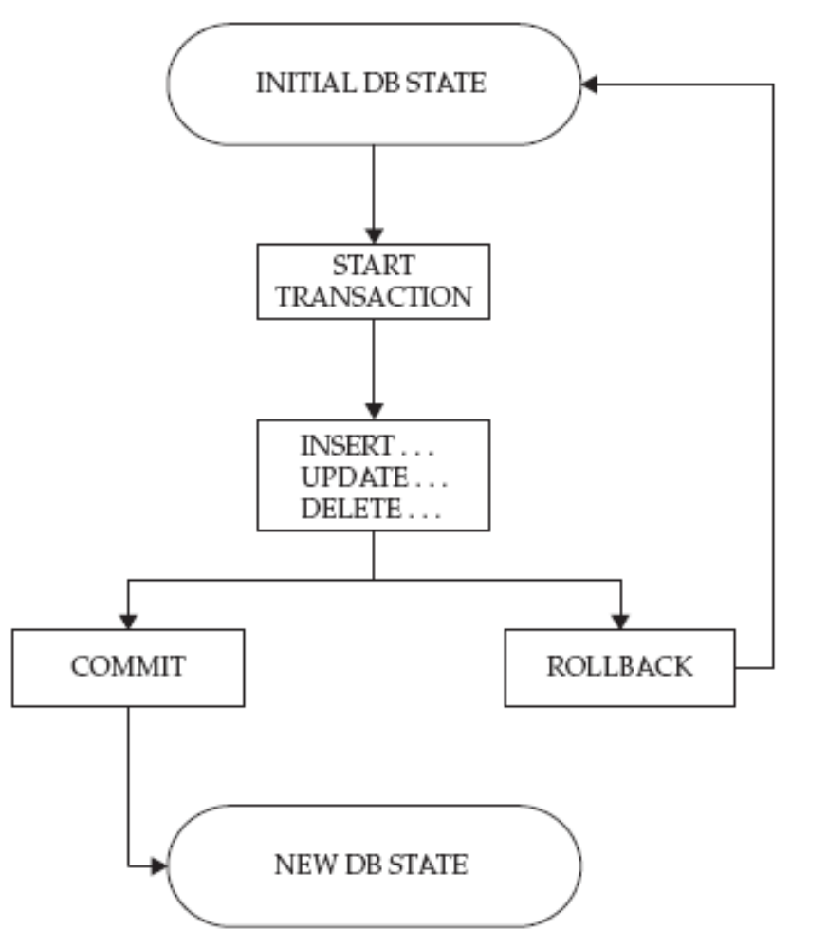
Transaction life cycle

Slide 24
Savepoints
user-defined points that can be used to mark substages within a transaction
Savepoints within a transaction are set with the SAVEPOINT command, which accepts a user-defined identifier
The ROLLBACK TO SAVEPOINT command can then be used to roll an in-progress transaction back to the named savepoint, reversing all changes made after the savepoint

Slide 25
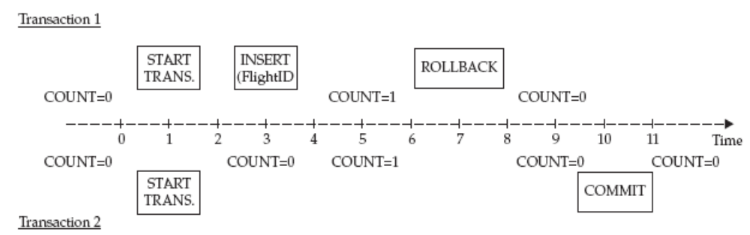
READ UNCOMMITTED

Slide 26
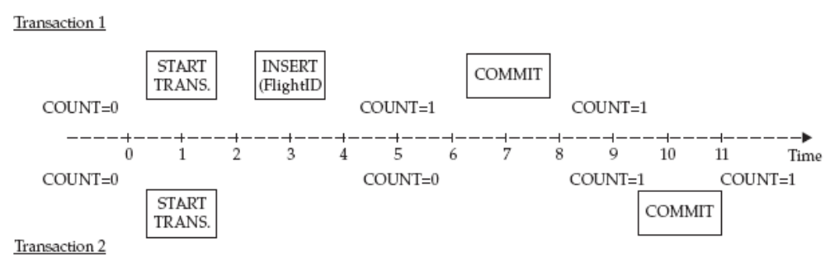
READ COMMITTED

Slide 27
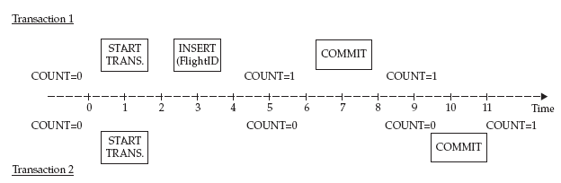
REPEATABLE READ

Slide 28
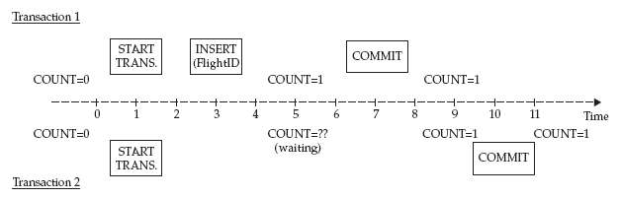
SERIALIZABLE

Slide 29
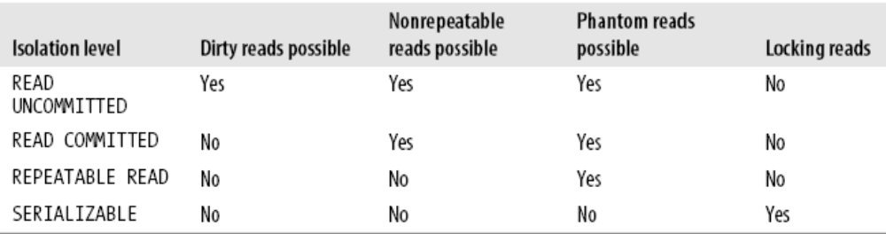
ANSI SQL isolation levels

Slide 30
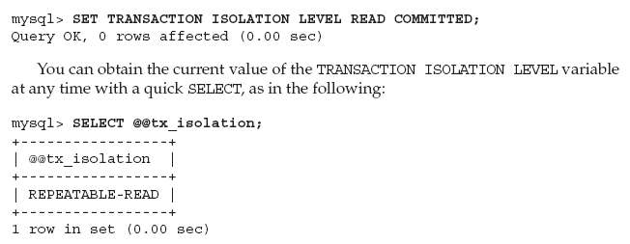
Modifying the Transaction Isolation Level

Slide 31
Pseudo-Transactions
MySQL still enables users to implement a primitive form of transactions through the use of table locks
  Table locks
  Page locks
    A lock applied to a portion of a table known as a page
    BDB (Berkeley DB) tables use page-level locking on 8-KB pages
  Row locks

Slide 32
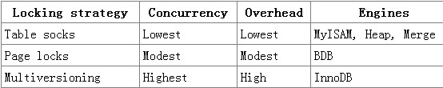
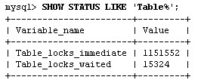
Locking models and concurrency in MySQL

Slide 33
Deadlocks
A deadlock is when two or more transactions are mutually holding and requesting locks on the same resources, creating a cycle of dependencies
  Deadlocks occur when transactions try to lock resources in a different order
To combat this problem, database systems implement various forms of deadlock detection and timeouts
Lock behavior and order are storage engine-specific, so some storage engines might deadlock on a certain sequence of statements even though others won’t

Slide 34
Transaction Logging
Transaction logging helps make transactions more efficient
  Instead of updating the tables on disk each time a change occurs, the storage engine can change its inmemory copy of the data
  The storage engine can then write a record of the change to the transaction log, which is on disk and therefore durable
  This is also a relatively fast operation, because appending log events involves sequential I/O in one small area of the disk instead of random I/O in many places
  Then, at some later time, a process can update the table on disk

Slide 35
Transactions in MySQL
MySQL AB provides three transactional storage engines: InnoDB, NDB Cluster, and Falcon, xtraDB
Several third-party engines are also available; the best-known engines right now are solidDB and PBXT
  AUTOCOMMIT
  Mixing storage engines in transactions
  Implicit and explicit locking

Slide 36
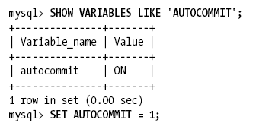
AUTOCOMMIT
MySQL operates in AUTOCOMMIT mode by default
You can enable or disable AUTOCOMMIT for the current connection by setting a variable
  Changing the value of AUTOCOMMIT has no effect on nontransactional tables, such as MyISAM or Memory tables, which essentially always operate in AUTOCOMMIT mode

Slide 37
Mixing storage engines in transactions
If you mix transactional and nontransactional tables (for instance, InnoDB and MyISAM tables) in a transaction, the transaction will work properly if all goes well
However, if a rollback is required, the changes to the nontransactional table can’t be undone
MySQL will not usually warn you or raise errors if you do transactional operations on a nontransactional table

Slide 38
Implicit and explicit locking
InnoDB uses a two-phase locking protocol. It can acquire locks at any time during a transaction, but it does not release them until a COMMIT or ROLLBACK
It releases all the locks at the same time.
The locking mechanisms described earlier are all implicit
InnoDB handles locks automatically, according to your isolation level

Slide 39
However, InnoDB also supports explicit locking, which the SQL standard does not mention at all:
  SELECT ... LOCK IN SHARE MODE
  SELECT ... FOR UPDATE
MySQL also supports the LOCK TABLES and UNLOCK TABLES commands
  Implemented in the server, not in the storage engines. These have their uses, but they are not a substitute for transactions
  If you need transactions, use a transactional storage engine

Slide 40
Multiversion Concurrency Control
Most of MySQL’s transactional storage engines, use row-level locking in conjunction with a technique for increasing concurrency known as multiversion concurrency control (MVCC)
  It avoids the need for locking at all in many cases and can have much lower overhead
MVCC works by keeping a snapshot of the data as it existed at some point in time
  This means transactions can see a consistent view of the data, no matter how long they run
  It also means different transactions can see different data in the same tables at the same time
Notes:
Most of MySQL’s transactional storage engines, such as InnoDB, Falcon, and PBXT, don’t use a simple row-locking mechanism

Slide 41
Understanding Storage Engines
A storage engine is a subsystem that manages tables
  Most database management systems have one subsystem to manage tables; MySQL Server can use different subsystems. Because a storage engine is applied at the table level, it is sometimes called table type
The MySQL pluggable storage engine is an architectural design that separates the code that manages the tables from the database server core code.
  This core code manages the components such as the query cache, the optimizer, and the connection handler
  The storage engine code handles the actual I/O of the table

Slide 42
SELECT Name FROM students WHERE Age>30
列族:Column Family

Slide 44
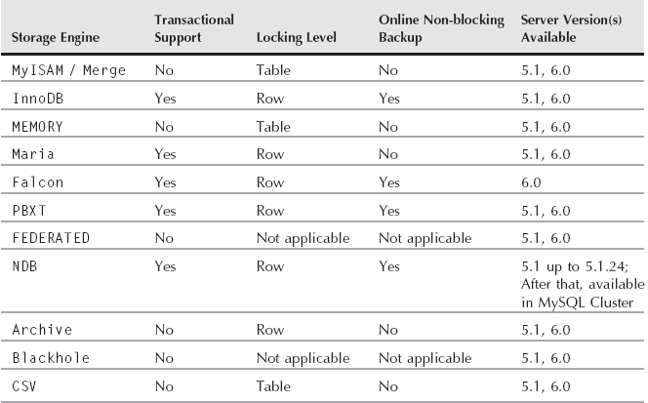
MySQL Server Storage Engine Overview

Slide 45
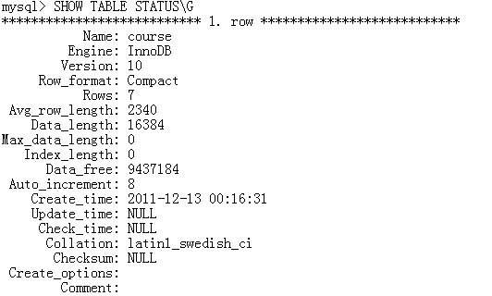

Slide 46
MyISAM storage engine
MyISAM is the default storage engine in mysqld, and is the storage engine used by the system tables
MyISAM provides a good compromise between performance and useful features, such as full-text indexing, compression, and spatial (GIS) functions
MyISAM doesn’t support transactions or row-level locks

Slide 47
Feature summary:
  Non-transactional
  No foreign key support
  FULLTEXT indexes for text matching
  No data cache
  Index caches — can be specified by name
  Implements both HASH and BTREE indexes (BTREE by default;)
  Table-level locking
  Very fast read activity, suitable for data warehouses
  Compressed data (with myisampack)
  Online backup with mysqlhotcopy
  Maximum of 64 indexes per table

Slide 48
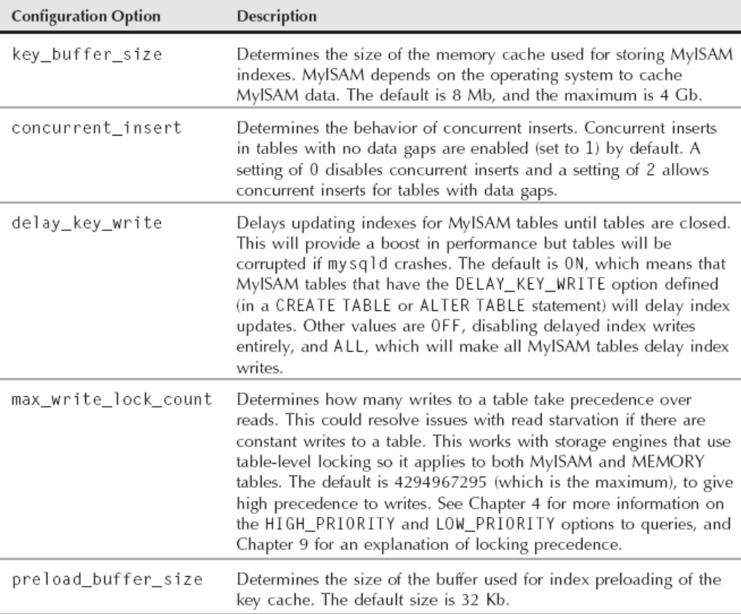
MyISAM Configuration Options

Slide 49
MyISAM utilities
Three utility programs are designed for working with MyISAM tables:
  myisamchk—Used to analyze, optimize, and repair MyISAM tables
  myisampack—Used to create compressed, read-only MyISAM tables

Slide 50
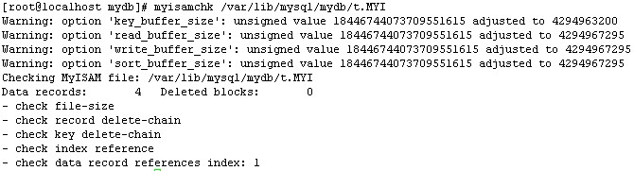
myisamchk
The myisamchk program has four different modes of operation
It can be used to analyze, optimize, check, and repair MyISAM tables
The default mode of operation is the check mode where it checks for possible corruption

Slide 51
myisampack
To create compressed read-only versions of tables can provide for a goodvperformance increase for data that is no longer being updated but still needs to be accessed
A compressed MyISAM table is read-only, and cannot have new rows inserted like an Archive table can
  myisampack table_name.MYI
Once the compression is done you have to run the myisamchk program to rebuild indexes
  myisamchk --rq --sort-index –analyze table_name_MYI

Slide 52
Merge storage engine
The Merge storage engine is actually a sort of wrapper table that wraps around MyISAM tables with the same schemas
All the underlying tables can be queried at once by querying the Merge table
Merge tables will use the same buffers and configuration options as for the underlying MyISAM tables
When you create a Merge table, two files are always created in the file system
  There is one file containing the table format that has a filename of the table followed by a suffix of .frm
  The second file also has a filename of the table but ends with a suffix of .MRG
You can also put the individual MyISAM tables on different hard drives to help increase performance

Slide 53
InnoDB storage engine
InnoDB was designed for transaction processing—specifically, processing of many short-lived transactions that usually complete rather than being rolled back
InnoDB stores its data in a series of one or more data files that are collectively known as a tablespace
A tablespace is essentially a black box that InnoDB manages all by itself
InnoDB’s index structures are very different from those of most other MySQL storage engines. As a result, it provides very fast primary key lookups

Slide 54
Feature summary:
  Transactional support provided by MVCC (Multi Version Concurrency Control)
  Row-level locking
  Foreign key support
  Indexing using clustered B-tree indexes
  Configurable buffer caching of both indexes and data
  Online non-blocking backup through separate commercial backup program

Slide 55
Tablespace configuration variables
A tablespace is a logical group of one or more data files in a database
The full path to each shared tablespace is formed by adding innodb_data_home_dir to each path specified in the innodb_data_file_path
By default if innodb_data_file_path is not defined, a 10Mb ibdata1 file is created in the data directory (datadir)

Slide 56
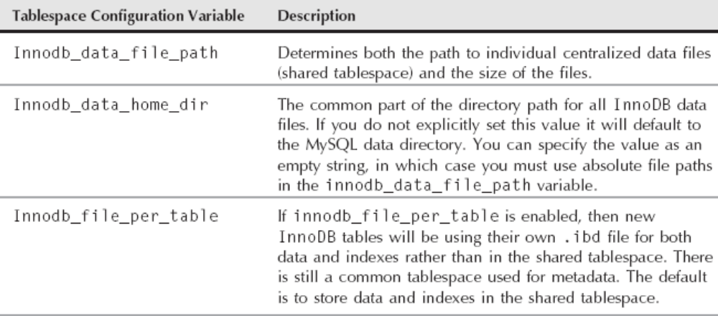

Slide 57
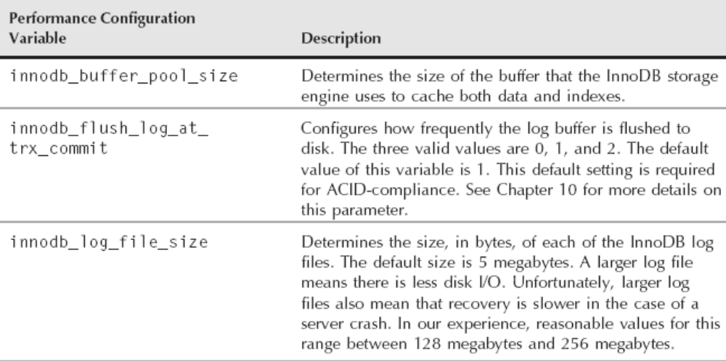
InnoDB Performance Configuration Variables
  mysql> SHOW ENGINE INNODB STATUS;

Slide 58
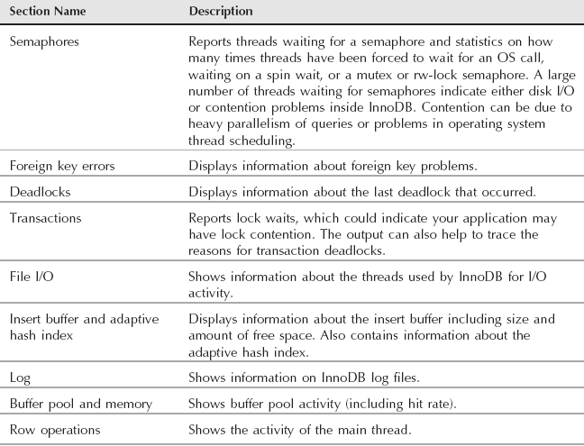
InnoDB Status Sections

Slide 59
InnoDB tablespace management
By default InnoDB uses a shared tablespace for all tables that consists of one or more files
  These files are used to store metadata for all the InnoDB tables across all databases on the server, and are usually referred to as ibdata files, because the default name for the first file is ibdata1
By default, ibdata files also contain all the data and indexes for all the InnoDB tables
  When an InnoDB table is defragmented in a shared tablespace configuration, the ibdata files will not shrink, even though the data and indexes are successfully defragmented

Slide 60
Working with ibdata files
By default ibdata files are located in datadir. Any options for the InnoDB storage engine should be listed in the [mysqld] directive of the configuration file
The innodb_data_home_dir option is used to specify the location of the ibdata files explicitly, to store them somewhere other than datadir
  innodb_data_home_dir = /data
  innodb_data_file_path=ibdata1:1024M;ibdata2:1024M:autoextend
Notes:
innodb_data_home_dir =
innodb_data_file_path=/d1/ibdata1:1024M;/d2/ibdata2:1024M:autoextend

Slide 61
InnoDB log files and crash recovery
When data is changed, affected data pages are changed in the innodb_buffer_pool
Then, the change is written to the redo log, which in mysqld is stored in the InnoDB log files (ib_logfile0 and ib_logfile1)
The pages are marked as dirty, because they have been changed, and eventually get flushed and written to disk

Slide 62
Some of the different parameters for the InnoDB log files and their ramifications are:
  innodb_log_files_in_group is set with a default of 2
    The log files are written in a circular manner
  innodb_log_file_size is the size of each log file in the log group
    The total, combined size of all the log files has to be less than 4 Gb
  innodb_fast_shutdown
    0, the log files are purged when mysqld shuts down
    1, which means that the log files are not purged before a shutdown
    2, simulates a crash, and at the next startup InnoDB will do a crash recovery
  innodb_flush_log_at_trx_commit controls how often the log files are written to
    0, to be written and flushed to disk once per second
    1, causes the log buffer to be written and flushed to disk after every transaction commit
    2, which causes the log buffer to be written after every transaction commit and flushes the log files to disk once per second
  innodb_log_buffer_size is the write buffer for InnoDB log files

Slide 63
User Management
主讲：马永亮(马哥)
QQ群:169777636
客服QQ：2813150558, 1661815153
http://www.magedu.com
http://mageedu.blog.51cto.com

Slide 65
About MySQL Users
The MySQL access control system enables you to create MySQL accounts and define what each account can do
A user in MySQL is a combination of a username and host string
In SQL statements that require account names, the name is given in 'user_name'@'host_name' format

Slide 66
Access Control Lists
MySQL keeps the ACLs (also called grant tables) cached in memory
  When a user tries to vauthenticate or run a command, MySQL checks the authentication information and permissions against the ACLs, in a predetermined order
  If you are not sure what user you are actually logged in as you can use the USER() and CURRENT_USER() functions to determine how you are connected
  SHOW GRANTS statement with no arguments shows the privileges for the user the connection was authenticated — the privileges for the CURRENT_USER()

Slide 67
Wildcards
Wildcard characters (% and _) are allowed in host strings
MySQL orders the access control list with the least specific hosts last
  Hostnames and IPs without wildcards or netmasks are placed before hostnames and IPs with wildcards and netmasks
  192.168.0.%
  192.168.0.0/255.255.255.0
  192.168.0.1_

Slide 68
System tables
All the user and permission information is stored in the mysql database in a set of tables known as the grant tables
In addition to the grant tables, the mysql database has tables containing other system information
  For example, a table called event is used by the event scheduler
The tables that are of interest when it comes user management are columns_priv, db, host, procs_priv, tables_priv, and user
  the GRANT, REVOKE, CREATE USER, DROP USER, and RENAME USER commands are designed for user management

Slide 69
Managing User Accounts
To create a user, you can use the CREATE USER command
To drop a user, you should use the DROP USER command
The RENAME USER command renames an existing account
Several types of privileges can be granted to an account
Privileges should be granted according to how the account is to be used

Slide 70
Approaches to Account Management
When you use statements such as CREATE USER and GRANT, the server determines the necessary modifications to the grant tables and makes the changes for you
If you modify the tables directly with a statement such as INSERT or DELETE, you must explicitly tell the server to reload the tables afterward by using a FLUSH PRIVILEGES statement or a mysqladmin flush- privileges command

Slide 71
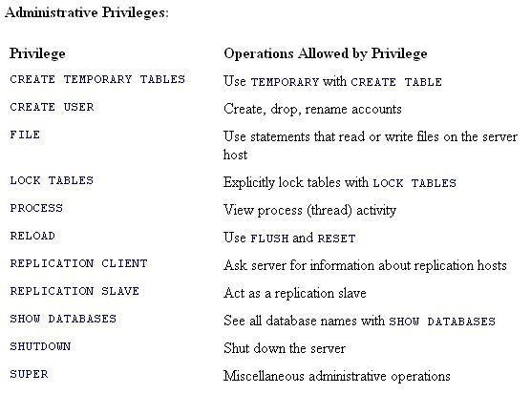
Types of Privileges That MySQL Supports

Slide 72
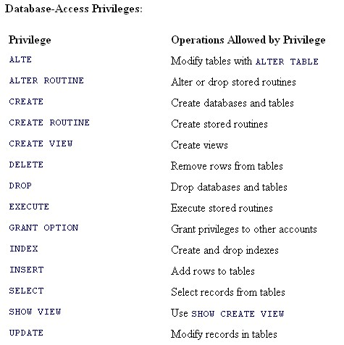

Slide 73
There are also some special privilege specifiers:
  ALL and ALL PRIVILEGES are shorthand for "all privileges except GRANT OPTION."
  USAGE means "no privileges" other than being allowed to connect to the server

Slide 74
Privileges can exist at different levels:
  Any privilege can be granted globally. An account that possesses a global privilege can exercise it at any time. Global privileges are therefore quite powerful and are normally granted only to administrative accounts
  Some privileges can be granted for specific databases: ALTER, CREATE, CREATE TEMPORARY TABLES, CREATE VIEW, DELETE, DROP, GRANT OPTION, INDEX, INSERT, LOCK TABLES, SELECT, SHOW VIEW, and UPDATE. A database-level privilege applies to all tables and stored routines in the database
  Some privileges can be granted for specific tables: ALTER, CREATE, DELETE, DROP, GRANT OPTION, INDEX, INSERT, SELECT, and UPDATE. A table-level privilege applies to all columns in the table
  Some privileges can be granted for specific table columns: INSERT, SELECT, and UPDATE
  Some privileges can be granted for specific stored routines: EXECUTE, ALTER ROUTINE, and GRANT OPTION

Slide 75
The Grant Tables
The user table contains a record for each account known to the server
  The user record for an account lists its global privileges
  It also indicates other information about the account, such as any resource limits it is subject to, and whether client connections that use the account must be made over a secure connection using the Secure Sockets Layer (SSL)
The db table lists database-specific privileges for accounts
The tables_priv table lists table-specific privileges for accounts
The columns_priv table lists column-specific privileges for accounts
The procs_priv table lists privileges that accounts have for stored procedures and functions

Slide 76
Granting Privileges
Syntax
  GRNAT privileges ON db.table TO user@’host’ IDENTIFIED BY ‘password’;
    When granting privileges for a table or stored routine, there is an ambiguity if there are multiple objects (table, procedure, or function) with the same name. To indicate the type of object explicitly, use the keyword TABLE, PROCEDURE, or FUNCTION preceding the name:
      ON TABLE db_name.table_name
      ON PROCEDURE db_name.routine_name
      ON FUNCTION db_name.routine_name
    To grant privileges at a column-specific level, use an ON clause that names a particular table, and specify a comma-separated list of column names within parentheses after each privilege to be granted
      GRANT SELECT(id,name) ON mydb.t1 TO ‘clyde’@’localhost’;
  If you want to give an account the capability to grant its privileges to other accounts, add a WITH GRANT OPTION clause to the statement.

Slide 77
The host part of an account name may be given in any of the following formats:
  The name localhost
  A hostname, such as instructor.example.com
  An IP number, such as 192.168.1.47
  A pattern containing the '%' or '_' wildcard characters
    Such as %.example.com or 192.168.0.%
    A host value of % matches any host, allowing the client to connect from anywhere
  An IP number/netmask combination
    The value allows a client to connect from any host with an address that matches the IP number for all bits that are 1 in the netmask
    For example, a value of 10.0.0.0/255.255.255.0 matches any host with 10.0.0 in the first 24 bits of its IP number

Slide 78
To find out what privileges a particular account has, use the SHOW GRANTS statement
  It displays the GRANT statements that would be required to set up the account
To see your own privileges, use SHOW GRANTS without an account name or with CURRENT_USER():
  SHOW GRANTS;
  SHOW GRANTS FOR CURRENT_USER();
To see the privileges for a specific account, specify that account name in the statement
  SHOW GRANT FOR user@’host’

Slide 79
Revoking Privileges
Use the REVOKE statement to revoke privileges from an account
Syntax
  REVOKE privileges ON db.table FROM user@’host’;
To revoke the GRANT OPTION privilege from an account that has it, you must revoke it in a separate statement
  REVOKE GRANT OPTION ON db.table FROM user@’host’

Slide 80
Changing Account Passwords
Use the SET PASSWORD statement, specifying the account name and the new password
  SET PASSWORD FOR ‘user’@’host’ = PASSWORD(‘newpass’);
  Any non-anonymous client can change its own password by omitting the FOR clause:
    SET PASSWORD = PASSWORD('NewPass');
Use GRANT with the USAGE privilege specifier at the global level and an IDENTIFIED BY clause:
  GRANT USAGE ON *.* TO ‘user'@‘host' IDENTIFIED BY 'NewPass';
    USAGE means "no privileges," so the statement changes the password without granting any privileges.

Slide 81
Disabling Client Access Control
The --skip-grant-tables option tells the server not to use the grant tables to control client access
  Anyone can connect from anywhere with no password, and, once connected, has full privileges to do anything
  That is convenient if you've forgotten the root password and need to reset it, because you can connect without knowing the password
  To prevent remote clients from connecting over TCP/IP, you may want to use the --skip-networking option as well
--skip-grant-tables disables the account-management statements (CREATE USER, GRANT, REVOKE, SET PASSWORD, and so forth)
Notes:
--skip-grant-tables disables the account-management statements (CREATE USER, GRANT, REVOKE, SET PASSWORD, and so forth). These statements require the in-memory copies of the grant tables, which aren't set up when you skip use of the tables. To make a change to the grant tables while those statements are inoperative, you can update the tables directly. But that is inconvenient, so it's preferable to issue a FLUSH PRIILEGES statement after you connect to the server. That causes the server to read the table tables, which also enables the account-management statements so that you can use them again. However, FLUSH PRIVILEGES does not affect which network interfaces the server listens to, so if you started the server with the --skip-networking option, you'll still need to restart it without that option to cause it to listen for TCP/IP connections again.

Slide 82
When Privilege Changes Take Effect
Table and column privilege changes apply to all statements issued after the changes are made
Database privilege changes apply with the next USE statement
Changes to global privileges and passwords do not apply to a connected client

Slide 83
Caching with MySQL
主讲：马永亮(马哥)
QQ群:169777636
客服QQ：2813150558, 1661815153
http://www.magedu.com
http://mageedu.blog.51cto.com

Slide 86
Introduction
One of the ways of making queries respond faster is to implement caching
  The server can skip the SQL parsing and optimization stages for repeated queries
There are three common ways to cache data with MySQL:
  Creating manual cache tables
  Using internal caching in mysqld
  Using the memcached distributed caching system.

Slide 87
How the Cache Uses Memory
It only caches SELECT statements and their corresponding result sets, and only for deterministic SELECT statements
  Deterministic SELECT statements are statements that always produce the same results no matter what, given the same
The query cache stores a rudimentary hash of the query along with its result set
  The query being compared must be byte-for-byte identical to the cached query — the queries themselves are not compared; their hashes are compared. So the following two are different
    SELECT customer_id,name from sakila.customer;
    SELECT customer_id,name FROM sakila.customer;

Slide 88
Queries are viewed as different by the query cache if they use different databases, protocol versions, or character sets
Furthermore, not all SELECT statements will be cached. SELECT statements with the following properties are not cached:
  Use of non-deterministic functions
  Most subqueries
  Use of user-defined functions
  Use of temporary tables
  SELECT statements in stored functions, triggers, views, and events
  Result sets larger than query_cache_limit (1Mb by default)
  Using SQL_NO_CACHE

Slide 89
Query cache invalidation
Query cache invalidation is when a query is removed from the query cache because its result set may have changed
  When a table is modified by either DDL or DML (either schema changes or data changes), all of the queries in the query cache referencing that table are invalidated and removed.

Slide 90
Query cache pruning
Query cache pruning is when a query is removed from the query cache because the query cache cannot find a free block in which to store a new query
  The query cache prunes older entries using a least recently used (LRU) algorithm

Slide 91
When the Query Cache Is Helpful
Caching queries isn’t automatically more efficient than not caching them
In theory, you can tell whether the cache is helpful by comparing the amount of work the server has to do with the cache enabled and disabled
  It’s hard to accurately calculate or predict the query cache’s benefit
  The type of query that benefits most from caching is one whose result is expensive to generate but doesn’t take up much space in the cache
query cache hit rate
  Qcache_hits / (Qcache_hits+Com_select)
    Com_select is the status variable that holds the number of executed SELECT queries that go through the full execution plan

Slide 92
Any SELECT query that MySQL doesn’t serve from the cache is a cache miss
A cache miss can occur for any of the following reasons:
  The query is not cacheable, either because it contains a nondeterministic construct (such as CURRENT_DATE) or because its result set is too large to store
  The server has never seen the query before, so it never had a chance to cache its result
  The query’s result was previously cached, but the server removed it
    This can happen because there wasn’t enough memory to keep it
    because someone instructed the server to remove it
    or because it was invalidated

Slide 93
Query cache memory usage and tuning
The query cache for the server is stored completely in memory, and does not persist across mysqld restarts
  Aside from about 40k of memory used by the query cache, the entire pool of memory is initialized as a single contiguous chunk of memory
  During query cache operation this chunk of memory is divided up into smaller blocks
  Each block must be at least the size specified by query_cache_min_res_unit, which defaults to 4 Kb
In addition to these blocks containing the result sets of the queries there are two hash tables
  Query hashes
  The list of database tables that each cached query reference
    When a table is modified, this second hash table is consultedto determine which queries should be removed due to query cache invalidation

Slide 94
Seven system variables are used to control the configuration and memory usage of the query cache
The values of these can be seen by using SHOW GLOBAL VARIABLES statement or in the GLOBAL_VARIABLES system view in the INFORMATION_SCHEMA

Slide 95
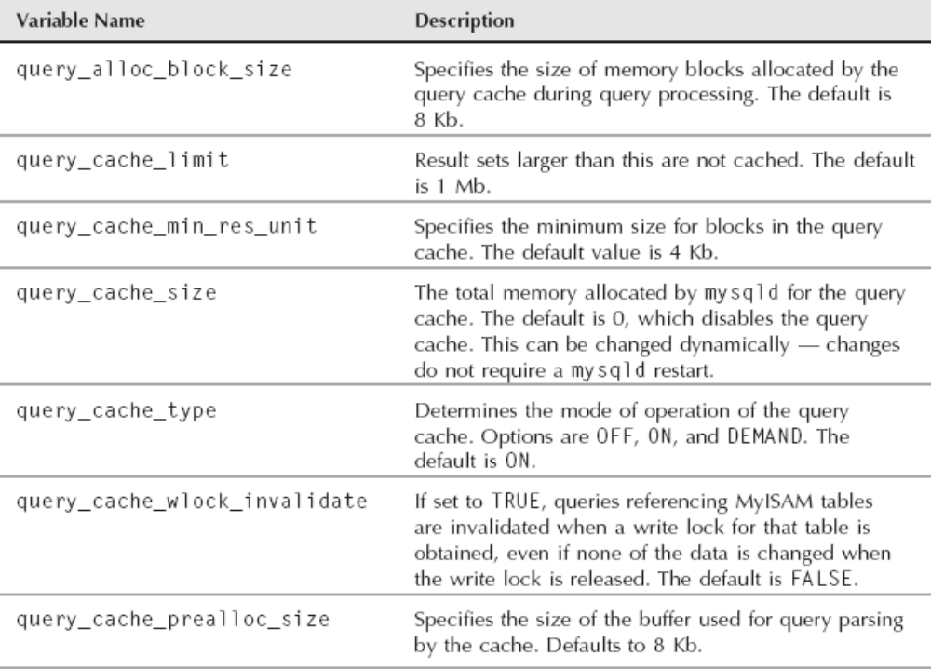
Query Cache System Variables

Slide 96
Query cache status variables
There are eight status variables relating to the query cache
These variables are used for managing and tuning the query cache
The values of these can be seen by using the SHOW GLOBAL STATUS statement or in the GLOBAL_STATUS system view in the INFORMATION_SCHEMA

Slide 97
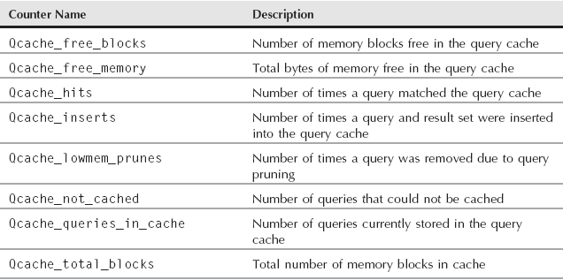
Query Cache Status Variables

Slide 98
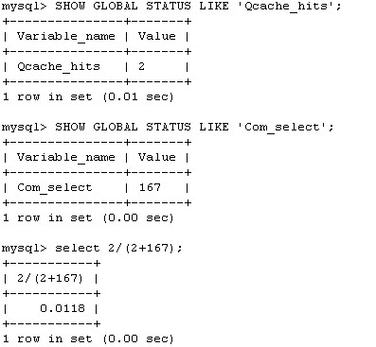
Hits ratio

Slide 99
Query cache fragmentation
With a query cache there are two causes of fragmentation
  The result sets do not always fit exactly into a block of memory
  The invalidation of queries stored in the cache. When a query is invalidated it is deleted from the cache
The best way to handle query cache fragmentation is to minimize the amount of fragmentation
  To minimize fragmentation is to set the block size of the query cache to the average result set size of your queries
    (query_cache_size-Qcache_free_memory)/Qcache_queries_in_cache
  To minimize the query cache invalidation and pruning

Slide 100
Utilizing memcached
The memcached caching system is a distributed, in-memory cache system that speeds up web applications by minimizing the amount of database queries needed
  http://memcached.org/
The basic principle of memcached is that a number of memcached daemons work together to provide data caching
  memcached is distributed because many daemons can work together to cache data

Slide 101
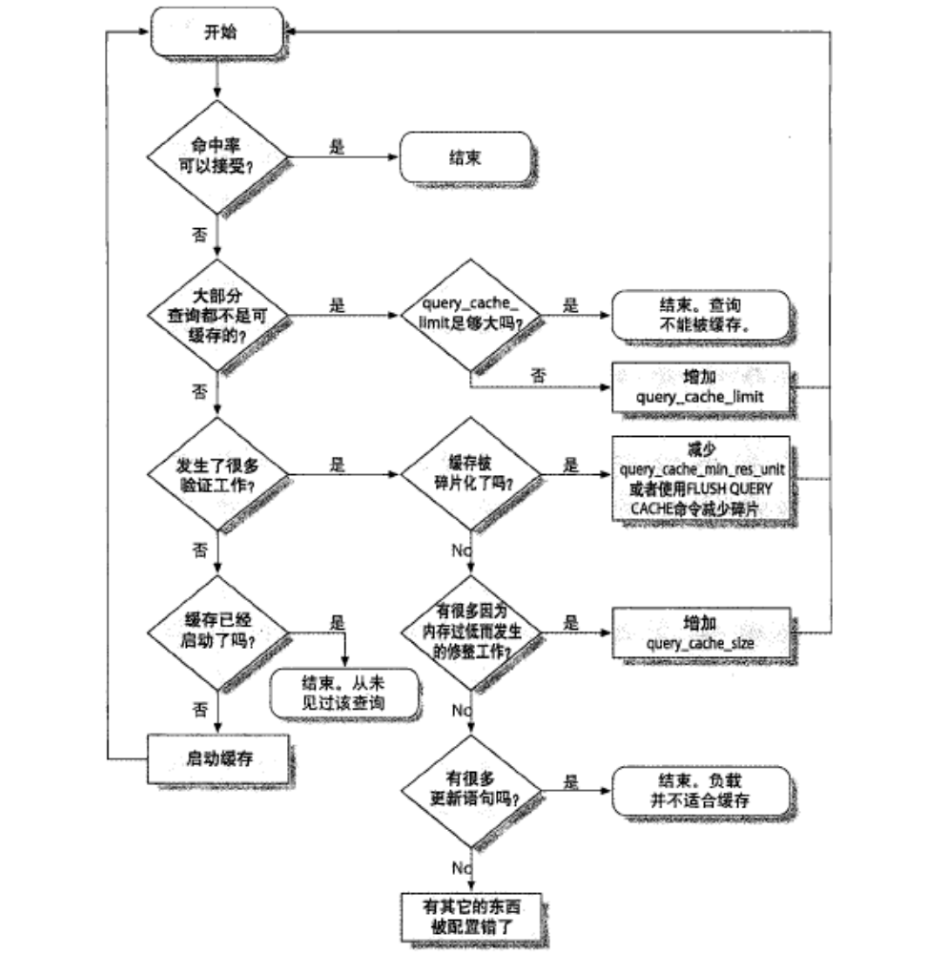

Slide 102
Backups and Recovery
主讲：马永亮(马哥)
QQ群:169777636
客服QQ：2813150558, 1661815153
http://www.magedu.com
http://mageedu.blog.51cto.com

Slide 104
500G

Slide 108
Backups and Recovery
主讲：马永亮(马哥)
QQ:113228115
客服QQ：1661815153
http://www.magedu.com
http://mageedu.blog.51cto.com

Slide 109
MySQL Logs
主讲：马永亮(马哥)
QQ:113228115
客服QQ：1661815153
http://www.magedu.com
http://mageedu.blog.51cto.com

Slide 111
innodb_buffer

Slide 118
错误日志
一般查询日志
慢查询日志
二进制日志
中继日志
事务日志(redo, undo)
  ACID

Slide 119
查询日志
  log
  general-log
  general-log-file

Slide 120
CREATE DATABASE mydb;
UPDATE tb SET salaris=salaris+1000;
INSER INTO tb SET Birthdate=CURRENT_TIME();

Slide 121
慢查询日志
  log-slow-queries=
  long-query-time=
  slow-query-log=
  slow-query-log-file=

Slide 122
错误日志
  log-error
  log-warnings

Slide 123
二进制日志
  binlog-format={STATEMENT|ROW|MIXED}
  log-bin=/log/mysql/log-bin
  sql-log-bin=
  max-binlog-size=
  expire_logs_days=

Slide 124
中继日志

Slide 125
Log Files
Four log files are used by mysqld
  the error log
  the binary log
  the general query log
  the slow query log
A fifth log type, the relay log, is used by a slave server
If the logs are enabled, mysqld writes them to the data directory unless otherwise specified
  By default, no logging is enabled

Slide 126
Error log
Contains entries for when the mysqld daemon started and stopped and also any critical errors that occur while the server is running
Information such as when the event scheduler executes an event and when replication starts and stops is also written to the error log
  服务器启动和关闭过程中的信息
  服务器运行过程中的错误信息
  事件调度器运行一个事件时产生的信息
  在从服务器上启动从服务器进程时产生的信息

Slide 127
To enable the error log, specify the log-error option
  The error log will be written to the data directory using the format host_name.err
  To customize the filename, give the log-error option a filename, such as:
    log-error=/var/log/mysqld.err
The log_warnings option is used to control whether or not warning messages are logged to the error log
  The default value is 1 (enabled)
  If the value is greater than 1, aborted connections are written to the error log
If you do not specify log-error, or if you use the --console option on Windows, errors are written to stderr, the standard error output

Slide 128
Binary logs
The binary logs are used for several reasons
  Can be used to perform a point-in-time recovery during a recovery process
    做即时点恢复
  Can be used to enable replication
    复制
The contents of the binary log are any statements that occur in the server that could potentially modify the databases
  DML
  DDL

Slide 129
DML, DCL, DDL
二进制，二进制日志事件

Slide 130
Insert into students (BirthDate) VALUE ‘2012-04-08 14:58:20’

Slide 131
To enable binary logging, use the log-bin option
The binary log index file is a plain text file that keeps track of the current binary logs
  By default, its name is mysql-bin.index
  To set the filename and path of the binary logs and binary log index file, specify the following options:
    log-bin = /data/logs/binary/changelog
    log-bin-index = /data/logs/relay/binarylog.index

Slide 132
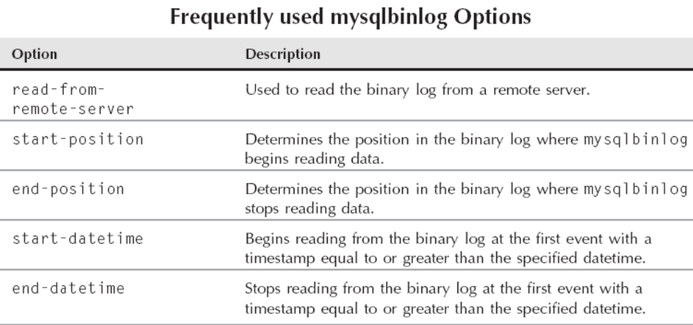
Binary log data is stored in a binary format
To display the binary logs in text/readable format you must use the mysqlbinlog tool

Slide 133
Mysqlbinlog examples
  mysqlbinlog mysql-bin.000001 \
  --start-datetime="2011-03-05 17:34:40" \
  --stop-datetime="2011-03-05 17:34:56" > sixteensecs.sql
  mysqlbinlog --read-from-remote-server -uuser -p \
  mysql-bin.000001 -h 192.168.0.182 -P 3306 \
  --start-position=932 --stop-position=1132 > remote000001.sql

Slide 134
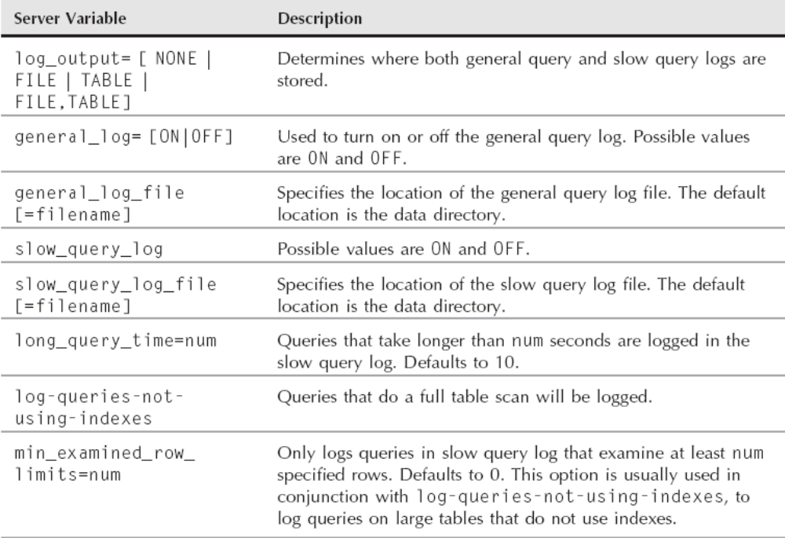
Server Variables Used to Manage General and Slow Query Logs

Slide 135
Rotating logs
flush logs
  Manually rotate the binary logs and error log
  For the other log files, FLUSH LOGS only closes and then reopens the log file
    Other log files can be rotated by moving the original file, creating a blank file to replace the original, and performing a FLUSH LOGS statement
purge binary logs
  Another manual method of log management that is specifically designed for the binary logs
  Unlike FLUSH LOGS, it deletes logs instead of saving them
    For example to purge all binary logs older than ’mysql-bin.00007’:
      mysql> PURGE BINARY LOGS TO ’mysql-bin.00007’;
    To purge all logs older than Mar 05, 2011 at 11:00 PM:
      mysql> PURGE BINARY LOGS BEFORE ’2011-3-5 23:00:00’;

Slide 136
About Backup
Backups can be made by copying database files directly, or by using programs designed for that purpose
  Such programs include mysqldump, mysqlhotcopy, MySQL Administrator, and InnoDB Hot Backup

Slide 137
Some principles with regard to backups
Make backups regularly
Enable the binary log so that you have a record of changes made after a given backup
Flush the logs when backing up so that the server will begin a new binary log file that corresponds to the time of the backup
Store your data directory and your backups on different physical devices so that a device failure cannot destroy both
Include your backups in your normal filesystem backup procedures so that you can recover the backup if necessary

Slide 138
Logical backup
Created by saving information that represents the logical database structures using SQL statements like CREATE DATABASE, CREATE TABLE, and INSERT
  Other names for a logical backup are a logical export and an export
  The advantages of a logical backup are that it allows the database administrator to manipulate the backup data using tools such as dd and grep and programming languages such as awk and Perl
  logical backups are more compatible between different versions of mysqld when you are upgrading your database server
  The disadvantages compared to a physical backup are that a logical backup is slower to back up and restore and may take up more space (but compresses well)

Slide 139
Physical backup
A physical backup is a backup of the actual database files or disk partitions
  This can be much faster to back up and restore than logical backups
  Though physical backups do not compress much (the data is usually in a binary format and thus somewhat compressed already), physical backups are often smaller than uncompressed logical backups
Physical backups may also be called raw backups

Slide 140
Full backup
A full backup is a standalone backup containing everything in the database
If necessary you could use the results of the full backup to re-create a server somewhere else
A full backup can be either a logical or physical backup

Slide 141
Incremental backup
An incremental backup is a backup that only contains the data changed since the previous backup
The previous backup may have been full or incremental
The advantage of an incremental backup compared to a full backup is quicker backup times
Incremental backups are used to be able to back up data more frequently than a full backup may allow

Slide 142
Consistent backup
A consistent backup is a backup at an exact moment in time. A backup process takes time to complete
An inconsistent backup is usually simpler and less resource-intensive to produce than a consistent backup
  However, an inconsistent backup cannot be used as a standalone backup
  An inconsistent backup may be used for partial data restores (such as restoring only Henry’s e-mail address)

Slide 143
Hot, Warm and Cold backup
Hot backup
  A backup of a database that is still running. During a hot backup, neither reads nor writes are blocked.
Warm backup
  A backup of a database that is still running. During a warm backup, read queries are not blocked but writes are prohibited from making any modifications to the database for the duration of the backup
Cold backup
  A backup performed while the database is shut down
  This makes it very easy to make a consistent copy of your data
  The disadvantage is that the server is not accessible during the time the backup is performed

Slide 144
Point-in-time restore
A point-in-time restore is a restoration of a database to a specified date and time
If this does not correspond to the time a full backup was performed, incremental backups and/or server logs must be used to finish the restoration process

Slide 145
Uses for backups
Disaster recovery
Data recovery
Easy test server creation
Easy slave creation

Slide 146
What to back up
Binary logs (for incremental backups, or to create a slave of the backed-up machine)
InnoDB log files (for physical backups)
mysqld option file (such as /etc/my.cnf)
Slave position information (master.info) if backup occurs on a slave
Relay logs on slave server if backup occurs on a slave

Slide 147
Backup locations
A production server that is in use and serving queries can be backed up using a hot backup method
Though a hot backup is non-blocking, it will impact the server and slow operations
Disk I/O, CPU, and RAM are all used by backups, which will make fewer resources available for mysqld
Often a slave server is implemented, and backups can be performed on the slave instead of the master

Slide 148
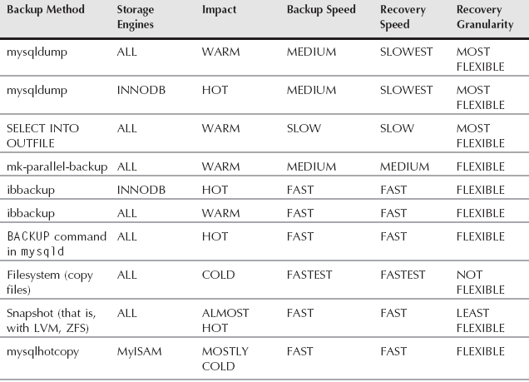
Backup Tools Overview

Slide 149
备份策略
  200M
    Fullbackup
      逻辑备份
        mysqldump
      物理备份
        Xtrabackup(InnoDB,XtraDB)
        LVM snapshot
  10G
    Full + increment backup
      逻辑
      物理
Binary log 最好不要跟数据文件放在同一磁盘上；

Slide 150
mysqldump
Provides a logical backup of entire database servers, individual databases, individual tables, or even subsets of data using the --where option
The logical backup created using mysqldump is often called a data dump：数据泵出
The output is in ASCII format — easily readable and manipulated

Slide 151
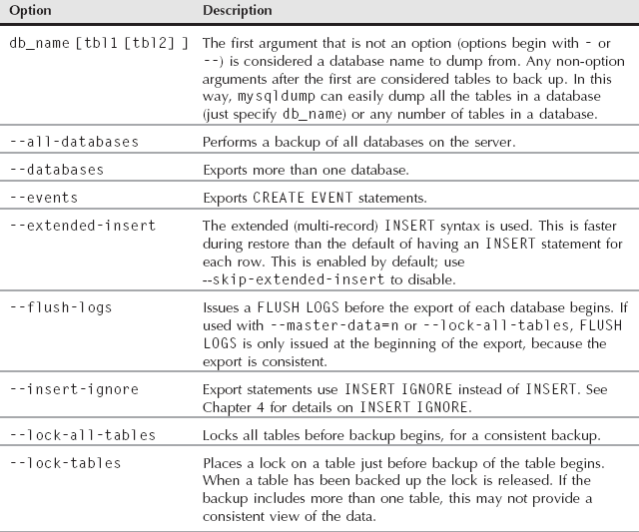
The Options of mysqldump

Slide 152
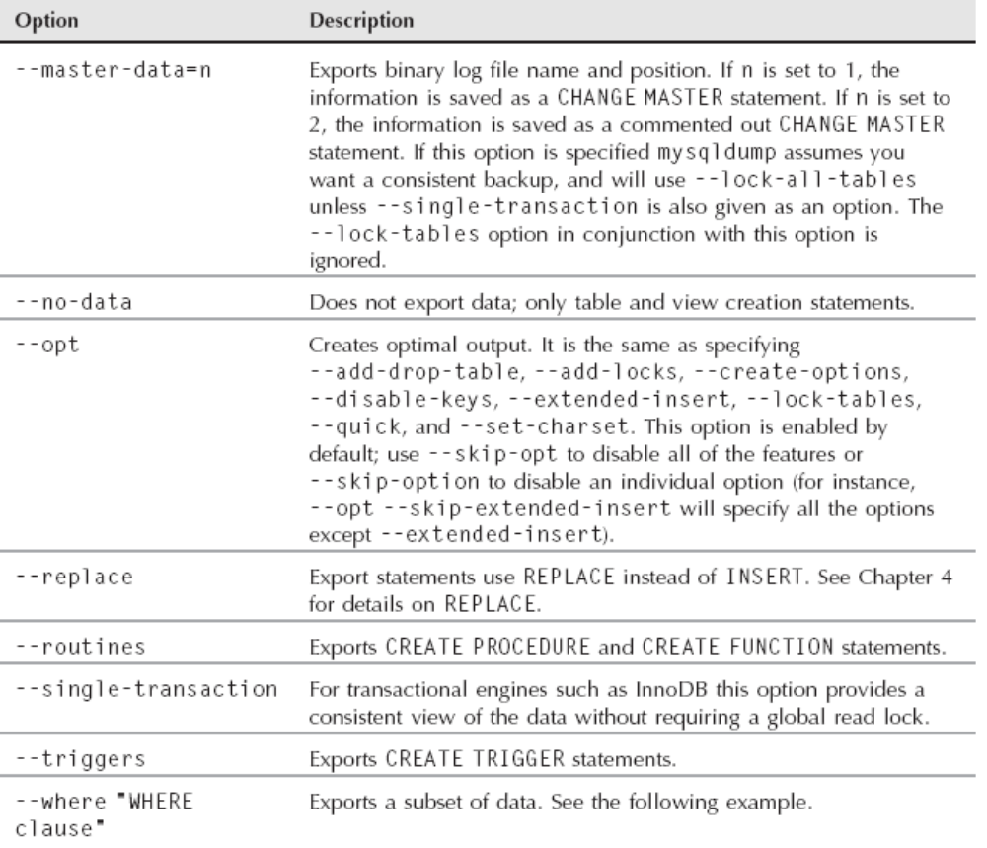

Slide 153
a
b1
b
c
d
快照访问路径

Slide 155
完全备份：1-10
增量：11+
1
11
2
1
1
7
10
3

Slide 157
Examples
To exports the entire server
  mysqldump -uroot -p --all-databases > dump.sql
To export a single database, or a single table:
  mysqldump --uroot -p mydb > mydb.sql
  mysqldump --uroot -p mydb t1 > mydb.sql
To export multiple databases:
  mysqldump --uroot -p --database mydb testdb > dbs.sql

Slide 158
SELECT INTO OUTFILE
You can use the INTO OUTFILE clause of the SELECT statement to back up individual tables on a server
The command used to load the dump created is LOAD DATA INFILE
  SELECT * INTO OUTFILE ’/tmp/t1.txt’ FROM t1;
  LOAD DATA INFILE ’/tmp/t1.txt’ INTO TABLE t1;

Slide 159
FULL+binlog实现即时点恢复；
Full
  --flush-logs
  Mysql-bin.000123-000199
Mysqladmin flush-logs
  Mysql-bin.000200
Mysqladmin flush-logs
  Mysql-bin.000301

Slide 160
50M
  如何实现指定的时间自动进行备份？

Slide 161
maatkit parallel dump/restore
The third-party maatkit toolkit (http://www.maatkit.org/) contains two useful scripts that are wrappers around the mysqldump program
These programs are mk-parallel-dump and mk-parallel-restore. Both backups and restores are performed in parallel
The defaults for both mk-parallel-dump and mk-parallel-restore are very sensible:
  mk-parallel-dump --basedir=/backups
  mk-parallel-restore /backups
    The --basedir option specifies the directory to store the exports

Slide 162
File system snapshot
Using snapshot functionality of file systems is one of the best ways to create a consistent, physical hot backup of your database files
A file system snapshot provides a point-in-time view (snapshot) of a disk partition

Slide 163
mysqlhotcopy
The mysqlhotcopy program is a Perl script written to provide a consistent backup of MyISAM and ARCHIVE tables
  When run, mysqlhotcopy uses the LOCK TABLES command to create read locks on the tables being backed up
  This allows a consistent backup across all the tables to be executed. The backup is done using either the cp or scp commands
  Though the server does not have to be shut down, any writes to the tables being backed up are blocked

Slide 164
The mysqlhotcopy script must be run on the host server where the datadir is located, and the operating system user running the script must have permissions to read the data files in the data directory
  mysqlhotcopy mydb /backup
  mysqlhotcopy --method=scp mydb \ username@backup.company.com:/backup

Slide 165
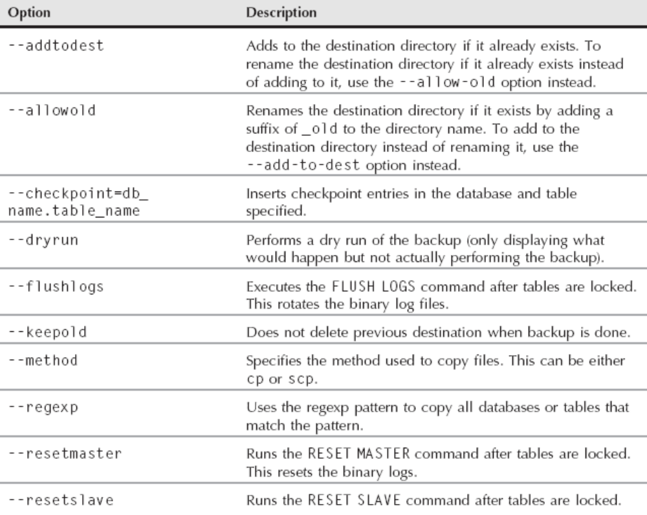
Frequently Used mysqlhotcopy Options

Slide 166
Recovering from Crashes
MySQL server uses a binary format for the log files to save space. This means you cannot view it directly
MySQL supplies a utility called mysqlbinlog to convert these logs to a text format that you can view
The process for performing a point-in-time restore is as follows:
  Restore the database using the last backup
  Determine the first binary log and starting position needed
  Determine the last binary log needed
  Convert the binary log(s) to text format with the mysqlbinlog utility, using options to specify the start and stop time
  Import the converted binary log(s)

Slide 167
Converts the mysql-bin.xxxxxx log to text format and store it in the mysql-bin.xxxxxx.sql file
  mysqlbinlog mysql-bin.000003 > mysql-bin.000003.sql
To create text files from parts of binary logs using mysqlbinlog, specify a starting place with either --start-datetime=’YYYY-MM-DD’ or --start-position=# and ending place with either --stop-datetime=’YYYY-MM-DD’ or --stop-position=#
  mysqlbinlog --stop-datetime=’2010-08-25 15:42:48’ mysql-bin.000002 > mysql-bin.000002.sql
  Once you have trimmed the file it becomes much easier to view with the tail command

Slide 168
Mydb
12.1 full, binlog, 15674
Restore full,
Mysqlbinlog --start-position 15674 --end-position 20101 | mysql -uroot -p
Mysqlbinlog --start-position 15674 --end-position 20101 > /tmp/bin.sql
Mysql -uroot -p < /tmp/bin.sql

Slide 169
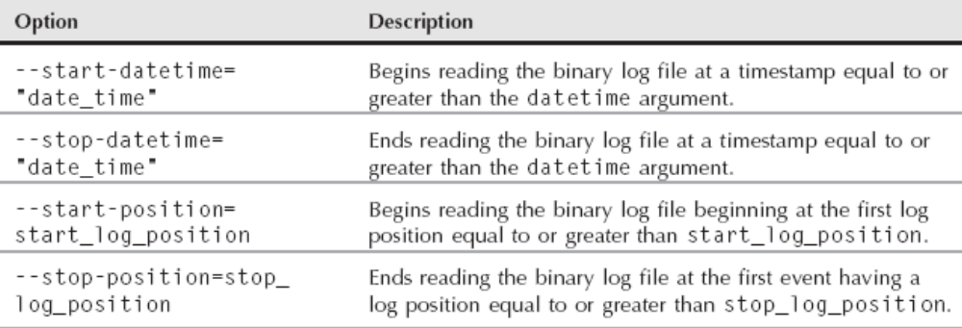
mysqlbinlog Options

Slide 170
Planning for Disasters
Database recovery is part of the disaster planning process
  What to do, who does it, and how long the recovery process takes when things break requires thought, planning, and usually coordination with other people and departments
  It is important that you rehearse plans and perform drills to make sure that the proper preparations are in place
A backup plan and corresponding periodic restores of your backups should be part of the disaster preparation. An incomplete list of issues covered could include:
  Power
  Employee termination process
  Data center failover plan
  Data retention strategies

Slide 171
Replication
主讲：马永亮(马哥)
QQ:113228115
客服QQ：1661815153
http://www.magedu.com
http://mageedu.blog.51cto.com

Slide 172
Replication Overview
Replication is the ability to keep distributed databases synchronized by copying either executed statements or data set changes from a master server to one or more slave servers
It is the primary method of keeping two mysqld instances synchronized

Slide 173
MySQL replication is asynchronous
  This means that the master does not wait for slaves to acknowledge receiving the data before committing any changes. The master simply writes events to the binary log with no regard to the status of any slave servers
  This means there is no guarantee that replication is actually synchronizing data appropriately

Slide 174
MySQL supports two kinds of replication: statement-based replication and rowbased replication
  Statement-based (or “logical”) replication has been available since MySQL 3.23, and it’s what most people are using in production today
  Row-based replication is new in MySQL 5.1
Both kinds work by recording changes in the master’s binary log* and replaying the log on the slave, and both are asynchronous—that is, the slave’s copy of the data isn’t guaranteed to be up-to-date at any given instant

Slide 175
Problems Solved by Replication
Data distribution
  It’s useful for maintaining a copy of your data in a geographically distant location, such as a different data center
Load balancing
  MySQL replication can help you distribute read queries across several servers, which works very well for read-intensive applications
Backups
  Replication is a valuable technique for helping with backups. However, a slave is neither a backup nor a substitute for backups
High availability and failover
Testing MySQL upgrades

Slide 176
How Replication Works
At a high level, replication is a simple three-part process:
  The master records changes to its data in its binary log. (These records are called binary log events.)
  The slave copies the master’s binary log events to its relay log
  The slave replays the events in the relay log, applying the changes to its own data

Slide 177
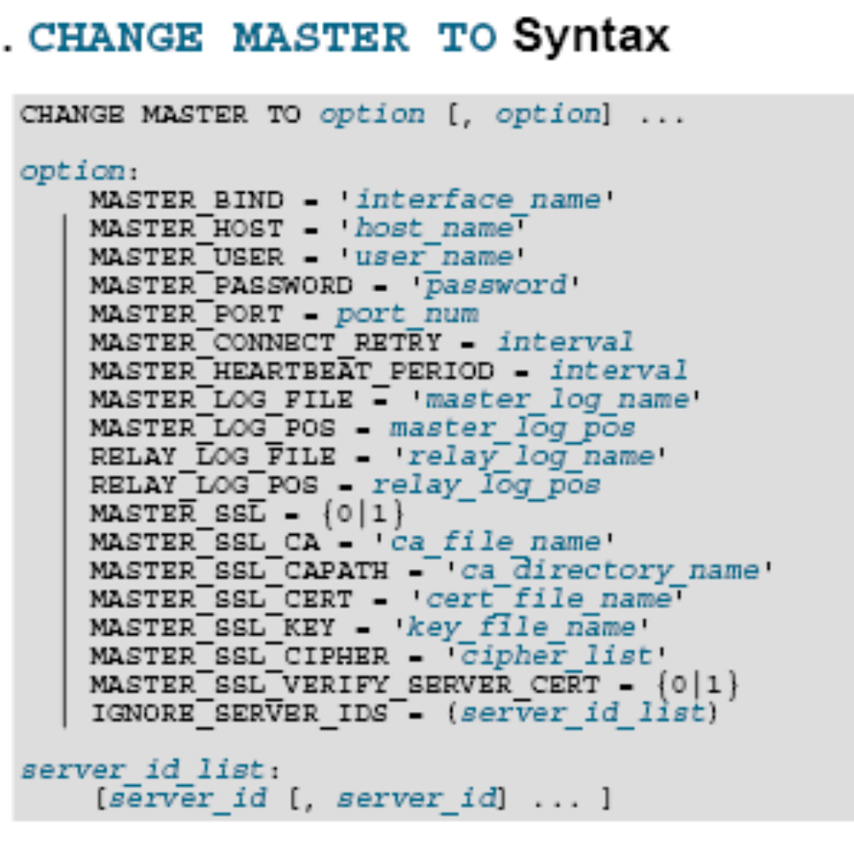

Slide 180
缓存
命中
解析
优化
执行

Slide 181
128MB

Slide 182

关于马哥教育
博客：http://mageedu.blog.51cto.com
主页：http://www.magedu.com
QQ：1661815153, 113228115
QQ群：203585050, 279599283

Slide 183
Thank You!

