Slide 1
iptables layer7 & tcp_wrapper
主讲：马永亮(马哥)
QQ群:169777636
客服QQ：2813150558, 1661815153
http://www.magedu.com
http://mageedu.blog.51cto.com

Slide 2
tcp/ip协议 网络 一个节点
  (sip, sport, cip, cport)

Slide 3
框架

Slide 8
172.16.100.7

Slide 10
源IP，目标IP
ip
head
tcp
head
app
head
data
源端口，目标端口

Slide 14
主机防火墙：工作于主机边缘
网络防火墙：工作于网络边缘

Slide 17
IDS
  HIDS：OSSEC
  NIDS：

Slide 18
route

Slide 20
123

Slide 22
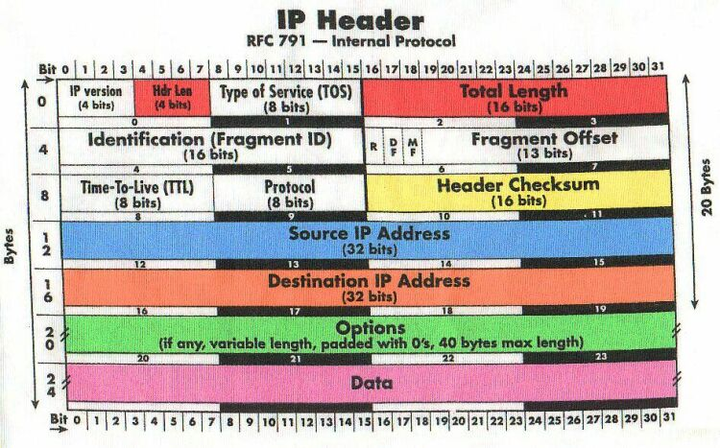
ipv4

Slide 23
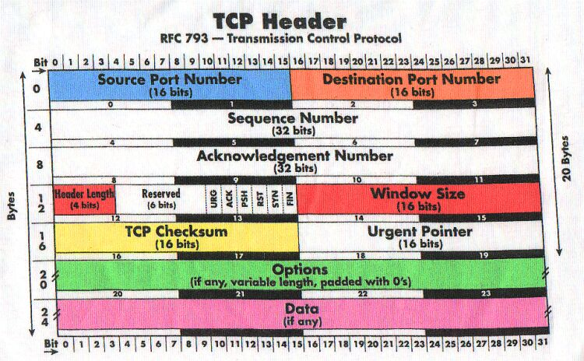

Slide 24
SYN
1111，
3333，1112
1112，3334

Slide 25
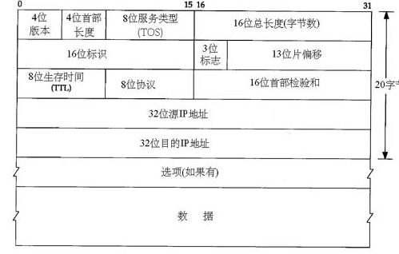
IP首部

Slide 26
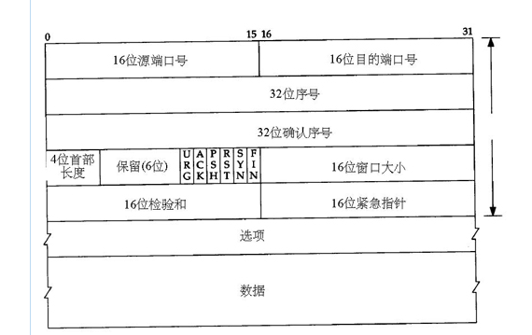
Tcp首部

Slide 28
closed
listen
syn_sent
syn_rcvd
established
established
fin_wait_1
colse_wait
fin_wait_2
closing
lastack

Slide 29
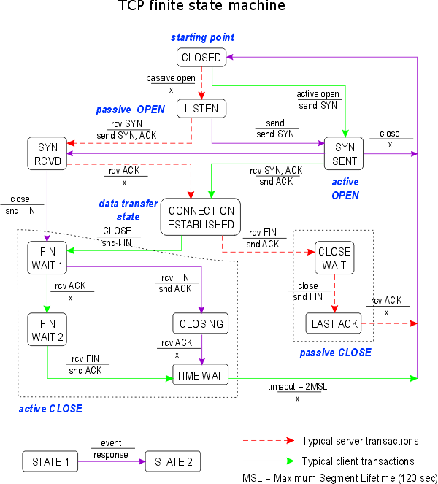

Slide 30
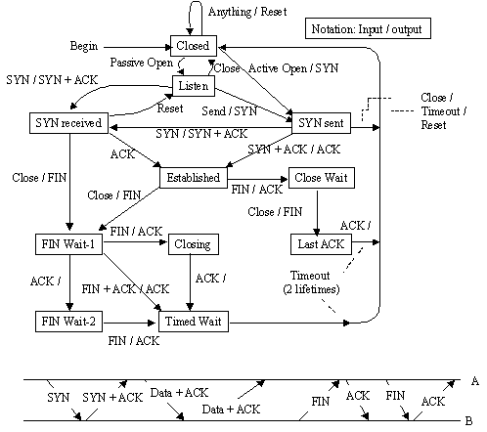
The TCP Finite State Machine (FSM)

Slide 31
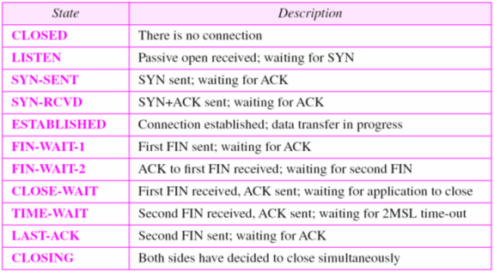
TCP State

Slide 32
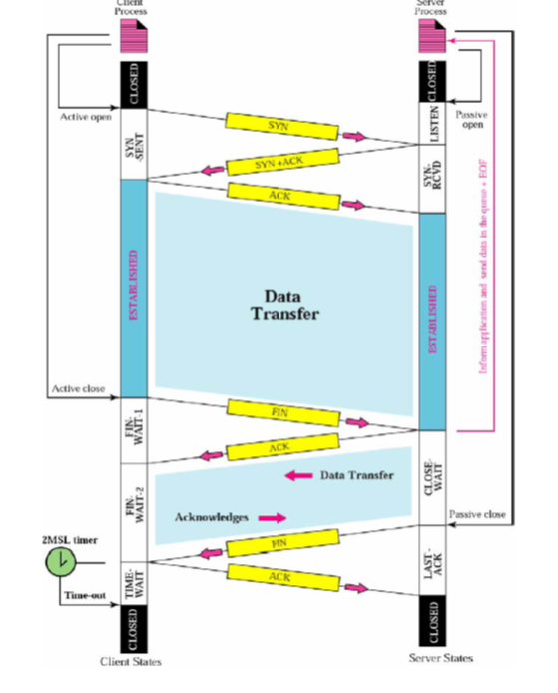

Slide 33
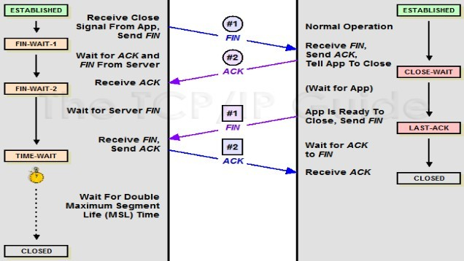

Slide 34
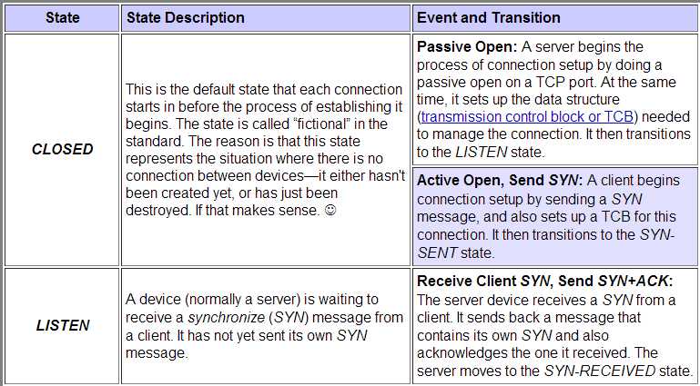

Slide 35
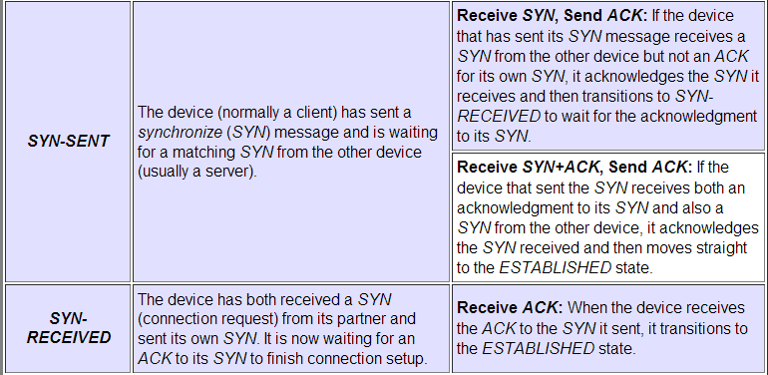

Slide 36
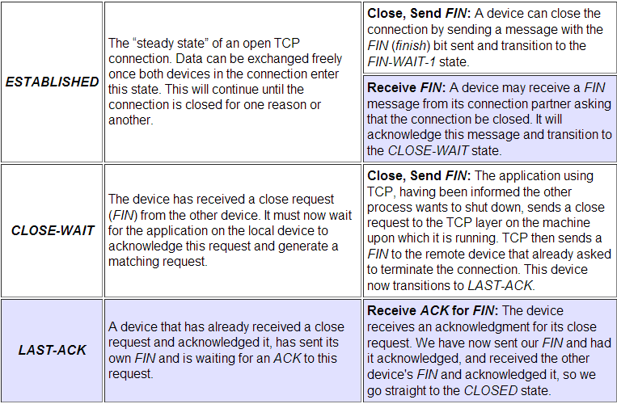

Slide 37
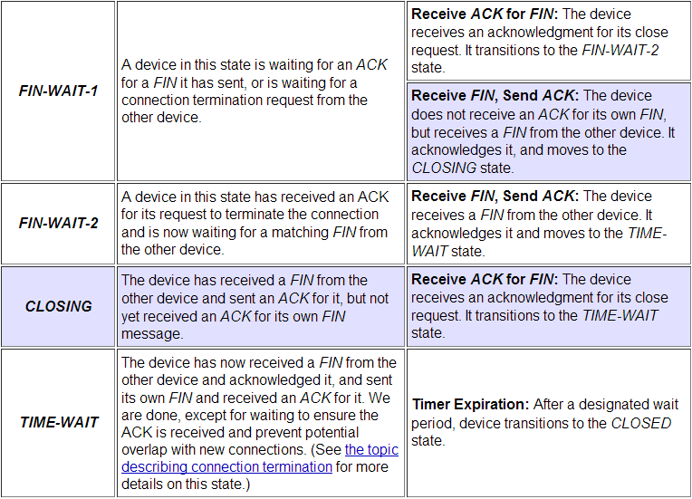

Slide 38
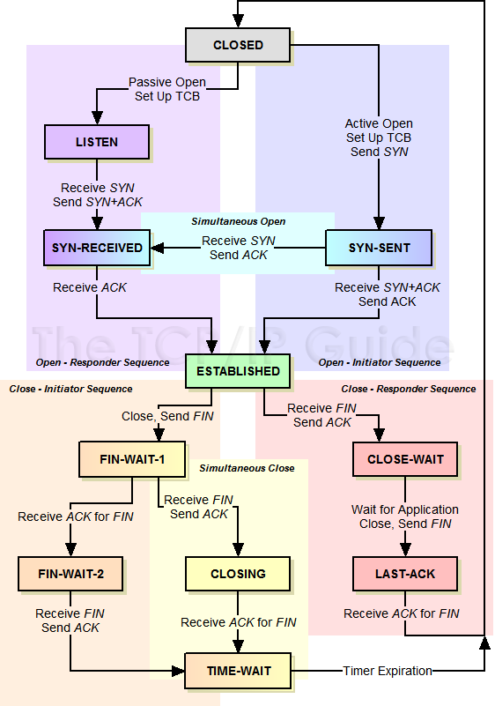
The TCP Finite State Machine (FSM)

Slide 39
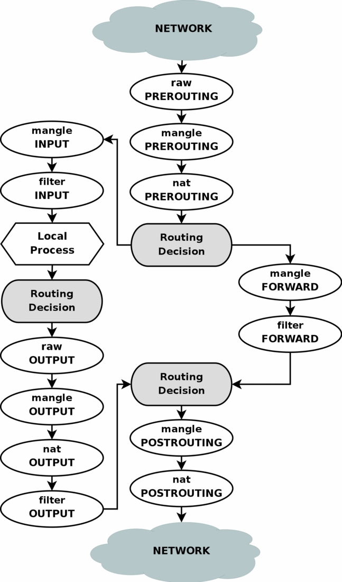

Slide 40
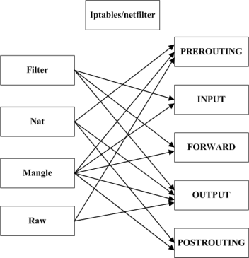

Slide 41

数据包过滤匹配流程
网络A
路
由
选
择
网络B
本机的应用进程
raw：OUTPUT
mangle：OUTPUT
入站数据流向
mangle：INPUT
nat：OUTPUT
出站数据流向
filter：INPUT
filter：OUTPUT
raw：PREROUTING
路
由
选
择
mangle：FORWARD
mangle：POSTROUTING
mangle：PREROUTING
filter：FORWARD
nat：POSTROUTING
nat：PREROUTING
转发数据流向

Slide 42
www.magedu.com
宿主
View：视图
C
3
2
SMTP
DNS
web
DMZ

Slide 43
ip_forward
192.16.10.0/24
A
172.16.0.0/16
1
2
B
/proc/sys/net/ipv4/ip_forward:1

Slide 44
web
ftp
80
21

Slide 46
/proc/sys/net/ipv4/ip_forward
NAT
ip
路由表
路由决策

Slide 47
udp: 53
dport
sport
dport
sport

Slide 49
通、堵

Slide 51
syn, ack, fin, rst

Slide 52
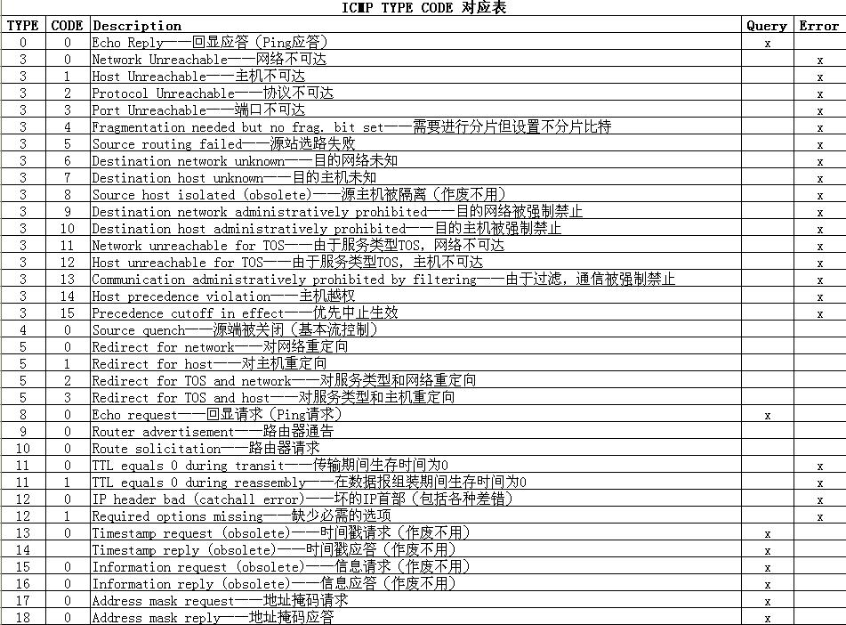

Slide 58
/proc/sys/net/ipv4/ip_forward
192.168.10.10

Slide 60
sex
hello there, sex, how are you?

Slide 67
80
ip_conntrack
  A→B

Slide 68
ip_conntrack
  /proc/net/ip_conntrack

Slide 69
www.magedu.com: IP
12.1.1.6
12.1.1.7
12.1.1.7
172.16.100.7
12.1.1.6
12.1.1.6
12.1.1.7
172.16.100.6
12.1.1.7

Slide 70
MAC: Media Access Control
MTU:1500（1460），1600
CRC
以太网, CSMA/CD
令牌环网
A
C
B
D
冲突域
广播域

Slide 71
1:a → 2：b
IP: network+host
mask
B
A
C
2
1
TCP/UDP

Slide 72
/proc/sys/net/ipv4/ip_forward
172.16.0.0/16
172.16.1.1
eth0
eth1

Slide 75
(192.168.10.11:43234, 1.1.1.1:80)
(2.2.2.2:53200, 1.1.1.1:80
192.168.10.11:43234
2.2.2.2:53200
1.1.1.1:80

Slide 76
web
ssh
smtp

Slide 78
web
itweb
1
3
2

Slide 80
ipfw 2.0
ipchains 2.2
iptables 2.4
  iptables: 用户空间工具
    编写规则
  netfilter
    内核中，框架(framework)
    hook function
      规则链
      INPUT, OUTPUT, FORWARD, PREROUTING, POSTROUTING

Slide 81
功能：
  filter
  nat
  mangle
  raw

Slide 82
172.16.0.0/16

Slide 83
table
raw
  PREROUTING, OUTPUT
mangle
  PREROUTING, INPUT, FORWARD, OUTPUT, POSTROUTING
nat
  PREROUTING, OUTPUT, POSTROUTING
filter
  INPUT, FORWARD, OUTPUT

Slide 84
filter
  匹配条件
    netfilter，检查模块
    扩展模块
  处理动作
    ACCEPT
    DROP, REJECT

Slide 85




SNAT策略的应用环境
Linux网关服务器
Internet
eth0: 218.29.30.31/30
eth1: 192.168.0.1/24
www.google.com
218.29.30.29
局域网PC机
192.168.0.100/24

Slide 86
SNAT策略的原理
未使用SNAT策略时的情况
Linux网关服务器
eth1：192.168.0.1
eth0：218.29.30.31
局域网客户端
192.168.0.100
Internet中的Web服务器
218.29.30.29
源地址：192.168.0.100
目标地址：218.29.30.29
源地址：192.168.0.100
目标地址：218.29.30.29
路
由
转
发
HTTP请求
HTTP请求
HTTP应答
无法正确路由
源地址：218.29.30.29
目标地址：192.168.0.100

Slide 87
SNAT策略的原理
在网关中使用SNAT策略以后
Linux网关服务器
eth1：192.168.0.1
eth0：218.29.30.31
局域网客户端
192.168.0.100
Internet中的Web服务器
218.29.30.29
源地址：192.168.0.100
目标地址：218.29.30.29
源地址：218.29.30.31
目标地址：218.29.30.29
SNAT
转换
HTTP请求
HTTP请求
HTTP应答
源地址：218.29.30.29
目标地址：192.168.0.100
源地址：218.29.30.29
目标地址：218.29.30.31

Slide 88
DNAT策略的应用环境
Linux网关服务器
Internet
www.benet.com
eth0: 218.29.30.31/30
eth1: 192.168.0.1/24
Internet中的客户机
218.29.30.29
网站服务器192.168.0.6/24
Ssh服务器

Slide 89
DNAT策略的原理
在网关中使用DNAT策略发布内网服务器
Linux网关服务器
eth0：218.29.30.31
eth1：192.168.0.1
局域网内的Web服务器
192.168.0.6
Internet中的客户机
218.29.30.29
源地址：218.29.30.29
目标地址：192.168.0.6
源地址：218.29.30.29
目标地址：218.29.30.31
DNAT
转换
HTTP请求
HTTP请求
HTTP应答
HTTP应答
源地址：192.168.0.6
目标地址：218.29.30.29
源地址：218.29.30.31
目标地址：218.29.30.29

Slide 90
Objectives
Upon completion of this unit, you should be able to:
  Describe IP and Routing
  Compare IPv4 and IPv6
  Describe IPv6 Features
  Understand Netfilter Architecture
  Learn to use the iptables command
  Understand Network Address Translation(NAT)

Slide 91
What is IPTables?
IPTables are building blocks of a framework within the Linux 2.4.x and 2.6.x kernels.
It is the successor of IPChains (2.2.x) and ipfwadm (2.0.x)
This framework enables packet filtering, network addresss [and port] translation (NA[P]T).
Also allows packet mangling.

Slide 92
Contd.
It works by creating a generic table structure of rulesets.
As in IPChains, each rule in an IPTable consists of a set of classifiers (IPTable matches) and a corresponding action (IPTable target).
IPTables, along with NetFilter, Connection Tracking, and the NAT Subsystem make up the entire framework.

Slide 93
Salient Features
Stateless Packet Filtering (IPv4 and IPv6)
Packet Filtering with states (as in IPv4)
All types of network address and port translation (NAT/NAPT)
Multiple layers of API's for 3rd party extensions
Large number of plugins and modules kept in a repository.

Slide 94
What can be done with IPTables?
Build internet firewalls based on packet filtering, with or without specifying states.
Use NAT and masquerading for sharing internet access if you don't have enough public IP addresses.
Do further packet manipulation (mangling), such as altering the TOS (Type of Service) bits of the IP header

Slide 95
PREROUTING,INPUT,FORWARD,OUTPUT, POSTROUTING
nat, filter, mangle, raw
-R
-A
-N
-D
-X

Slide 96
iptables -t filter INPUT -d 192.168.0.2 -p icmp --icmp-type 8 -j DROP
iptables -t filter OUTPUT -s 192.168.0.2 -p icmp --icmp-type 0 -j DROP
  iptables -F
  iptables -t filter -R DROP
  iptables -A INPUT -s 0.0.0.0/0.0.0.0 -p tcp --dport 22 -j ACCEPT
iptables -t nat -A PREROUTING -s 192.168.0.0/24 -j SNAT --to-source 1.1.1.1
iptables -t filter -A FORWARD -s 192.168.0.10/24 -d 1.1.1.1 -j DROP

Slide 97
iptables -t nat -A POSTROUTING -s 192.168.0.0/24 -d 1.0.0.0/24 -j MASQUERADE
iptables -t filter -A FORWARD -s 192.168.0.0/24 -d 1.0.0.253 -j DROP

Slide 98
-m {state|multiport|limit|mac}
Connection State
  NEW: SYN=1, FIN ACK RST=0
  ESTABLISHED: ACK=1
  RELATED: (ftp)
  INVALID
multiport
  --source-ports
  --destination-ports
  --ports

Slide 99
limit
  --limit /second, /hour, /minute, /day , /month
  --limit-burst
mac
  --mac-source XX:XX:XX:XX:XX:XX

Slide 100
iprange
  [!]--src-range ip-ip
  [!]--dst-range ip-ip
string
  --string pattern
  --algo bm|kmp

Slide 101
connlimit

Slide 102
Local:192.168.0.0 Remote :1.0.0.0/24
Inner:192.168.0.254
Outer:1.1.1.1
Local machine:192.168.0.2, 192.168.0.3
iptables -t nat -A PREROUTING -s 1.0.0.0/24 -d 1.1.1.1 -p tcp --dport 2020 -j DNAT --to-dest 192.168.0.2:22
iptables -A FORWARD -s 1.0.0.253 -d 192.168.0.2 -p tcp --dport 22 -j DROP

Slide 103
service iptables restart
service iptables save
  /etc/sysconfig/iptables
iptables-save > /etc/sysconfig/myrules
iptables-restore < /etc/sysconfig/myrules.2

Slide 104
at now+3min
  iptables-save > /etc/syspconfig/myrules.3
  iptables -t filter -F
iptables -A INPUT -p tcp --dport 22 -j DROP

Slide 105
WEB
  iptables -P INPUT DROPdestination-ports 22,25,80 -j ACCEPT
  iptables -P OUTPUT DROP
  iptables -A INPUT -d 192.168.0.2 -p tcp --dport 80 -m state --state NEW -j ACCEPT
  iptables -A INPUT -d 192.168.0.2 -p tcp --dport 25 -m state --state NEW -j ACCEPT
  iptables -A INPUT -d 192.168.0.2 -p tcp --dport 22 -m state --state NEW -j ACCEPT
  iptables -A INPUT -d 192.168.0.2 -p tcp -m state --state NEW -m multiport --destination-ports 22,25,80 -j ACCEPT
  iptables -A OUTPUT -s 192.168.0.2 -p tcp --sport 80 -m state --state ESTABLISHED -j ACCEPT

Slide 106
-m state
  NEW
  ESTABLISHED
  RELATED
  INVALID
-m multiport
  --source-ports port1,port2,port3,…
  --destination-ports port1,port2,port3,…
  --ports port1,port2,port3,…

Slide 107
/sbin/modprobe ip_conntrack_ftp
iptables -A INPUT -p TCP -i eth0 --dport 21 -m state --state NEW -j ACCEPT
iptables -A INPUT -p ALL -m state --state ESTABLISHED,RELATED -j ACCEPT
iptables -A OUTPUT -p ALL -m state --state ESTABLISHED,RELATED -j ACCEPT

Slide 108
sshd
  iptables -A INPUT -s OTHERs -d LOCAL_IP -p tcp --dport 22 -m state --state NEW,ESTABLISHED -j ACCEPT
  iptables -A OUTPUT -s LOCAL_IP -d OTHERs -p tcp --sport 22 -m state --state ESTABLISHED -j ACCEPT
ftp
  modprobe ip_conntrack_ftp
  iptables -A INPUT -s OTHERs -d LOCAL_IP -p tcp --dport 21 -m state --state NEW,ESTABLISH -j ACCEPT
  iptables -A INPUT -s OTHERs -d LOCAL_IP -m state --state ESTABLISHED,RELATED -j ACCEPT
  iptables -A OUTPUT -s LOCAL_IP -d OTHERs -p tcp --sport 21 -m state --state ESTABLISHED -j ACCEPT
  iptables -A OUTPUT -s LOCAL_IP -d OTHERS -m state --state ESTABLISHED,RELATED -j ACCEPT

Slide 109
SNAT策略概述
SNAT策略的典型应用环境
  局域网主机共享单个公网IP地址接入Internet
SNAT策略的原理
  源地址转换，Source Network Address Translation
  修改数据包的源IP地址

Slide 110
iptables l7-filter
主讲：马永亮(马哥)
QQ:113228115
客服QQ：1661815153
http://www.magedu.com
http://mageedu.blog.51cto.com

Slide 111
二进制文件，库文件，配置文件，帮助文件
/usr/local/apache/
source:
  tar zxvf package-1.1.1.tar.gz
  cd package-1.1.1
  ./configure --prefix
  make
  make install

Slide 112
Application Layer Packet Classifier
L7-filter is a classifier for Linux's Netfilter that identifies packets based on application layer data.
  It can classify packets as Kazaa, HTTP, Jabber, Citrix, Bittorrent, FTP, Gnucleus, eDonkey2000, etc., regardless of port.
  It complements existing classifiers that match on IP address, port numbers and so on.
http://l7-filter.sourceforge.net/

Slide 113
userspace-beta

Slide 114
iptables tcp/ip
l7-filter
App data →
netfilter,
iptables

Slide 115
What Need To Get
The 2.4 or 2.6 Linux kernel source (2.6 strongly preferred) from kernel.org
The iptables source from netfilter.org
"l7-filter kernel version" package (netfilter-layer7-vX.Y.tar.gz)
"Protocol definitions" package (l7-protocols-YYYY-MM-DD.tar.gz)

Slide 116
Kernel Patch
Use the appropriate kernel patch from the "Layer 7 patches" package to patch the kernel
  Please read the README in the package to determine which patch to use
  # tar zxvf linux-2.6.28.10.tar.gz -C /usr/src
  # tar zxvf netfilter-layer7-v2.22.tar.gz -C /usr/src
  # ln –s /usr/src/linux-2.6.28.10/ /usr/src/linux
  # cd /usr/src/linux/
  # patch -p1 < ../netfilter-layer7-v2.22/kernel-2.6.25-2.6.28-layer7-2.22.patch

Slide 117
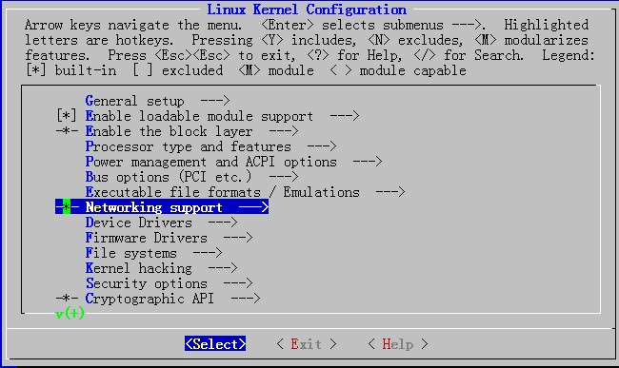
Configuring and Compiling the kernel
Before you configure kernel make sure you have development tools (gcc compilers and related tools) are installed on your system.
  # cp /boot/config-2.6.18-164.el5 /usr/src/linux/.config
  # make menuconfig

Slide 118
Configuring and Compiling the kernel
Networking support → Networking Options →Network packet filtering framework →Core Netfilter Configuration
  <M> Netfilter connection tracking support
  <M> “layer7” match support
  <M> “string” match support
  <M> “time” match support
  <M> “iprange” match support
  <M> “connlimit” match support
  <M> “state” match support
  <M> “conntrack” connection match support
  <M> “mac” address match support
  <M> "multiport" Multiple port match support

Slide 119
Configuring and Compiling the kernel
Networking support → Networking Options →Network packet filtering framework → IP: Netfilter Configuration
  <M> IPv4 connection tracking support (required for NAT)
  <M> Full NAT
    <M> MASQUERADE target support <M> NETMAP target support <M> REDIRECT target support

Slide 120
Compiling and installing the kernel
Start compiling and installing
  make
  make modules_install
  make install
Edit the /boot/grub/grub.conf, set the default booting kernel to the new kernel
Restart

Slide 121
iptables
# cp /etc/init.d/iptables ~/iptables
# cp /etc/sysconfig/iptables-config ~/
# rpm -e iptables-ipv6 iptables iptstate --nodeps
# tar jxvf iptables-1.4.6.tar.bz2 –C /usr/src
# cd /usr/src/iptables-1.4.6
# cp ../netfilter-layer7-v2.22/iptables-1.4.3forward-for-kernel-2.6.20forward/libxt_layer7.* ./extensions/
./configure --prefix=/usr --with-ksource=/usr/src/linux
make
make install

Slide 122
iptables
# tar zxvf l7-protocols-2009-05-28.tar.gz
# cd l7-protocols-2009-05-28
# make install
# mv ~/iptables /etc/rc.d/init.d/
# service iptables start

Slide 123
l7-filter uses the standard iptables extension syntax
  iptables [specify table & chain] -m layer7 --l7proto [protocol name] -j [action]

Slide 124
L7-filter Supported Protocols
bittorrent
  P2P filesharing / publishing tool
edonkey
  eDonkey2000 - P2P filesharing
kugoo
  KuGoo - a Chinese P2P program
msn-filetransfer
  MSN (Micosoft Network) Messenger file transfers
msnmessenger
  Microsoft Network chat client
pplive
  Chinese P2P streaming video
qq
xunlei

Slide 125
connlimit
  [!] --connlimit-above n
  Allows you to restrict the number of parallel connections to a server per client IP address (or client address block).
  Example:
    iptables -A INPUT -p tcp --syn --dport 22 -m connlimit --connlimit-above 2 -j REJECT
    Allow 2 ssh connections per client host

Slide 126
string
  This modules matches a given string by using some pattern matching strategy.
  It requires a linux kernel >= 2.6.14.
  [!] --string pattern
    Matches the given pattern.
  --algo {bm|kmp}
    Select the pattern matching strategy. (bm = Boyer-Moore, kmp = Knuth-Pratt-Morris)
  Examples:
    iptables –A OUTPUT –p udp --dport 53 -m string --string “verycd” --algo bm -j DROP
    iptables -A OUTPUT -p tcp --dport 80 -m string --string “法轮功” --algo kmp -j DROP
Notes:
The Boyer-Moore algorithm is considered as the most efficient string-matching algorithm in usual applications.
The Boyer–Moore string search algorithm is a particularly efficient string searching algorithm, and it has been the standard benchmark for the practical string search literature.[1] It was developed by Bob Boyer and J Strother Moore in 1977. The algorithm preprocesses the target string (key) that is being searched for, but not the string being searched in (unlike some algorithms that preprocess the string to be searched and can then amortize the expense of the preprocessing by searching repeatedly). The execution time of the Boyer-Moore algorithm can be sub-linear: it doesn't need to check every character of the string to be searched, but rather skips over some of them. Generally the algorithm gets faster as the key being searched for becomes longer. Its efficiency derives from the fact that with each unsuccessful attempt to find a match between the search string and the text it's searching, it uses the information gained from that attempt to rule out as many positions of the text as possible where the string cannot match.

Slide 127
time
  This matches if the packet arrival time/date is within a given range.
  --datestart YYYY[-MM[-DD[Thh[:mm[:ss]]]]]
  --datestop YYYY[-MM[-DD[Thh[:mm[:ss]]]]]
    Only match during the given time, The possible time range is 1970-01-01 T00:00:00 to 2038-01-19 T04:17:07
  --timestart hh:mm[:ss]
  --timestop hh:mm[:ss]
    The possible time range is 00:00:00 to 23:59:59.
    Leading zeroes are allowed.
Notes:
The Knuth–Morris–Pratt string searching algorithm (or KMP algorithm) searches for occurrences of a "word" W within a main "text string" S by employing the observation that when a mismatch occurs, the word itself embodies sufficient information to determine where the next match could begin, thus bypassing re-examination of previously matched characters.
The algorithm was conceived by Donald Knuth and Vaughan Pratt and independently by J. H. Morris in 1977, but the three published it jointly.

Slide 128
time
  [!] --monthdays day[,day...]
    Only match on the given days of the month. Possible values are 1 to 31.
  [!] --weekdays day[,day...]
    Only match on the given weekdays. Possible values are Mon, Tue, Wed, Thu, Fri, Sat, Sun, or values from 1 to 7, respectively.
  Examples:
    -m time --weekdays Sa,Su
    -m time --timestart 12:30 --timestop 13:30

Slide 129
-j LOG
  --log-level level
    Level of logging
  --log-prefix prefix
    Prefix log messages with the specified prefix; up to 29 letters long, and useful for distinguishing messages in the logs.
  --log-tcp-options
    Log options from the TCP packet header.
  --log-ip-options
    Log options from the IP packet header.

Slide 130
项目
某公司根据业务规划，需要建立一个DMZ区域，并在其中提供DNS, WWW, FTP, MYSQL, NFS等服务；
公司申请获得了一个公网IP，123.18.1.32/24，并注册申请了域名test.org；
现期望：
  内网用户能够通过这个申请到的公网IP访问互联网；
  通过公网IP将内网中的DNS，WWW, FTP, MYSQL服务输出给互联网和内网用户访问；NFS服务则只允许DMZ区域和内网用户访问；
    WWW为LAMP架构；
    FTP需要开启虚拟帐号的功能，且其访问的目录为了扩展，希望使用逻辑卷(比如，挂载至/var/upload);
  为加强安全，内网主机不允许来自互联网的主机访问；
  内网用户访问DNS, WWW等服务器时使用路由方式直接访问，而外网用户则需要通过外网地址访问；
  DMZ区域中的主机不能主动向别的主机发起连接请求；
  请根据以上要求给出你的设计图；而后模拟实现此应用；

Slide 132
树莓

Slide 133
案例
dns server
Firewall
outer clients
web server
inter clients
1、dns server和web server使用内网地址；但允许outer clients通过Firewall的外网地址访问；
2、web server的域名为www.magedu.com，但interclients解析为web server的内网地址，outer clients访问时解析为Firewall的外网地址；

Slide 134
案例
dns server
Firewall
outer clients
web server
web server
inter clients
1、dns server和web server使用内网地址；但允许outer clients通过Firewall的外网地址访问；
2、web server的域名为www.magedu.com，但interclients解析为web server的内网地址，outer clients访问时解析为Firewall的外网地址；

Slide 135

关于马哥教育
博客：http://mageedu.blog.51cto.com
主页：http://www.magedu.com
QQ：2813150558, 1661815153, 113228115
QQ群：169777636, 279599283

Slide 136
Thank You!

