Slide 1

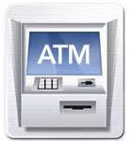
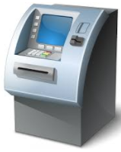
Architecture
X Bank
browser
Screen server
ATMP
Blockchain ATM network
Y Bank
http
ATMP
Blockchain protocol

Slide 2
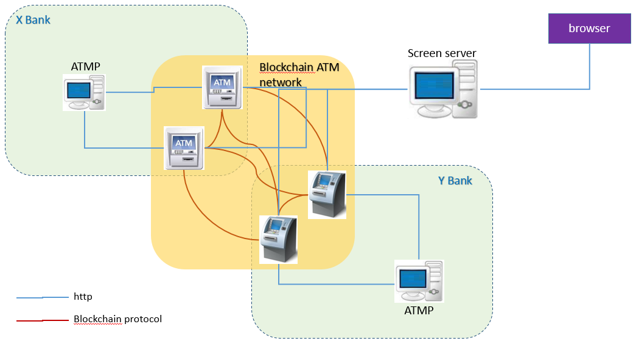
Technologies and data flow
Physical Server1 (120.79.43.12):
Port 1: Xbank ATMP
Port 2: Ybank ATMP
Port 3: Screen server
Physical Server2 (119.23.28.88):
Port 7101: Xbank ATM1
Port 7102: Xbank ATM2
Physical Server3 (119.23.12.79)
Port7101: Ybank ATM1
Port7102: Ybank ATM2
Transaction flow (Bank B customer perform transaction on Bank A ATM001):
Browser call screen server HTML/JS
Screen server HTML/JS call Bank A ATM001 node.js
Bank A ATM001 node.js call smart contract
Smart contract fire event to Bank B ATM002 node.js
Bank B ATM002 node.js call Bank B ATMP web service
Bank B ATMP web service respond Bank B ATM002 node.js
Bank B ATM002 node.js call smart contract
Smart contract fire event to Bank A ATM001 node.js
Bank A ATM001 node.js respond screen server HTML/JS
Screen server HTML/JS update browser
ATMP: web service + database
ATM: Geth + node.js + smart contract
Screen server: HTML/JS/CSS

Slide 3
servers
Physical Server1 (119.23.12.79):
Port 1: Xbank ATMP
Port 2: Ybank ATMP
Port 3: Zbank ATMP
Port 4: Screen server
BTM:
RPC Port 7101:
Raftport port: 7201
Port: 7301
Physical Server2 (119.23.28.88):
Xbank ATM1:
RPC Port 7101:
Raftport port: 7201
Port: 7301
Xbank ATM2
RPC Port 7102:
Raftport port: 7202
Port: 7302
Physical Server3 (120.79.43.12)
Ybank ATM1:
RPC Port 7101:
Raftport port: 7201
Port: 7301
Ybank ATM2
RPC Port 7102:
Raftport port: 7202
Port: 7302
Physical Server4 (120.79.41.102):
Zbank ATM1:
RPC Port 7101:
Raftport port: 7201
Port: 7301
Zbank ATM2
RPC Port 7102:
Raftport port: 7202
Port: 7302

Slide 4
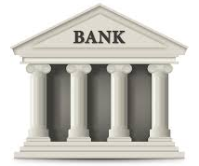
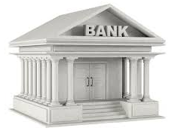

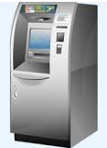
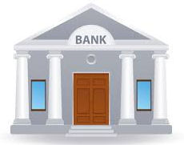
Please select an ATM
Withdraw cash
Y Bank
X Bank
Z Bank

Slide 5
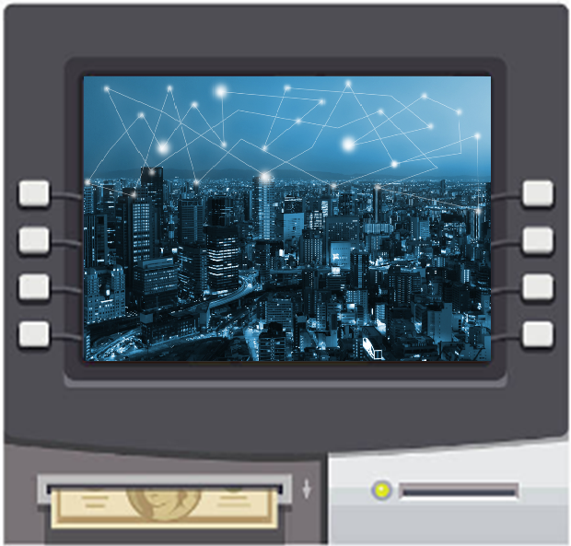
Withdraw cash
Please insert your card

Slide 6
Withdraw cash
Please enter amount
$

Slide 7
Withdraw cash
Please take your money

Slide 8
Please select an ATM
Withdraw cash
X Bank
Y Bank
Z Bank

Slide 9
Please select an ATM
Withdraw cash
X Bank
Y Bank
Z Bank

Slide 10
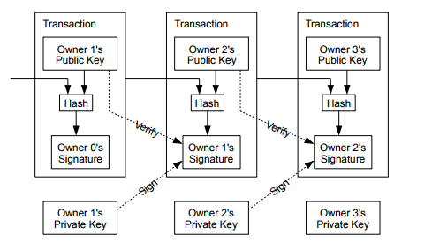
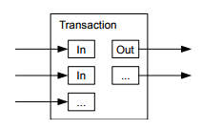
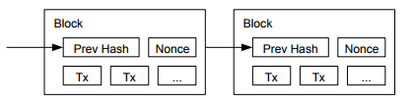
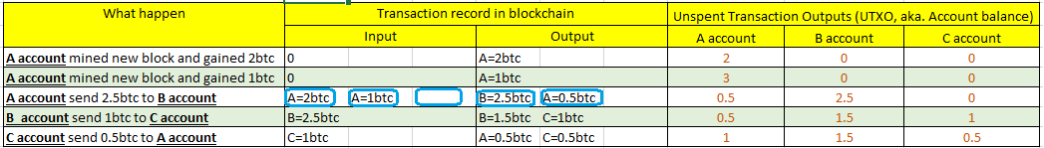
Transaction record

Slide 11

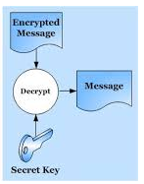
Transaction confirmation
A transaction is created and broadcasted to the whole network
Each node verify the transaction’s signature
Each node put the verified transaction to a potential block locally. This block contains other transactions.
Each node compete to try resolving the mathematical problem of the potential block (find the Nounce).
The first node resolved the mathematical problem announce to the whole network of the new block.
Other nodes verify the block information, and add the new mined block to the local chain.
1
2
3
Potential Block
Prev_Hash
Time_stamp
Transaction created
Tx Hash
Nounce
Tx 1
Tx 2
…
New Tx
4
5
6
New block
Block 1
New block
Block 1
Prev_Hash
Time_stamp
Prev_Hash
New block
Prev_Hash
Tx Hash
Nounce
Tx Hash
Prev_Hash
Tx Hash
Tx Hash
Tx 1
Tx 2
…
New Tx

Slide 12
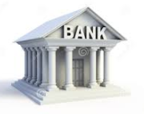
Please select a bank
Open account

Slide 13
A new card is added
Open account

Slide 14
Bank network
Withdraw cash

Slide 15
Assumptions
Every ATM is always online, have enough money inside
The blockchain ATM network is using its own currency “ETH”, its exchange rate with HKD is always 1:1 as an agreement between all member banks

Slide 16

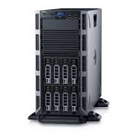

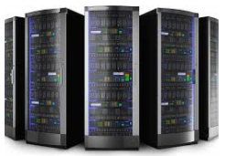
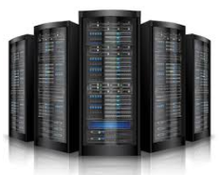


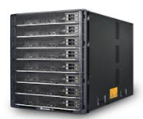

As is
……

Slide 17
With blockchain

Slide 18


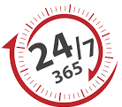


With blockchain
No 3rd party association cost, pure bank-to-bank communication
No customer information exchange with 3rd party, all customer information stay in bank
No server down time, real 7 X 24
Never can transaction record be changed
No fake transaction can be accepted in blockchain, even if some hackers in it
The architecture can be easily extended to other inter-bank system, e.g. transfer, payment, capital exchange etc.

