Slide 1

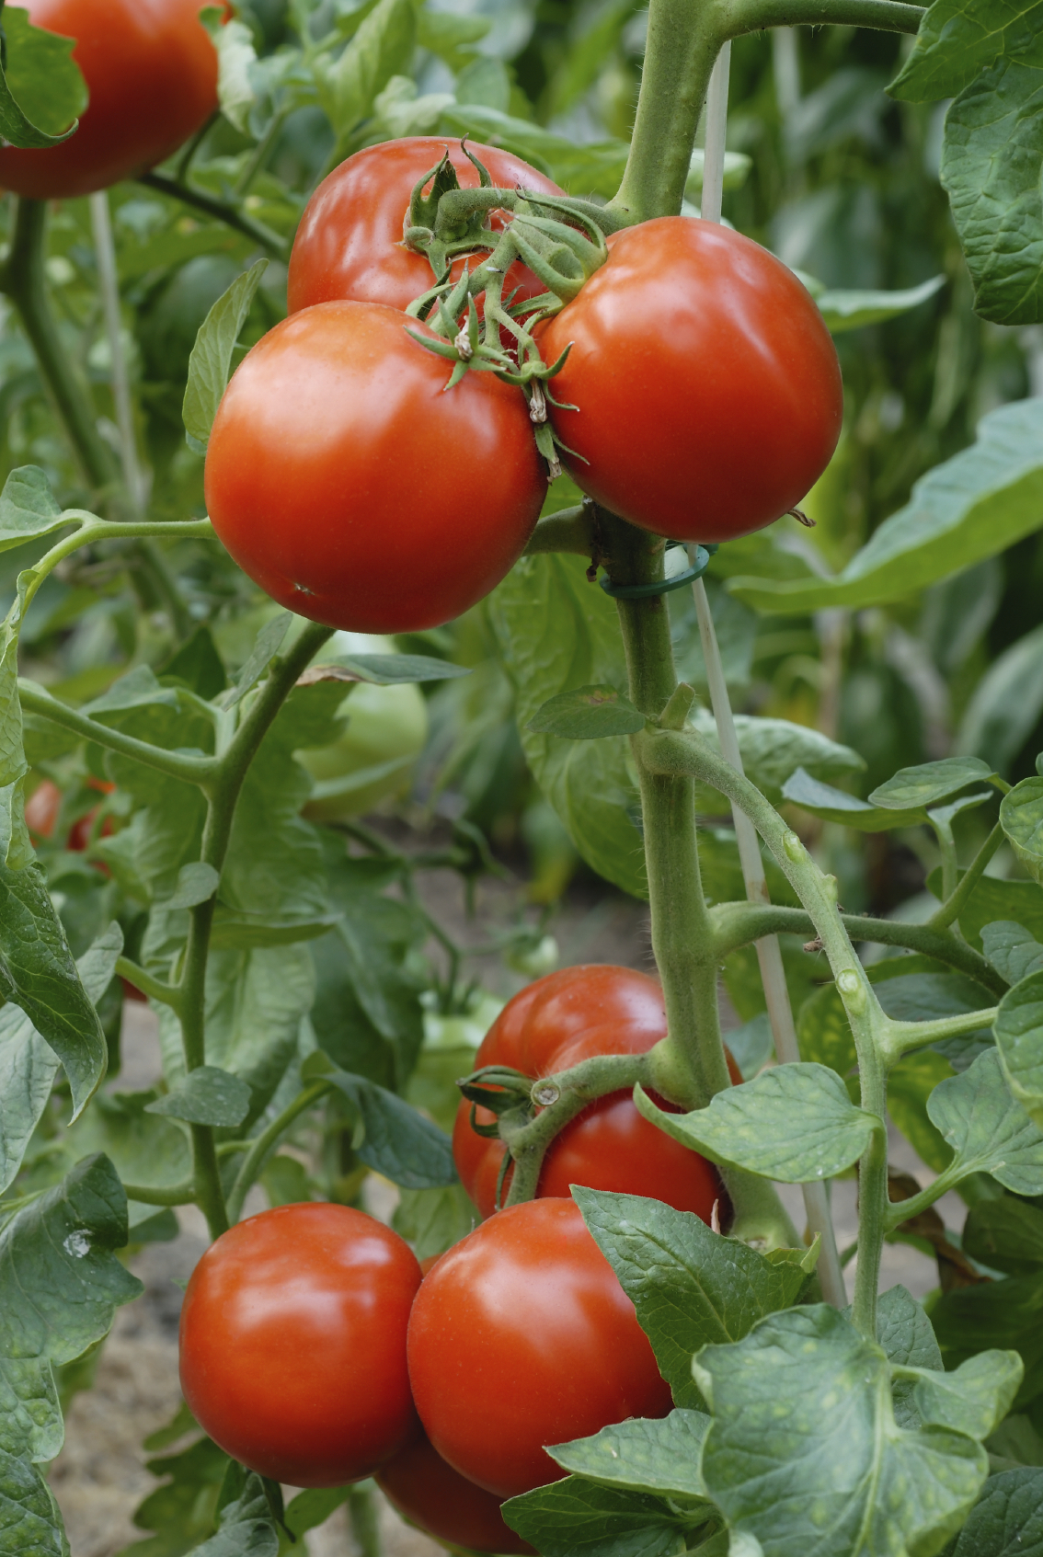
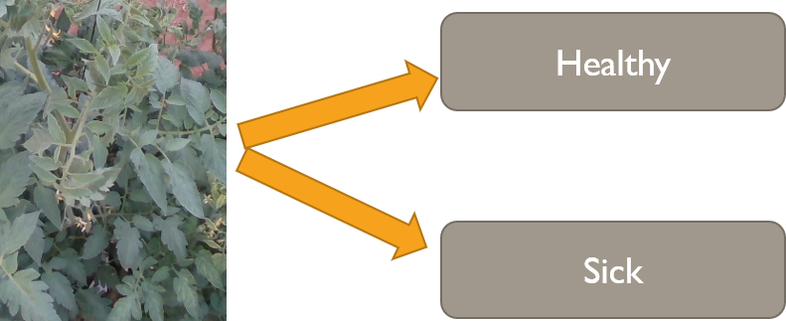
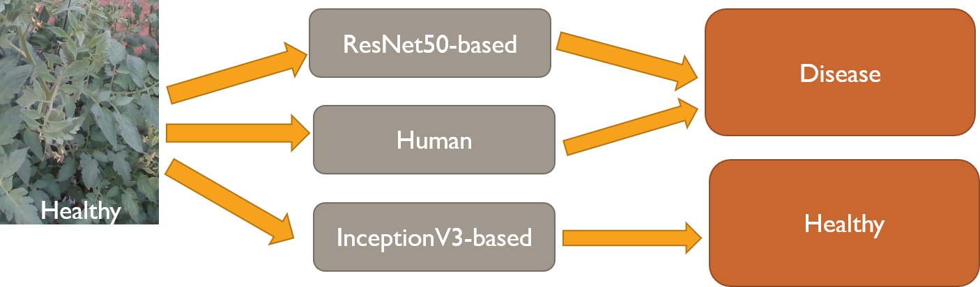
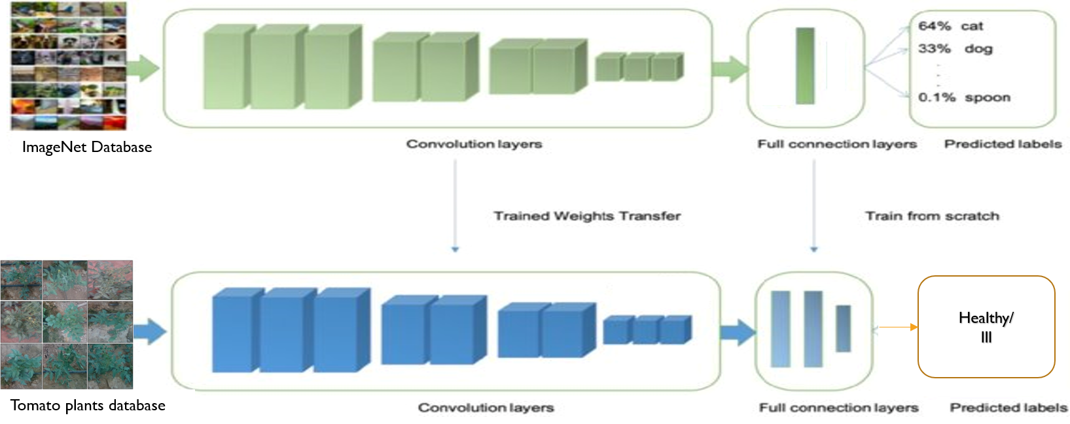
TYLCV Identification in Tomato Plant Images
using Transfer Learning and InceptionV3
Students: Amir Gabay, Yiftach Savransky, Amit Damri
Ben-Gurion University of the Negev
Faculty of Engineering Science
Department of Software and Information Systems Engineering
Objective
The Problem
Novel method to recognize TYLCV disease in tomato plants
1. Recognize TYLCV disease in Tomato plants
2. Image classification task
Contribution
Higher performances achieved
3. Dataset - Tomato plant images Ranked by sickness level
Our Method
Pre-trained InceptionV3 on ImageNet dataset
Transfer learning - Architecture modification & Fine tuning
Experiments
Conclusions
Accuracy Comparison
Novel method > ResNet50 based model
McNemar's test: p-value = 0.003
Novel method > Human level
McNemar’s test: p-value = 0.049
ResNet50
InceptionV3
Human
InceptionV3
Test Set
User Study
AUC Comparison
ResNet50
InceptionV3
Human
InceptionV3
Test Set
User Study

