Slide 1

TYLCV IDENTIFICATION in Tomato Plant Images using Transfer Learning and INCEPTIONV3
Submitted By:
Amir Gabay
Yiftach Savransky
Amit Damri
Ben-Gurion University of the Negev
Faculty of Engineering Science
Department of Software and Information Systems Engineering

Slide 2
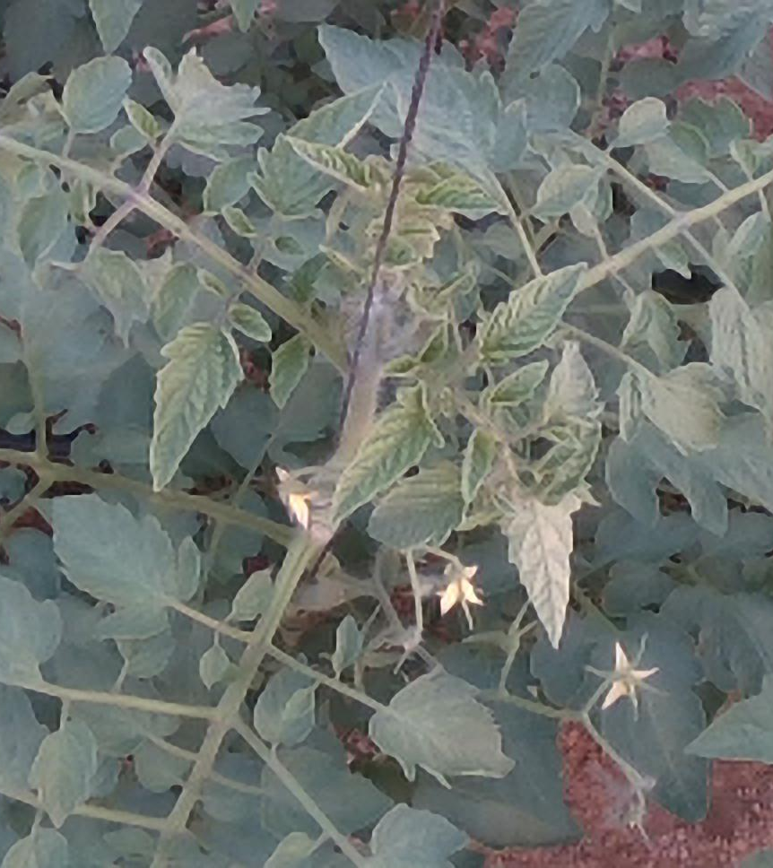
introduction
Recognize disease in tomato plants
Image classification model
Deep CNN
Transfer learning based - ImageNet
Outperformed human level
Outperformed ResNet50 performance

Slide 3
TYLCV
Tomato yellow leaf curl virus (TYLCV)
Symptoms (Moriones et al. 2000)
Upward curling of leaflet margins
Reduction of leaflet area
Yellowing of young leaves
Stunting and flower abortion
Causes up to total yield loss

Slide 4
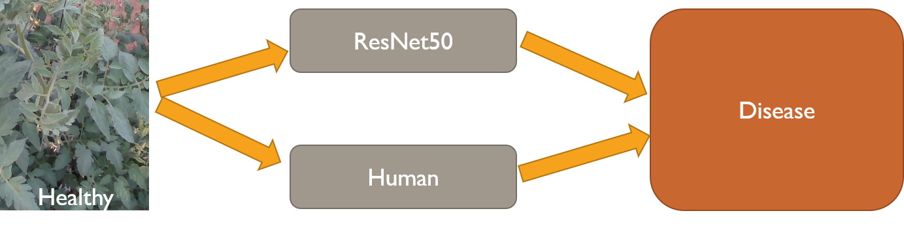
Problem Presentation
Tomato plants disease – binary classification task
Human farmers recognition
Financial problems
Limited results
ResNet50 transfer learning recognition
Limited results

Slide 5
Related Work
(Maxime, et al. 2019)
Improve classification using transfer learning
(Bharadwaj et el. 2019)
Transfer learning to classify Malaria cell images
(Hentschel et al. 2016)
Transfer learning to classify paintings

Slide 6
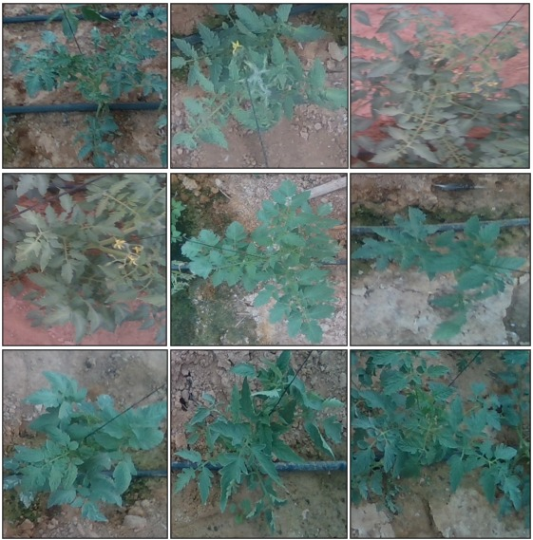
Dataset
1000 RGB images
Rank of sickness level
By experts
Converted to binary labels
55% healthy, 45% ill

Slide 7
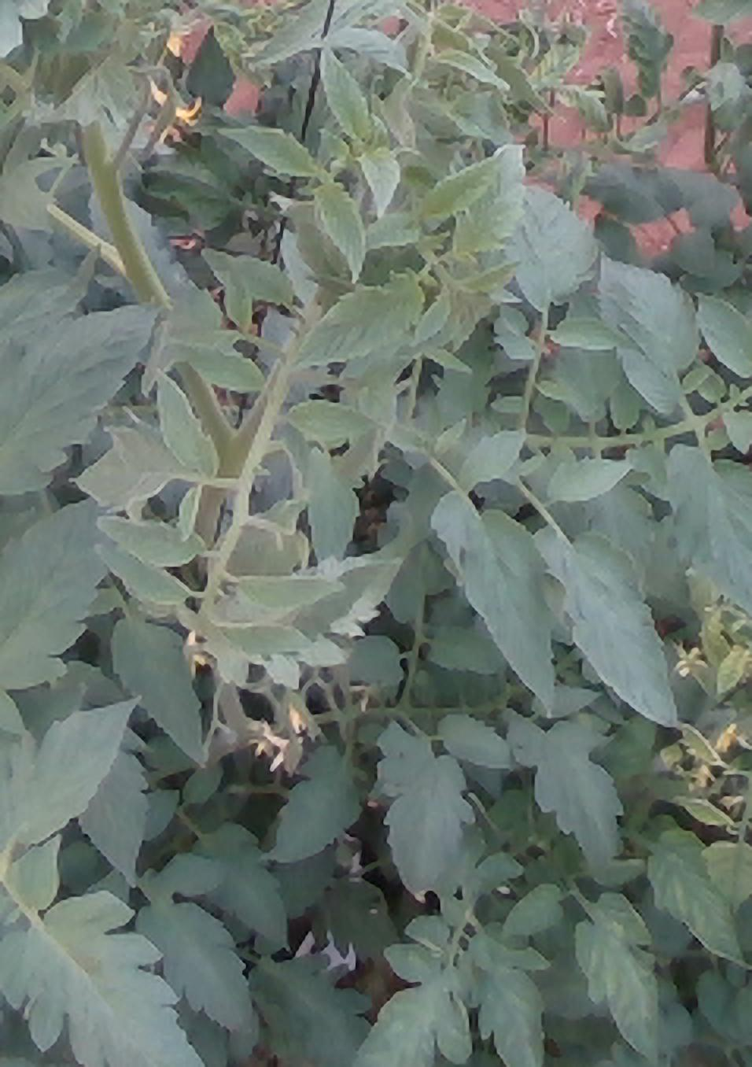
Preprocessing
Rescale – [0,255] to [0,1]
Data augmentation
Random rotation
Horizontal flips
Random crop
Identical sizes
(256,256)
Original
Crop
Rotation
Flip

Slide 8
Novel Method
Pre-trained InceptionV3 (Szegedy et al. 2015)
ImageNet dataset
Transfer learning
Architecture modification
Fine tuning
Notes:
ImageNet - 1000 categories,1.2 million images

Slide 9
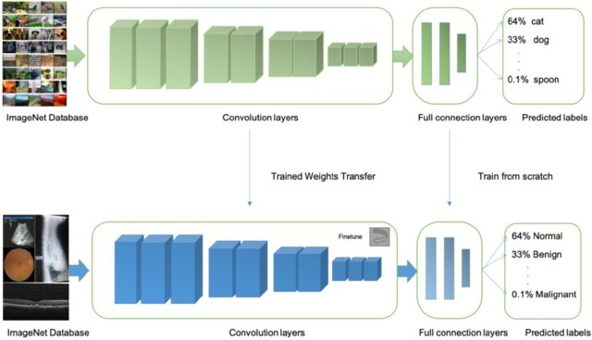
Transfer Learning
InceptionV3 model
ImageNet Database
Healthy/
Ill
Tomato plants database

Slide 10
Experiments
Training
InceptionV3 - based
ResNet50 - based
Metrics
Accuracy
AUC
Statistical significance
McNemar's test – p-value = 0.003
AUC | Accuracy | Model
0.71 | 0.69 | ResNet50
0.782 | 0.785 | InceptionV3

Slide 11
User Study
Participants
7 graduate students
Classify 8 images
Compared with InceptionV3
Statistical test
McNemar’s test
p-value = 0.049
AUC | Accuracy | Model
0.64 | 0.64 | Participants
0.81 | 0.8 | InceptionV3

Slide 12
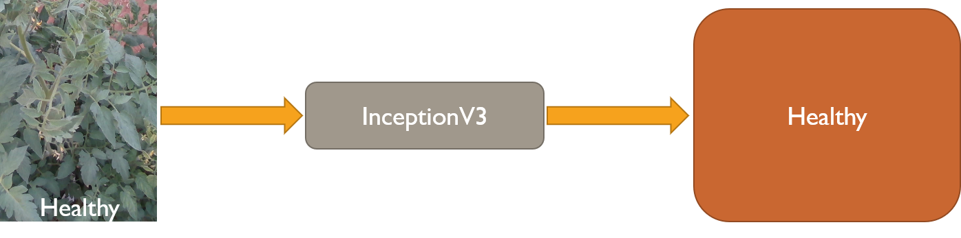
Conclusions
InceptionV3-based > ResNet50-based
Better performances on ImageNet
InceptionV3-based > Human level
Humans recognize limited patterns

Slide 13
Summary
Recognize TYLCV disease in tomato plants
Transfer learning using InceptionV3
Better performances
Future work
Performance optimization
Different CNN models
Thank you for listening!

Slide 14
References
Oquab, Maxime, et al. "Learning and transferring mid-level image representations using convolutional neural networks." Proceedings of the IEEE conference on computer vision and pattern recognition. 2014.
Reddy, A. Sai Bharadwaj, and D. Sujitha Juliet. "Transfer Learning with ResNet-50 for Malaria Cell-Image Classification." 2019 International Conference on Communication and Signal Processing (ICCSP). IEEE, 2019.
Hentschel, Christian, Timur Pratama Wiradarma, and Harald Sack. "Fine tuning CNNS with scarce training data—Adapting ImageNet to art epoch classification." 2016 IEEE International Conference on Image Processing (ICIP). IEEE, 2016.
Szegedy, Christian, et al. "Going deeper with convolutions." Proceedings of the IEEE conference on computer vision and pattern recognition. 2015.
Moriones, E., and J. Navas-Castillo. "Tomato yellow leaf curl virus, an emerging virus complex causing epidemics worldwide." Virus research 71.1-2 (2000): 123-134.‏

