Slide 1
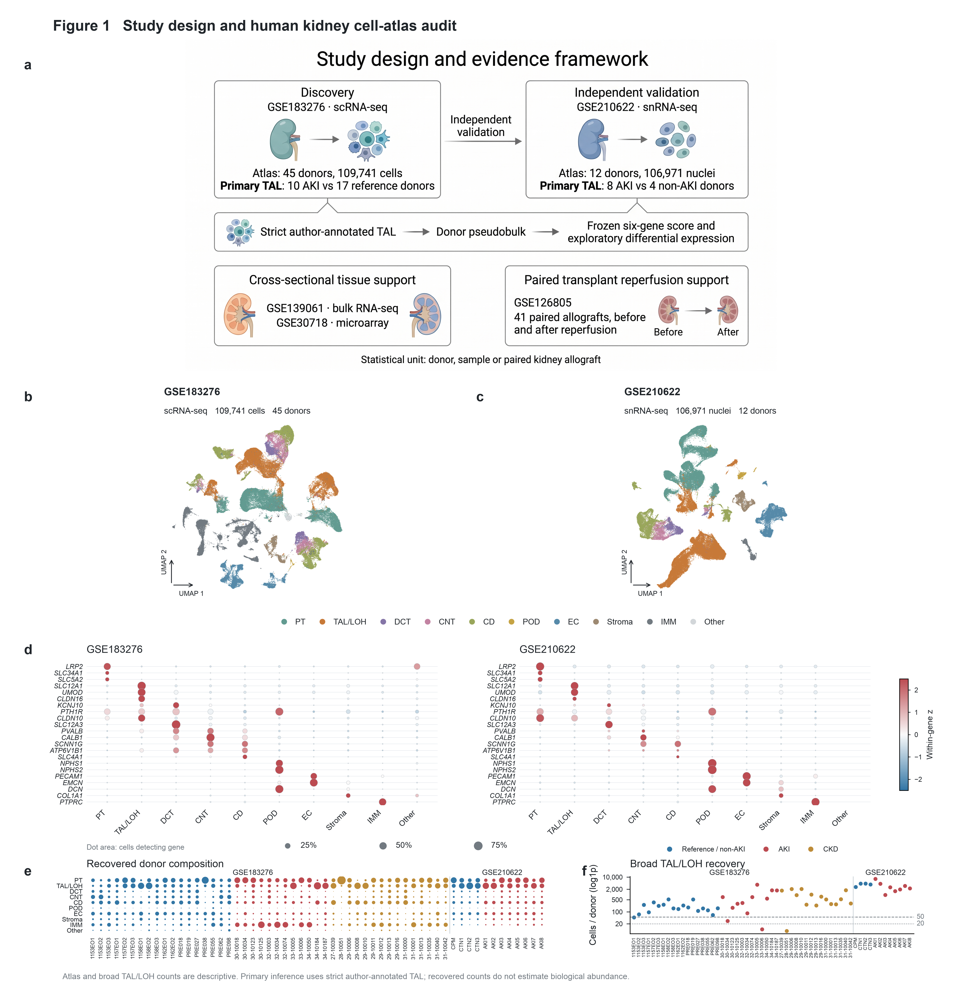
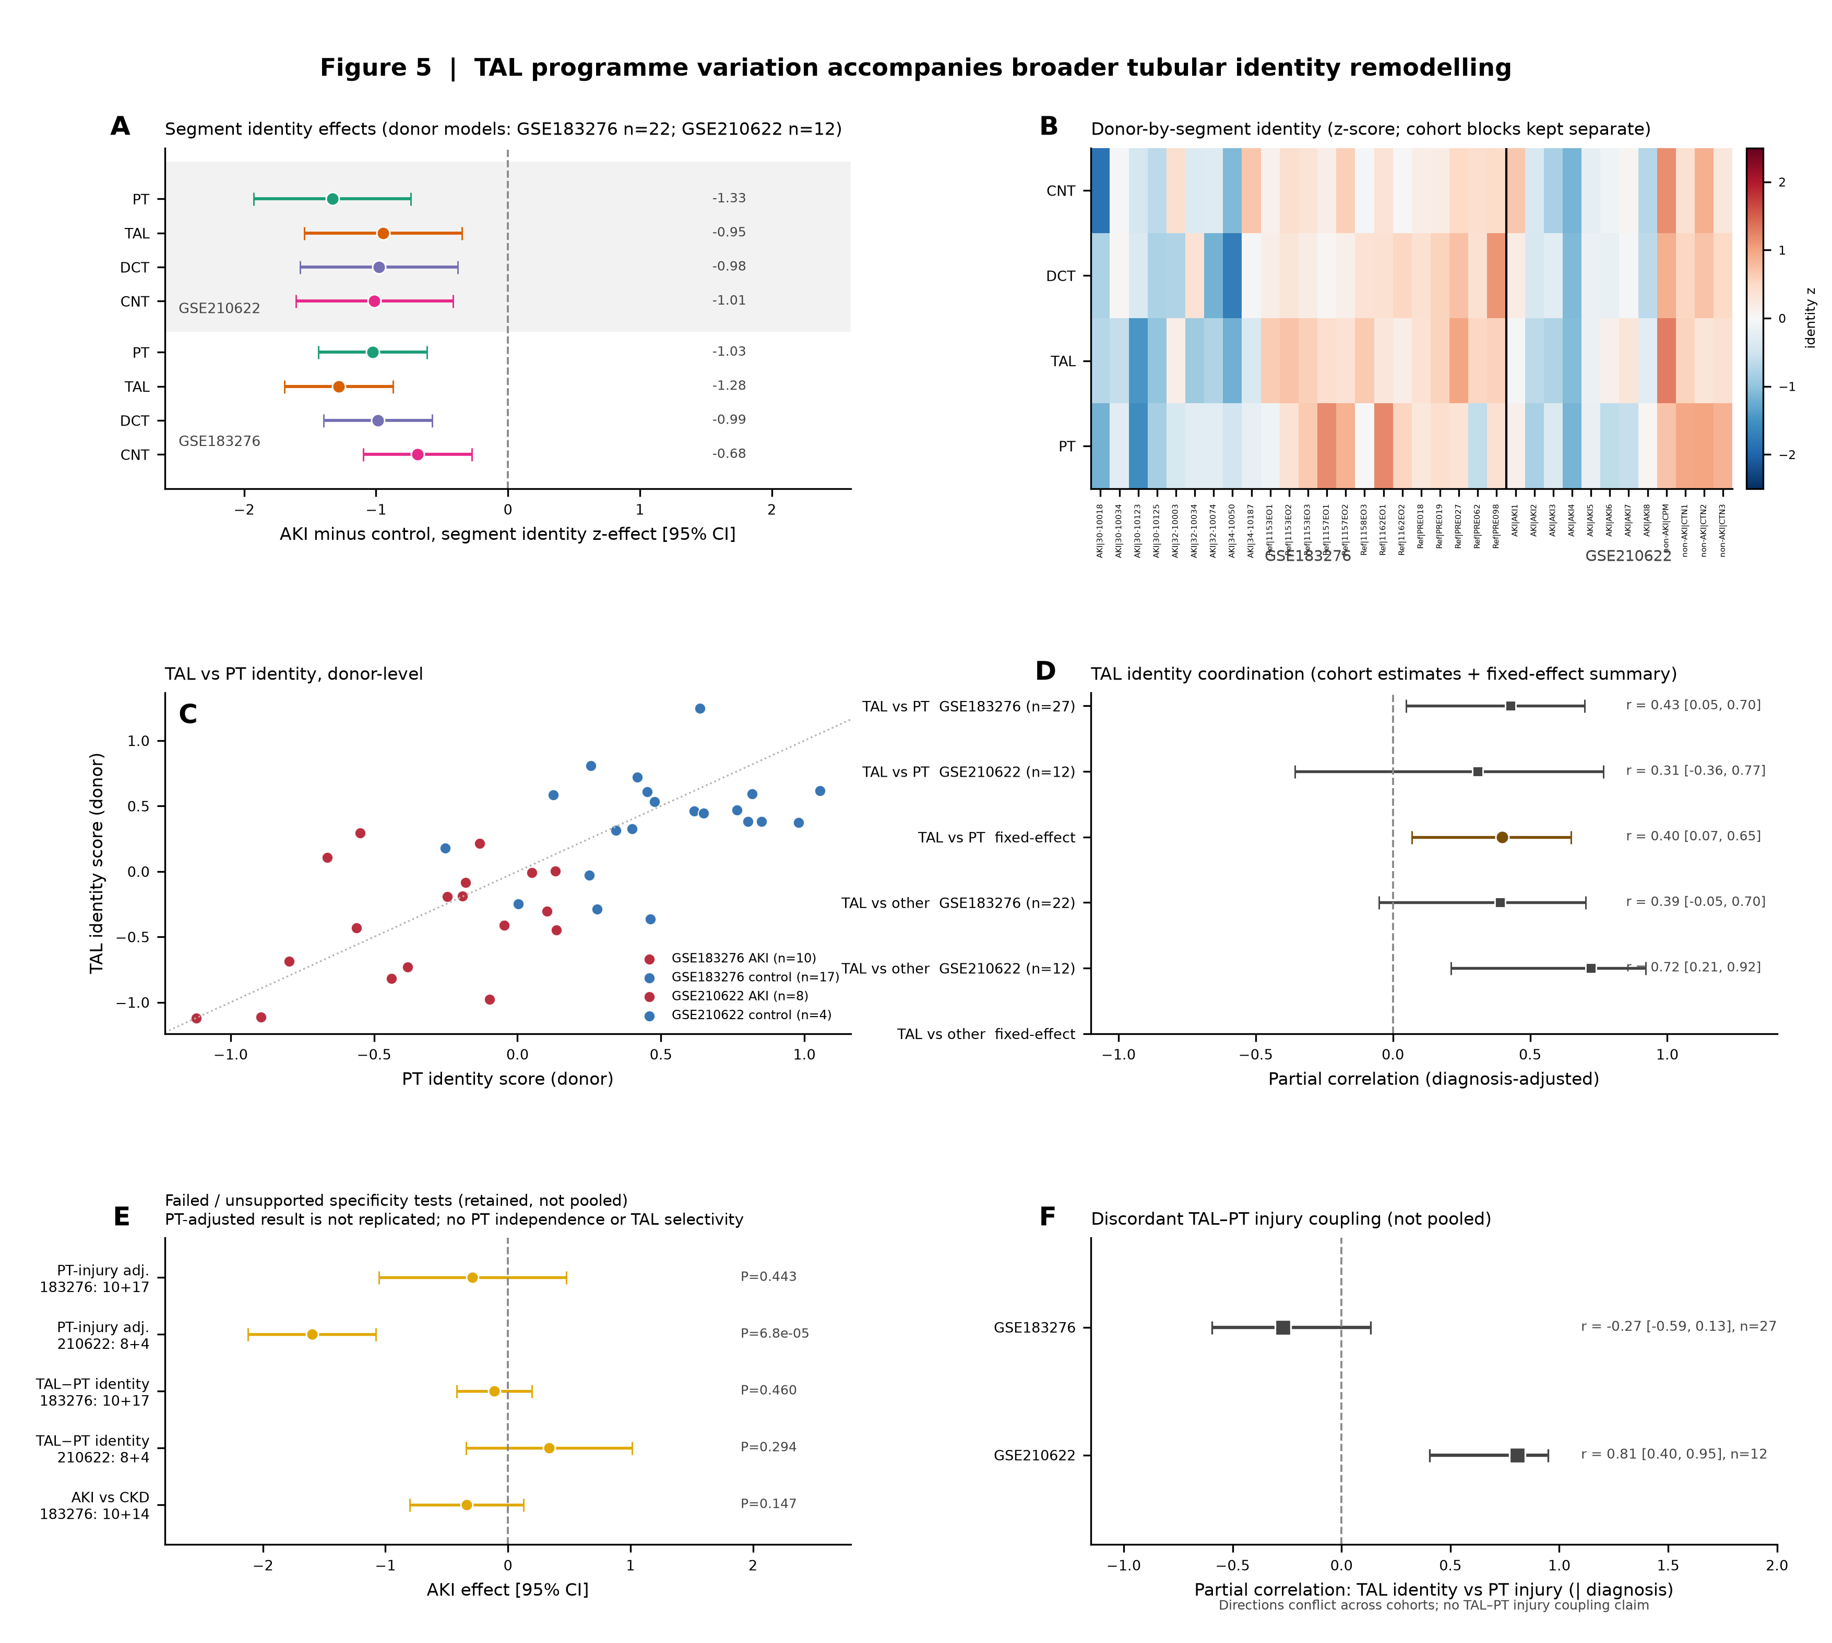
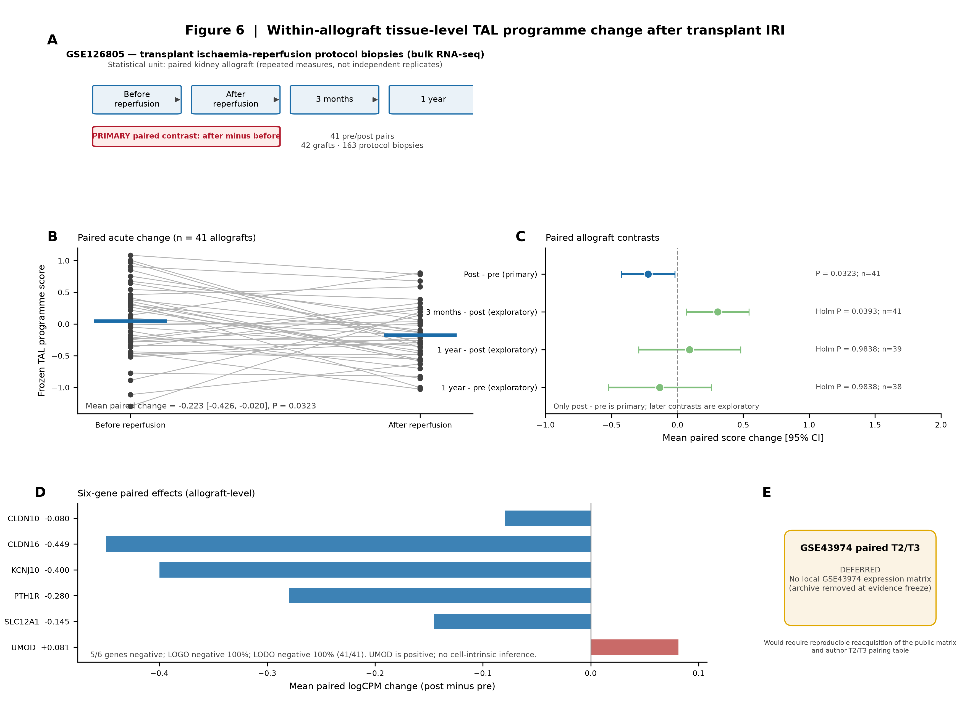
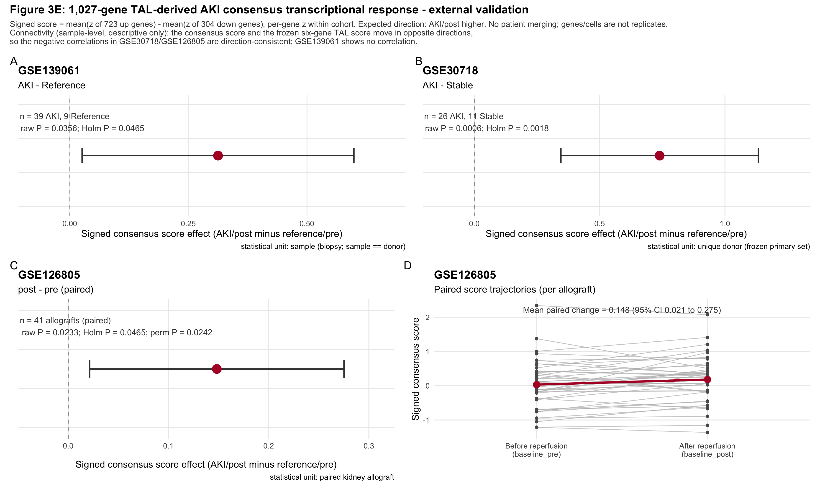
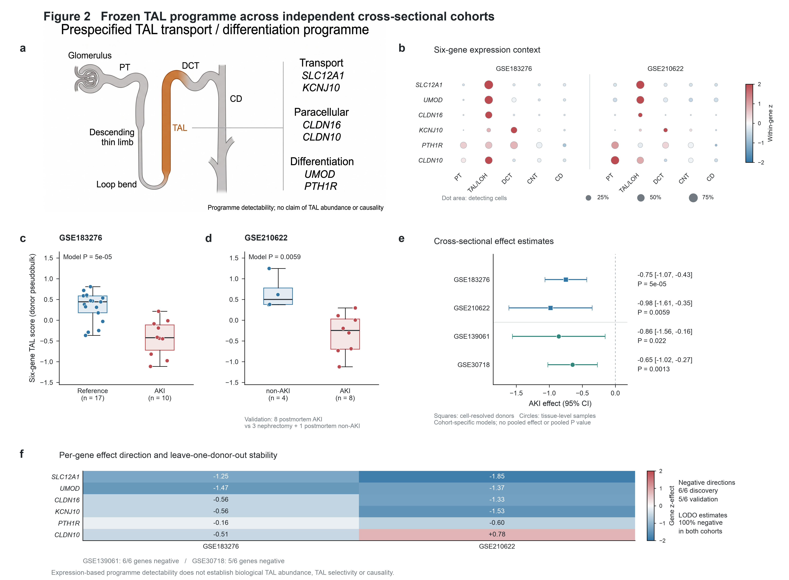
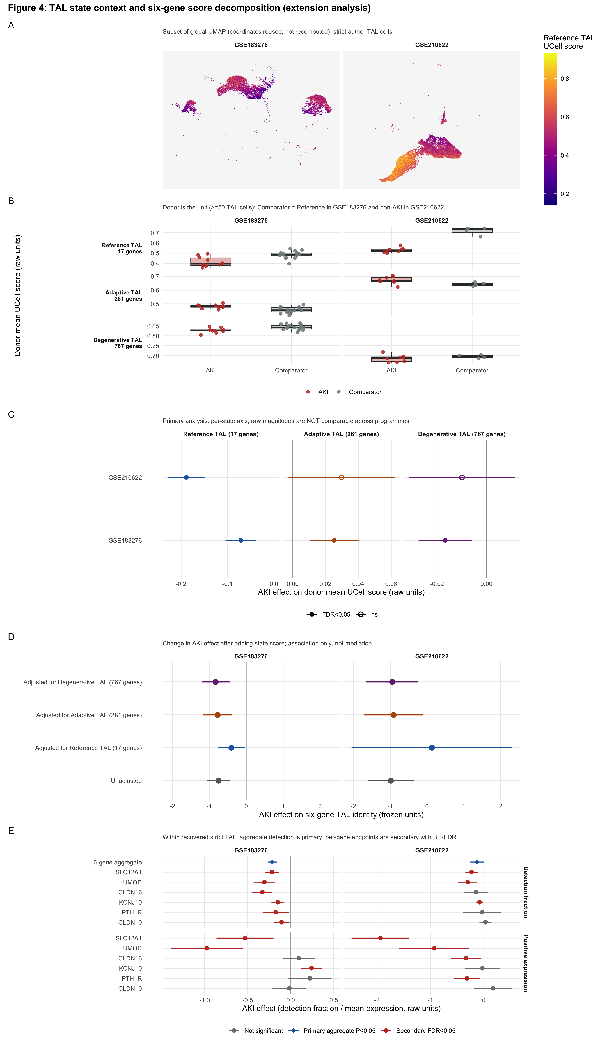
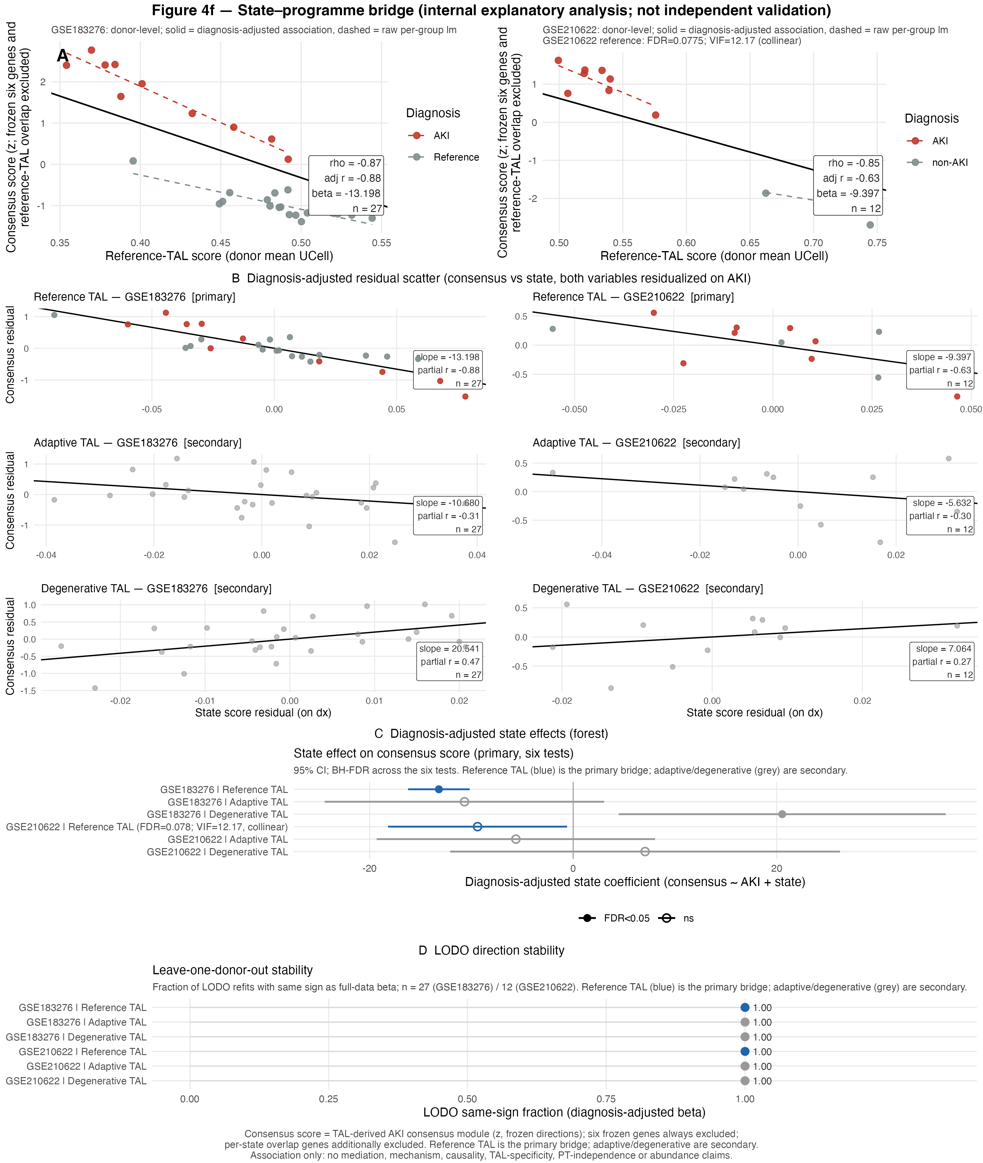
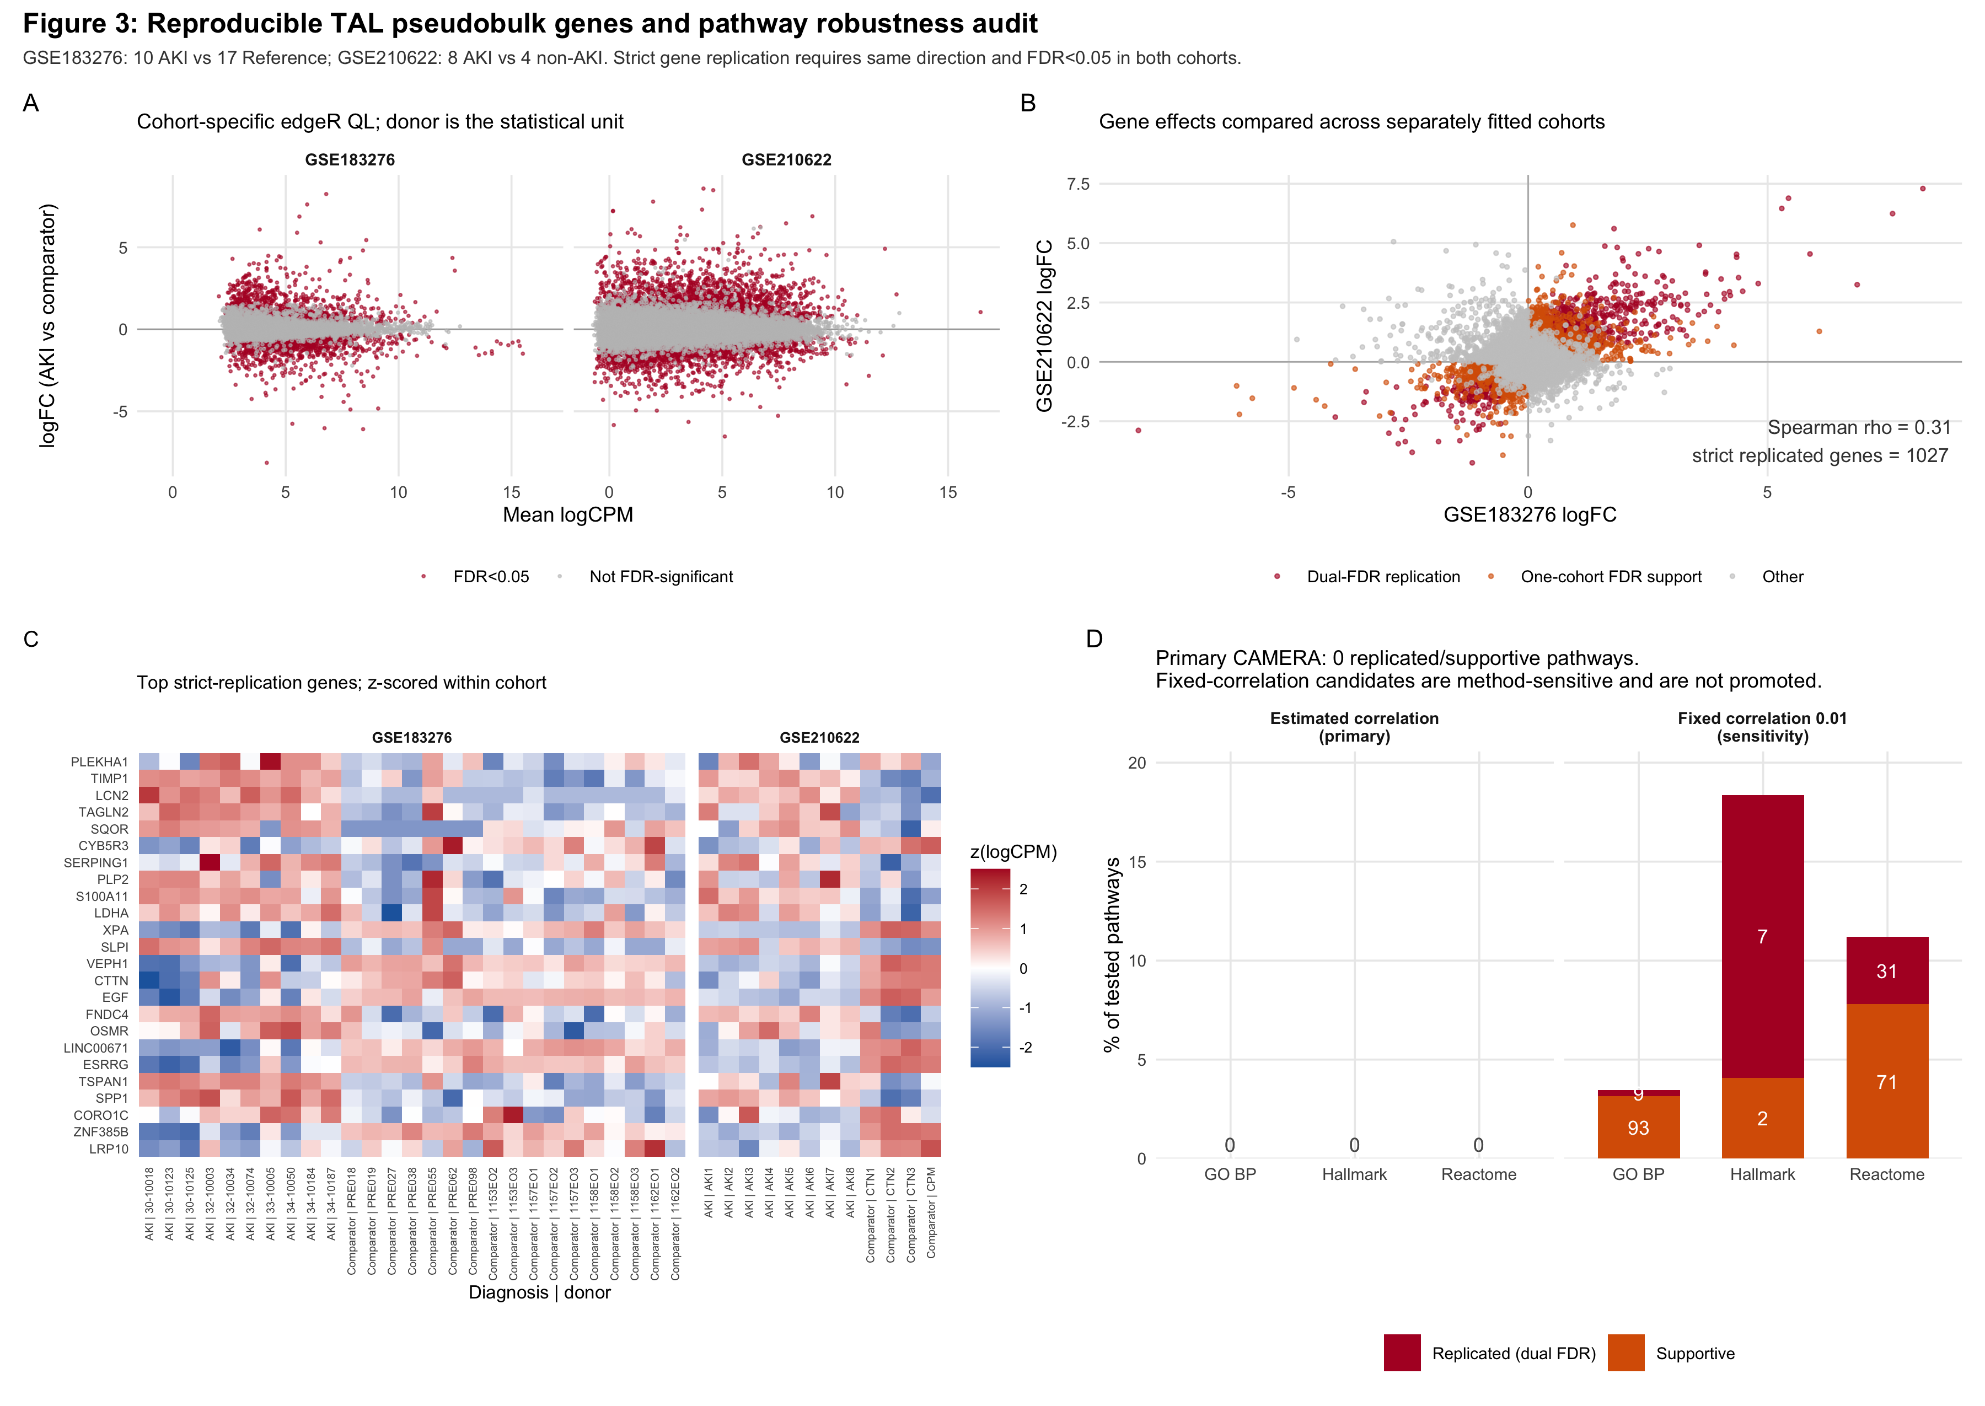
Cross-cohort transcriptomics identifies reproducible thick ascending limb
programme remodelling in human acute kidney injury
[AUTHOR(S)] · [AFFILIATION(S)]
Five human cohorts · donor/sample/paired allograft as the statistical unit
INTRODUCTION
METHODS
OBJECTIVE
Human AKI involves broad tubular transcriptional remodelling, but the reproducibility and context of TAL transport/differentiation changes across independent human cohorts remain uncertain.
Two cell-resolved cohorts were analysed by donor-level TAL pseudobulk; two tissue cohorts provided cross-platform support; 41 paired allografts tested acute reperfusion change. Cohorts were modelled separately with LODO/LOKO stability checks.
Test a prespecified six-gene TAL programme, extend the result to a reproducible gene-level response, and position that response within continuous TAL-state and broader tubular-remodelling contexts.
RESULTS
1. Cell-resolved atlases recover donor-supported TAL populations
4. The signed 1,027-gene response validates in three tissue cohorts
7. TAL remodelling occurs within coordinated tubular identity change
8. Paired allografts provide longitudinal reperfusion support
Atlas panels are descriptive; formal analyses use strict author-annotated TAL cells/nuclei.
All three primary external tests are Holm-significant; support persists after removing frozen genes.
TAL identity covaries with PT and other tubular identity programmes across donors.
The frozen programme decreases after reperfusion across 41 paired kidney allografts.
2. The frozen six-gene TAL programme is lower across cohorts
3. Donor-pseudobulk extends the signal to genes, not a shared pathway
5. Continuous TAL-state scoring defines the explanatory context
6. The TAL-derived response associates with lower reference-TAL context
The primary score is lower in both cell-resolved cohorts and concordant in tissue datasets.
1,027 genes pass same-direction dual-FDR; primary CAMERA yields no replicated pathway.
Reference-TAL scores and aggregate six-gene detection are lower in both cell-resolved cohorts.
Strong GSE183276 association with directionally concordant but collinear GSE210622 support.
PRIMARY EVIDENCE RECEIPT
DISCUSSION
CONCLUSION
INTERPRETATION AND NEXT STEP
GSE183276
β −0.751 · P=5×10⁻⁵ · 27/27 LODO negative
The evidence supports a reproducible TAL transport/differentiation programme decrease across cell-resolved, tissue-level and paired longitudinal settings. The 1,027-gene response is externally detectable, while the absence of a robust shared pathway argues against assigning a single mechanism from transcriptomics alone. Continuous reference-TAL scoring connects the frozen endpoint with broader TAL-derived remodelling.
A prespecified TAL programme is reproducibly less detectable in human AKI and lies within a broader, externally supported tubular remodelling response. These results provide a focused foundation for targeted spatial or experimental validation.
Interpretation: programme remodelling, not proof of TAL-selective injury, PT independence, cell-intrinsic change or causality. Adaptive/degenerative state activation and a shared pathway mechanism did not replicate. Next step: targeted spatial localisation or experimental perturbation of the frozen programme and consensus response.
GSE210622
β −0.983 · P=0.0059 · 12/12 LODO negative
GSE139061
β −0.858 · P=0.022
GSE30718
β −0.649 · P=0.0013
GSE126805
Δ −0.223 · P=0.0323 · 41/41 LOKO negative
All five cohorts were analysed separately; cells were never treated as independent patient replicates.
TAKE-HOME
Five separately analysed cohorts converge on lower TAL programme detectability in human AKI, with gene-level, state-context and paired longitudinal support.
Five-cohort evidence freeze · manuscript v4.3
All original figures shown in full; no image crops.
Notes:
[Sources]
- Source poster: /Users/yige/Desktop/Undergraduate/ZJU Summer Rearch/Codex_env/projects/AKI_TAL_severity_analysis/poster/AKI_TAL_IMRAD_poster.pptx
- Manuscript: /Users/yige/Desktop/Undergraduate/ZJU Summer Rearch/Codex_env/projects/AKI_TAL_severity_analysis/manuscript/manuscript_v4.md
- Evidence map: /Users/yige/Desktop/Undergraduate/ZJU Summer Rearch/Codex_env/projects/AKI_TAL_severity_analysis/manuscript/evidence_map.md
- Figure assets: /Users/yige/Desktop/Undergraduate/ZJU Summer Rearch/Codex_env/projects/AKI_TAL_severity_analysis/figures/extension/
- Public cohorts: GEO GSE183276, GSE210622, GSE139061, GSE30718, GSE126805
[/Sources]

