Slide 1
AMD RADEON HACKATHON 2026
TRACK 3 — PHYSICAL AI CHALLENGE
Franka Multi-Fruit Sorting
via SmolVLA on AMD ROCm
100%
Closed-Loop Evaluation
Success Rate (2/2 episodes)
Team: ROCm Robotics | Developer: yigenfeng0707-netizen
Platform: AMD ROCm 7.2.1 + PyTorch 2.9.1+rocm7.2.1 + Radeon Pro W7900 (48GB)

Slide 2
Application Scenario & Real-World Value
Task
3
3
A Franka 9-DOF robotic arm sorts 3 fruits (plum, banana, lemon) into color-matched bowls in the Genesis physics simulator.
Fruit Categories
Color-Matched Bowls
Input
Dual RGB cameras (world + wrist) at 224x224 + 9-D proprioceptive state + language task string
9-DOF
224x224
Franka Arm Control
Dual Camera RGB
Output
9-DOF joint position targets — fully autonomous, no hand-engineered perception or planning in the loop
Success Criterion: target fruit center of mass within 6cm of target bowl center
Real-World Industry Value
Logistics Sorting
E-commerce grocery warehouses sorting mixed produce at scale
Food Processing
Classifying produce by variety and maturity grade before packaging
Agriculture 4.0
Autonomous post-harvest handling from orchard to binning

Slide 3
End-to-End AMD ROCm Pipeline
All 5 stages run on a single AMD Radeon Pro W7900 — no CPU offload, no CUDA dependency
1
2
3
4
5
Genesis Physics Sim
Scripted Data Collect
LeRobot Dataset
SmolVLA Fine-tune
Closed-loop Eval
gs.init(backend=gs.gpu)
Franka 9-DOF + dual cams
3 fruits + 3 bowls
Pick-and-place policy
LeRobotDataset writer
Success-only episodes
local/sort_fruit
world+wrist RGB (224x224)
9-D state + 7-D action
AdamW, bs=4
2000 steps, 5 min
final loss 0.073
Fresh Genesis scene
Policy autonomous
100% success
AMD ROCm 7.2.1 | PyTorch 2.9.1+rocm7.2.1 | Radeon Pro W7900 (48GB) | Genesis 1.2.3 | LeRobot 0.6.0 | SmolVLA (Apache-2.0)
Key Design Decisions
• SmolVLA over OpenVLA — smaller footprint, faster inference, Apache-2.0
• Genesis over MuJoCo — GPU-accelerated sim, Pythonic API, LeRobot integration
• Dual-camera config — world (global) + wrist (egocentric) viewpoints

Slide 4
Six Engineering Contributions to ROCm
Non-obvious engineering problems solved to make the SmolVLA + Genesis + LeRobot stack run end-to-end on AMD ROCm
1
DOF Separation Control
2
cam.render() List Handling
3
Local Dataset Loading
Separate control_dofs_position calls for 7 arm motors vs 2 fingers prevents misaligned targets and grasp failures.
Genesis returns a Python list not tuple. Use [0] indexing + np.asarray() to recover RGB image safely.
Omit --dataset.root entirely to avoid HF Hub 401 errors for local datasets. Default path resolution works.
4
rename_map Persistence
5
predict_action Helper
6
MPLBACKEND=Agg
Persist camera key mapping (world->camera1, wrist->camera2) to checkpoint config for eval-time validation.
Delegate to LeRobot's predict_action to convert uint8 to float32 before resize, sidestepping ROCm's missing uint8 bilinear kernel.
Set MPLBACKEND=Agg for headless rendering on remote GPU instances with no display server.

Slide 5
Key Results & Performance
100%
Closed-Loop Success Rate
5 min
Training Time
2/2 episodes autonomous
2000 steps on W7900
0.073
Final Training Loss
6.7
Steps per Second
AdamW, bs=4, lr=1e-4
Steady-state throughput
~85% GPU Utilization | ~18 GB VRAM (of 48 GB) | ~80 ms Per-Step Inference | ROCm: 5 min vs CUDA: ~7 min
Evaluation Detail
Fruit | Target Bowl | Result | Steps
018_plum | 024_bowl_purple | SUCCESS | 308
011_banana | 024_bowl_yellow | SUCCESS | 221

Slide 6
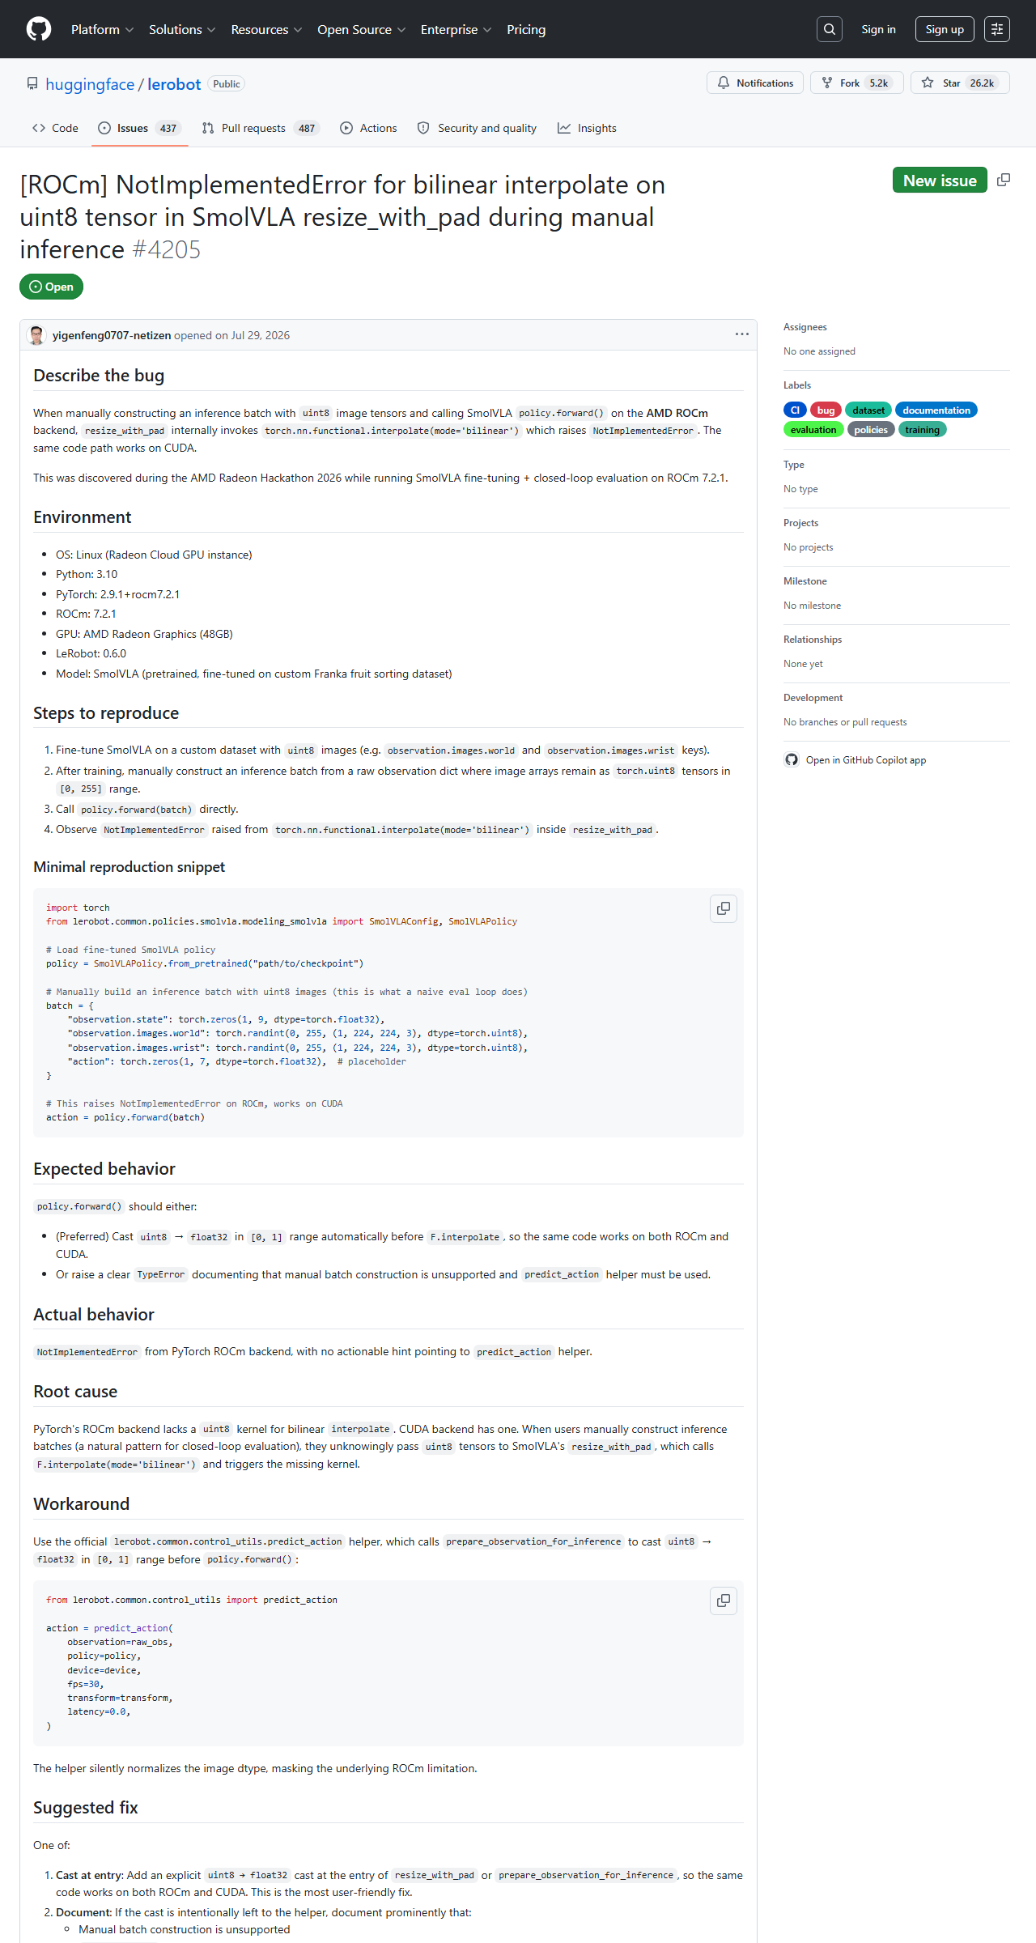
Upstream Open-Source Contribution
Repository
huggingface/lerobot
Issue #4205
[ROCm] NotImplementedError for bilinear interpolate on uint8 tensor in SmolVLA resize_with_pad during manual inference
Direction
Improves AMD ROCm platform support — the missing uint8 bilinear-interpolation kernel in PyTorch ROCm backend
Status: OPEN | Submitted: 2026-07-29
URL: github.com/huggingface/lerobot/issues/4205
Impact: Documents a genuine ROCm platform gap with minimal reproduction. References related LeRobot issues #2210, #2218. Directly contributes to the 10-point Upstream Open-Source Community Contributions dimension.

Slide 7
Why This Project Stands Out
Strong across all 5 evaluation dimensions (100 points total)
30 pts
Robot Capability
100% autonomous closed-loop success. No scripted perception or planning in the inference loop — policy acts purely from RGB pixels.
20 pts
AMD GPU & ROCm Adoption
Entire pipeline (sim, data, train, eval) on single W7900. No CPU offload, no CUDA dependency. End-to-end AMD GPU residency.
20 pts
Innovation
6 non-obvious engineering contributions solving real ROCm-specific issues. Each discovered during development, all documented in code.
20 pts
Application Value
Logistics sorting, food processing, Agriculture 4.0. High real-world relevance with reproducible blueprint for AMD-accelerated robotic sorting.
10 pts
Upstream Contribution
Issue #4205 to huggingface/lerobot, improving AMD ROCm platform support. Open-source contribution beyond the competition artifact.

Slide 8
Thank You
Reproducibility & Verification Links
Pull Request
github.com/AMD-DEV-CONTEST/Radeon-hackathon-2026-07/pull/45
Fork Repository
github.com/yigenfeng0707-netizen/Radeon-hackathon-2026-07
Upstream Issue
github.com/huggingface/lerobot/issues/4205
Team: ROCm Robotics | Developer: yigenfeng0707-netizen | PR #45

