Slide 1
Sprint #1:
LoveCoding OJ
Team #43:
Yige Wang, Yichi Liu, Xinyue Chen

Slide 2
Outline
Vision
Design
Approach
Progress
Plan
References

Slide 3
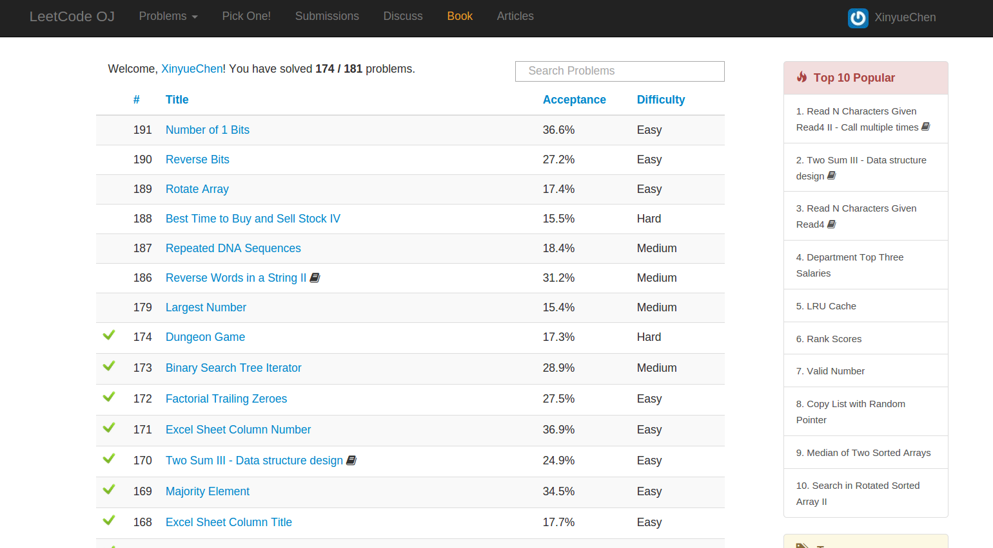
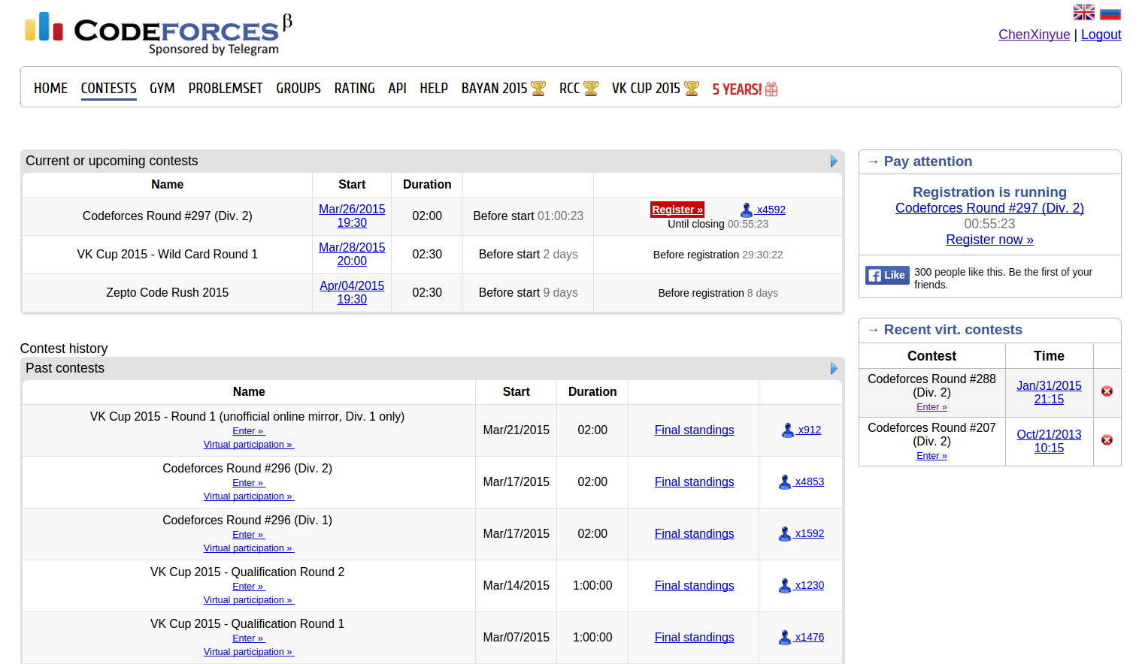
Vision
An online judging platform
Algorithm problems
Algorithm competitions

Slide 4
Design
Account Management
Login, register, profile
Ranking, history
Problem Management
Upload and display
Rich feature code editor
Sandbox evaluation
Competition Management

Slide 5
Approach
Web framework: Django
Cloud Deployment: AWS
Code editor: CodeMirror
Sandbox: pysandbox

Slide 6
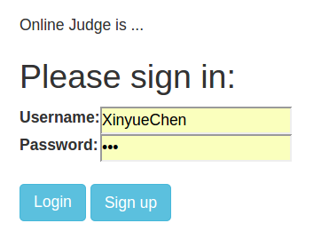
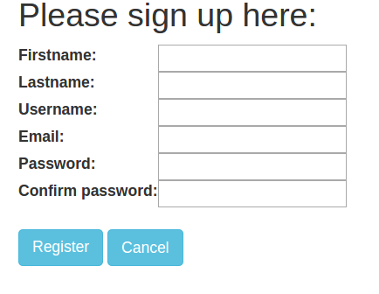
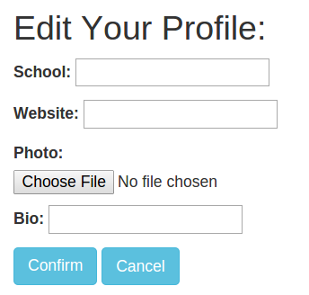
Progress
Account Management

Slide 7
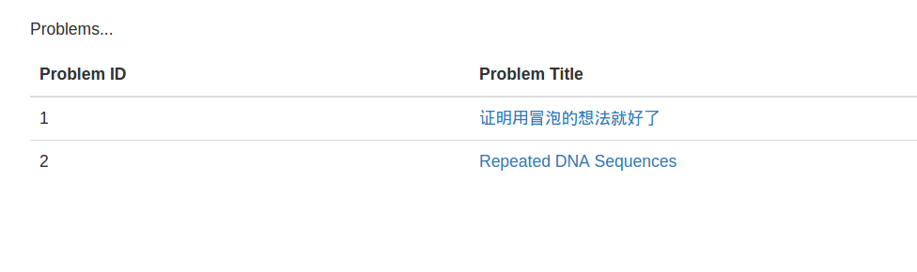
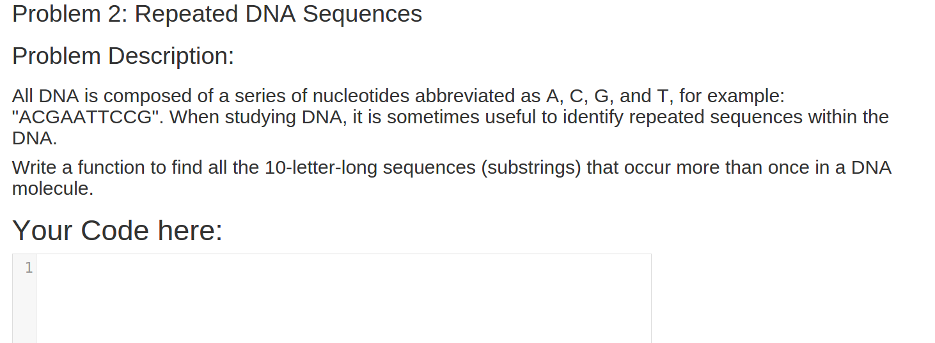
Progress
Problem Management

Slide 8
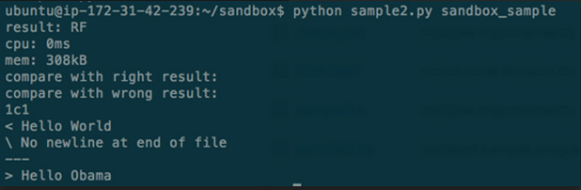
Progress
pysandbox

Slide 9
Plan
Sprint #2
All basic features
problem evaluation
competition
discussion
Final
UI improvement
Concurrency concern

Slide 10
References
Django: https://www.djangoproject.com/
Bootstrap: http://getbootstrap.com/
CodeMirror: https://codemirror.net/
Pysandbox: https://github.com/openjudge/sandbox

