Slide 1
LoveCoding OJ
Sprint # 2
Team # 43: Xinyue Chen, Yichi Liu, Yige Wang

Slide 2
Agenda
About LoveCoding
Progress
Demo
Next Steps

Slide 3
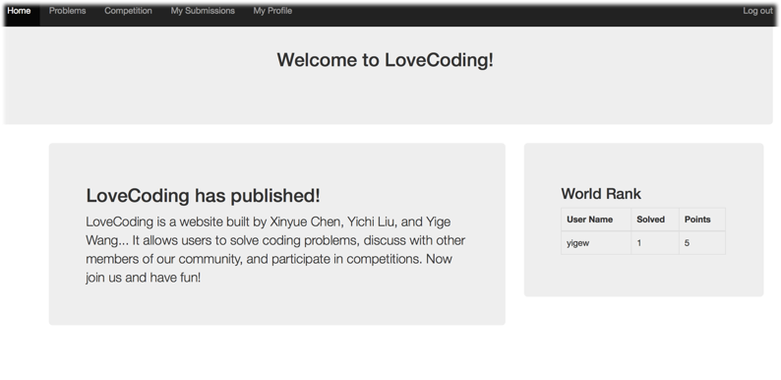
About LoveCoding

Slide 4
Progress
Sprint #1
Sprint #2
Problem Management Optimization
Problem Evaluation
Homepage
Competition Prototype
Discussion
UI Improvement
Data Model Design
HTML WireFrames Design
Code Editor
User Log & Register
User Profile Display & Edition
Problem Upload & Display

Slide 5
Problem Management
Merge Code-Mirror
Submission Management
Problem Evaluation
Celery: Asynchronous Task Queue
Lo-runner: Sandbox

Slide 6
Homepage
Competition Prototype
Discussion
UI Improvement

Slide 7
Demo

Slide 8

Next Steps
Competition Optimization
Cloud Deployment
Robustness
Concurrency Concern
UI Improvement

Slide 9
Questions?

