Slide 1
Objectives
Classification - Transfer Learning
Generative Model – Experiment with Autoencoders

Slide 2
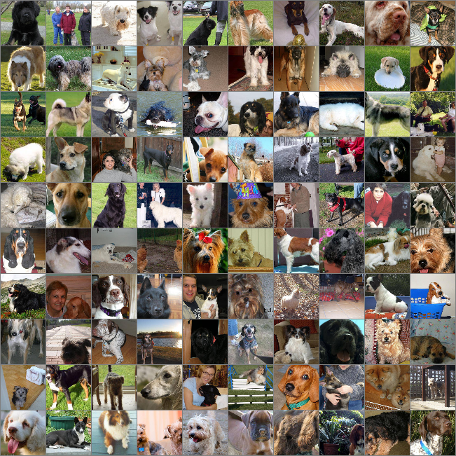
Image Data Set
Dog breed classes: 120
Training Image numbers: 327,000
Test Image numbers: 10,157
Cropped Image Dimensions: 299 x 299 x 3

Slide 3

1. Classification
Evaluation Metric: Multi Class Log Loss
Model: Inception v3
  Pre-trained on ImageNet for 1000 different categories
  Smallest out of the pre-trained models at 96 MB
  Batch normalisation – Normalises activations at each layer, which reduces sensitivity to changes of weights in the network
  RELU activation functions – Eliminates vanishing gradient problem, and is computationally efficient

Slide 4
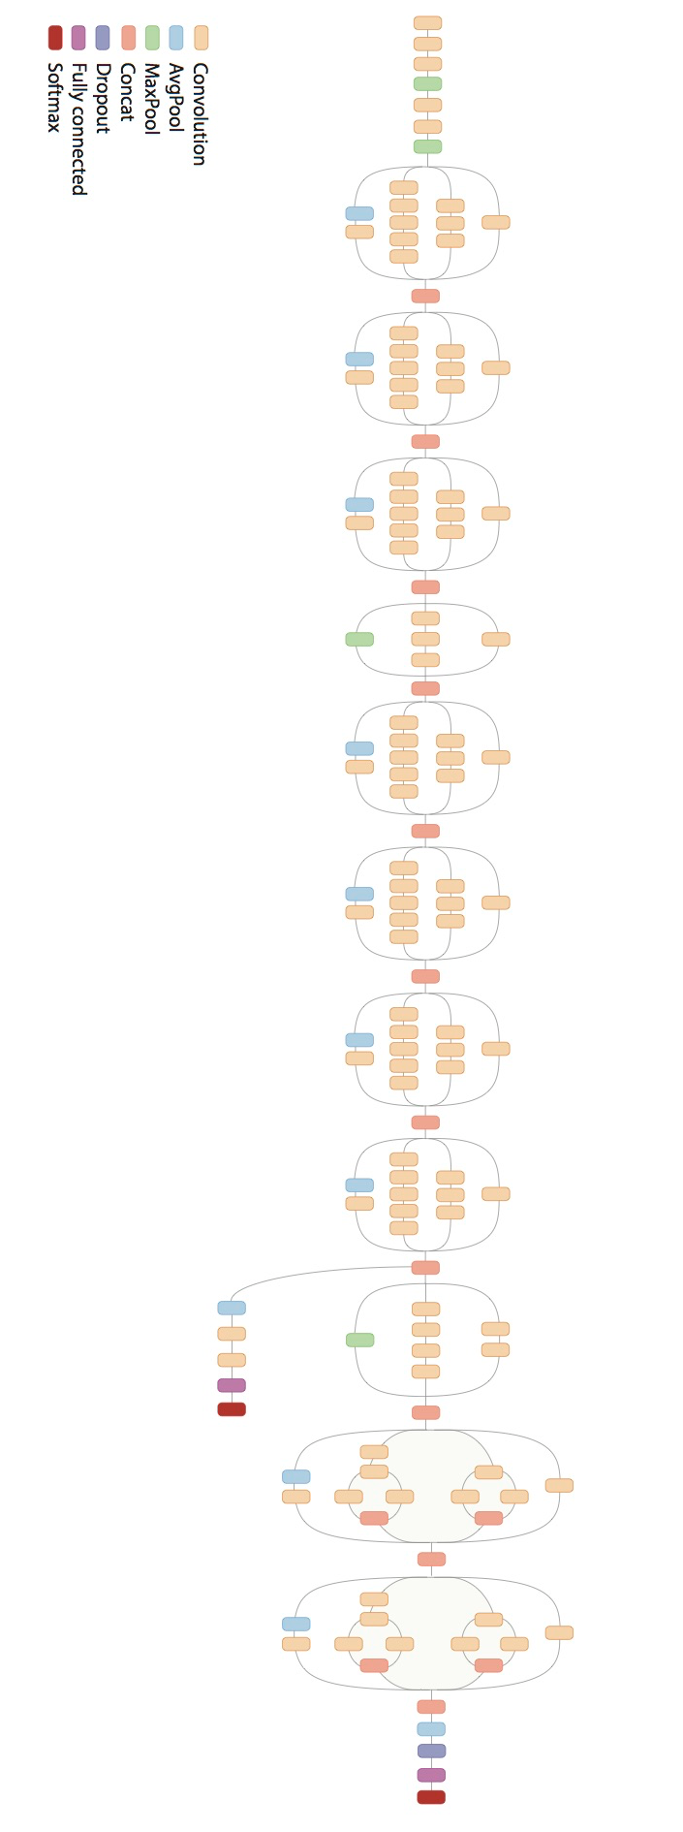
1. Classification
Model Architecture: Transfer Learning
Input to final Layer: [None, 2048]
Weights: [2048 x 120]
Softmax Layer: [120]
Cost function: softmax_cross_entropy_with_logits
Optimizer: Gradient Descent
layer_3
FC-2048
softmax-120
output

Slide 5
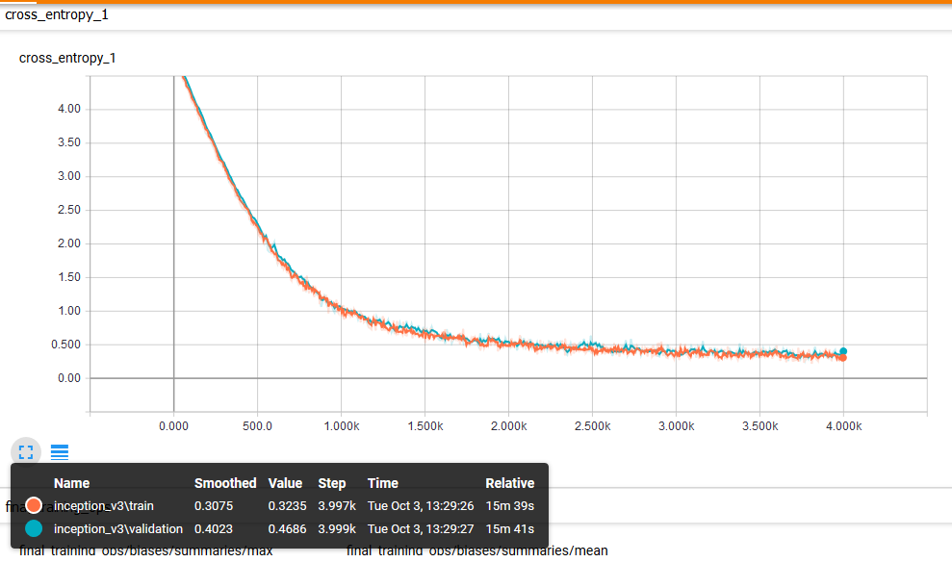
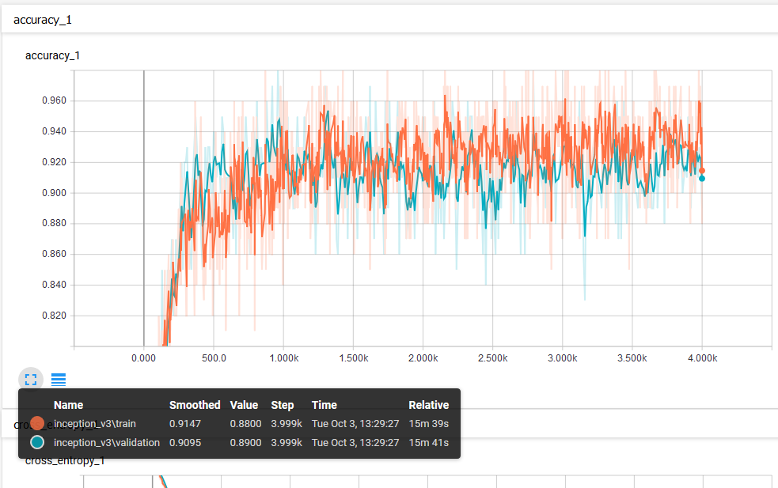
1. Classification
Results
Training/Validation Set Loss: 0.34, 0.47
Training/Validation Set Accuracy: 0.91, 0.9
Kaggle Submission Log Loss: 0.58
Improvements
Image augmentation – Generalises model and reduces overfitting
Experiment with Inception v5, VGGNet
Use deeper fully connected layers

Slide 6
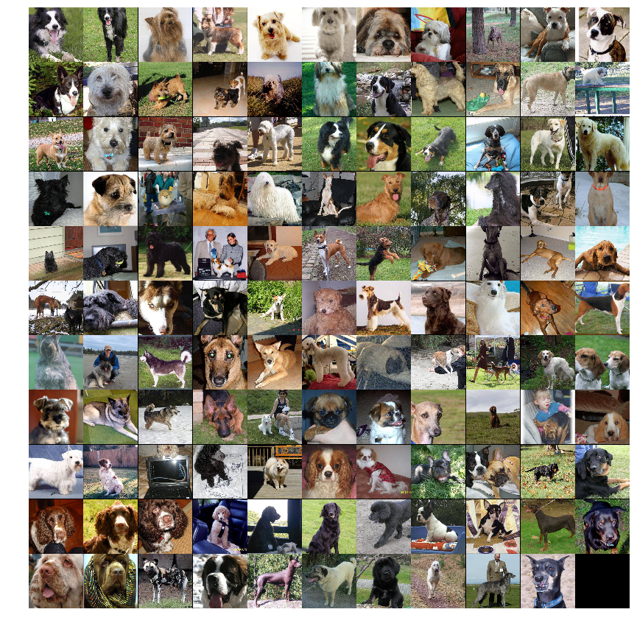
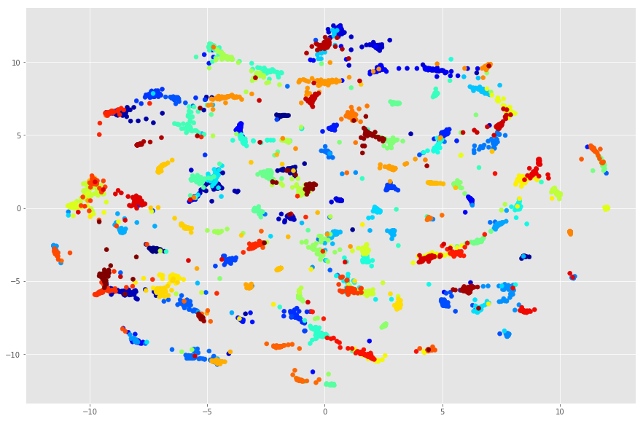
1. Classification
Clustering – Latent Manifold
t-SNE: preserve the local distances of the high-dimensional data in some mapping to low-dimensional data
Grid view of clustering

Slide 7
2. Generative Model
Objectives
Experiment with Variational Encoders effectiveness
Explore Style Transfer

Slide 8
2. Generative Model
Generative Models - Given training data, generate new samples from same distribution. A form of unsupervised learning.
Why Generative Models?
Data created by Generative Models can be used for simulation and planning (Reinforcement Learning)
Enable inference of latent representations that can be useful as general features

Slide 9
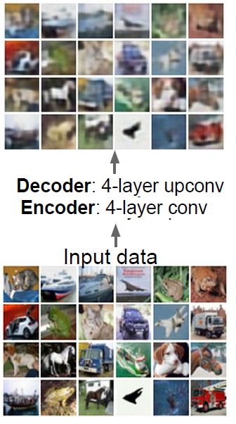
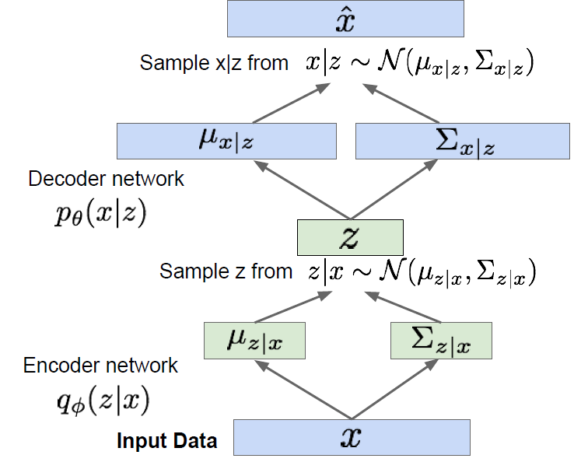
2. Generative Model
Variational Autoencoders
Input data x, reduced to latent variables z by the Encoder, and reconstructed to x-hat by the Decoder.
Train model such that features can be used to reconstruct original data
Generate latent vectors (z) that roughly follow a Unit Gaussian Distribution
The objective is to optimise :
  Generative Loss - mean squared error that measures how accurately the network reconstructed the images
  Latent Loss - KL divergence that measures how close the latent variables match a Unit Gaussian Distribution
Maximise likelihood of original input being reconstructed
Further information of Variational Encoders http://kvfrans.com/variational-autoencoders-explained/

Slide 10
2. Generative Model
Autoencoder Configuration
Experiment with Variational Encoders effectiveness
https://github.com/yigher/machine_learning/raw/master/python/generative_models/autoencoder_dog/montage_dog.gif
Explore Style Transfer
https://github.com/yigher/machine_learning/raw/master/python/generative_models/autoencoder_dog/montage_goyte.gif
Encoder | Decoder
Input: [None, 64, 64, 3] | Convolutional Layer 1: [None, 16, 16, 128]
Convolutional Layer 1 : [None, 32, 32, 64] | Convolutional Layer 2: [None, 32, 32, 64]
Convolutional Layer 2 : [None, 16, 16, 128] | Convolutional Layer 3: [None, 64, 64, 3]
Convolutional Layer 3 : [None, 8, 8, 256] | Convolutional filter sizes: [5, 3, 3]
Convolutional filter sizes: [5, 3, 3]
Variational Layer: [None, 8, 8, 256]
Fully Connected Layer: 256
Latent Samples: 128

