Slide 1
VERT.X
Yiguang Hu

Slide 2
What is it?
Simple/lightweight
Scalable
Asynchronous
Concurrent
PolyGlot

Slide 3
Simple
A groovy server example:
vertx.createHttpServer().requestHandler { req ->
req.response.end "<html><body><h1>Hello from vert.x!</h1></body></html>"
}.listen(8080, "localhost")
Notes:
Explain the code:
Request handler handle request event
Asynchronous
The handler accept request and response
Response is on request
server list port on server

Slide 4
Demo create a simple server that dispays a static html page
vertx run http/Servertxt.groovy

Slide 5
PolyGlot
Java
groovy
Ruby
Scala
JavaScript
kotlin

Slide 6
Scalable
Linear horizontal scale
Message passing
Automatic load-balancing
Efficiently utilizes server cores

Slide 7
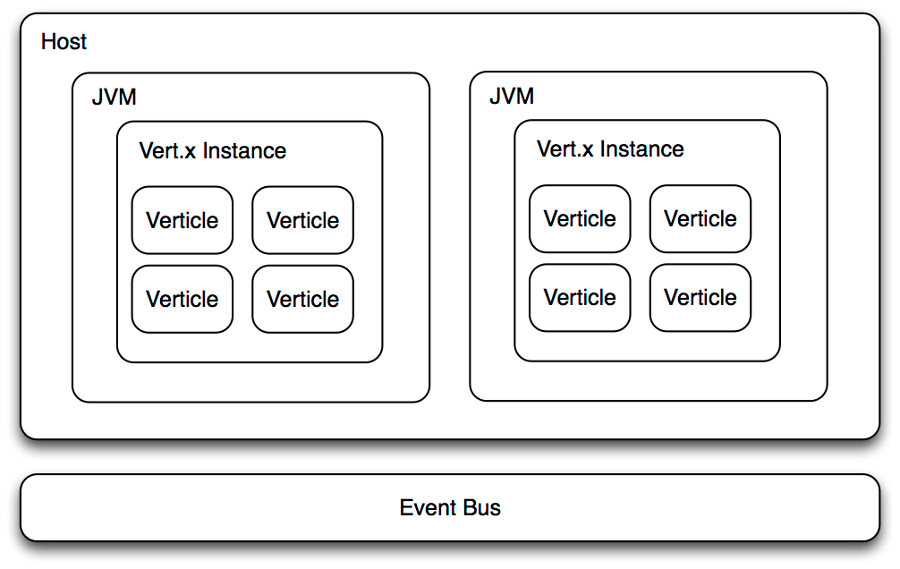
Vert.x Architecture

Slide 8
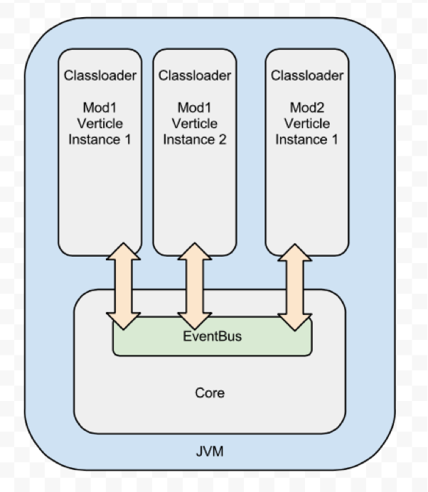
Event Bus
Verticle
Verticle

Slide 9
Scaling
Instances: -instance 10
Clustering: -cluster

Slide 10
Demo 1 (Groovy version)
groovy version
vertx.createHttpServer().requestHandler { req ->
req.response.end "<html><body><h1>Hello from vert.x!</h1></body></html>"
}.listen(8080, “localhost")

Slide 11
Demo 2 (JavaScript version)
vertx.createHttpServer().requestHandler(function(req) {
req.response.end("<html><body><h1>Hello from vert.x!</h1></body></html>");
}).listen(8080);

Slide 12
Demo 3 (Chat Server)

Slide 13
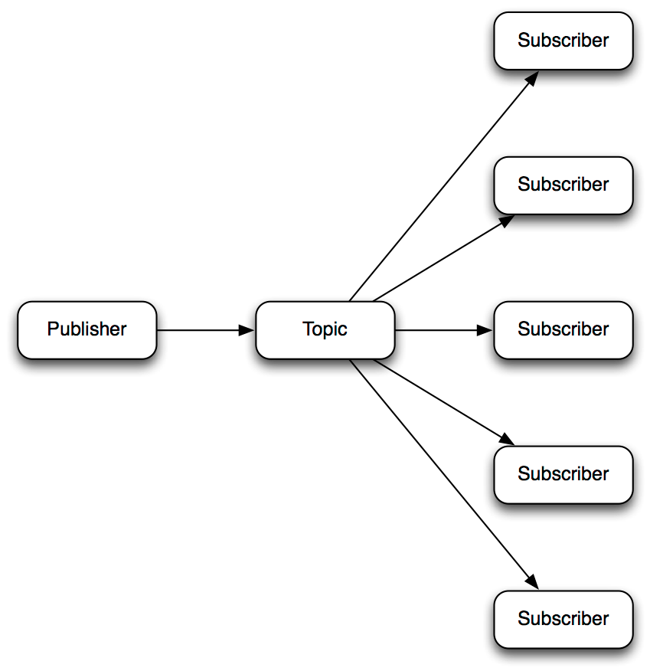
Publish/subscribe messaging

Slide 14
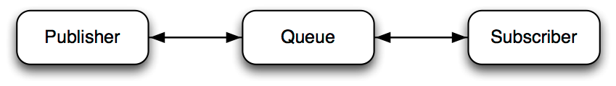
P-to-P

Slide 15
Sender
def eb = vertx.eventBus()
def i=0
vertx.setPeriodic(1000) {
eb.send("news-feed", "Some news! "+ i++)
}

Slide 16
receiver
vertx.eventBus().consumer("news-feed").handler({message ->
System.out.println("1 received message.body() = " + message.body());
});

