Slide 1
Comparative Analysis of A* and UCS Algorithms
Graph Theory Project

Slide 2
Introduction
• Comparison of A* (A-star) and UCS (Uniform Cost Search) algorithms
• Performance analysis on different graph sizes
• Impact of heuristic function
• Evaluation based on expanded nodes and execution time
• Visualization of A* paths for different graph sizes

Slide 3
Methodology
• Tested graph sizes:
- 7 different levels (from 5 to 35 vertices)
- 10 random graphs per level
• Measured metrics:
- Number of expanded nodes
- Algorithm execution time
- Improvement percentage
• Heuristic function: Minimum weighted distance
• Path visualization for sample graphs

Slide 4
Implementation Details
• Graph Structure:
- Adjacency list representation
- Weighted edges (range 1-20)
- Connected graph guarantee
• A* Algorithm:
- f(n) = g(n) + h(n)
- Admissible heuristic
• UCS Algorithm:
- Dijkstra-based implementation
- Using only g(n)

Slide 5
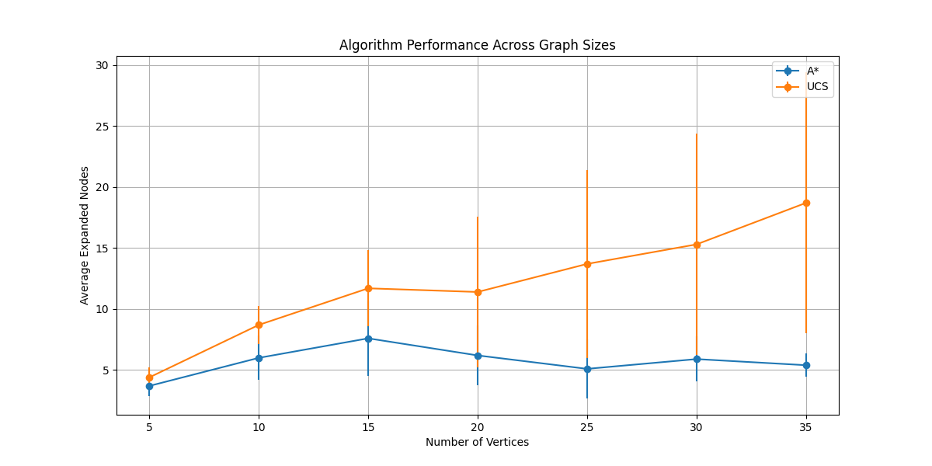
Overall Performance Comparison

Slide 6
A* Path Visualizations
• Sample optimal paths found by A* algorithm
• Different graph sizes demonstrate algorithm's adaptability
• Path colors indicate:
- Red: Start node
- Green: Goal node
- Blue: Optimal path
• Edge weights shown on connections

Slide 7
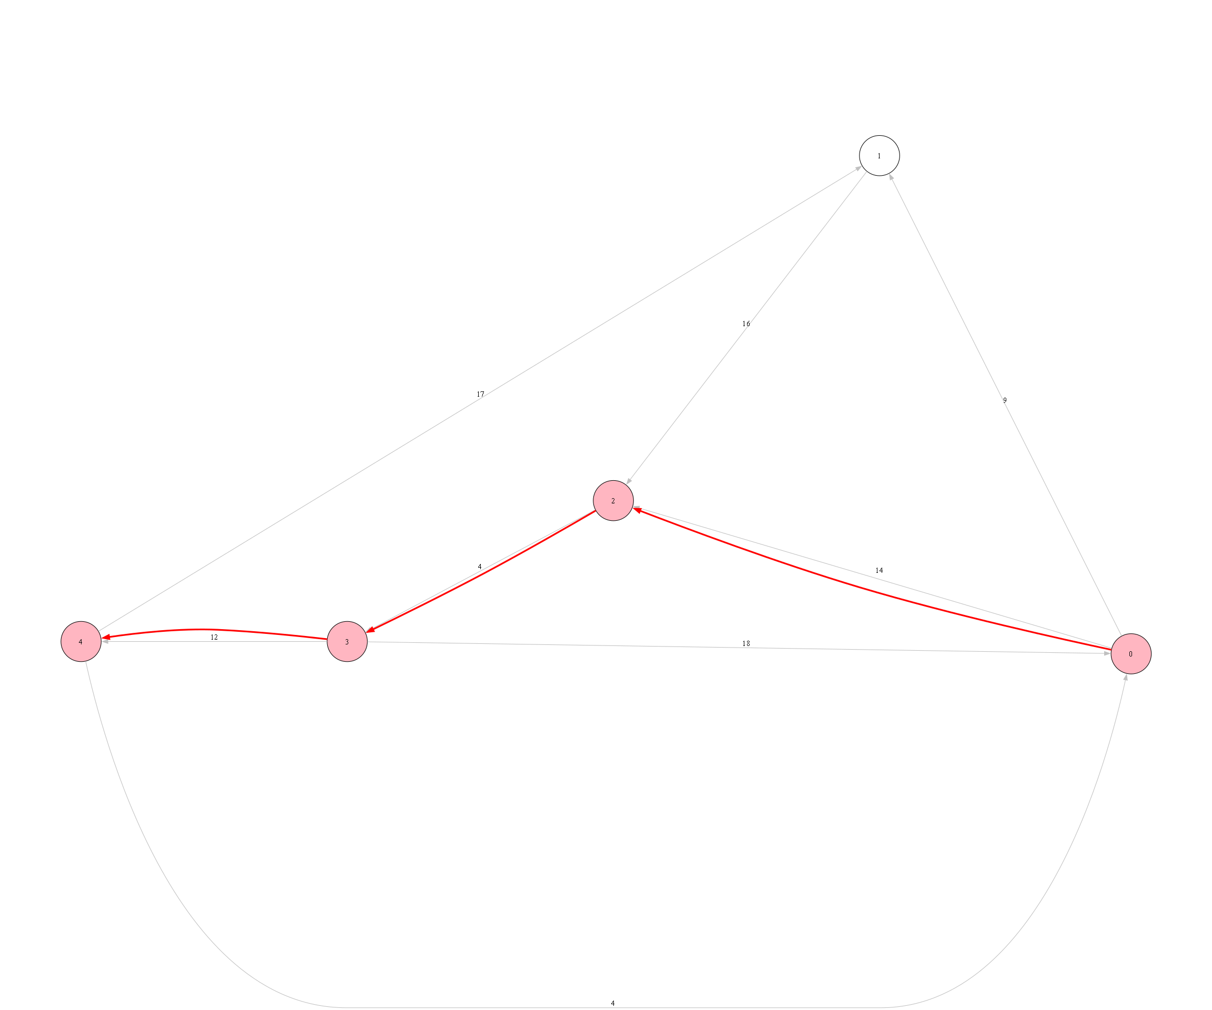
A* Path Visualization - Sample Graph

Slide 8
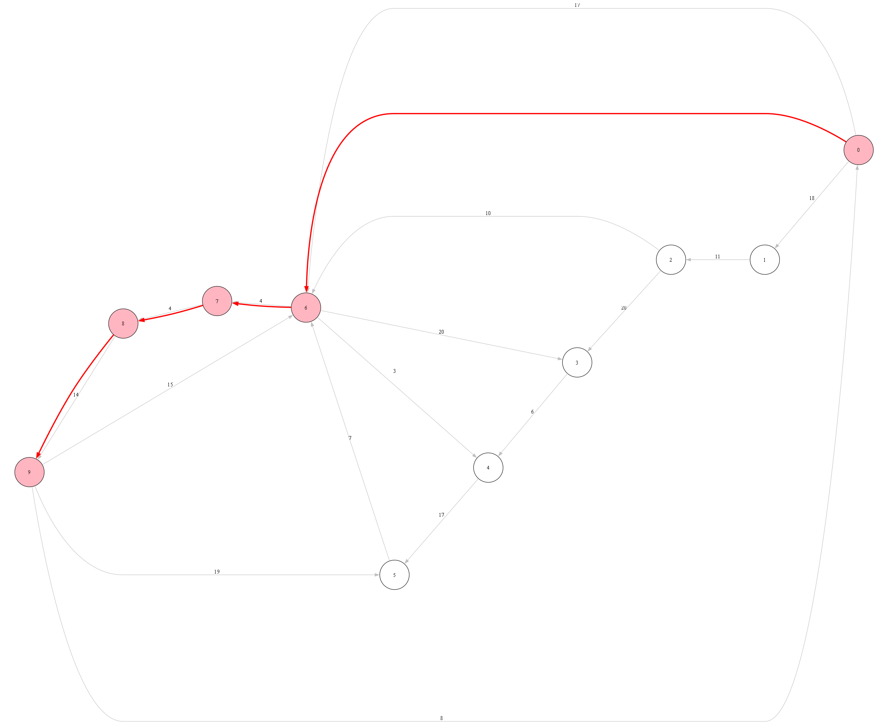
A* Path Visualization - Sample Graph

Slide 9
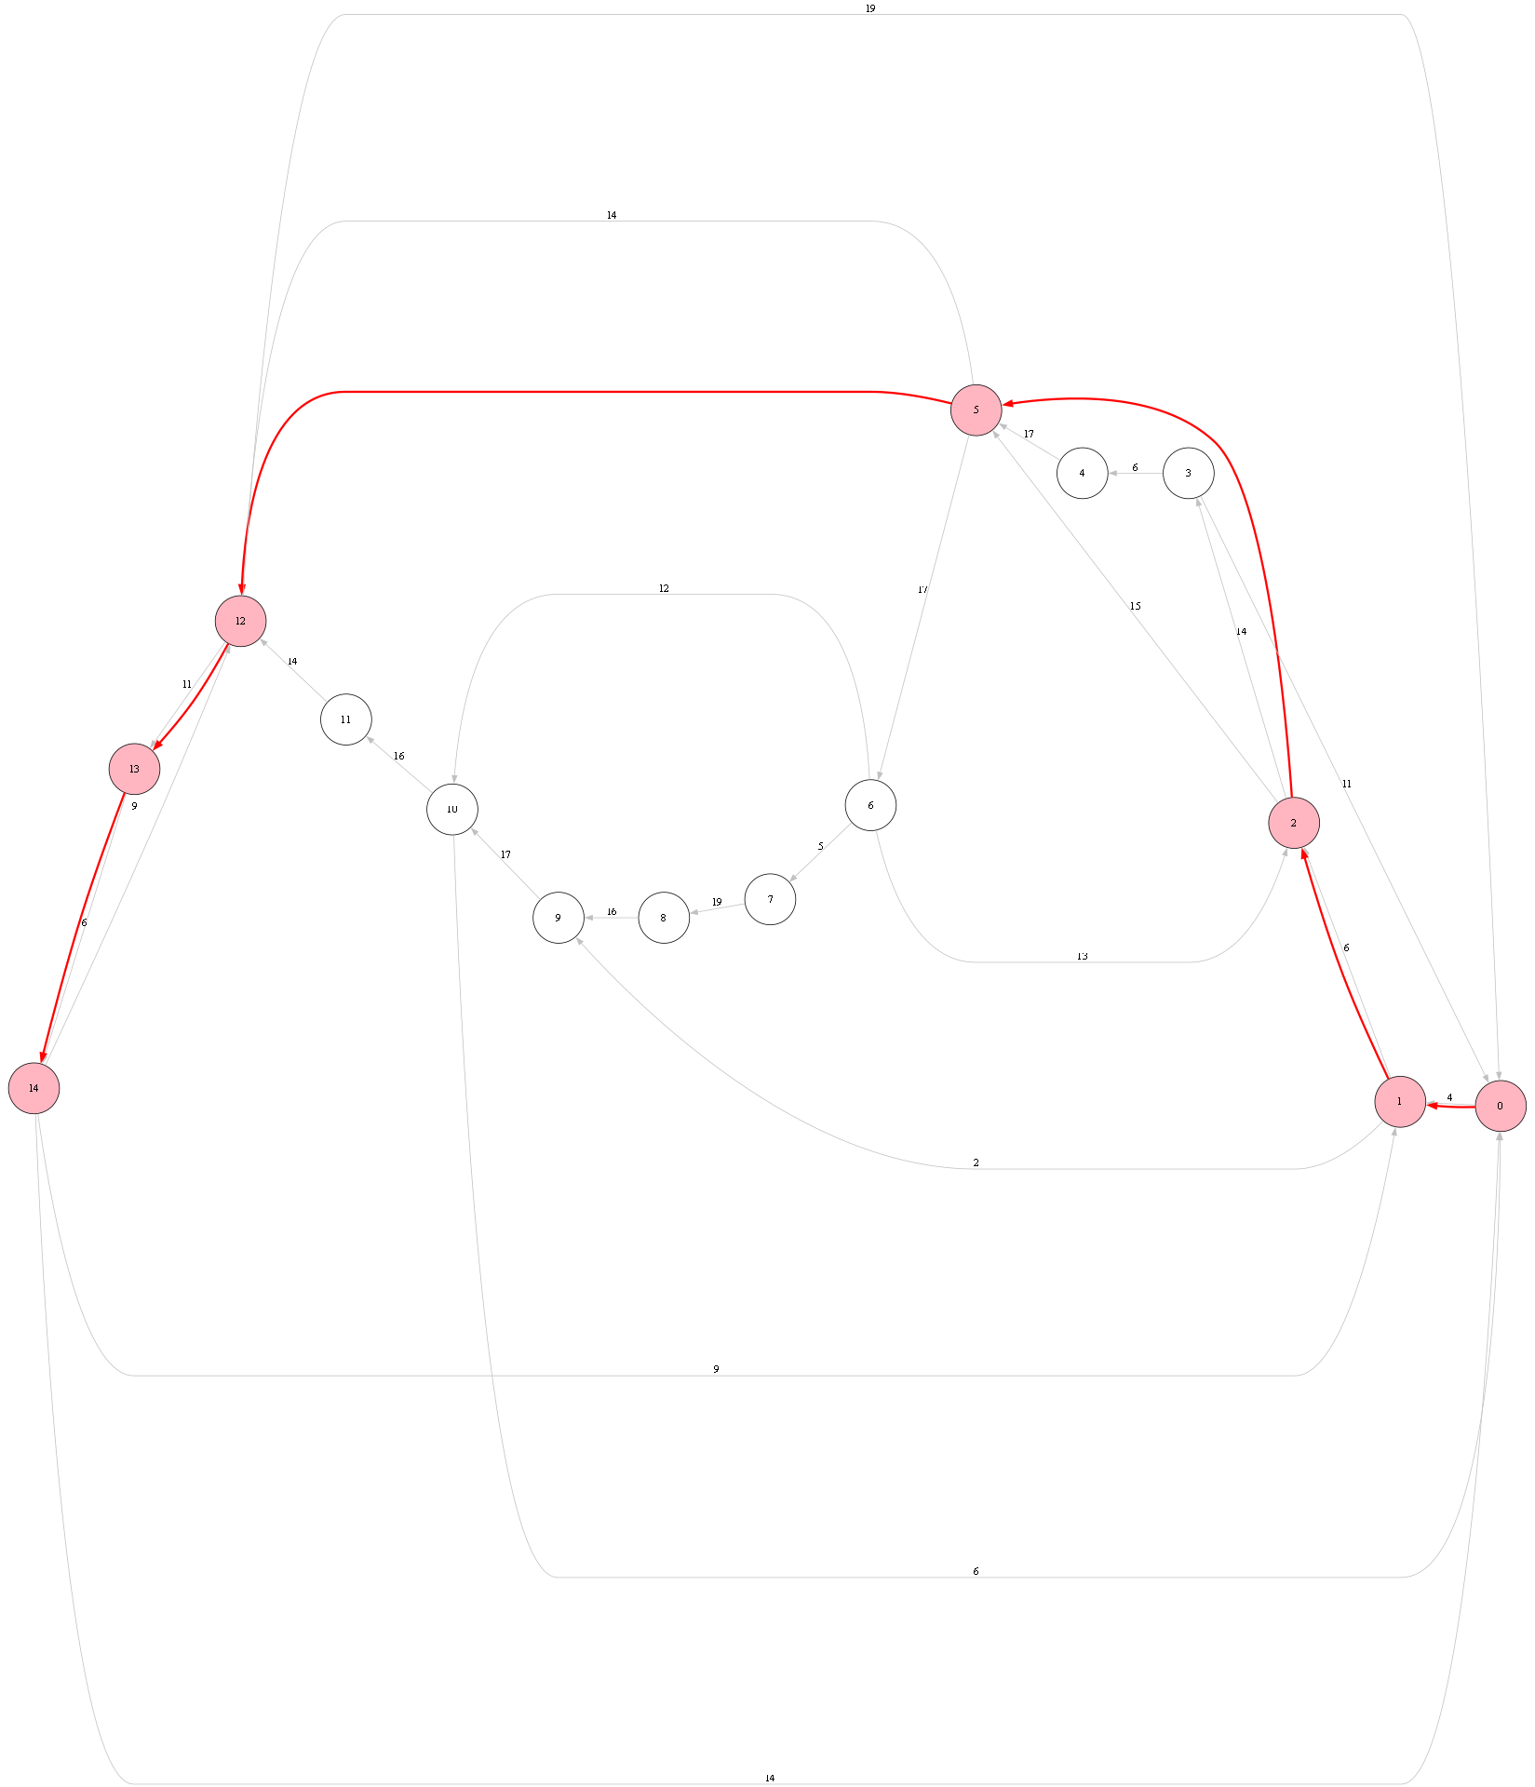
A* Path Visualization - Sample Graph

Slide 10
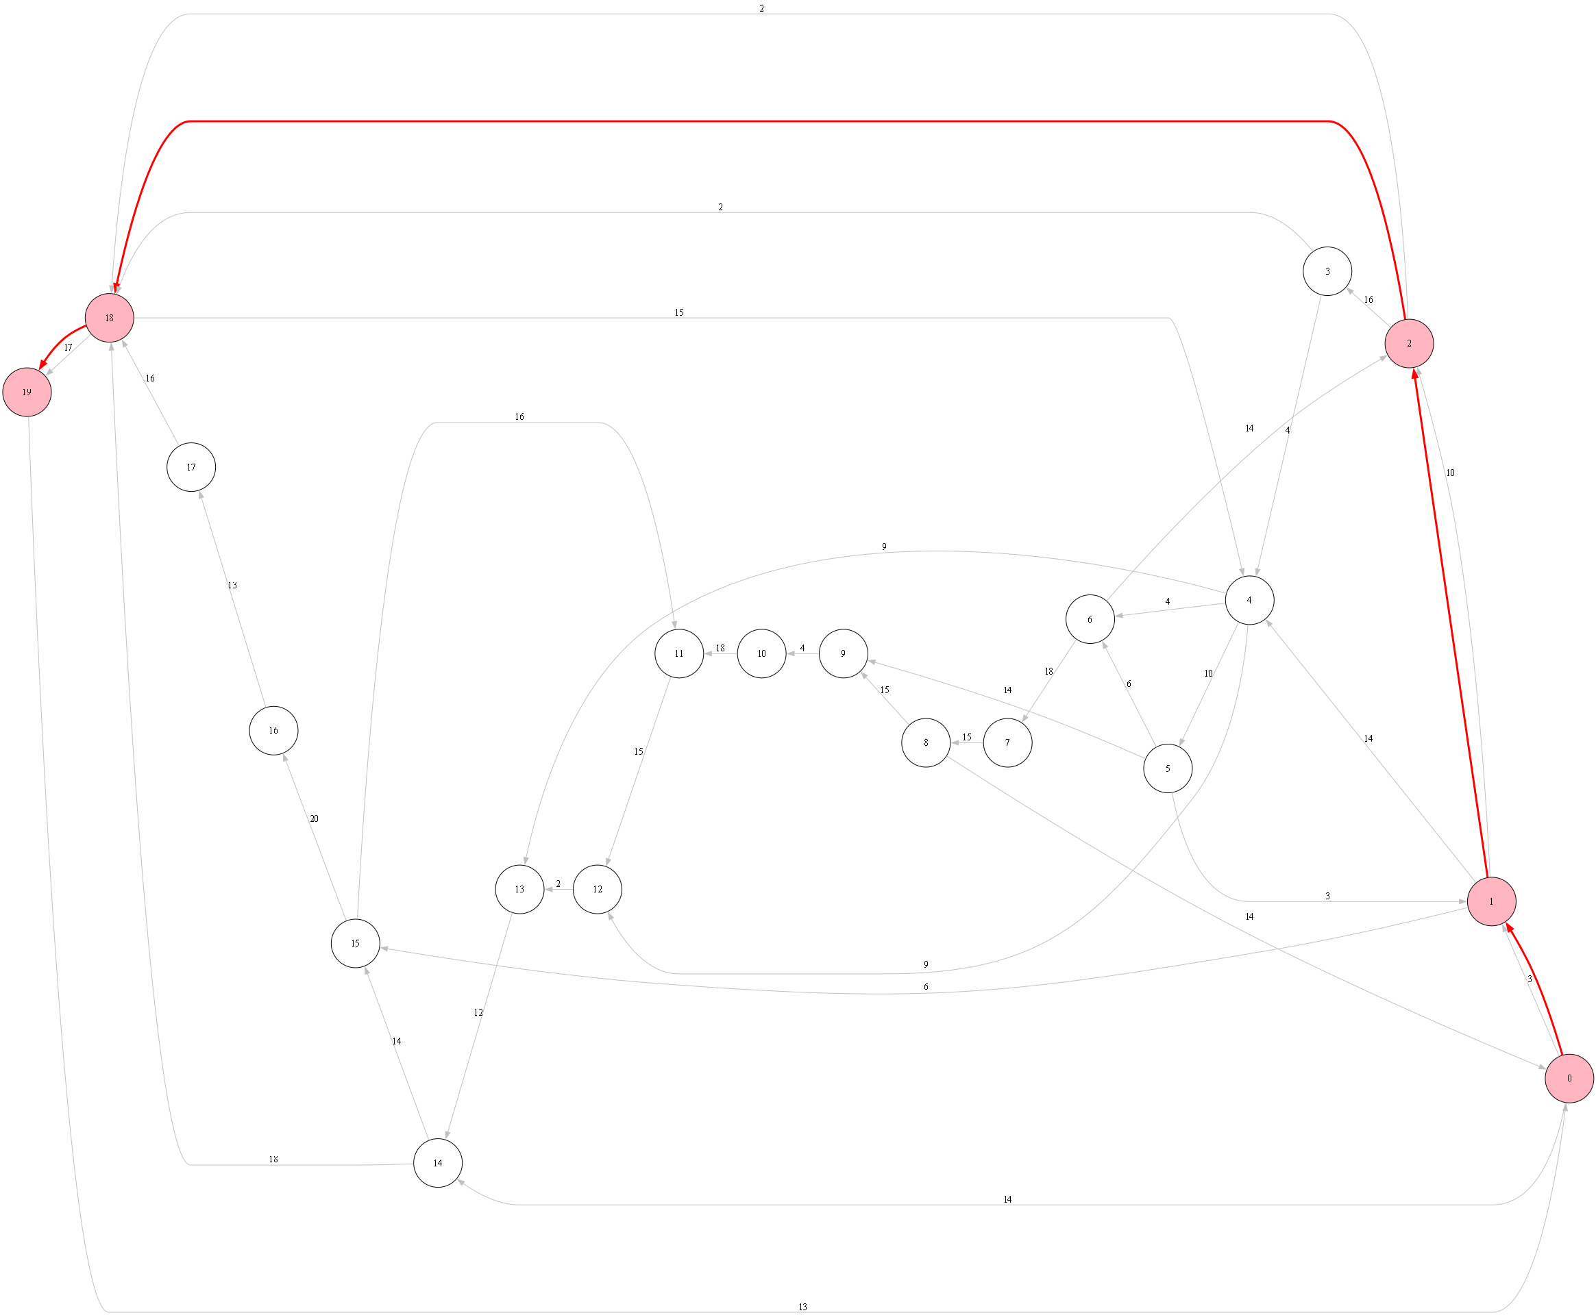
A* Path Visualization - Sample Graph

Slide 11
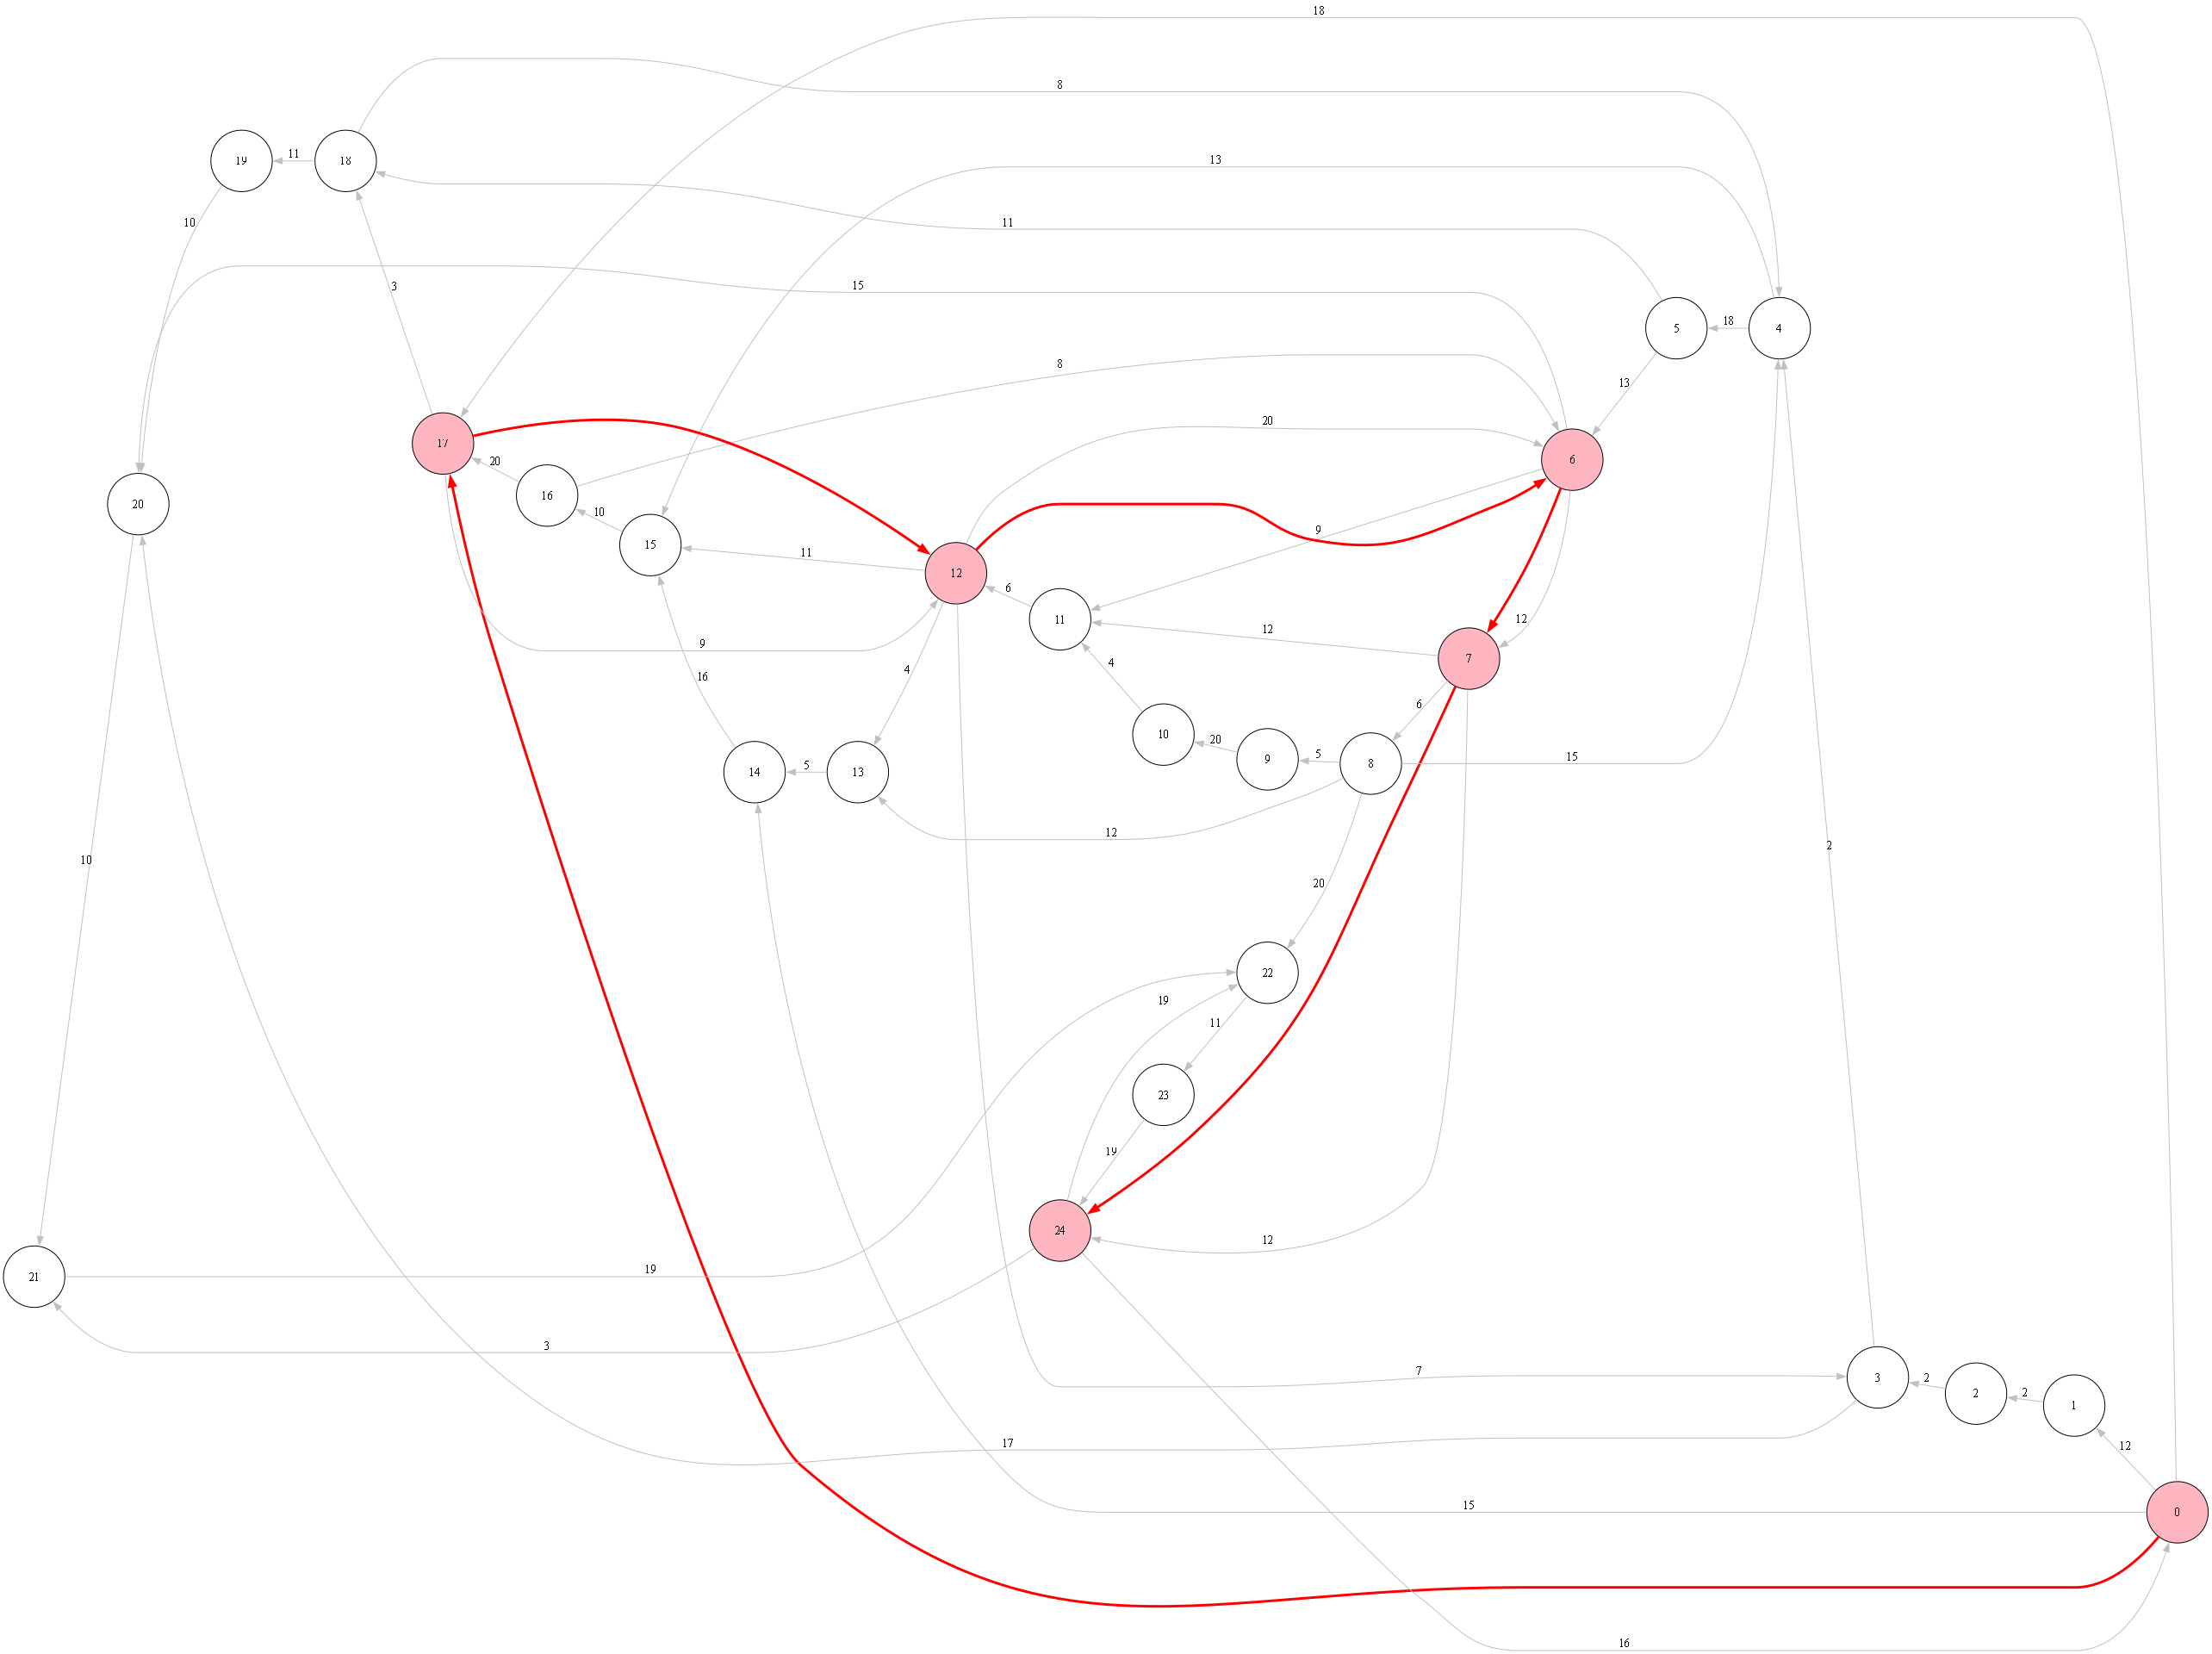
A* Path Visualization - Sample Graph

Slide 12
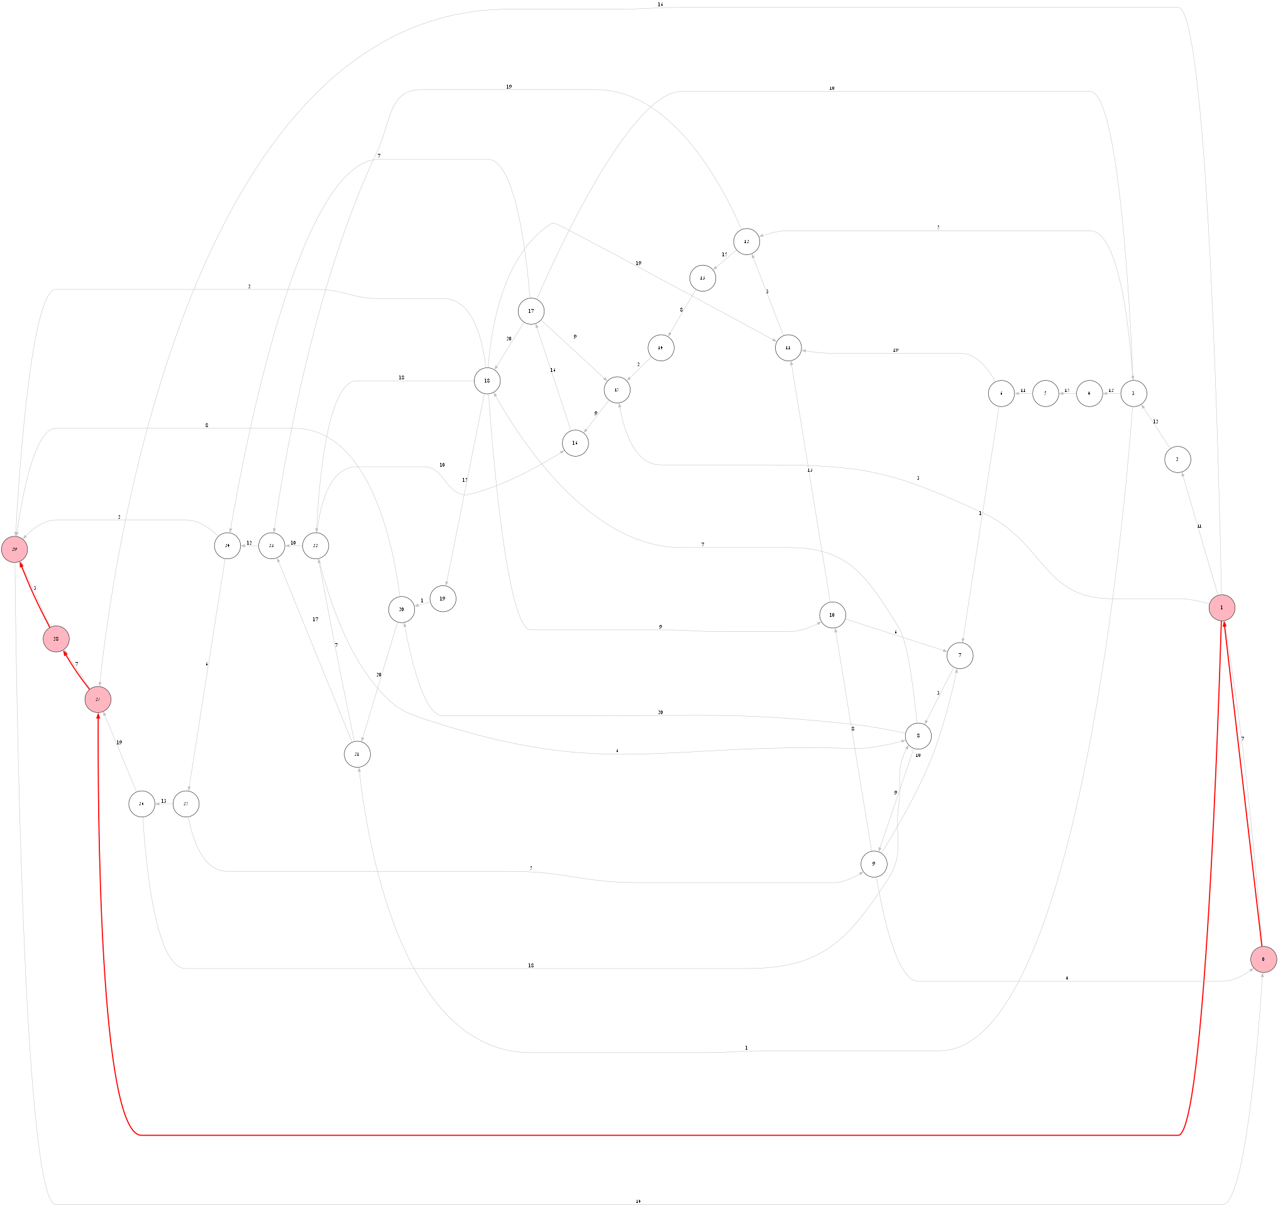
A* Path Visualization - Sample Graph

Slide 13
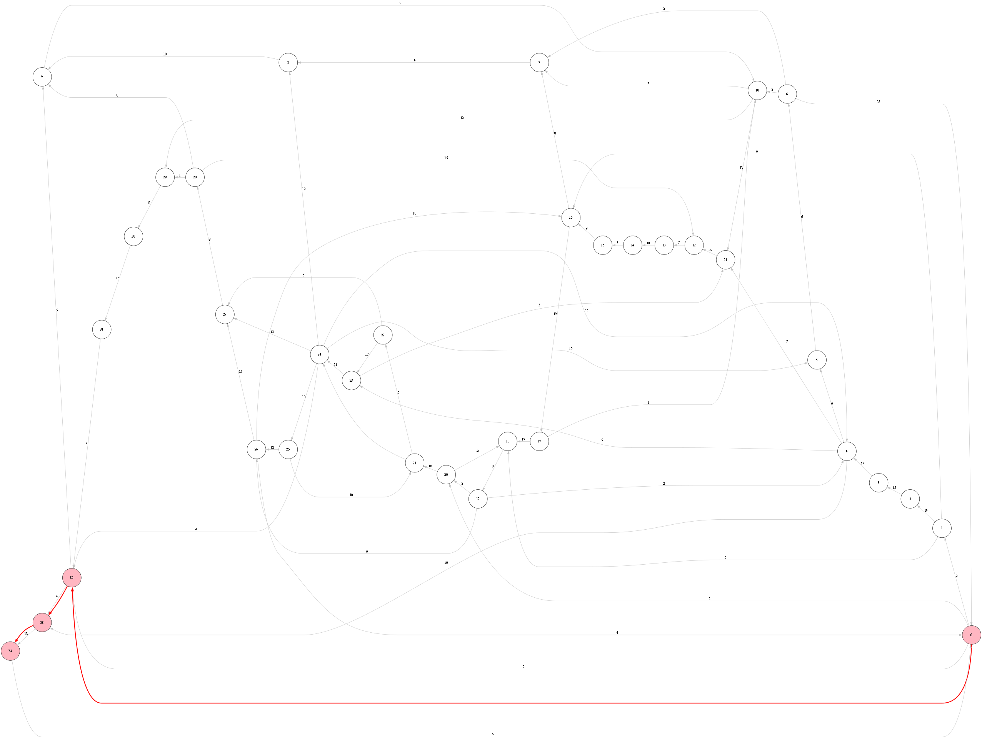
A* Path Visualization - Sample Graph

Slide 14
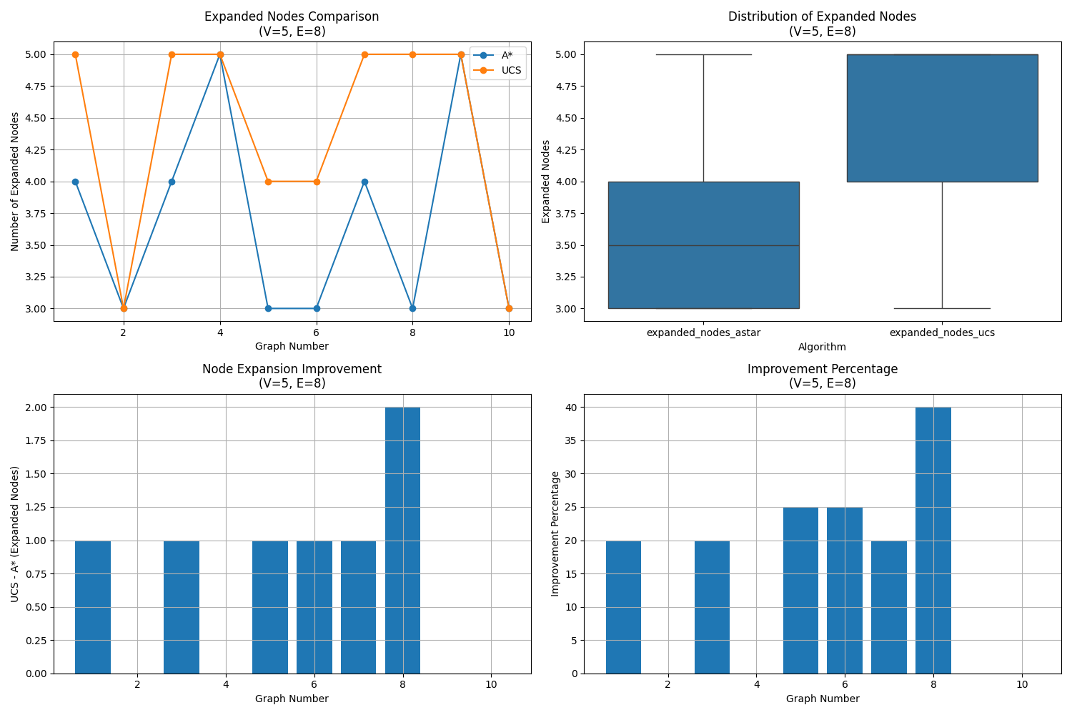
Performance Analysis (V=5, E=8)

Slide 15
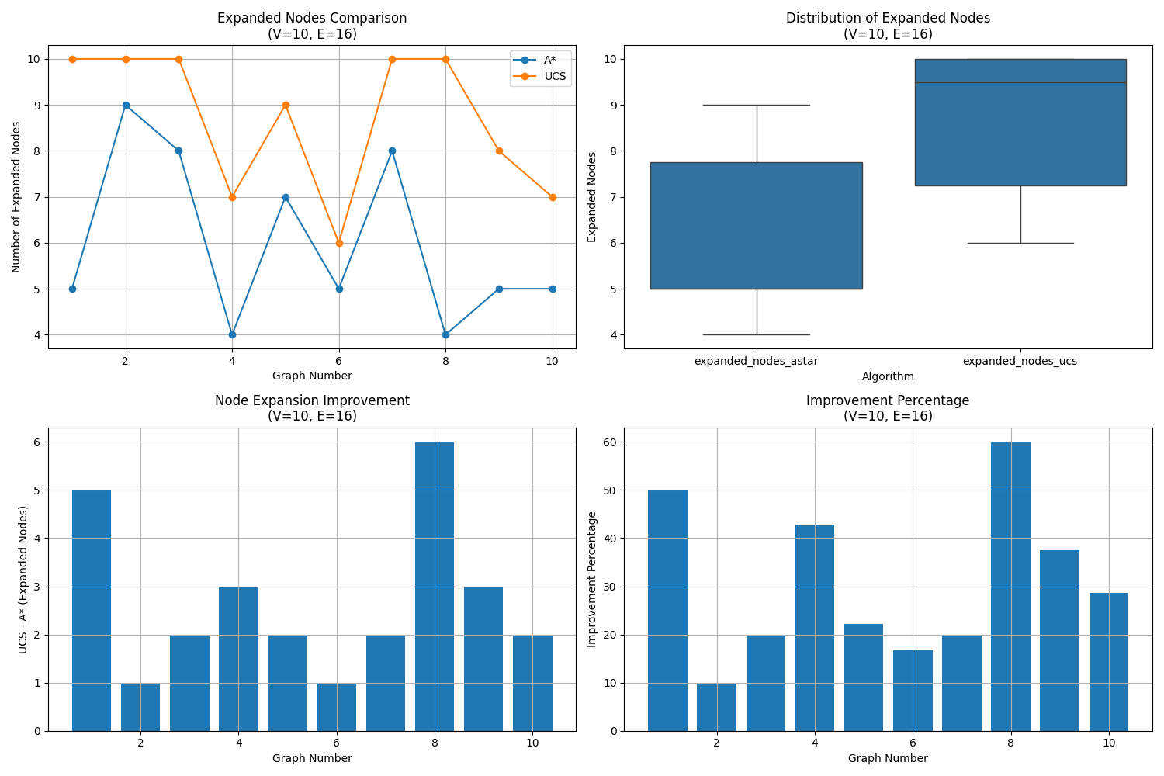
Performance Analysis (V=10, E=16)

Slide 16
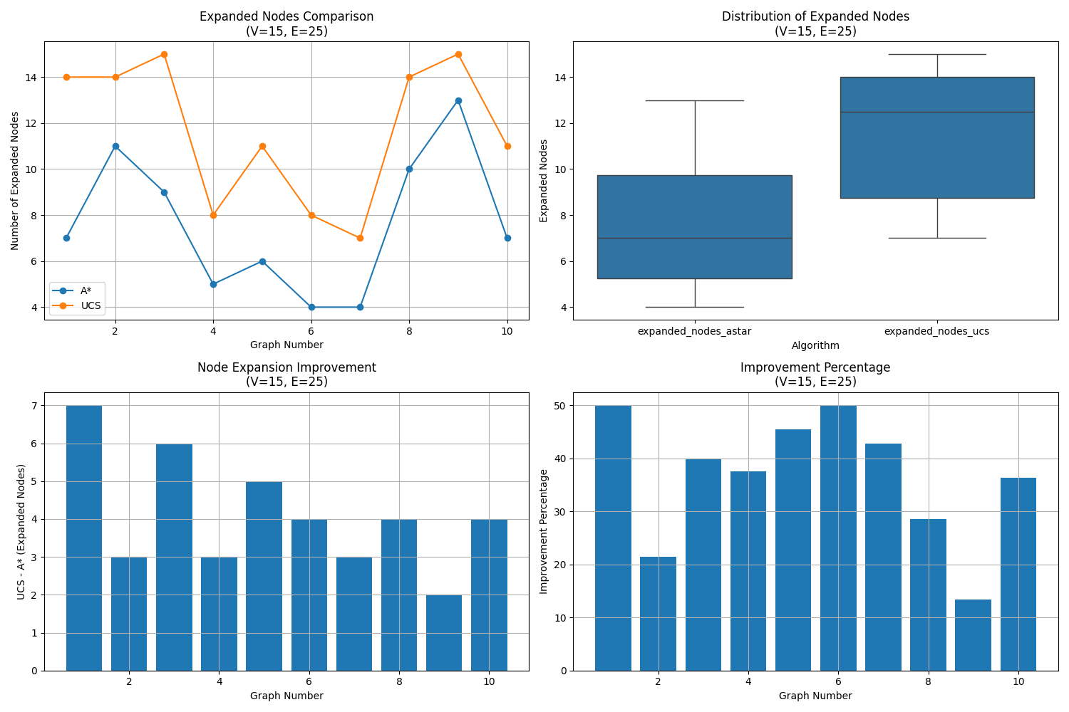
Performance Analysis (V=15, E=25)

Slide 17
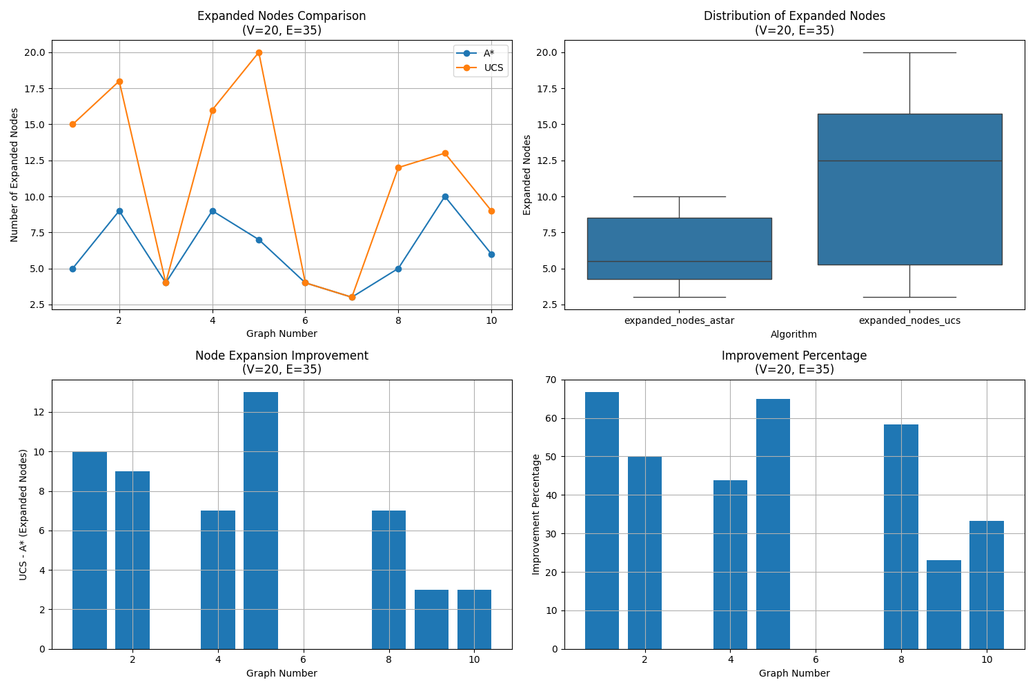
Performance Analysis (V=20, E=35)

Slide 18
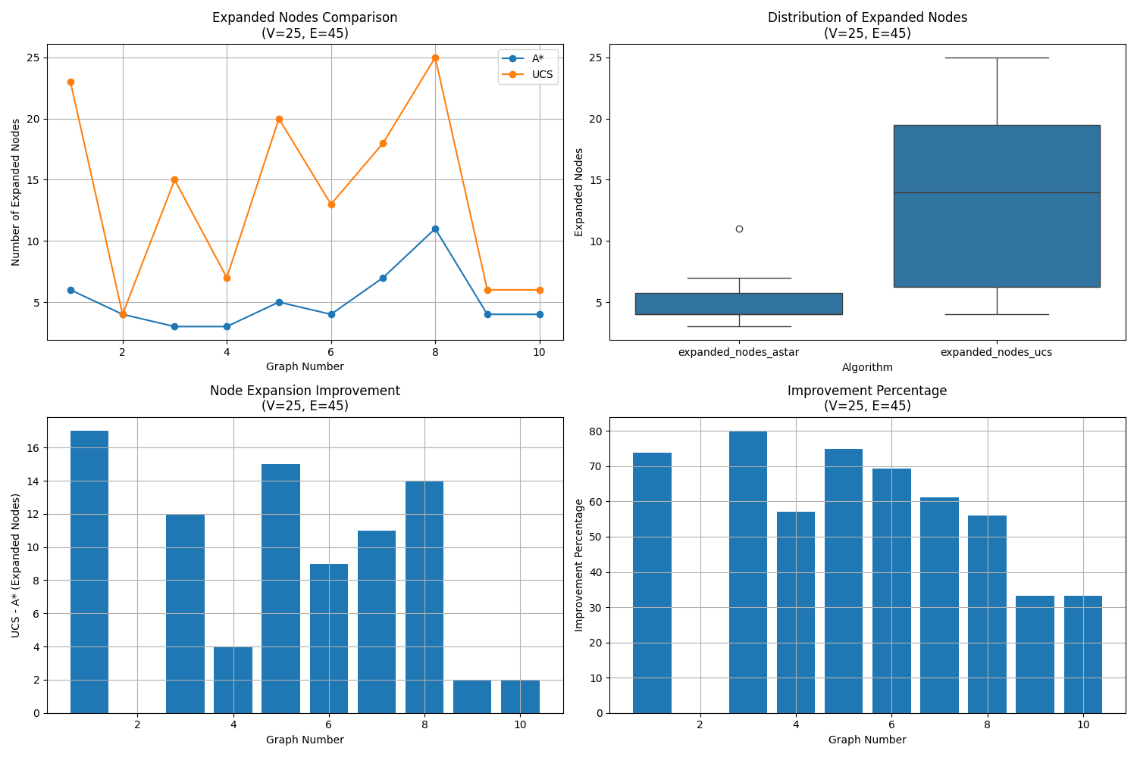
Performance Analysis (V=25, E=45)

Slide 19
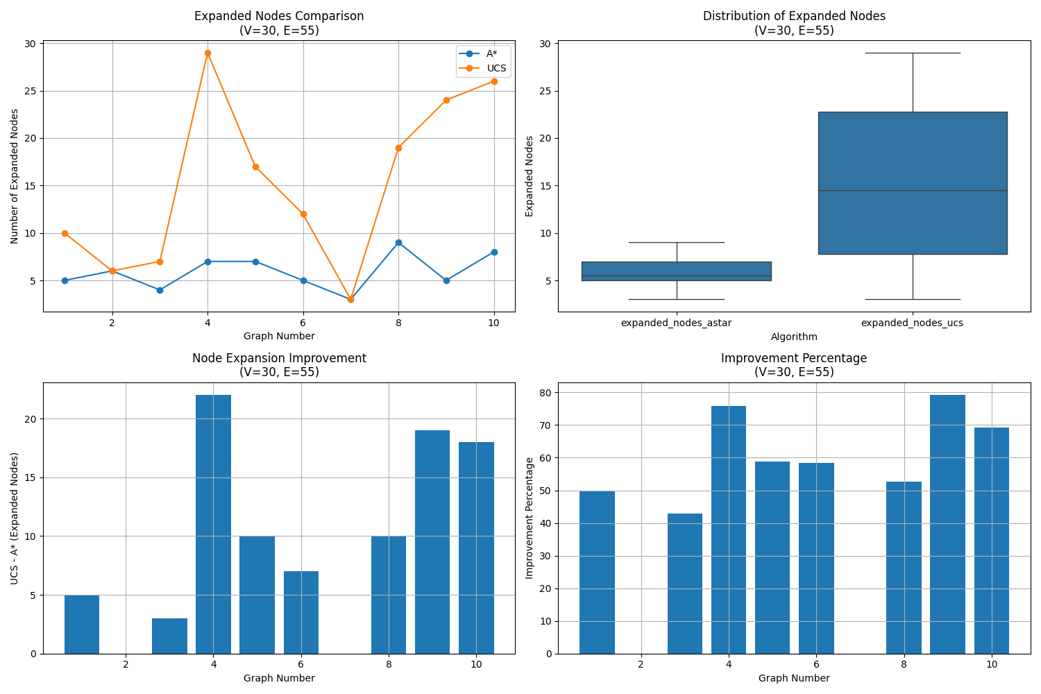
Performance Analysis (V=30, E=55)

Slide 20
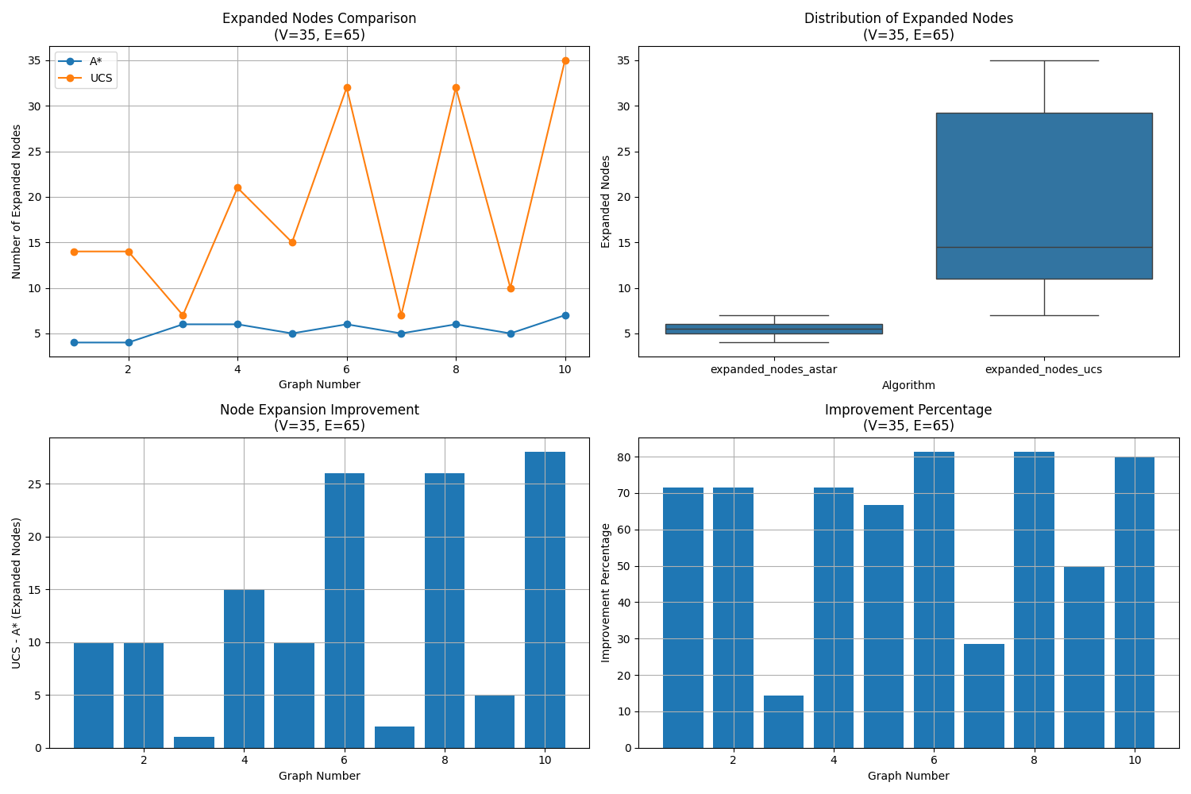
Performance Analysis (V=35, E=65)

Slide 21
Key Findings
• Average improvement: 46.1%
• Maximum improvement: 71.1%
• A* algorithm advantages:
- Fewer node expansions
- Increasing performance gap with graph size
- Consistent execution time
• Impact of heuristic function:
- Significant reduction in search space
- Maintaining optimal solution guarantee
• Visual confirmation of optimal paths

Slide 22
Detailed Analysis
• Small Graphs (V=5):
- Minimal difference between A* and UCS
- Both algorithms efficient
- Clear path visualization
• Medium-sized Graphs (V=15-25):
- A* advantage becomes apparent
- UCS expanded nodes increase significantly
- More complex path structures
• Large Graphs (V=30-35):
- A* maintains consistent performance
- UCS performance degrades significantly
- Sophisticated path finding demonstrated

Slide 23
Conclusion
• A* algorithm is more effective with appropriate heuristic function
• A* advantage increases with graph size
• Heuristic function significantly reduces search space
• Optimal path guarantee is maintained
• Visual examples confirm efficient path finding
• A* is recommended for practical applications

