Slide 1
Music Listening Habits and Productivity Analysis
Yigit Kaan Tonkaz
29154

Slide 2
Introduction
This analysis explores the impact of music attributes such as tempo, loudness, and genre on productivity. Clustering and regression techniques were applied to uncover patterns and generate actionable recommendations for optimizing music choices based on task types.

Slide 3
Data Preprocessing
1. Outlier Removal:
- Tempo: 60-200 BPM, Loudness: -5 to 5 normalized.
2. Missing Value Handling:
- Replaced with genre-specific medians.
3. Feature Engineering:
- Interaction features like Tempo_Loudness_Interaction.
4. Aggregated session-level metrics.

Slide 4
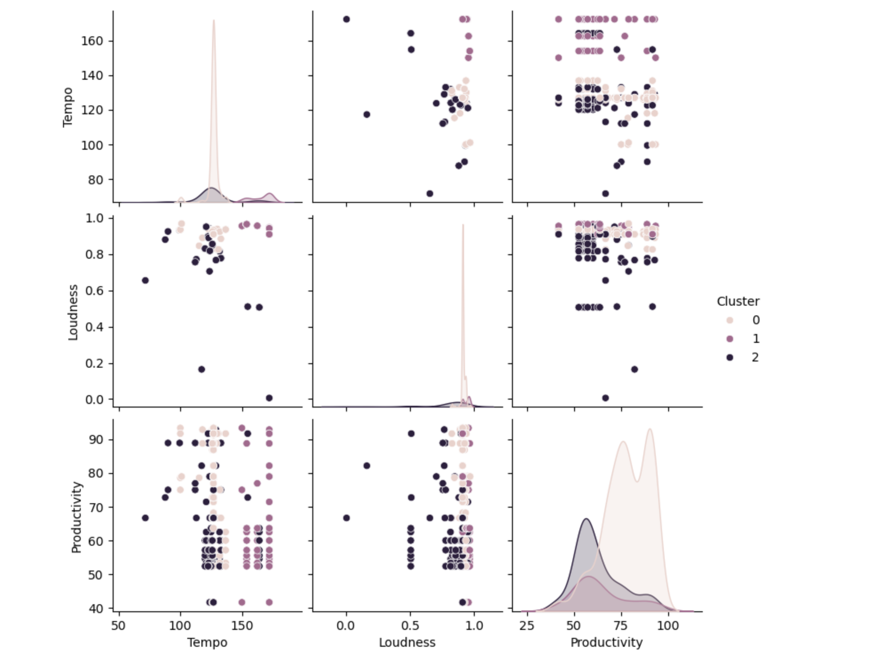
The pairplot provides a detailed look at the relationships between tempo, loudness, and productivity across three clusters

Slide 5
Cluster Observations:
Cluster 0: High productivity aligns with moderate tempo (~126 BPM) and loudness (0.91).
Cluster 1: Moderate productivity favors higher tempo (~165 BPM) and loudness (~0.94).
Cluster 2: Low productivity is associated with moderate tempo and lower loudness values (~0.81).
Key Insight: Clear separations indicate that loudness and tempo combinations significantly influence productivity levels.

Slide 6
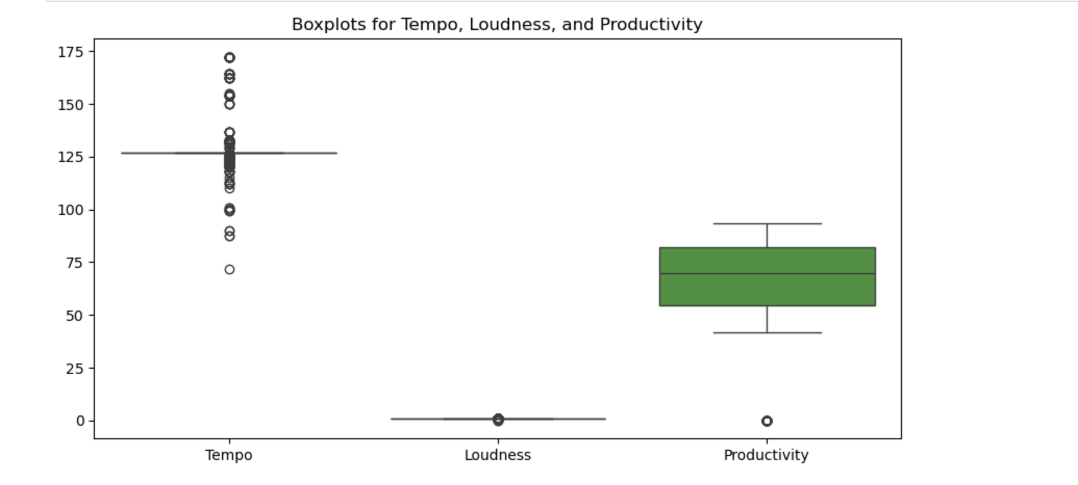
The boxplots illustrate the distribution of Tempo, Loudness, and Productivity across the dataset.

Slide 7
Findings:
Tempo: A wide range is observed (80–170 BPM), but central tendencies are clear.
Loudness: Mostly concentrated around normalized values (0.8–1), with minimal outliers.
Productivity: High variability is present, indicating significant influence from other factors such as task types or individual preferences.
Key Insight: Productivity is not evenly distributed and shows a greater variance compared to tempo and loudness.

Slide 8
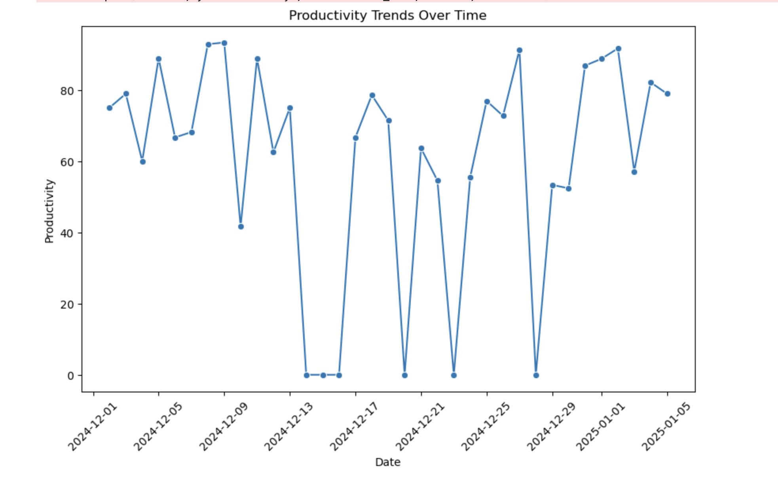
- External factors, such as task types, time of day, or external distractions, likely influence these trends. - Consistent peaks suggest optimal times or music habits that maximize productivity.

Slide 9
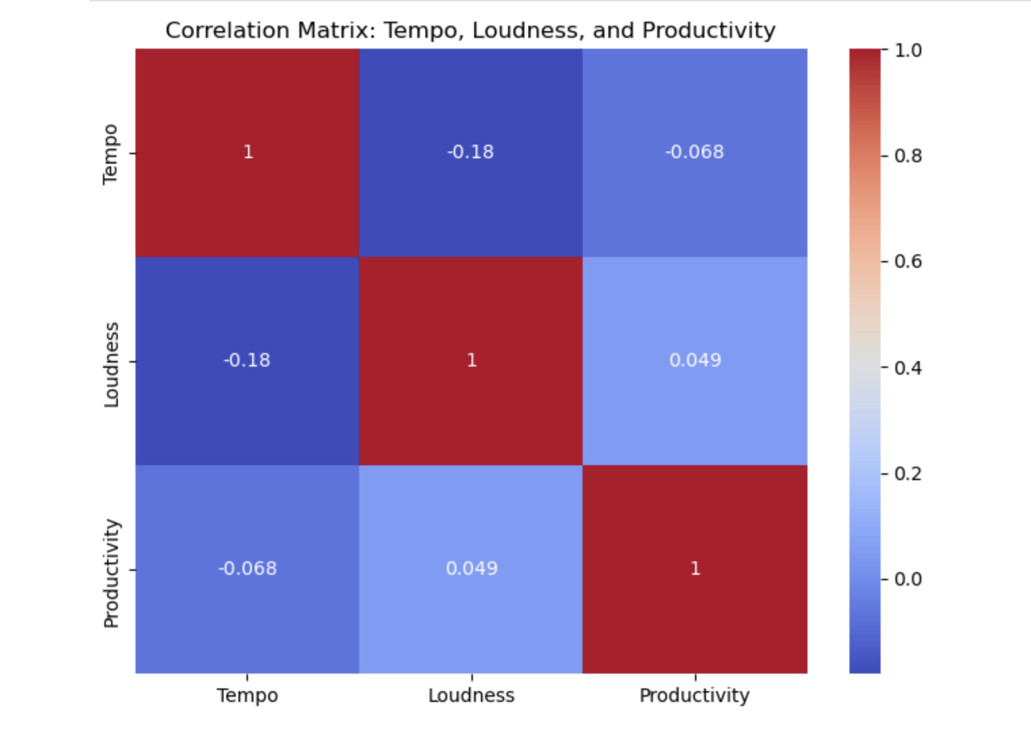

Slide 10
Correlation Insights:
Weak negative correlation between tempo and productivity (-0.068), suggesting higher tempo is not always beneficial.
Slight positive correlation between loudness and productivity (0.049), indicating higher loudness slightly improves productivity.
Combined effects of tempo and loudness are more impactful than individual correlations.
Key Insight: While correlations are weak, their interplay defines optimal productivity levels.

Slide 11
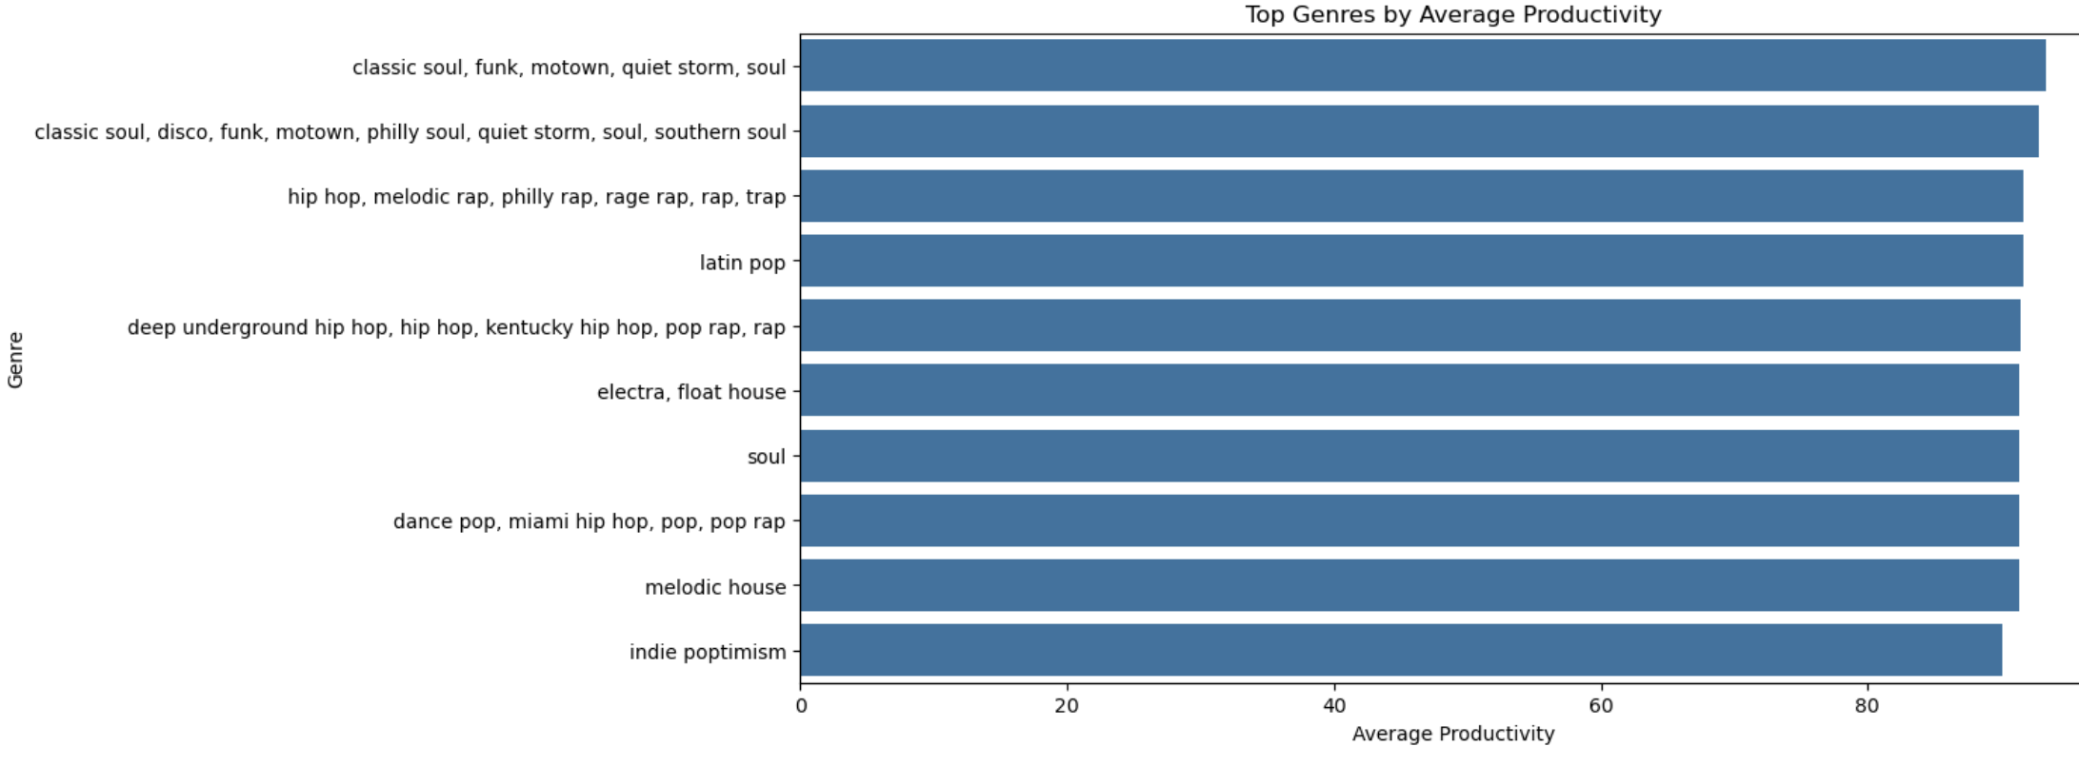
Genres Aligned with High Productivity: Classic Soul, Funk, and Motown. Genres for Relaxation: Dance Pop and Melodic House align with lower productivity tasks. Key Insight: Genre preferences significantly correlate with productivity levels.

Slide 12
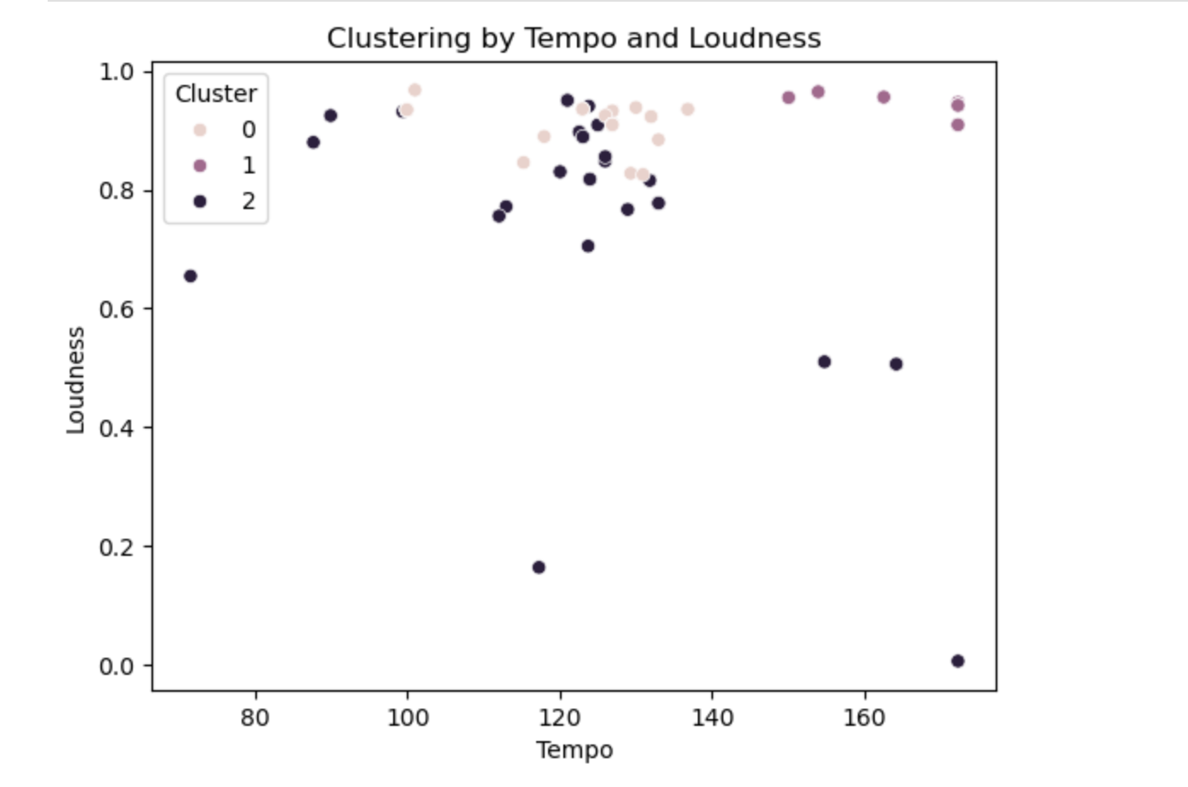

Slide 13
Findings:
Distinct clusters are observed based on combinations of tempo and loudness.
Cluster 0 (High productivity): Balanced tempo and loudness.
Cluster 1 (Moderate productivity): High tempo and loudness.
Cluster 2 (Low productivity): Low loudness with moderate tempo.
Key Insight: Clustering validates that optimal combinations of tempo and loudness vary by productivity requirements.

Slide 14
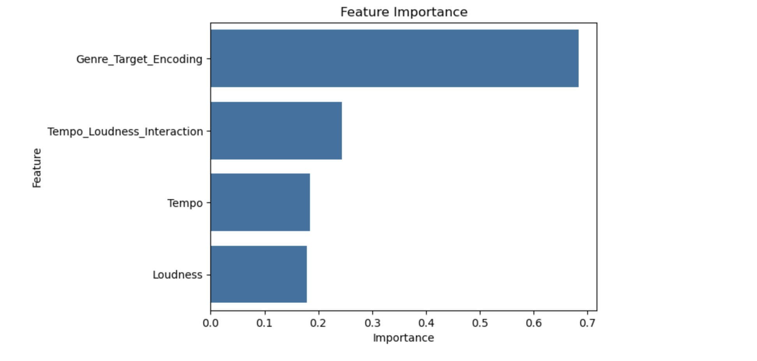

Slide 15
Findings:
Genre Target Encoding has the highest importance, emphasizing the critical role of genres in determining productivity.
Interaction features (Tempo × Loudness) significantly contribute to model predictions.
Tempo and Loudness individually play secondary roles.
Key Insight: Genre is the most impactful feature, followed by interactive attributes.

Slide 16
Summary of Key Results:
High Productivity: Moderate tempo (120–130 BPM) and loudness (0.90+), with genres like Classic Soul and Funk.
Moderate Productivity: High tempo (>160 BPM) and loudness (~0.94), with genres like Hip-Hop and Trap.
Relaxation: Moderate tempo (125–130 BPM) and lower loudness (0.75–0.85), with genres like Dance Pop and Melodic House.

Slide 17
Conclusion
This project successfully demonstrates the impact of music attributes on productivity.
Tailored recommendations provide actionable insights for work, study, and relaxation.
Future work could explore additional attributes such as lyrics or user mood.

