Slide 1

Image Analysis & Computer Vision
Anomaly Detection Based on Autoencoder and
Denoising Convolutional Neural Network
Project Presentation
Supervised by: Giacomo Boracchi, Vincenzo Caglioti
Yusuf Yiğit Pilavcı
Şemsi Yiğit Özgümüş
POLITECNICO DI MILANO

Slide 2

Presentation Outline
Introduction
Problem Definition
Proposed Architecture
Experiment Results
Conclusion
POLITECNICO DI MILANO

Slide 3
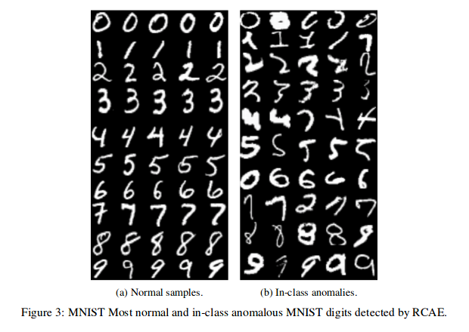
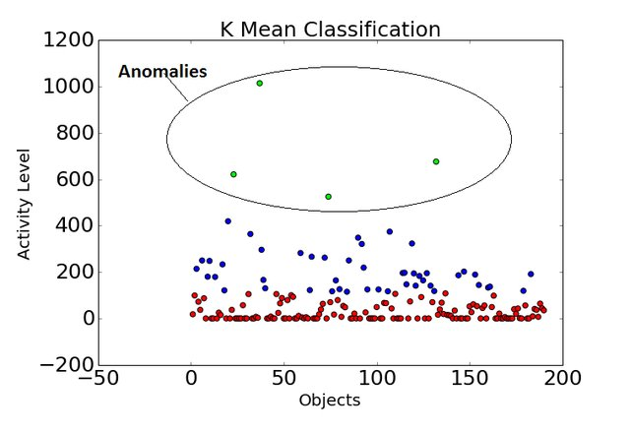
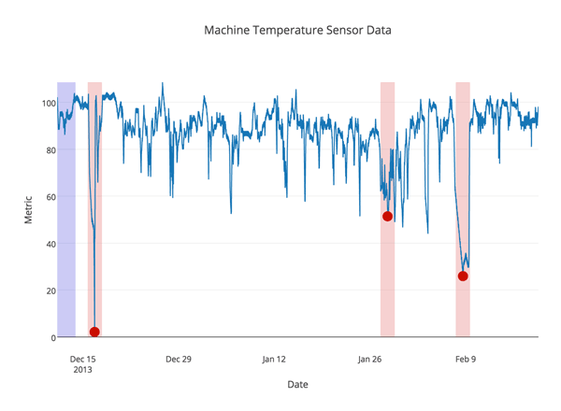
What is Anomaly Detection ?
(Hawkins’ Definition of Outlier, 1980) “ An outlier (or anomaly) is an observation that differs so much from other observations as to arouse suspicion that it was generated by a different mechanism.”
“Finding patterns in given data that has new or unexplained characteristics.”
Depending on the context term may change: novelty, outlier, aberration, discordant observation etc.
POLITECNICO DI MILANO

Slide 4
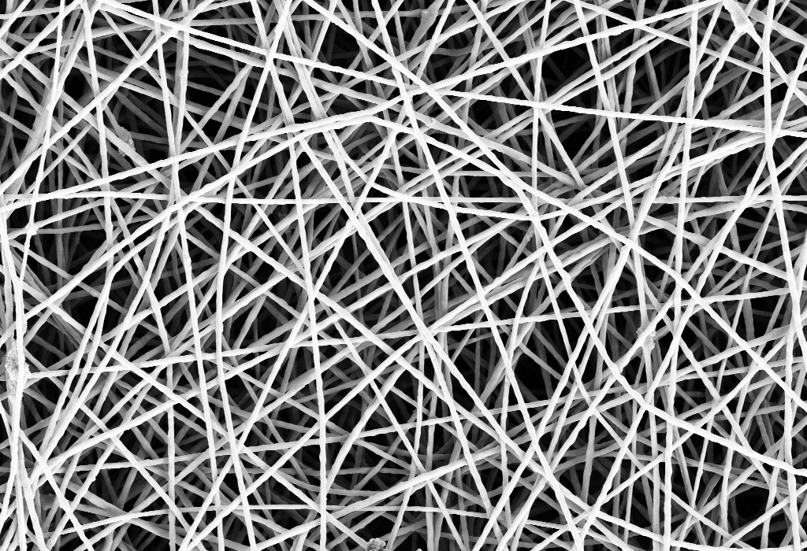
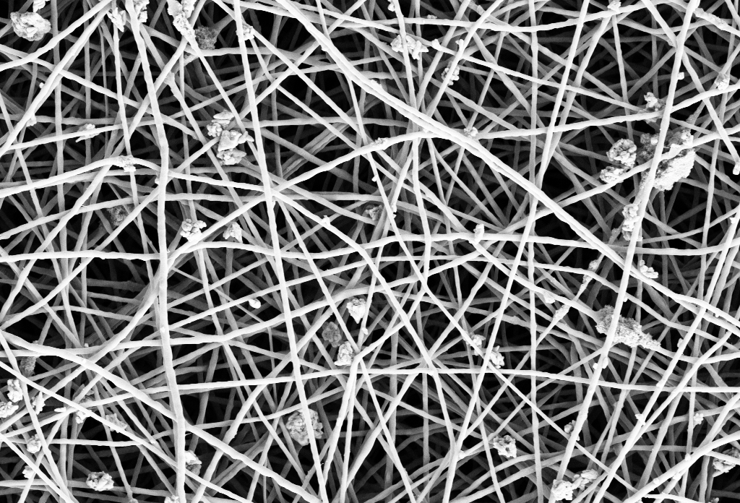
Problem Definition
We particularly examine automated detection of defects in nanofibrous materials
Dataset is set of Scanning Electron Microscope (SEM) images
Challenges
Filament pattern is geometrically pseudo random. (Does not align with a predefined texture)
Trade off between patch size, resolution and accuracy.
High variation in between images without defects.
POLITECNICO DI MILANO

Slide 5
Architecture Overview
Architecture consists of an Autoencoder Network and a Denosining Network combined.
Training of the architecture is sequential
Considering :
First the Autoencoder Network with the following objective function:
Then the Denoising Network is trained with fixed autoencoder network outputs with the following objective function:
POLITECNICO DI MILANO

Slide 6
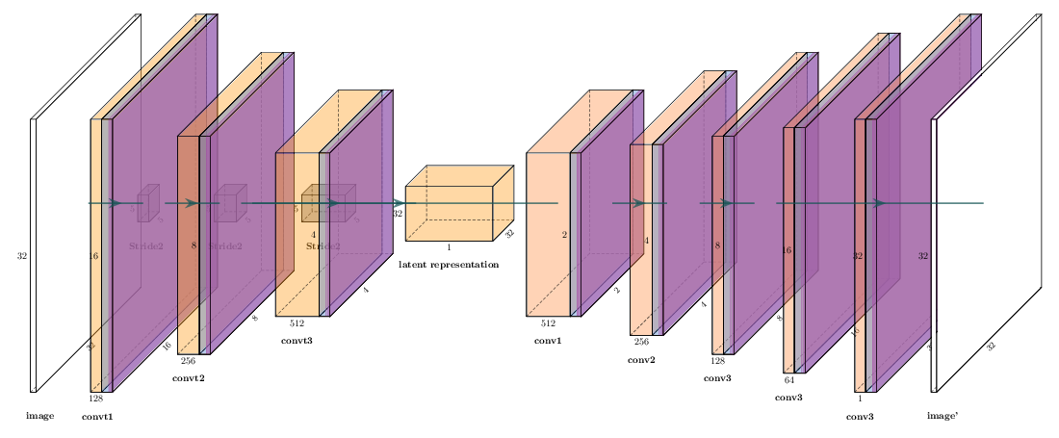
Autoencoder Network
Encoder and Decoder Networks
Encoder Network :
3 Layers of Convolution + Batch Normalization + Leaky ReLU with
Kernel size (5 x 5)
Stride (2 x 2)
Filters 128 > 256 > 512
Dense Layer with number of Nodes equal to the latent representation
Decoder Network :
5 Layers of Transposed Convolution + Batch Normalization + Leaky ReLU with
Kernel size (5 x 5)
Stride (2 x 2)
Filters 512 > 256 > 128 > 64 > 1
Trained with reconstruction error
Anomaly score is defined with ℓ₂ norm of the reconstruction error
POLITECNICO DI MILANO

Slide 7
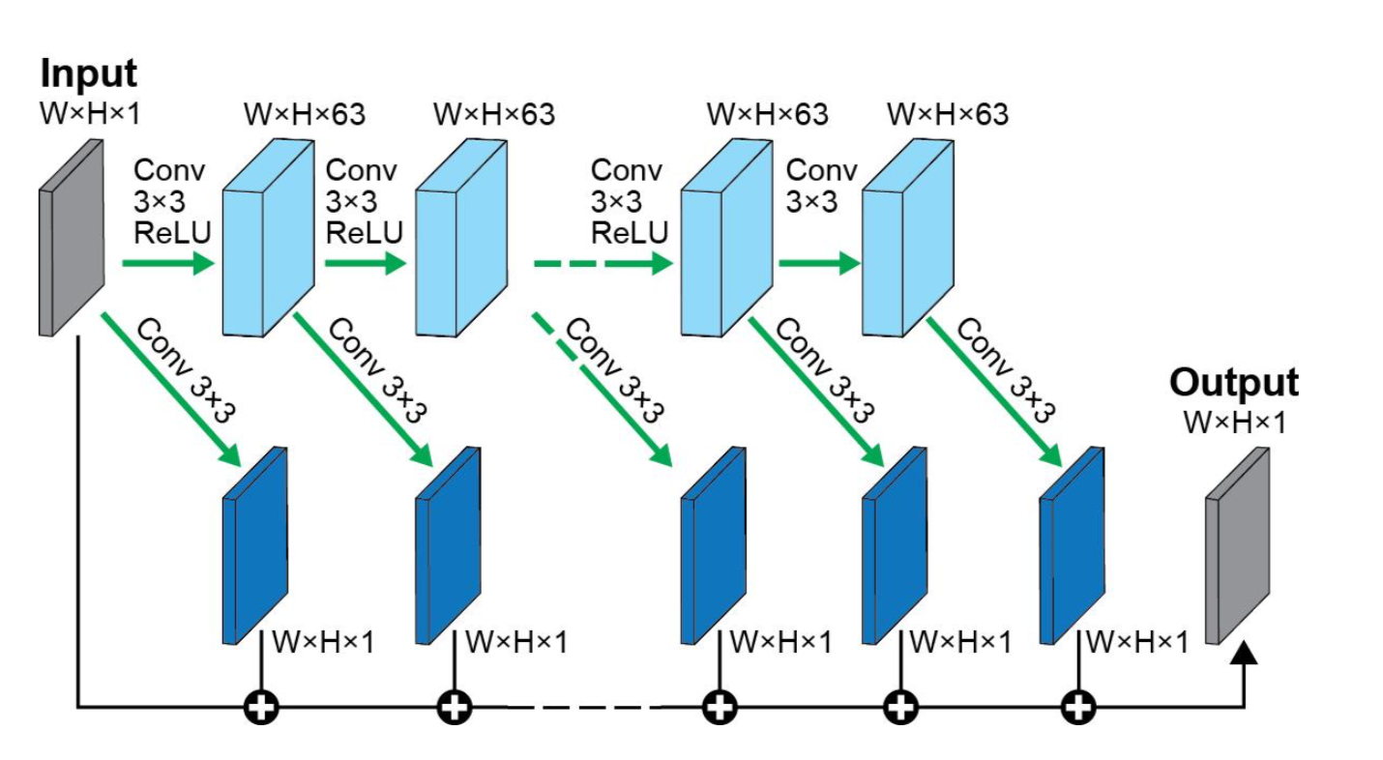
Denoising Network
20 fully convolutional layers of network with two branches:
63 3x3 Conv filters trained
1 3x3 Conv filter trained and accumulated through layers
Trained by reconstruction error
For anomaly score, residual computed with
Smooth Reconstruction or
Feature mask
POLITECNICO DI MILANO

Slide 8
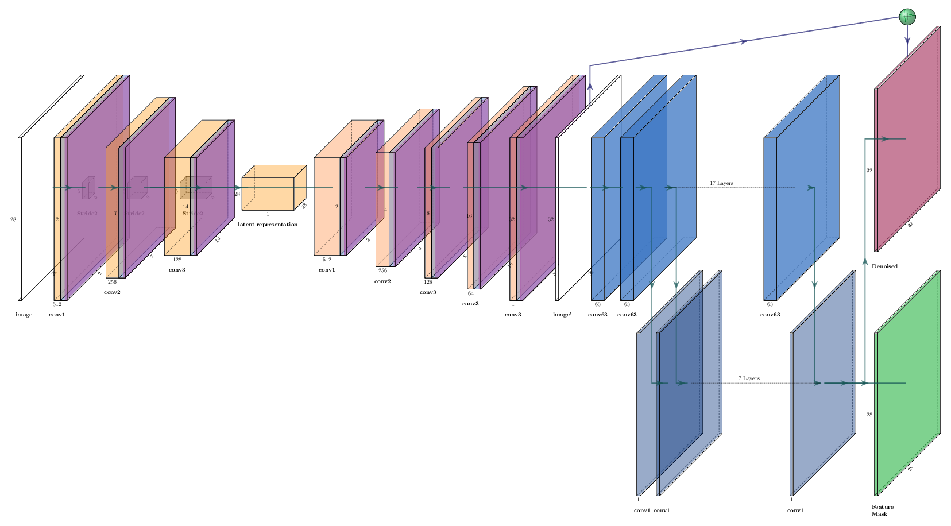
Proposed Architecture
POLITECNICO DI MILANO

Slide 9
Experiment Results
 | Performance Metrics
Score Type | AUROC | Precision | Recall | F1 Score
Reconstuction | 0.6135 | 0.12040 | 0.28527 | 0.16933
Smooth Reconstruction | 0.75003 | 0.22560 | 0.35636 | 0.27629
Feature Mask | 0.80022 | 0.60295 | 0.38098 | 0.46692
Experiment results for Denoising Autoencoders are considered.
Smoothing reconstruction improves the precision and recall capacity of the model.
Computing residual with feature mask instead of the smooth reconstruction for anomaly score greatly increases precision while also improving the recall capacity.
POLITECNICO DI MILANO

Slide 10
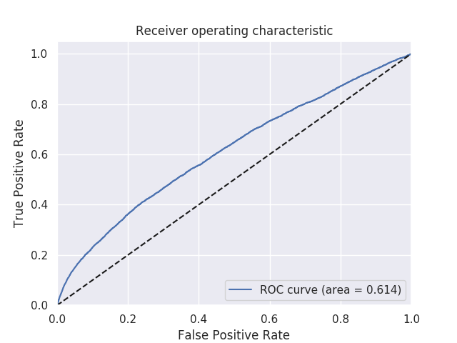
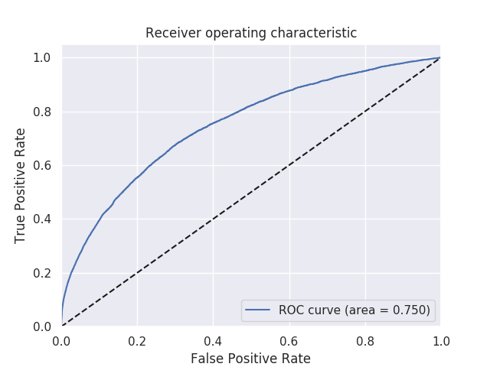
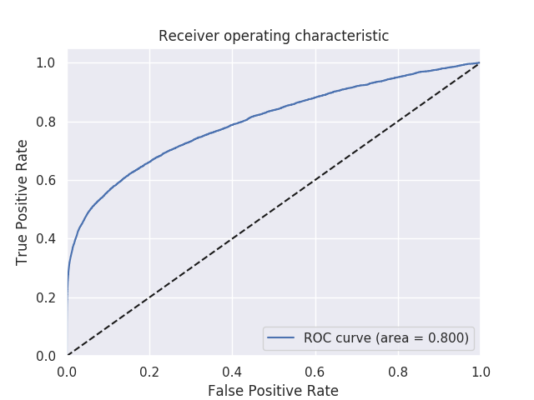
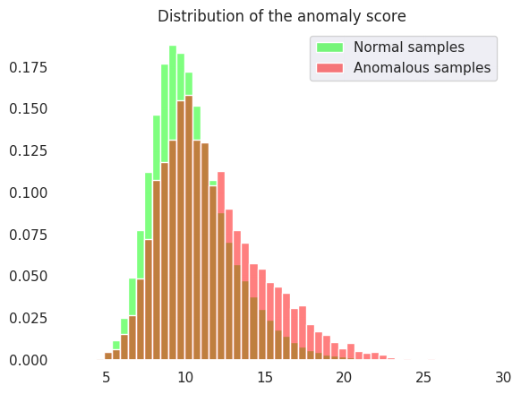
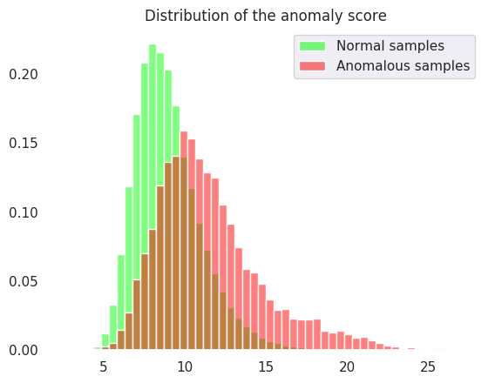
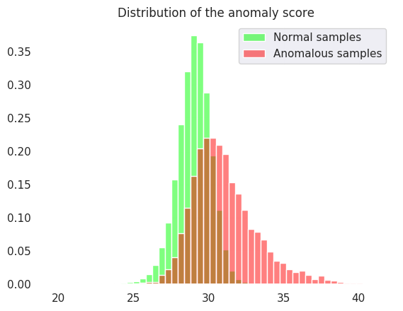
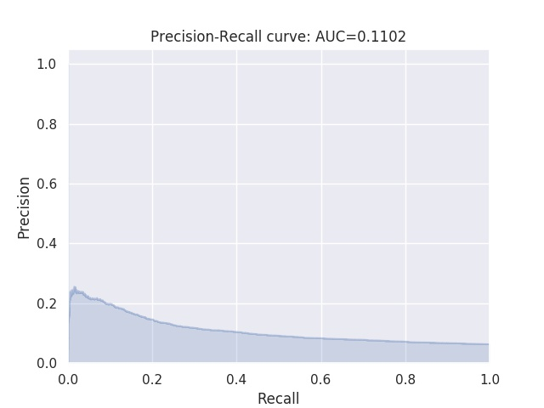
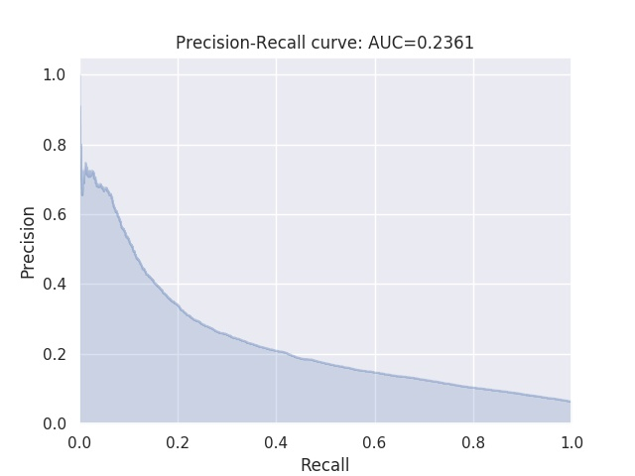
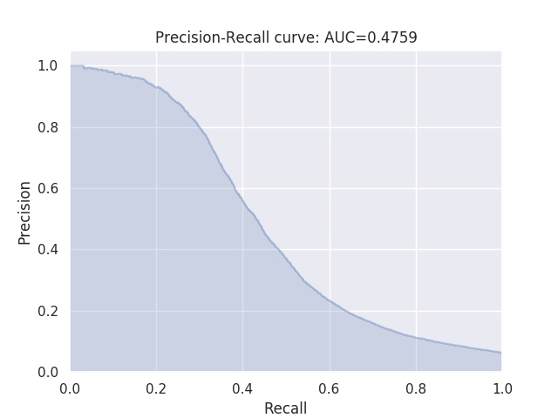
Experiment Results
Reconstruction
Smooth Reconstruction
Feature Mask
POLITECNICO DI MILANO

Slide 11
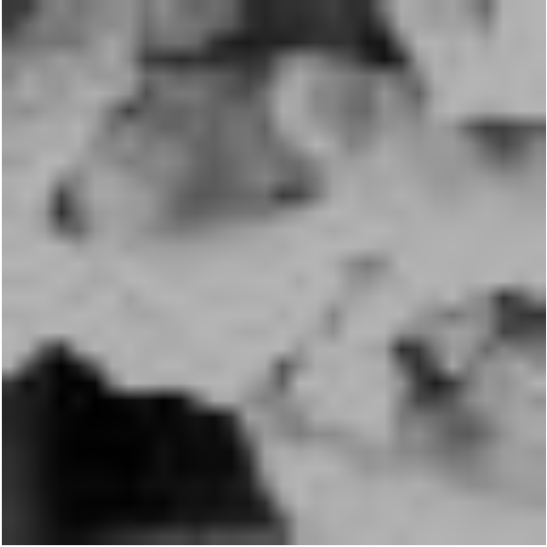
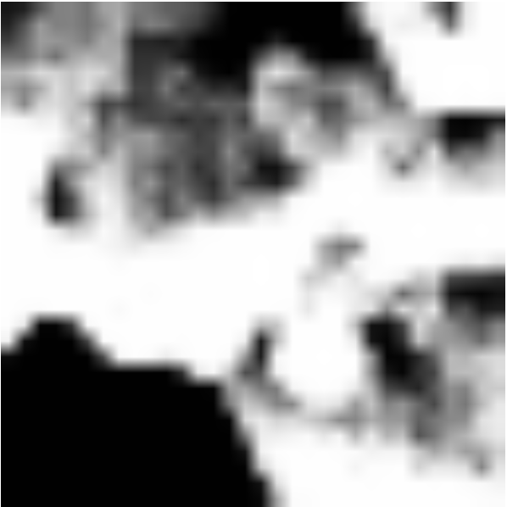
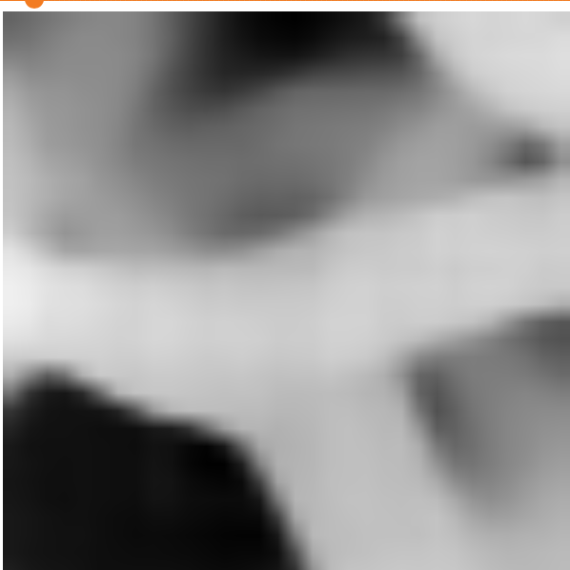
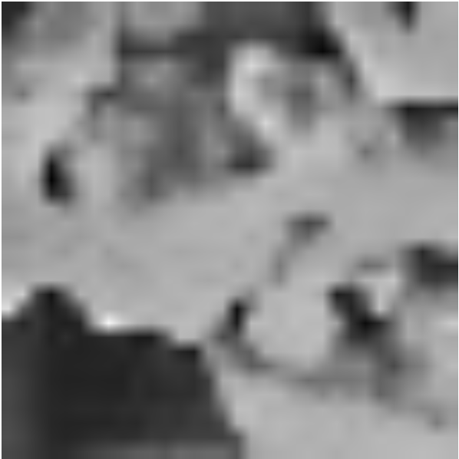
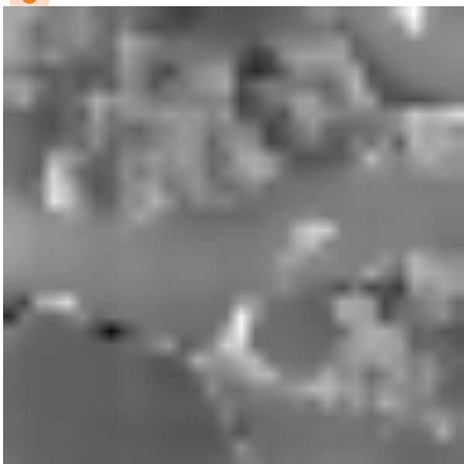
Qualitative Results
Query Sample
Reconstruction
Denoised Reconstruction
Residual Image
Feature Mask
POLITECNICO DI MILANO

Slide 12
Conclusion
Automated Anomaly Detection is implemented with autoencoder and fully convolutional denoising network.
Three different autoencoder methods are tested.
Different outputs from denoising network explored for anomaly score.
Future works are possible with extension on Generative Adversarial Networks and further examinations of FC denoising network.
POLITECNICO DI MILANO

Slide 13
Thank you for your attention
POLITECNICO DI MILANO

