Slide 1
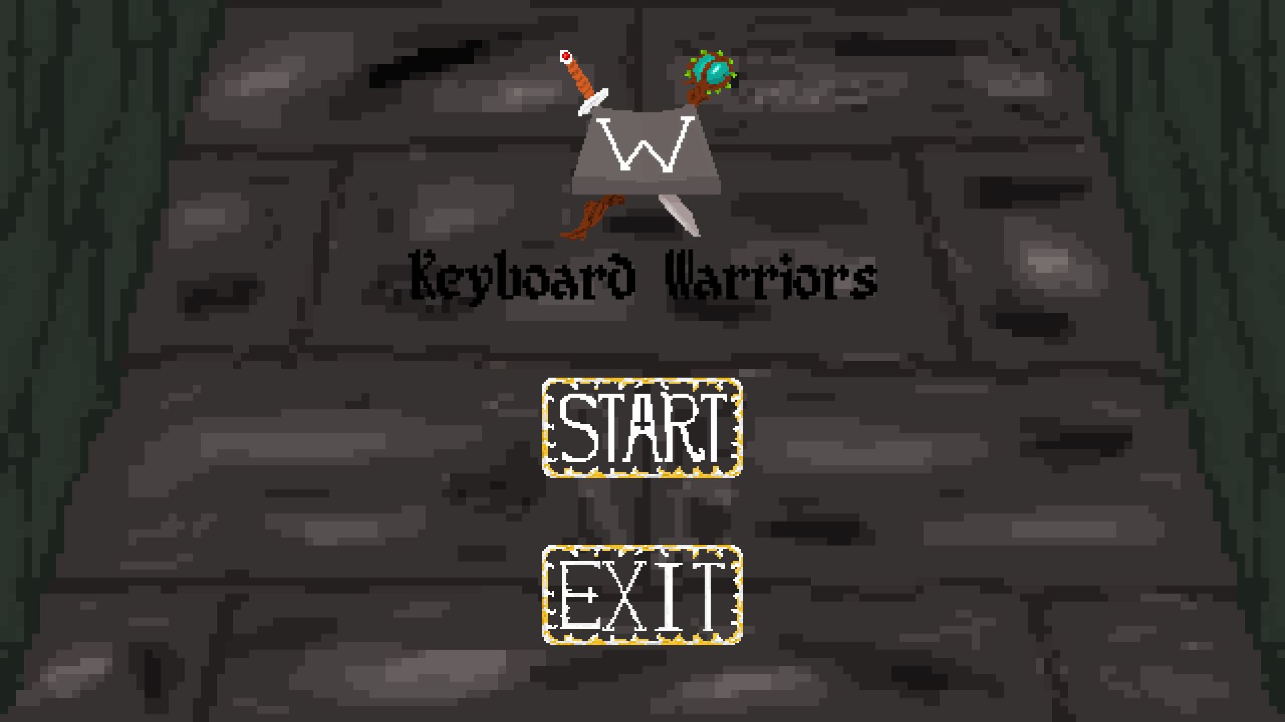
StacsHack : Swords and Sorcery

Slide 2
Overview
A game focused on improving the User’s typing ability and linguistic skills in a fun, interactive way!
The game implements similar elements from any other standard dungeon crawling RPG, whilst being educational.

Slide 3
Our Vision
Through developing this game we hope to:
  Encourage learning through an exciting game environment.
  Inspire our interests for linguistics in others.
  Bridge the gap between and gain the benefits of both playing entertaining games and learning.

Slide 4
Gameplay – Our idea
Upon starting the game, the Player will be put into an RPG inspired world, where they get to play as a chosen class and defeat mobs of enemies with their typing abilities.
The Player will traverse a dungeon as enemies, ramping in difficulty will attempt to overwhelm the player with keyboard inputs.
In order to conquer success in this game, the Player will have to defend themselves against each enemy and attack them with keyboard inputs based on their chosen class.

Slide 5
Gameplay Mechanics – Overview
The game consists of four main states:
  A Main menu/Title Screen
  A Character selection screen
  A Game screen
  A Pause menu

Slide 6
Gameplay Mechanics – Main Menu
This is where the Player’s journey will begin, from here the Player can either:
  heroically defeat the waves of mobs thrown at them and assert dominance over this RPG kingdom. (Start)
  or flee from battle in fear and show that they are a great supine protoplasmic invertebrate jelly. (Exit)

Slide 7
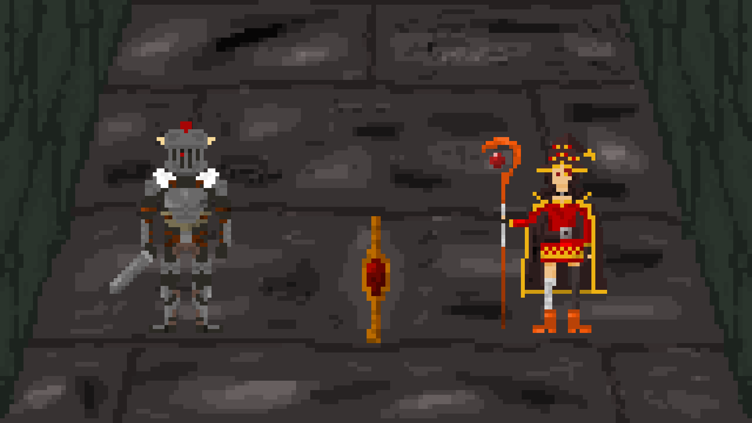
Gameplay Mechanics – Character Selection
Here, the user will be able to select a Class for the character they will play as. Each class will differ from each other:
  In Health
  In their move-sets
    These include the attacks that will be available to them after defending against enemy attacks successfully
    Note: Some classes may also provide the ability to heal themselves/cast healing spells!

Slide 8
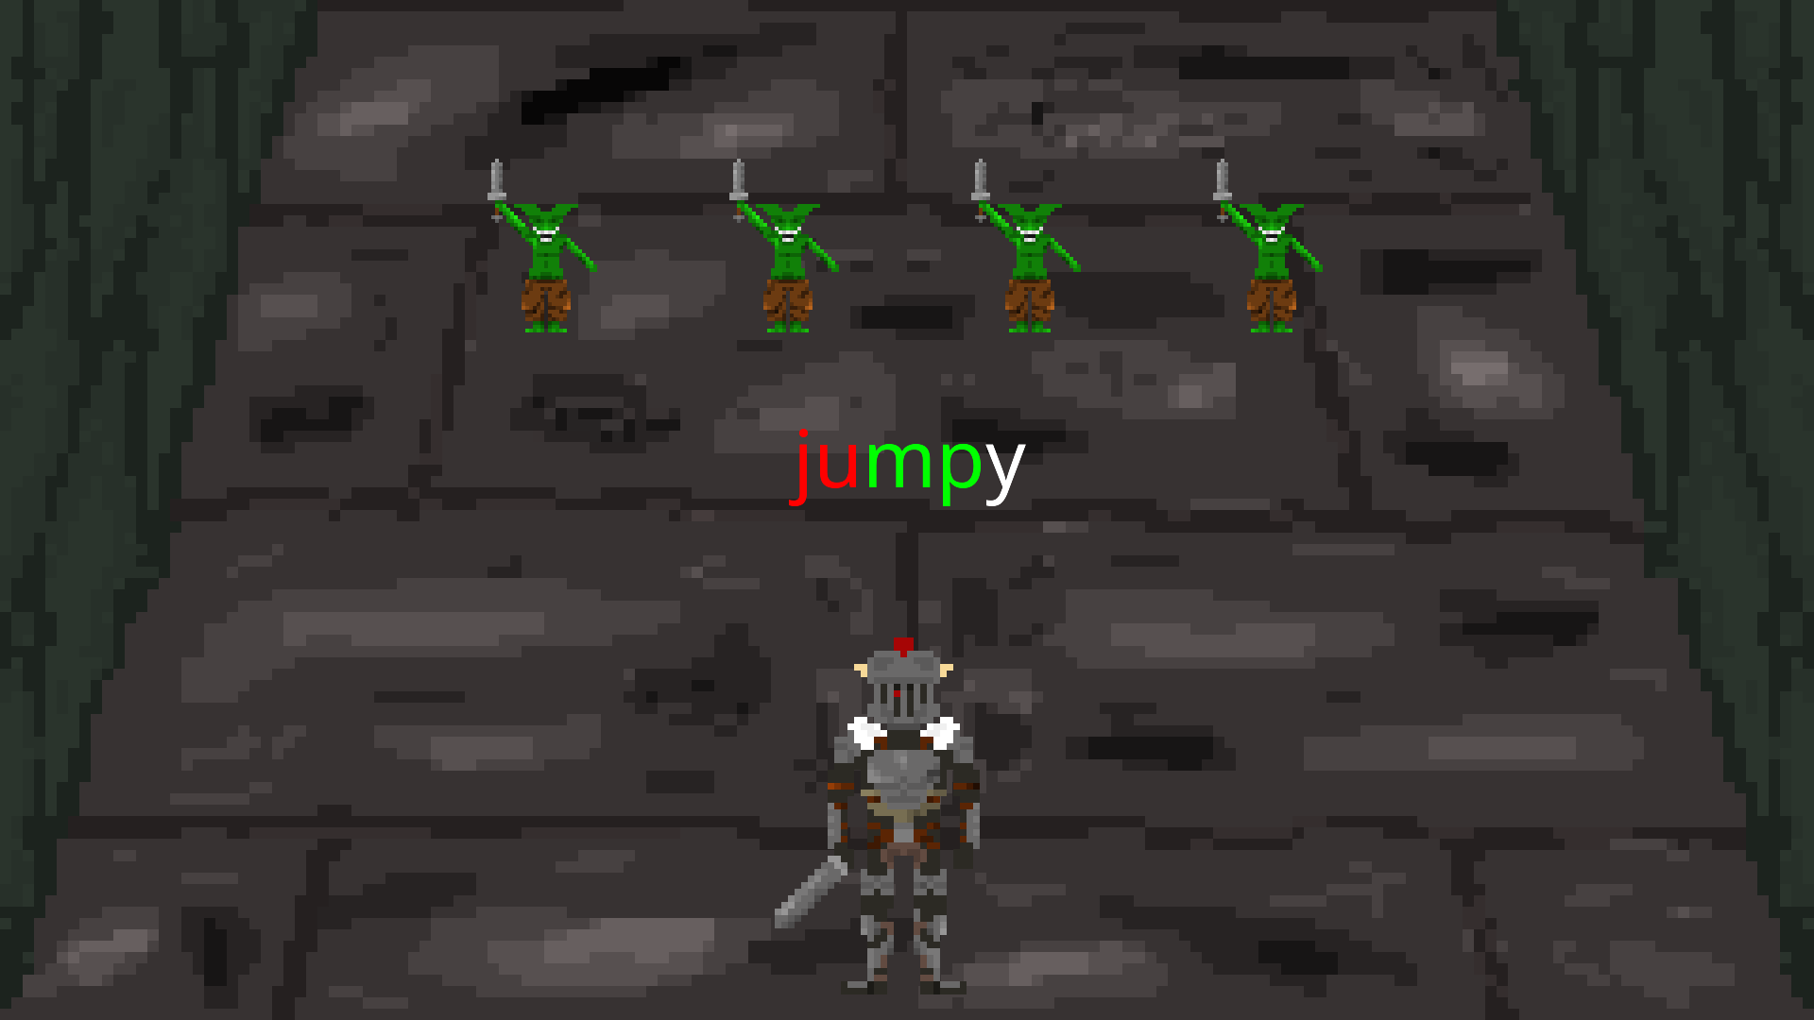
Gameplay Mechanics - Game
This is where the Player will be able to hack their way through mobs of enemies and bosses.
Each enemy the Player encounters will send words to the user, the stronger the enemy, the bigger the words.
In order to defeat these enemies, the player must type the words sent to them before being given the choice of three moves they can use on their turn.

Slide 9
Gameplay Mechanics – Turn
Each turn will follow this structure:
  An enemy will be spawned at the top of the screen and attempt to attack the Player with a random word
    note enemies can vary in difficulty and type (there are bosses!)
  The Player must type the word/attack within a given time or the player will lose health based on the length of the word they were unable to type.
  If the Player manages to type the word, the Player will be given three words (based on their class) of which they can use to attack the enemy/heal themselves.
  This turn based system continues until the Player has no Health or until the Player has slain all enemies in a given round. In that case, a new round will start and a new enemy will appear.

Slide 10
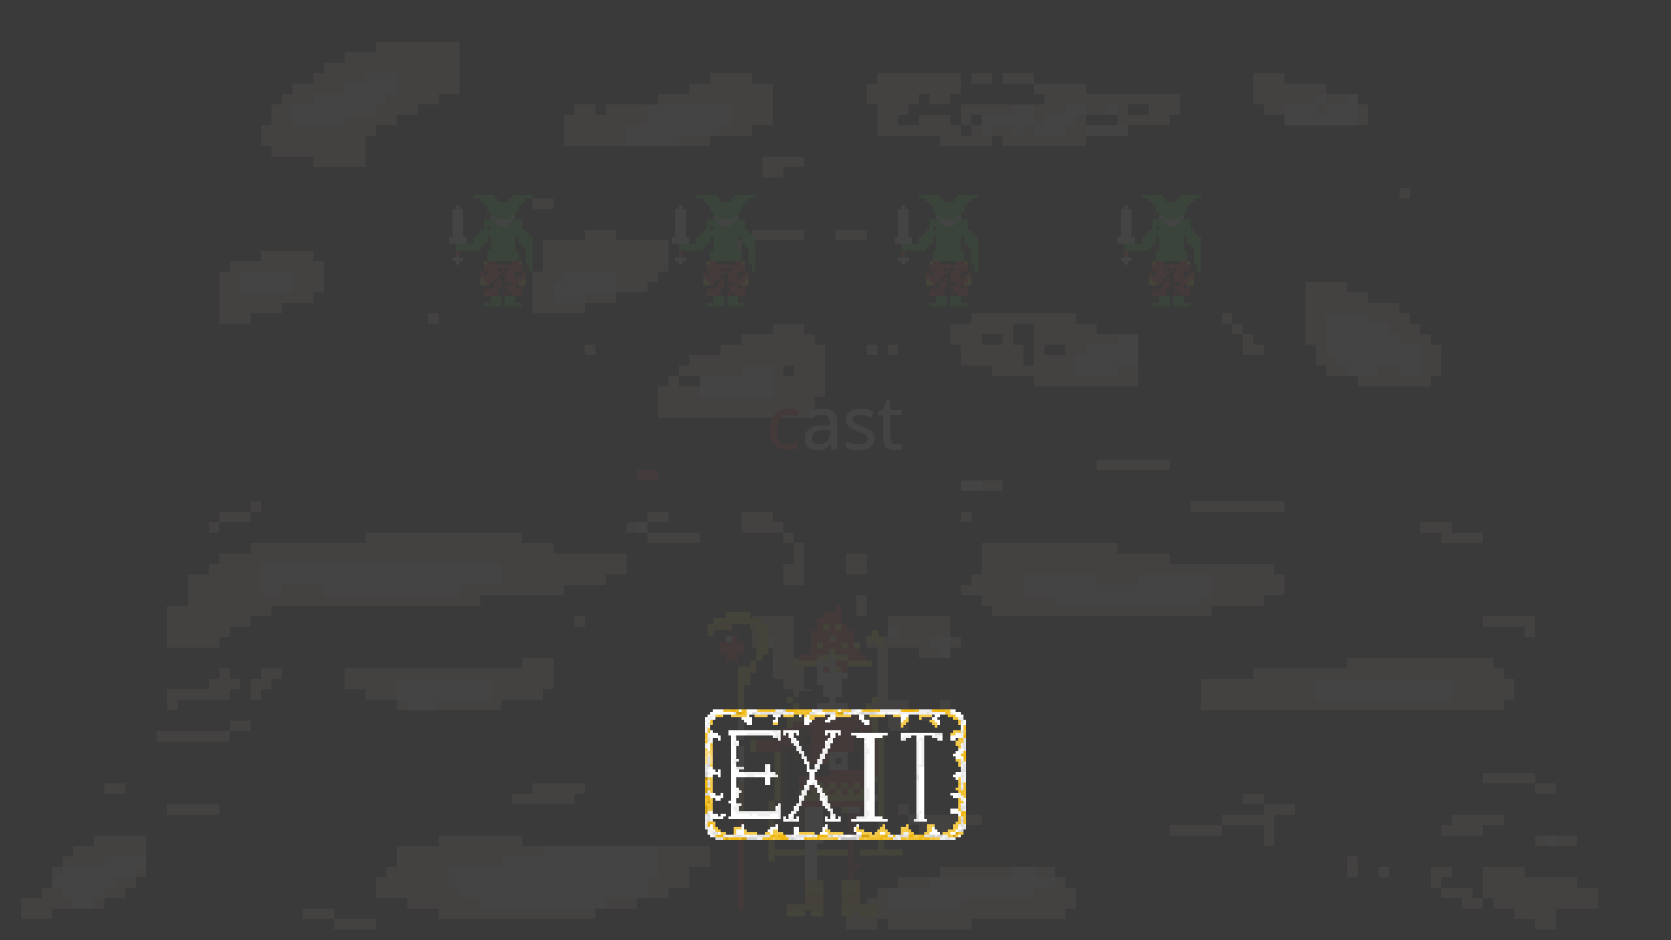
Gameplay Mechanics – Pause screen
Of course, the player will be able to pause the game at any moment they wish by pressing “Esc”, from here the player can exit to the main menu if they wish.

Slide 11
Future Aspirations
Initially, we set off to build this project with multiplayer compatibility in mind, Players would be able to build teams to fight monsters collectively. The team would function as one singular unit and be eliminated

Slide 12
End

