Slide 1
Gamma-ray imaging in Nuclear Security – Compton Imaging
Yigong Zhang
John Davis

Slide 2
Outline
Motivation
Compton kinematics
Image reconstruction
Challenges

Slide 3
Motivation
Detect threat source in the environment
Dirty bomb
Map radionuclide distribution
Cs-137 in Fukushima
Astrophysics study
f
Notes:
For the gamma-ray imaging in nuclear security application,
We wish to localize threat source in the environment to prevent terrorist activity, like dirty bomb detonation.
And we can also use it to map radionuclide distribution to tell the radiation background in certain area, like Cs-137 leakage in Fukushima.
Compton imaging also has application in astrophysics study. It can be used to image the activity of a star.

Slide 4
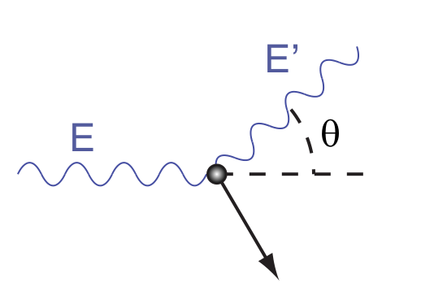
Compton Kinematics
Known:
E’
E_tot = E’ + E_dep
3D positions of the interactions
Unknown:
Incoming gamma-ray direction
E’ = f(E_tot,θ)
Notes:
We talked about Compton scattering in X-ray CT. It’s a bad thing for X-ray CT since it gives us noise in back projected image. But here, we are gonna make an image out of it.
Here’s the compton kinematics. The scattered gamma-ray energy is a function of incoming energy and the scattering angle.
What are known here are: total energy E, and scattered energy E’.
What we are trying to find is the incoming gamma-ray direction.

Slide 5
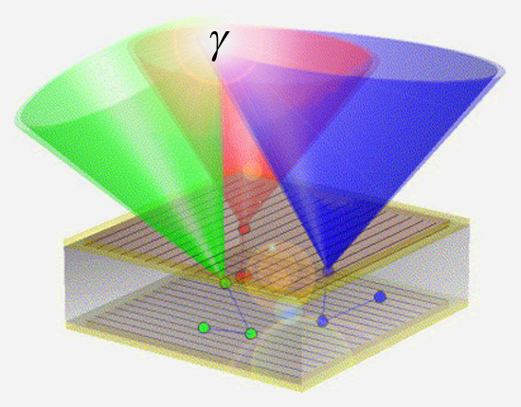
Image reconstruction
E’
E_tot
theta = g(E_tot, E’)
Notes:
The symbols, colored with blue, are the known information: Total energy and scattered energy. So we can calculate the scattering angle theta through Compton kinematics. Then, with the information on the location of interactions, a cone surface can be reconstructed to represent the possible location of the source. So each interaction sequence gives us a cone surface like this. With more and more events detected, the source location can be reconstructed more accurately.
This is the back projection.

Slide 6
Challenges
Energy resolution
High Purity Germanium
CdZnTe
Position resolution
Complex readout electronics
100+ readouts within 2cm by 2cm
Notes:
What’s the challenge in making a Compton imager? So first, only the detectors that are able to provide excellent energy and 3D position resolution can be used. For energy resolution concern, detector crystal that are commonly used are HPGe and CZT. They are expensive!
To have a 3d position resolution, we need to pixellated the readout. The complex readout electronics after the pixellation is another challenge. For example, in the pixellated CZT detectors, more than 100 readout are within an area of 2cm by 2cm.

Slide 7
Challenges
Multiple interactions
Sequence reconstruction
Insert picture on sequence reconstruction
Notes:
In the event reconstruction, you might ask how do you know where the gamma-ray first fit in the detector. Why not the other way around? To be honest, I don’t know, either. But Each scat

Slide 8
Challenges
High sensitivity for Energy > 150 keV
Insert cross section comparison plot.
Notes:
Show compton, pair, and photoelectric effect cross section plot.

