Slide 1
IBM CAPSTONE PROJECT – The Battle of Neighborhoods: Chinese restaurants in New York City

Slide 2
Background
More and more Chinese restaurants in NYC:
The number of Chinese immigrants has risen sharply in NYC.
The U.S. is currently home to more than 40,000 Chinese restaurants Record-low sales
The need to enjoy Chinese cuisine is on the rise.

Slide 3
Business Problem
1. What is / are the best location(s) for Italian cuisine in New York City?
2. In what Neighborhood and/or borough should I open an Italian restaurant to have the best chance of being successful?
3. Where would I go in New York City to have the best Italian food?

Slide 4
Data and Methodology
Data:
New York City data containing neighborhood boundaries will be obtained from the data source: https://data.cityofnewyork.us/City-Government/Borough-Boundaries/tqmj-j8zm
All data related to locations and quality of Italian restaurants will be obtained via the FourSquare API utilized via the Request library in Python.
New York City data containing the neighborhoods and boroughs, latitudes, and longitudes will be obtained from the data source: https://cocl.us/new_york_dataset
Mehodology:
Collect,clean and extract useful Data;
Explore and Understand Data;
Data visualization;

Slide 5
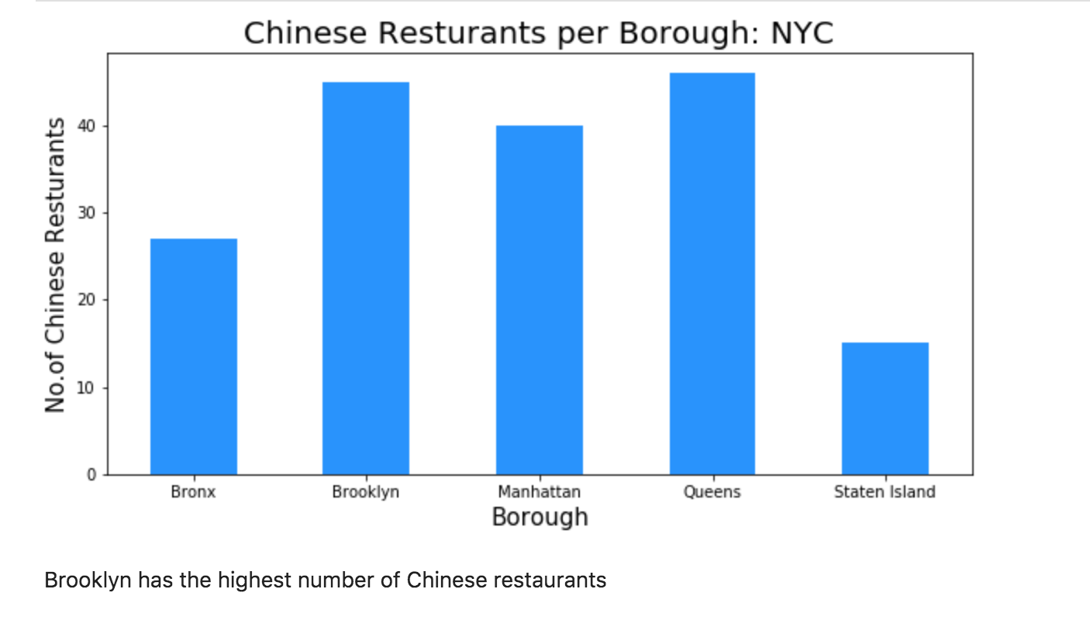
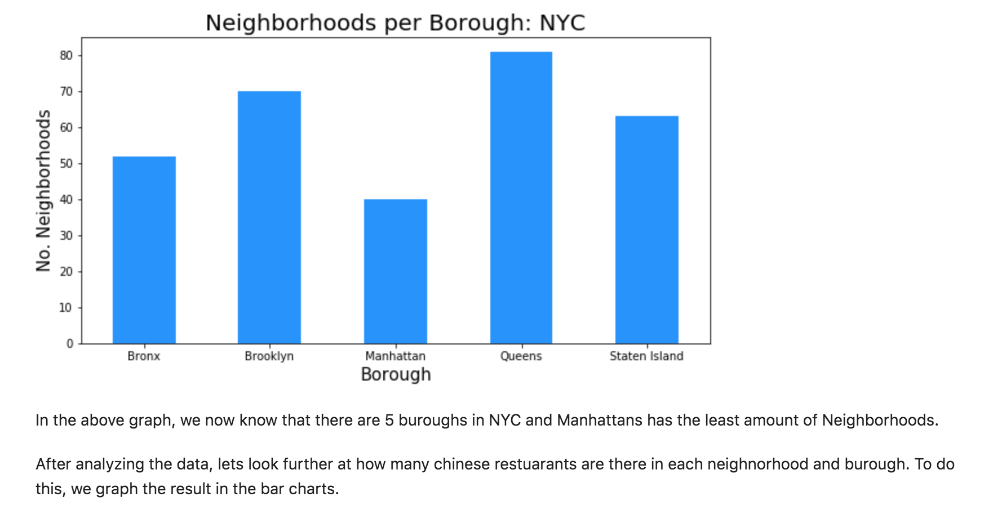
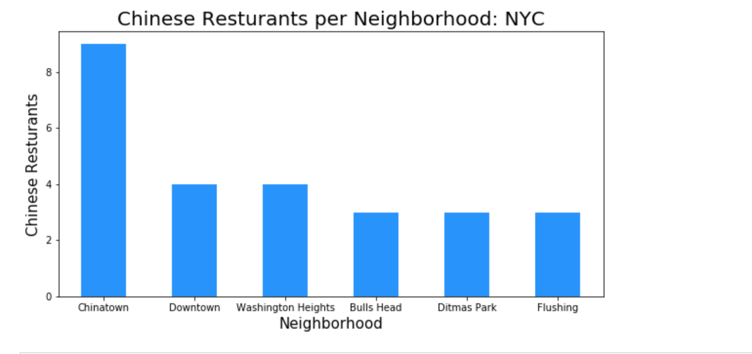
Results

Slide 6
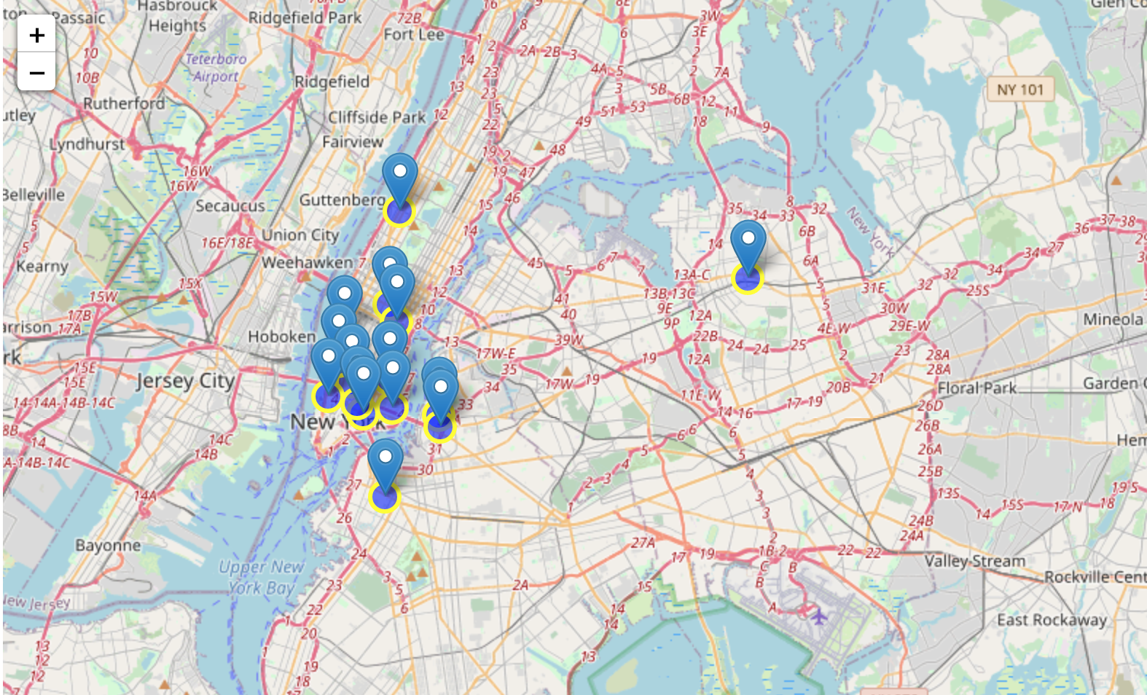
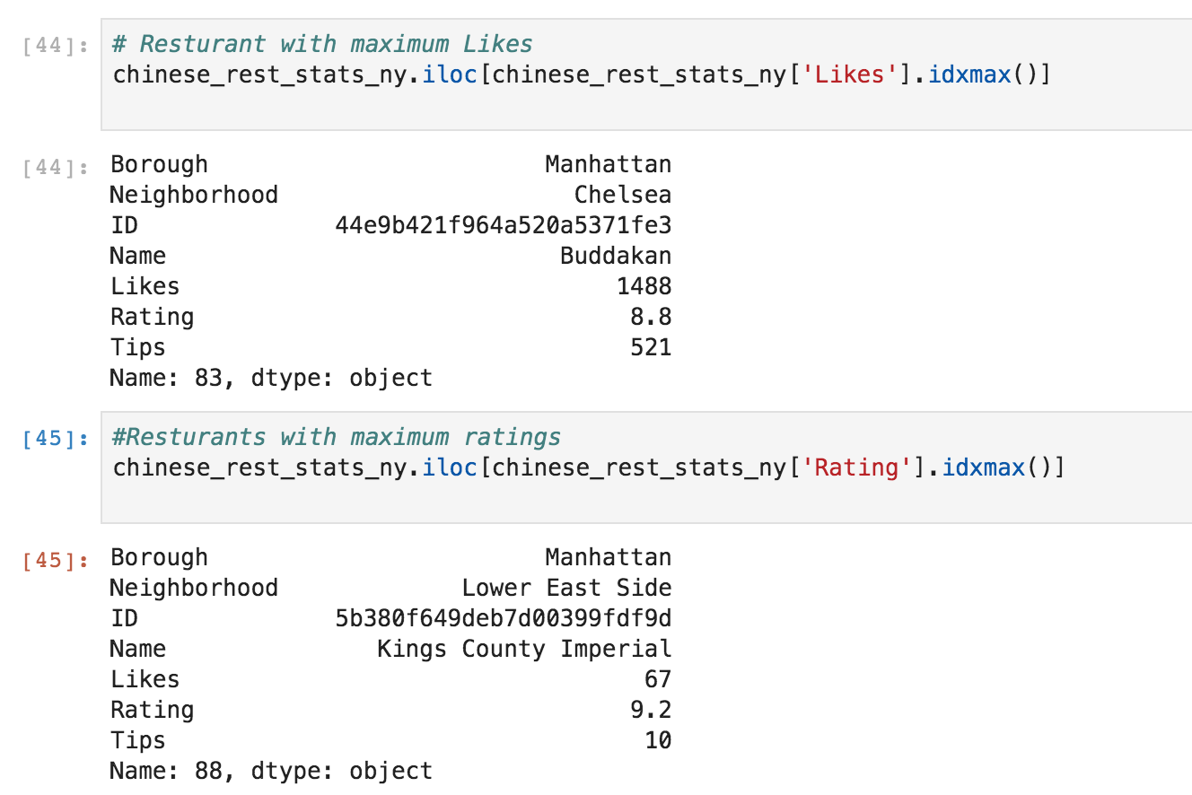
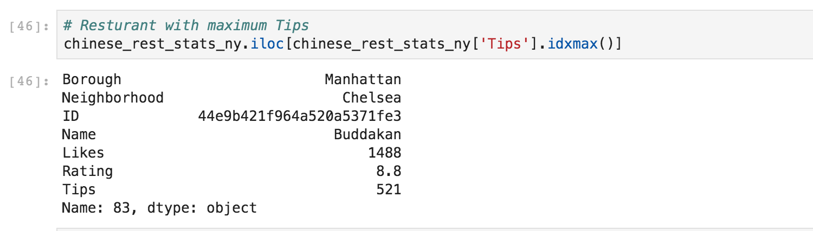
Results

Slide 7
Solution
Clustering London neighborhoods in order to recommend venues and the current average price of real estate where homebuyers can make a real estate investment.

Slide 8
Conclusion/ Discussion:
Based on likes, I will recommend Buddhakam in Manhattan to be the best location for Chinese cuisine.
Based on the number of Chinese resturants, I will recommend Brooklyn and Queen to be the area to try different new Chinese food.
Based on density on the map and also ratings, I will recommend opening a restaurant in Manhattan as the area has the highest average tips and less competitive than Brooklyn and Queen.
We definitely have bias in this research since we will be only using Foursquare. To get a more comprehensive

