Slide 1
Causes for Percentages of Total Water in Different Carriers in the Water Cycle.
CMSE 201, section 005, created by Yihan Wang

Slide 2
The research question for this project is, what affects the percentage of total water in different carriers in the water cycle?
The model that I applied to my chosen topic for this project is water cycle compartmental model
The computational techniques that I used to run my model are numerical simulation with ordinary differential equations, data visualization, parameter definition and initialization, and percentage analysis.
The answer I arrived at is that,
if the water cycle is simple, circling one way, and fixed water flow rate, then no matter what kind of water distribution initially, the distribution after several days only depends on the rate of water flow in each carrier.
For more complicated water cycle, initial water distribution and rate of water flow both matters.

Slide 3
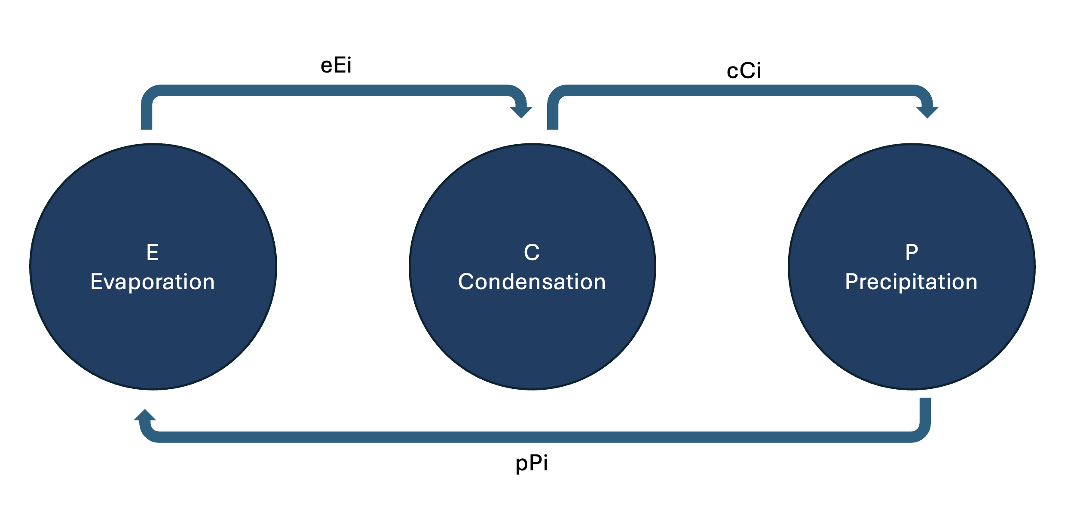
To answer the question, I first created an Evaporation, Condensation, and Precipitation Model.
Water traveling through the three compartments, can be represented graphically as a compartmental model

Slide 4
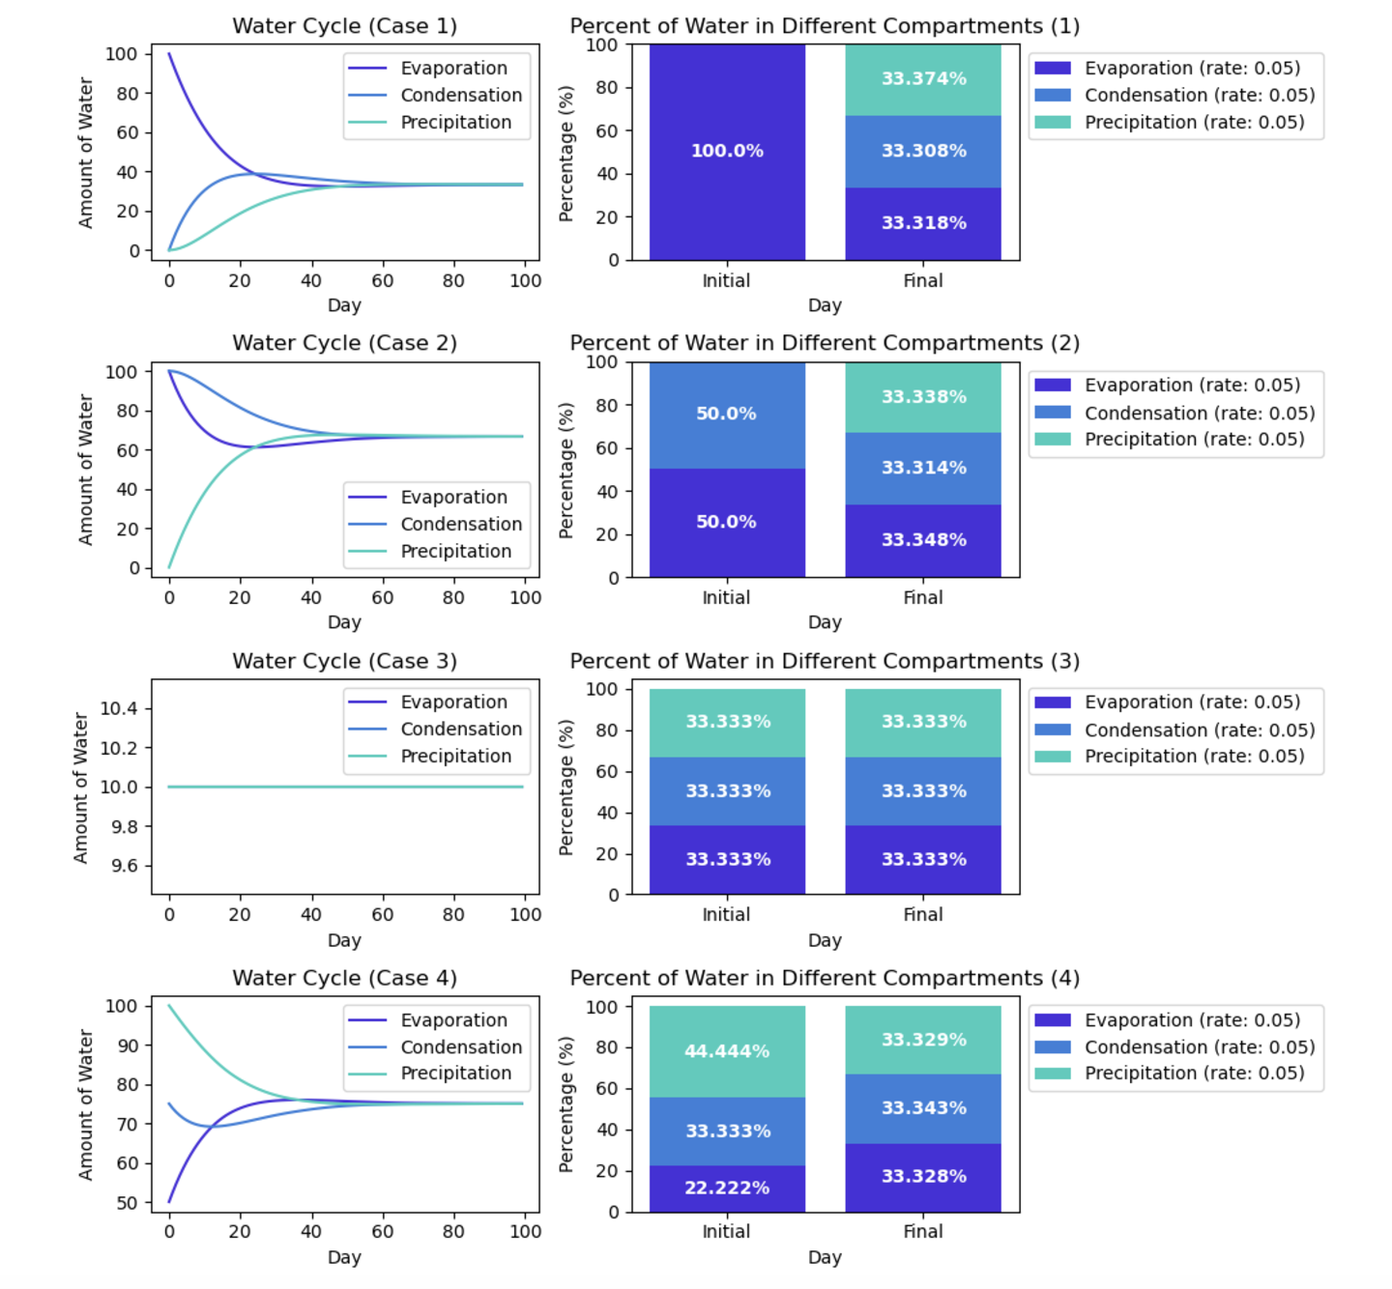
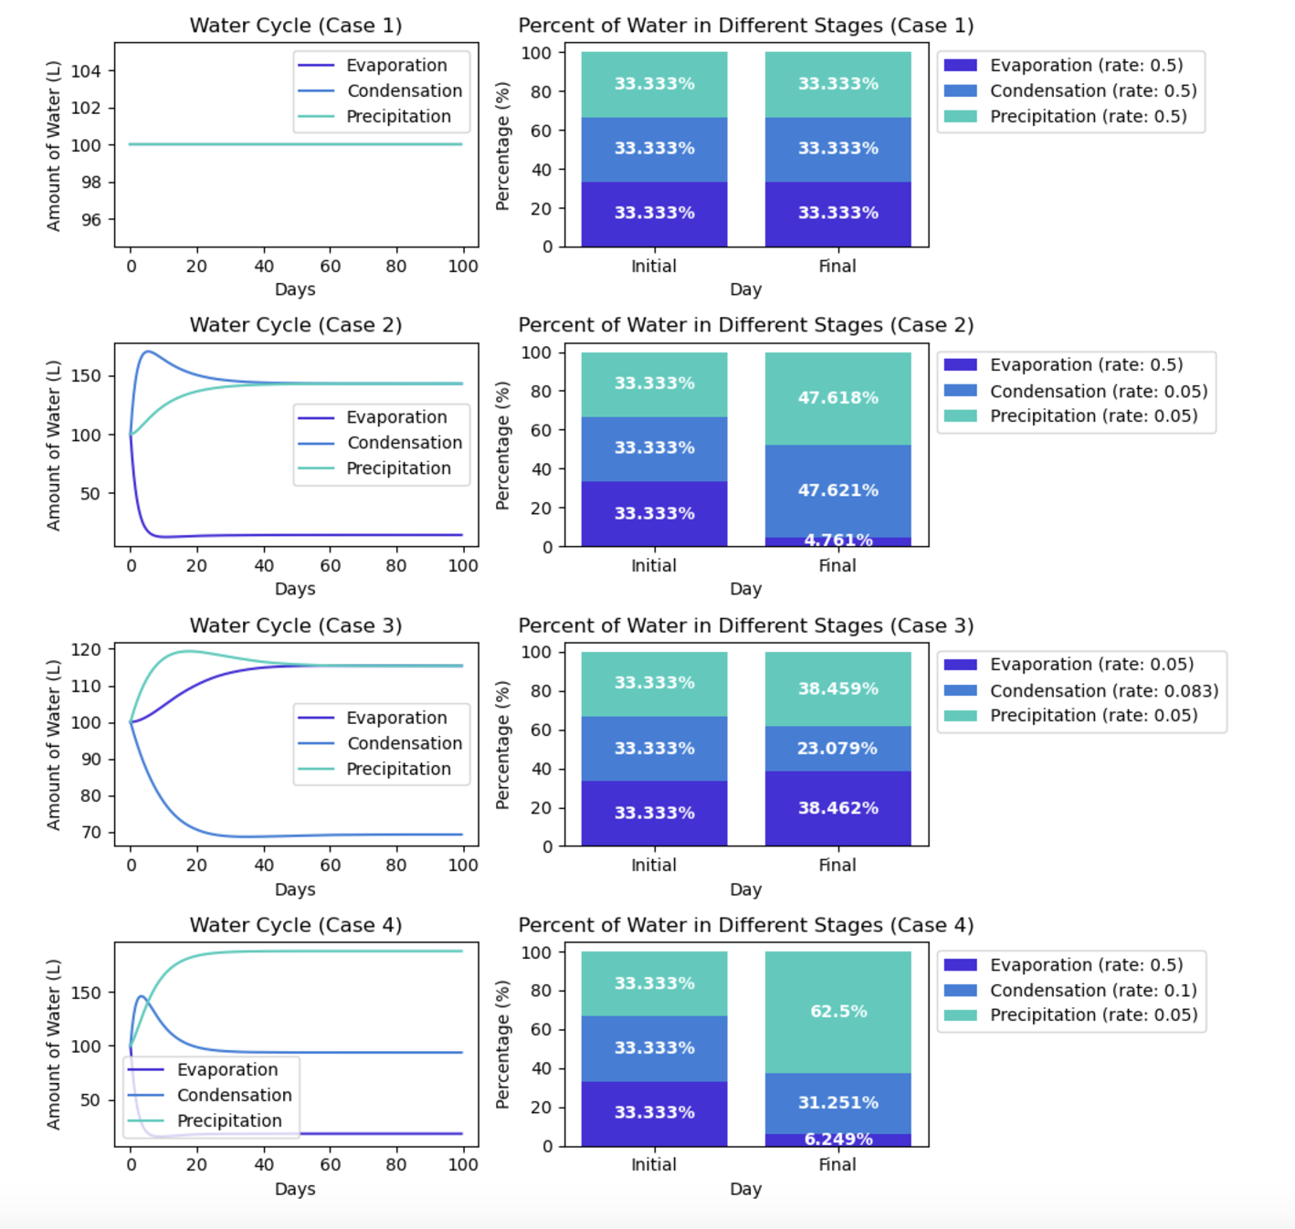
On the left is testing the affect of changing initial water distribution on final water distribution. On the right is testing the affect of changing water flow rate of each compartments on final water distribution.

Slide 5
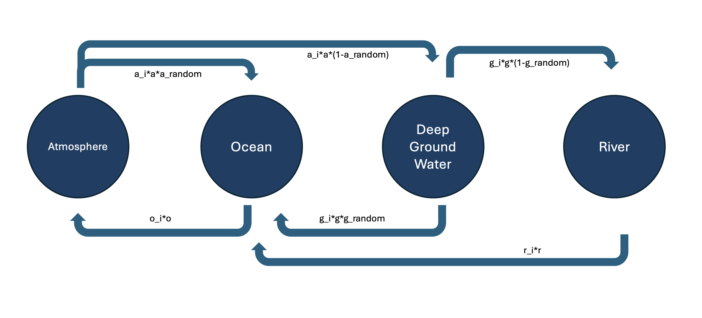
Another simple water cycle model, Ocean, Deep Ground, Atmosphere, and River Model was created to help answer the question. This time it was designed to reflex real life situation more.
Water traveling through the compartments can be represented graphically as a compartmental model

Slide 6
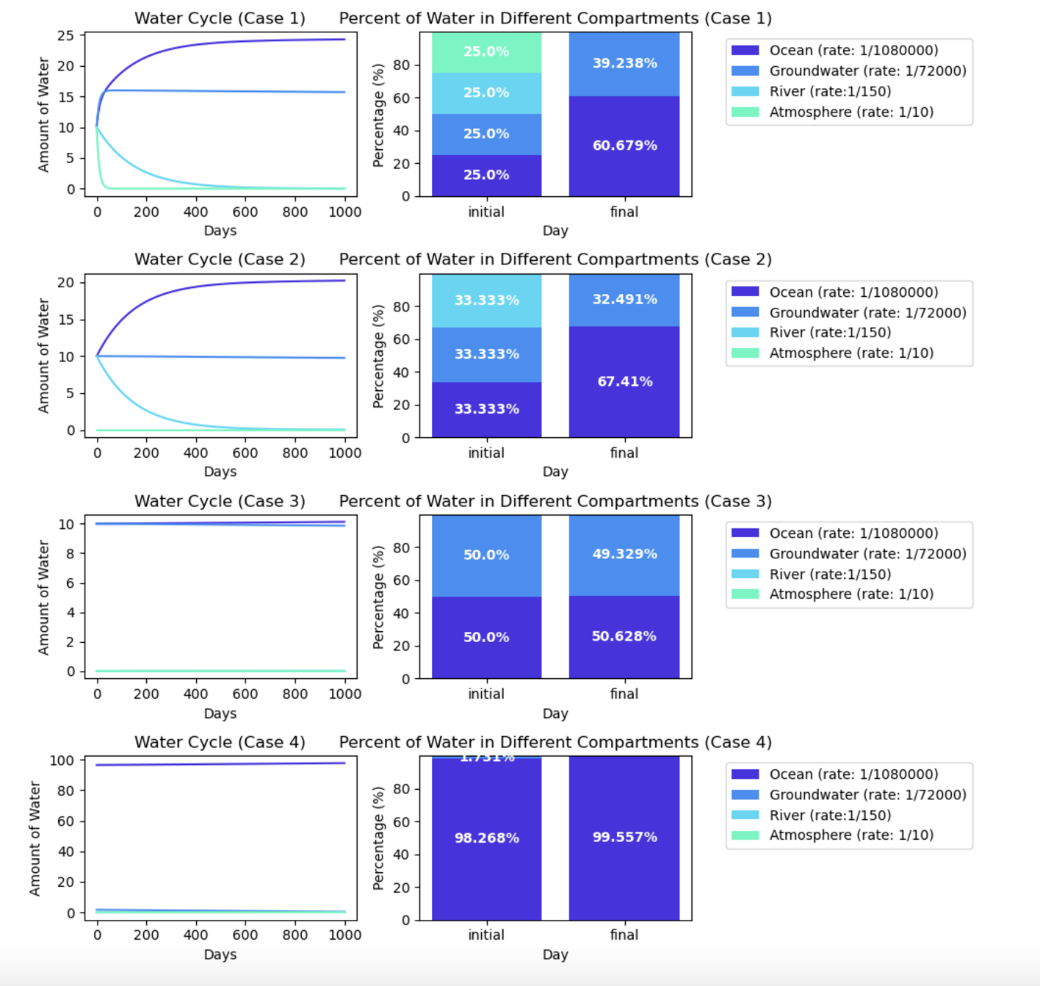
One the left is testing how changing initial water distribution affects final water distribution for the compartments in Ocean, Groundwater, River, and Atmosphere Model that reflects real life scenario.

