Slide 1


Building Compartmental Models

Slide 2


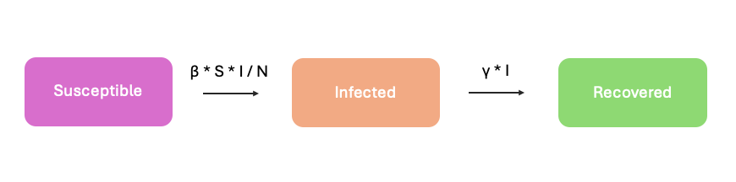

What is Compartmental Models?
A compartmental model is a mathematical way of representing a system by dividing it into separate “compartments” (or groups), and then describing how something moves or changes between those compartments over time
Think of it like splitting a population or system into categories and tracking how individuals or quantities flow between them.

Slide 3
Common example: Disease spread
The model consists of 3 groups:
- S (Susceptible): people who can catch the disease
- I (Infected): people who have the disease and can spread it
- R (Recovered): people who have recovered and are immune
The model uses equations to describe how people move between groups each step (rate of change every step)
- from S -> I (when they get infected)
- from I -> R (when they recover)

Slide 4
Common example: Disease spread
The model consists of 3 groups:
- S (Susceptible): people who can catch the disease
- I (Infected): people who have the disease and can spread it
- R (Recovered): people who have recovered and are immune
The model uses equations to describe how people move between groups each step (rate of change every step)
- from S -> I (when they get infected)
- from I -> R (when they recover)

Slide 5
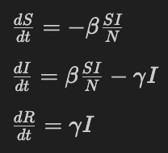
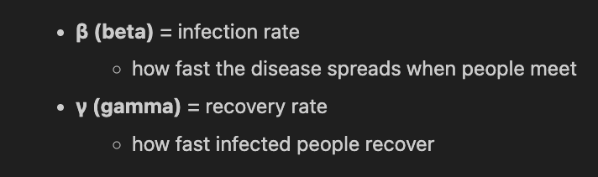
Let’s build the basic SIR model
We split the population into three compartments:
S(t): susceptible
I(t): infected
R(t): recovered
Total population: N = S + I + R
The differential equations: The parameters:

Slide 6
Assignment instructions
In today's class you will be building three compartmental models.
Form a group 2-3 students
You may start with 5 minutes to brainstorm with your group, drawing a variety of variants of possible models.
10 minutes to draw the model your group came up.
5 minutes share idea with the whole class

Slide 7


A Cold Spreads Through a Dorm
A student in a college dorm gets sick on Monday. By Wednesday, several students on the same floor are coughing. Some students isolate in their rooms. Others recover and return to class.
Think about:
- What groups of students exist?
- How do students move between groups?
- What causes the spread to speed up or slow down?

Slide 8

A Viral Dance Trend on TikTok
A new dance trend appears online. At first only a few people share it. Then suddenly everyone seems to repost it. After two weeks, people get bored and move on.
Think about:
- Who has not seen the trend?
- Who is actively sharing it?
- Who lost interest?
- How does the trend “spread” like a disease?

Slide 9


Traffic Jam During Rush Hour
Cars move smoothly early in the morning. As more vehicles enter the highway, traffic slows. One small accident causes a long traffic jam. Eventually the road clears again.
Think about:
- What traffic “states” exist?
- How do cars transition between them?
- What factors create bottlenecks?

Slide 10


Forest Fire in Dry Weather
A lightning strike starts a fire in a dry forest. Nearby trees catch fire quickly because of strong wind. Eventually the fire dies out after fuel is exhausted.
Think about:
- Which trees are vulnerable?
- Which are actively burning?
- Which are already destroyed?
- What controls how fast the fire spreads?

Slide 11
install Scipy
in terminal, run either one:
conda install -c conda-forge scipy
python -m pip install scipy
to import copy the following:
from scipy.integrate import solve_ivp
import numpy as np

Slide 12
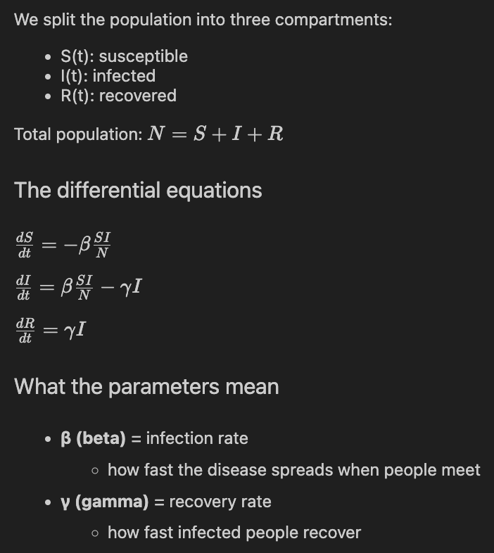
Let’s model the basic SIR model
To model this in code, we will use the solve_ivp function from the scipy library

Slide 13
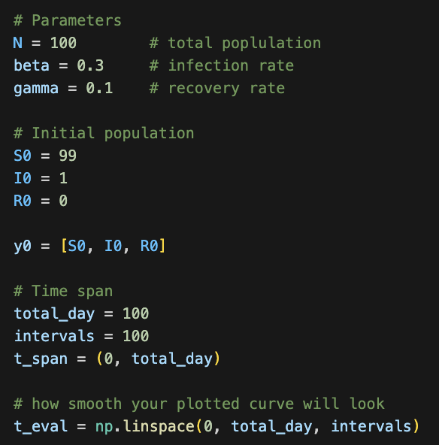
Let’s model the basic SIR model
First let us define the initial parameters, population, and time span

Slide 14
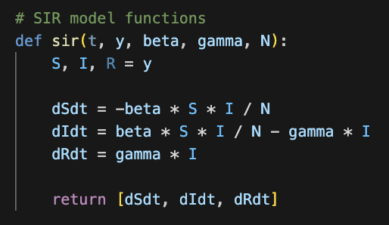
Let’s model the basic SIR model
Then let us define the SIR model functions.
In the parameters are the constants we are using
T is the current step in time, y is the current population
Below are the rate of change in population of each group
Finally, return current rate of change

Slide 15
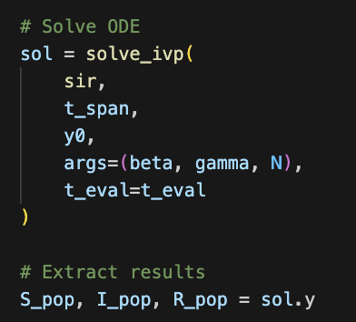
Let’s model the basic SIR model
Finally, let us give everything to the solve_ivp function, which will model the system from day 0 to 100, for 100 intervals (as what we defined)
sol.y will return back lists of the population of each group at every step

Slide 16
install
to install in terminal type:
conda install conda-forge::matplotlib
or
python -m pip install -U matplotlib
to import:
import matplotlib.pyplot as plt

Slide 17
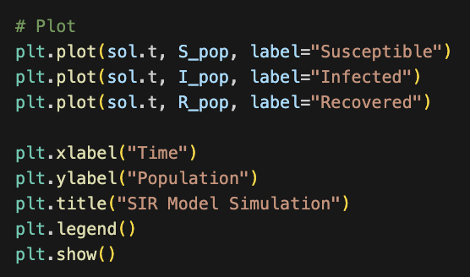
Let’s model the basic SIR model
sol.t returns a list of the individual step intervals.
Let us plot the population of each group at each step

Slide 18
Make your own model
think of a topic that you are interested in. Define the groups of people in the system. Draw arrows to indicate how people flow from one group to another. After this, define the rate of change of each group (ex: people/day)

Slide 19
Make your own model
Recall in the example model, we split the population into three compartments:
S(t): susceptible
I(t): infected
R(t): recovered
Total population: N = S + I + R
The differential equations: The parameters:

Slide 20
Make your own model
how are the derivatives defined?
for dS/dt -
The number of susceptible people decreases only when they become infected.
To model infections, we assume:
each infected person has about β potentially infectious contacts per unit time;
the probability that a contact is with a susceptible person is S/N, since S out of the N people are susceptible.
So one infected person causes approximately βS/N​ new infections per unit time.
In total: I * β * S / N

Slide 21
Make your own model
for dR/dt -
Recovered people only increase when infected people recover.
If the recovery rate of infected people are γ, and there are totally I people at that day, γ * I people will change into recovered people per day

Slide 22
Make your own model
for dI/dt -
In previous two slides, we just defined the amount of susceptible people change to infected per day and how many infected people change to recovered per day, the change for infected people will be dI/dt = I * β * S / N - γ * I

