Slide 1
Making Predictions Using Data
An Introduction

Slide 2
Introduction
Core Idea
Regression is the process of finding a mathematical relationship between variables so that we can:
- Understand the relationship (e.g., how does density change with altitude?)
- Make predictions for new values of x
In this notebook, we will explore how to use data to make predictions.
We will start out using a line of best fit to make predictions. This is called linear fitting ( or simple linear regression).

Slide 3
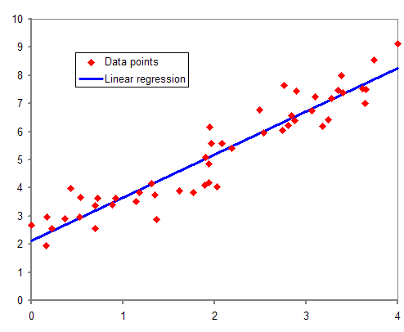
1. Linear Regression
Equation
For linear regression, we are trying to fit the data with a classic slope-intercept equation:
y = mx + b
y= β0​ + β1 ​x or y​= a + b x
They mean the exact same thing: a slope and a y-intercept
Term | Meaning
Independent variable (x) | The variable you control or observe
Dependent variable (y) | The variable you are trying to predict
Parameters | The constants in the model (m, b, a, β0, β1) that are adjusted during fitting
Residual | The difference between observed and predicted values
Least Squares | The method of minimizing the sum of squared residuals
R² | A score from 0–1 measuring how well the model fits the data

Slide 4
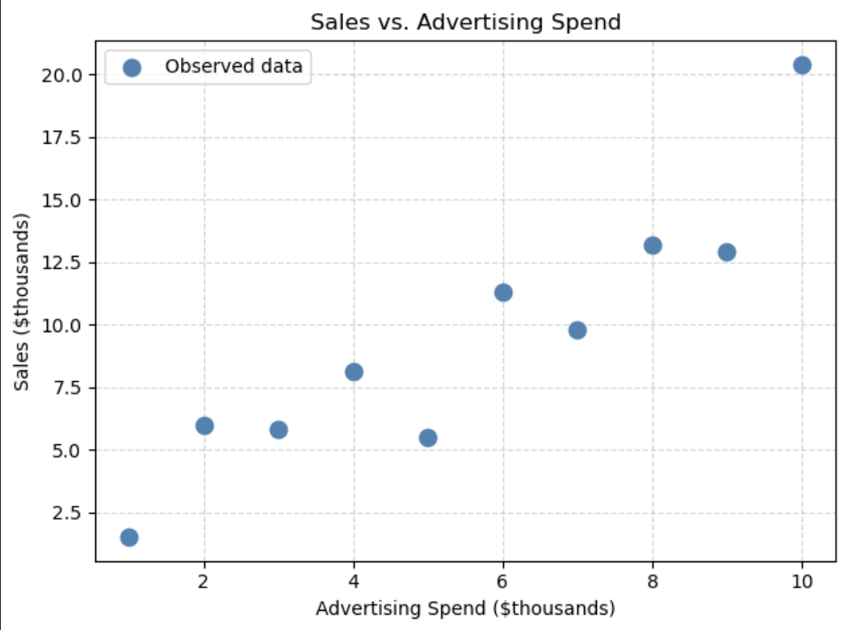
2. Predicting Future Trends
Core Idea
Imagine you are running a business. You have collected data on how much money was spent on advertising and the corresponding sales figures each month.
Key question: If you increase your advertising budget, can you predict how much your sales will increase?
Let's start by plotting the data to look for a trend.

Slide 5
Predicting Future Trends
Core Idea
Looking at the scatter plot above:
1. Does there appear to be a relationship between advertising spend and sales?
2. As advertising increases, what happens to sales?
3. If you spent $11,000 on advertising, what would you predict the sales to be?
Your prediction: _____

Slide 6
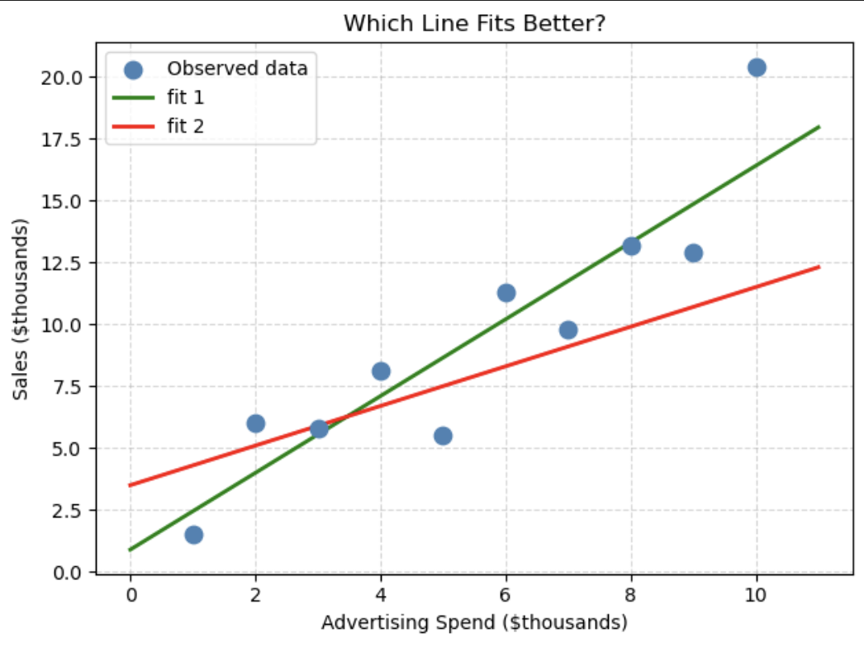
3. Determining the Line of Best Fit
Core Idea
When data shows a linear trend, we can draw a straight line through it. But which line is best?
Consider two candidate lines below.

Slide 7
Determining the Line of Best Fit
Core Idea
The line of best fit (also called a regression line) is the best line, it is a line that minimizes the sum of the squared residuals, where a residual is the difference between an observed value and the value predicted by the line.

Slide 8
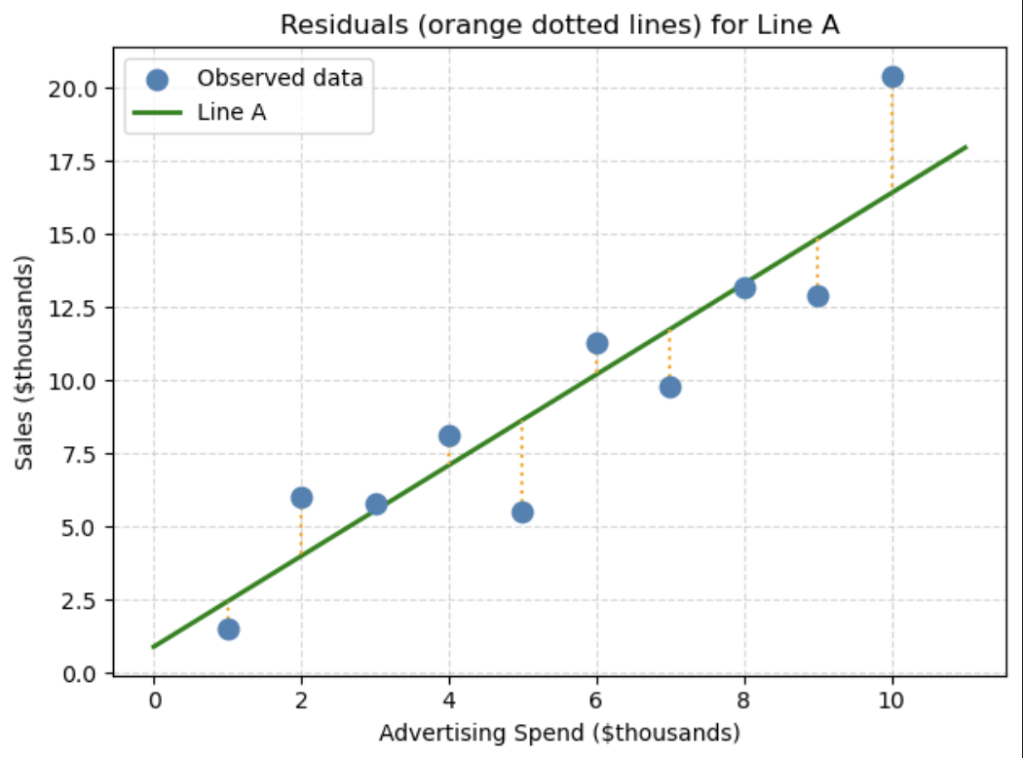
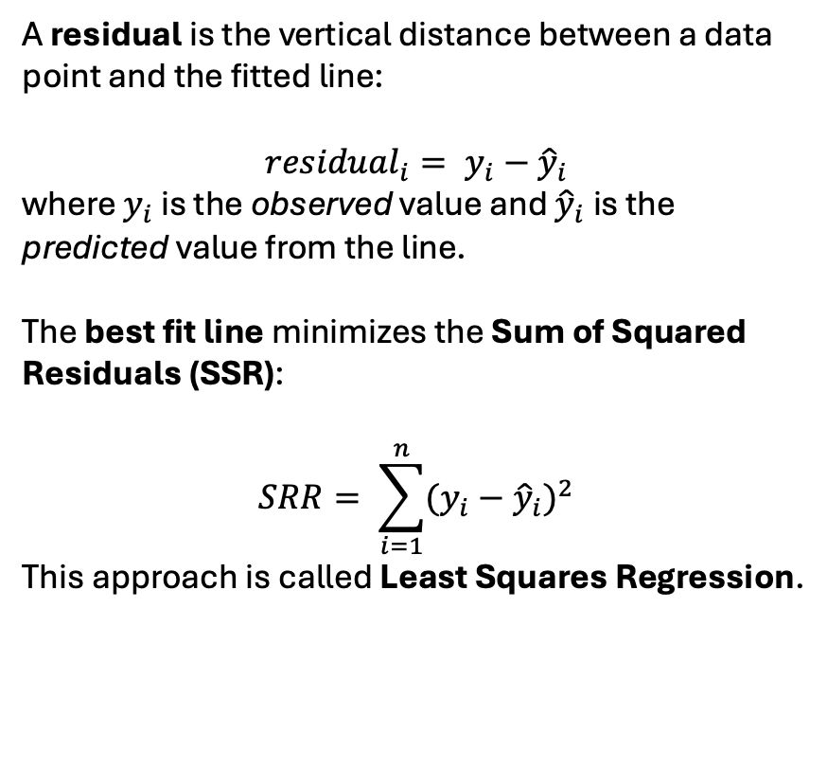
Determining the Line of Best Fit
What is residuals?
A residual is the vertical distance between a data point and the fitted line:
$${residual}_{i}= y_{i}−{\hat{y}}_{i}$$
where $y_{i}$ is the observed value and ${\hat{y}}_{i}$is the predicted value from the line.
The best fit line minimizes the Sum of Squared Residuals (SSR):
$$SRR= \sum_{i=1}^{n}{{(y_{i}−{\hat{y}}_{i})}^{2}}$$
This approach is called Least Squares Regression.

Slide 9
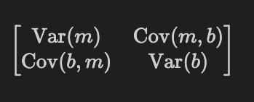
Using a Computer to Fit a Line
curve_fit
curve_fit from scipy.optimize automatically finds the best-fit parameters for any mathematical function you give it.
You need to provide:
1. A Python function that represents your mathematical model (e.g., y = A*x + B)
2. Your x data and y data
curve_fit returns:
- popt — the optimal parameters (e.g., the best values of A and B)
pcov — the parameter covariance matrix (used to estimate uncertainty in the parameters)
If your model is: y = mx + b
popt contain the estimations for m and b
pcov is a matrix like:

Slide 10
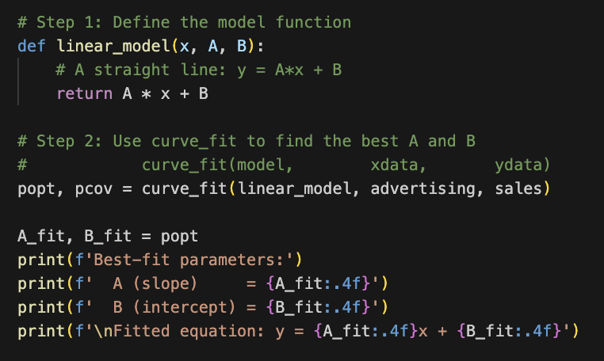
4. Using a Computer to Fit a Line
Example: Fitting a Linear Model
Say we want to fit: y = Ax + B
onto the advertising vs sales data

Slide 11
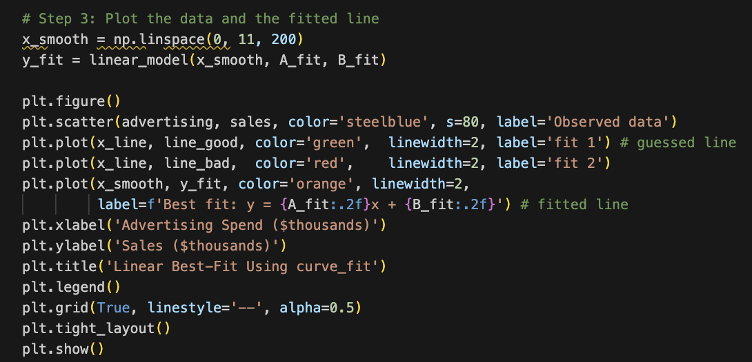
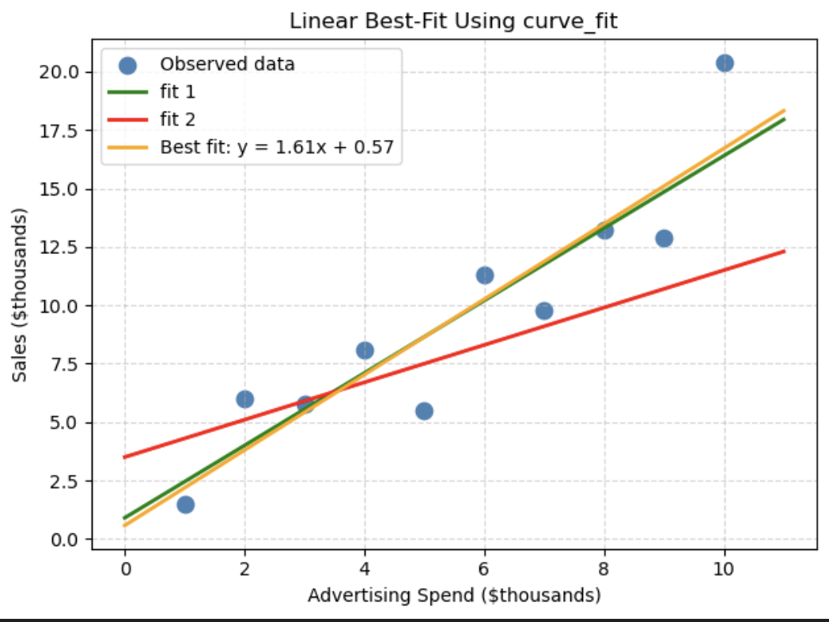
4. Using a Computer to Fit a Line
Example: Fitting a Linear Model
Say we want to fit: y = Ax + B
onto the advertising vs sales data
Let us plot it

Slide 12
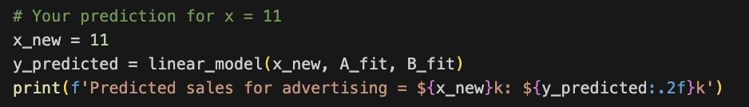
4. Using a Computer to Fit a Line
Example: Fitting a Linear Model
Using the fitted model above, predict the sales if the advertising budget is $11,000 (i.e., x = 11).

Slide 13
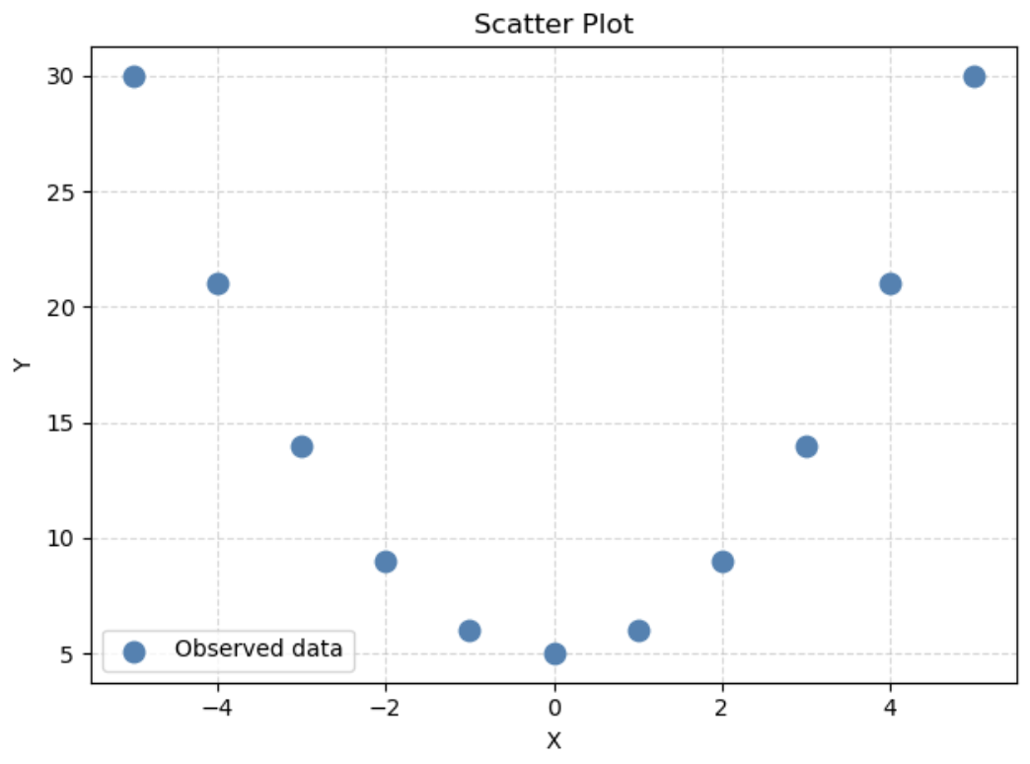
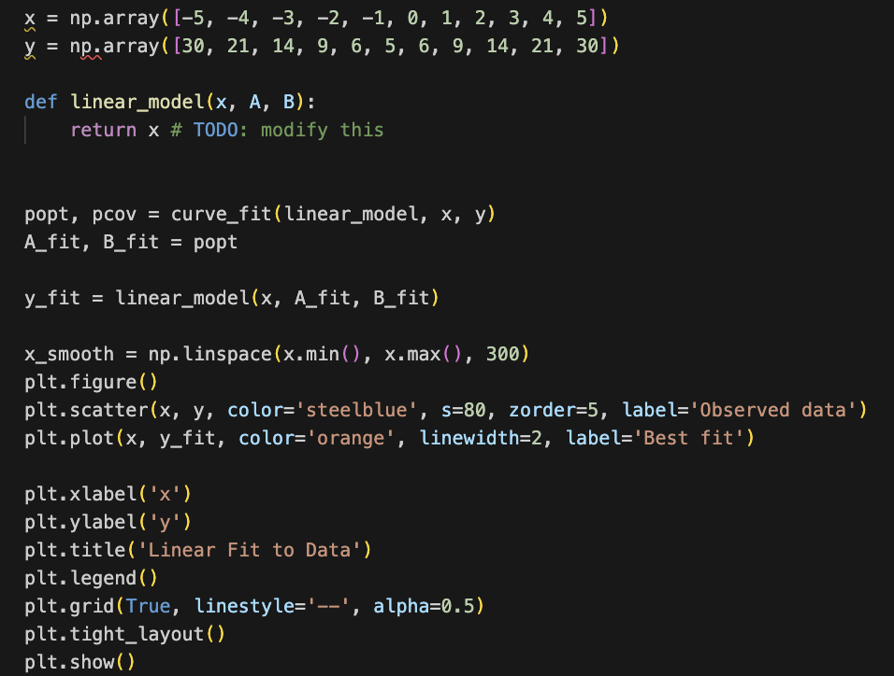
4. Using a Computer to Fit a Line
Try It Yourself
find line of best fit for this:

Slide 14
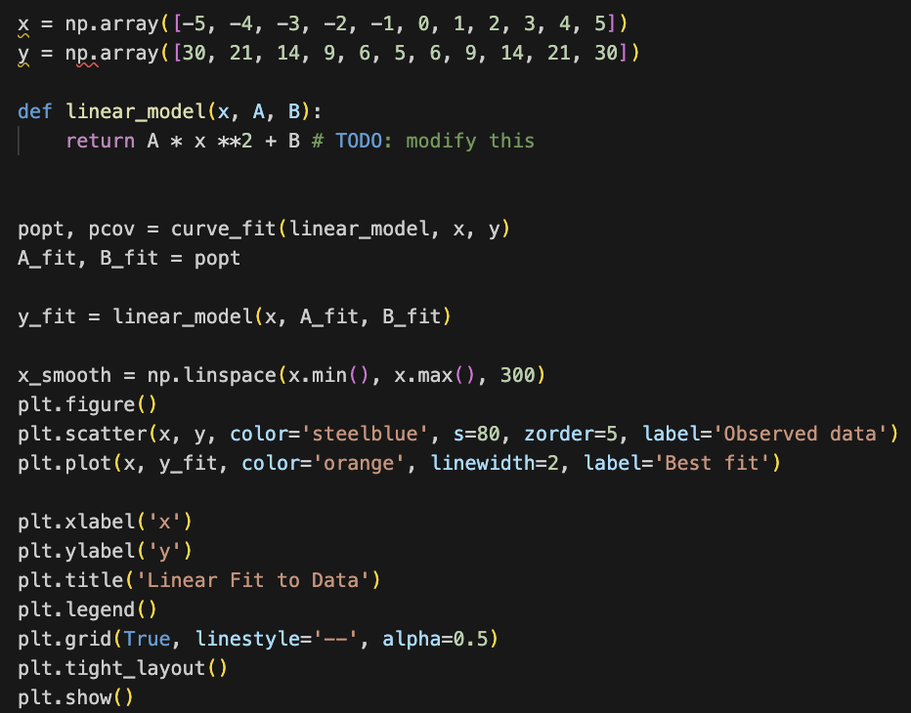
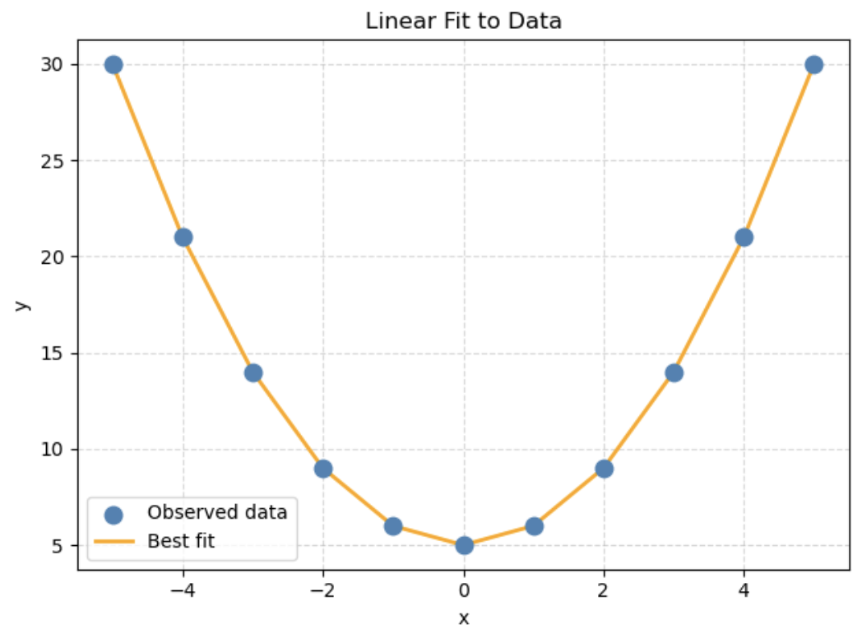
4. Using a Computer to Fit a Line
Try It Yourself
find line of best fit for this - answer

Slide 15
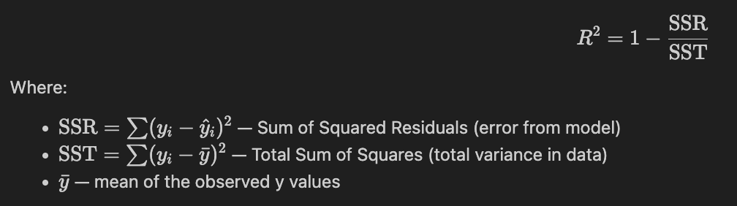
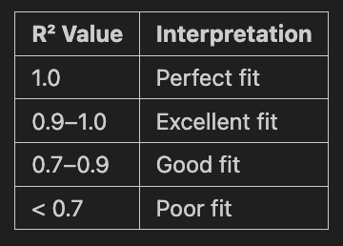
4. Using a Computer to Fit a Line
How Good is the Fit? (Goodness of Fit)
After fitting a model, we need to ask: how well does it describe the data?
The R² (R-squared) Score
R² is the most common measure of goodness of fit for linear fits. It tells you what fraction of the variance in your data is explained by the model.

Slide 16
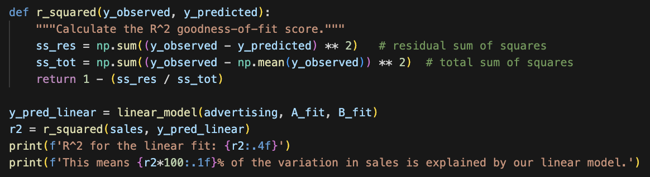
4. Using a Computer to Fit a Line
How Good is the Fit? (Goodness of Fit)
Let us find R² for the sales and advertising data

Slide 17
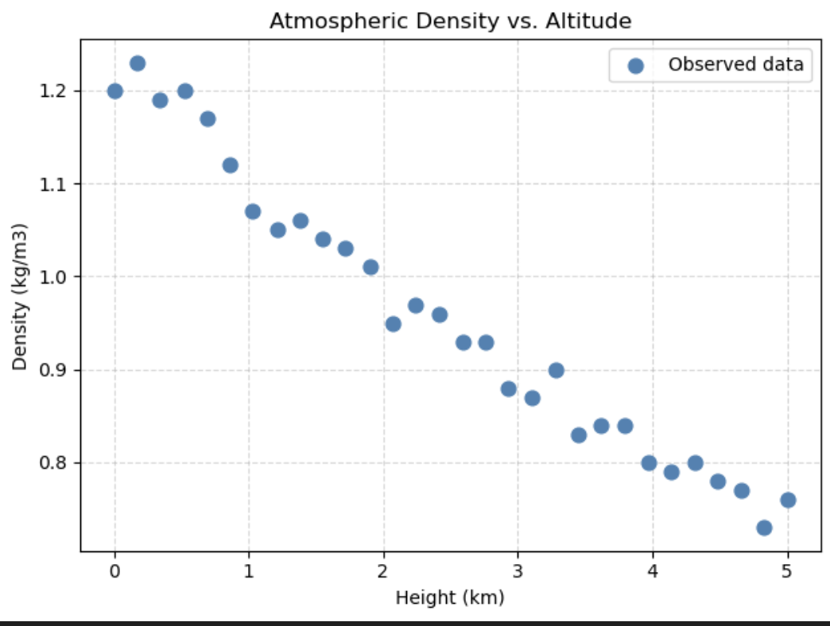
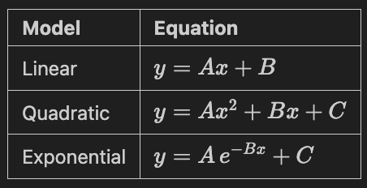
5. Comparing Models: Atmospheric Density vs. Height
How Good is the Fit? (Goodness of Fit)
Now let's apply what we've learned to a real-world physics dataset.
The data below represents atmospheric density (kg/m³) at various altitudes (km) above Earth's surface.
We will test three different models and decide which one fits best:

Slide 18
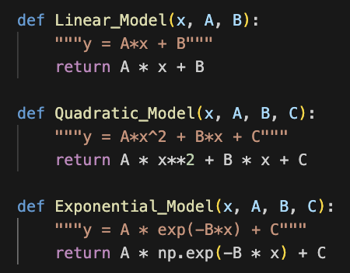
5. Comparing Models: Atmospheric Density vs. Height
Step 1: Define All Three Model Functions

Slide 19
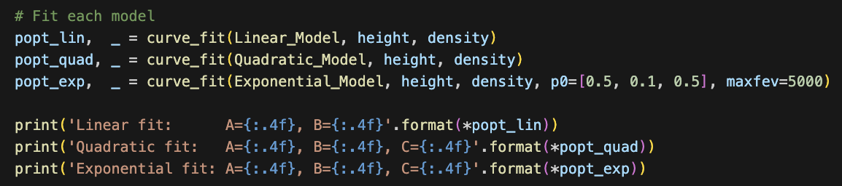
5. Comparing Models: Atmospheric Density vs. Height
Step 2: Fit All Three Models to the Data

Slide 20
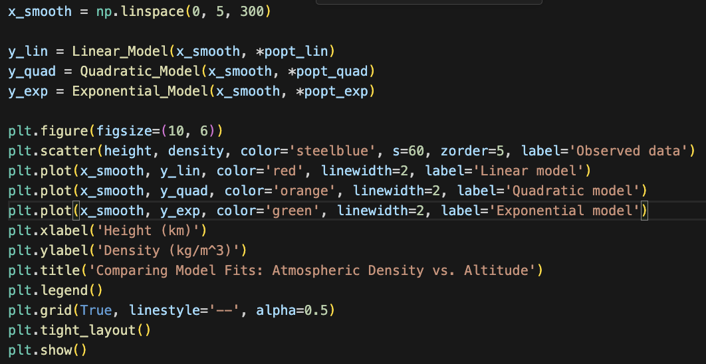
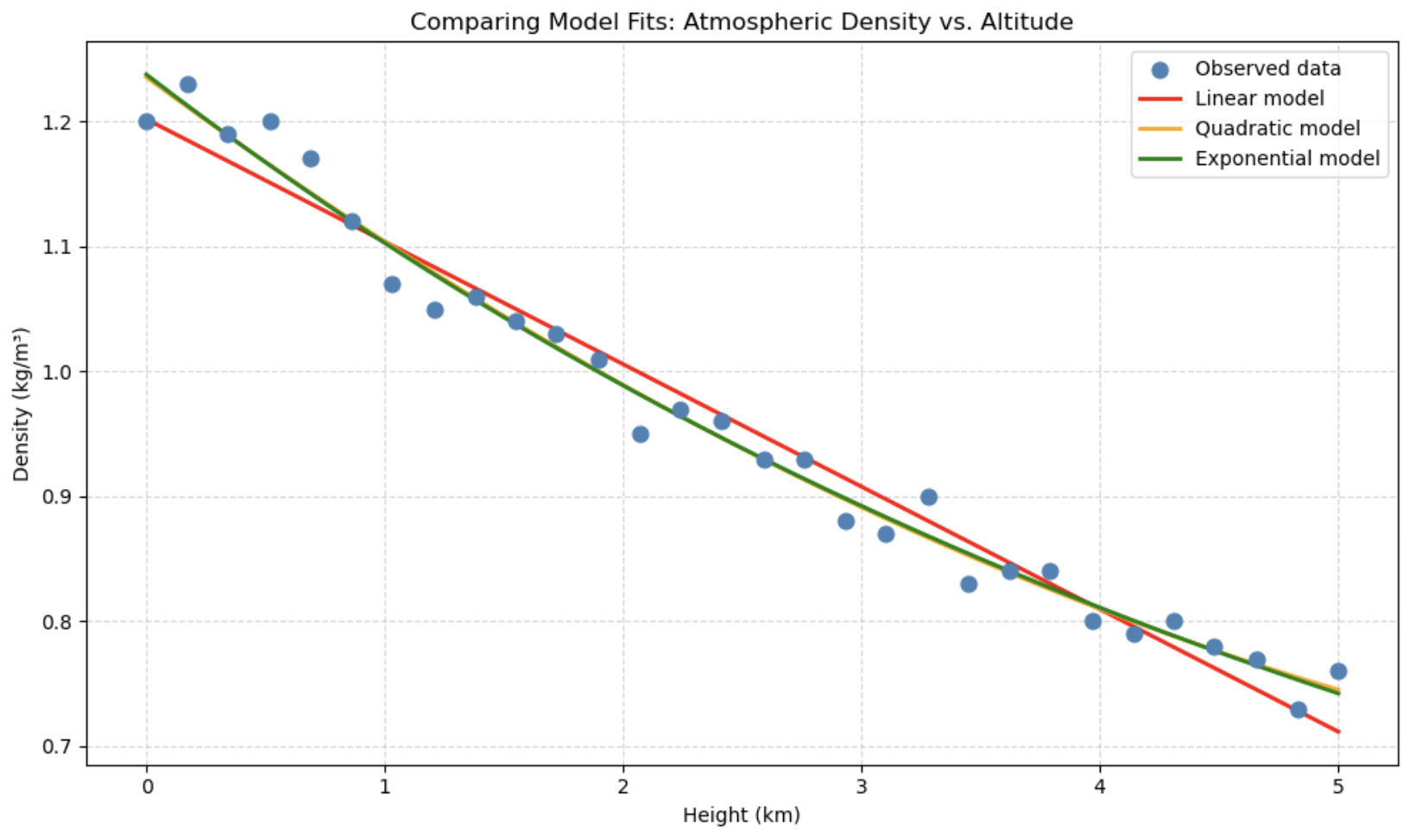
5. Comparing Models: Atmospheric Density vs. Height
Step 3: Plot All Three Fits Together

Slide 21
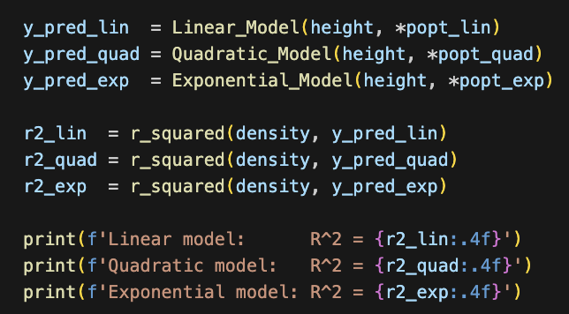
5. Comparing Models: Atmospheric Density vs. Height
Step 5: Examine Residual Plots

Slide 22
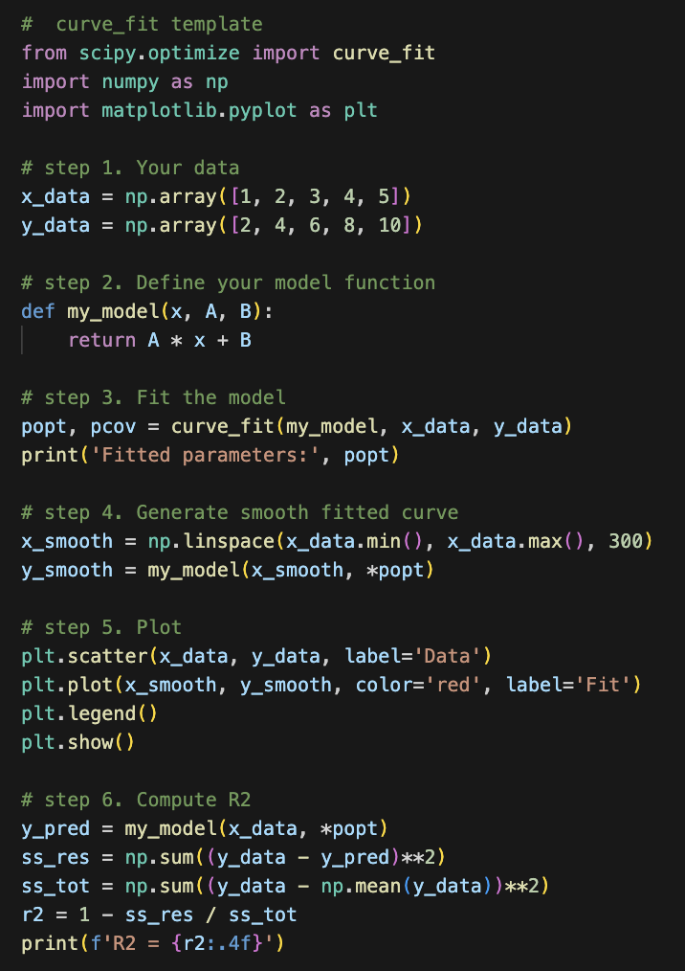
6. Summary: Using curve_fit
Here is a concise template you can reuse for any fitting problem:

Slide 23
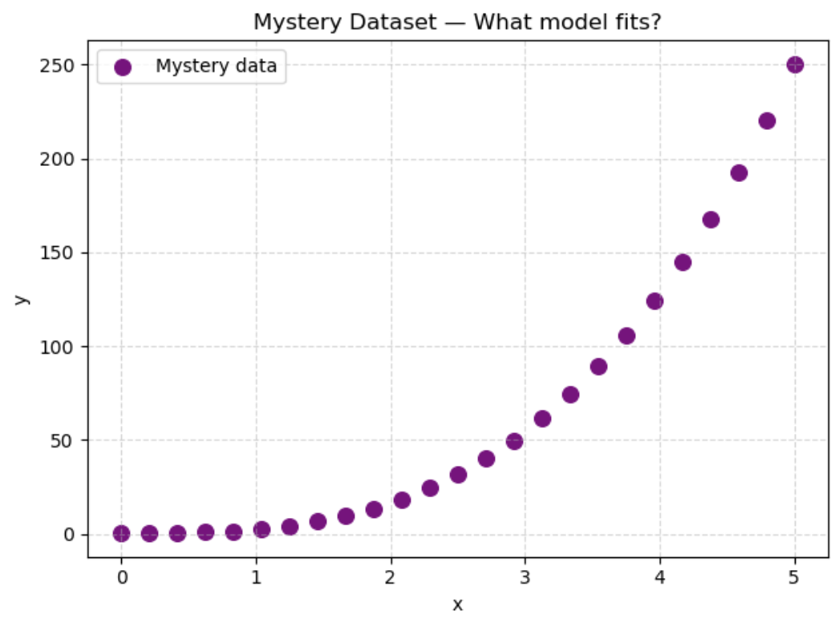
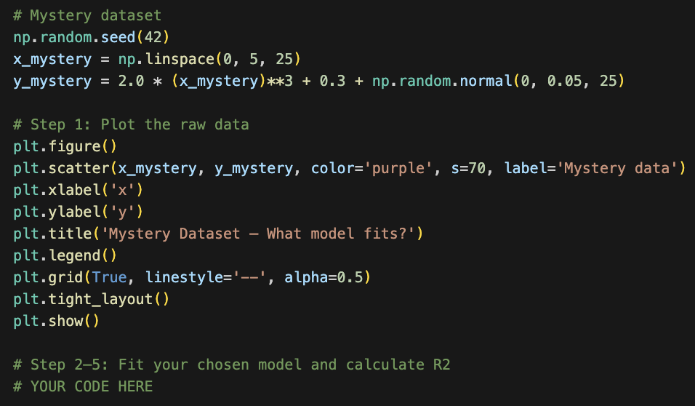
7. Practice: Fit Your Own Model
Below is a new mystery dataset. Your task:
1. Plot the data
2. Decide which model (linear, quadratic, or exponential) looks best
3. Fit that model using curve_fit
4. Plot the data with the fitted curve
5. Calculate R^2 and report the result

Slide 24
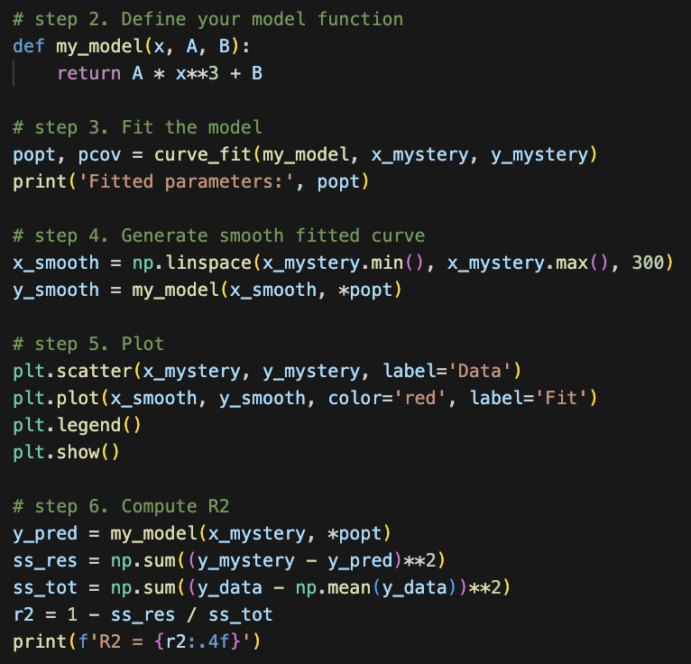
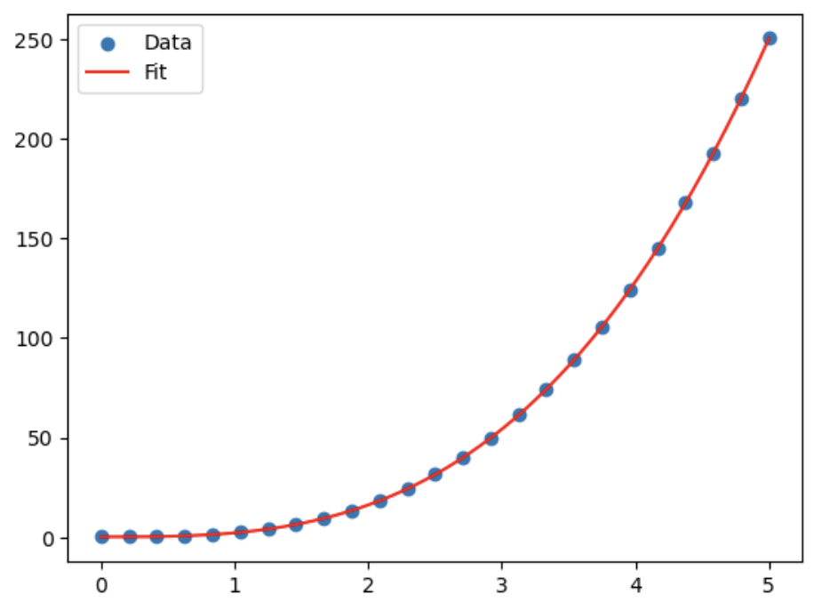
7. Practice: Fit Your Own Model
Solution:

