Slide 1
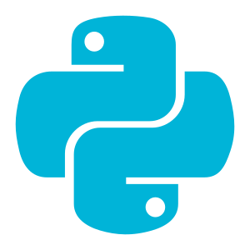
INTRODUCTION TO PYTHON & AI
Class 1
Welcome &
Environment Setup
Getting your machine ready + first Python steps
Today: Introduction • Setup • Python Fundamentals

Slide 2


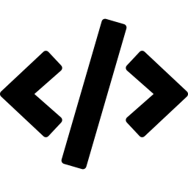
Today's Agenda
01
Welcome & Course Overview
Goals, structure, and what you'll build
02
Environment Setup
Python and VS Code
03
Python Basics
int, float, str, bool, lists

Slide 3
Course Overview
What is this course?
Python Programming Fundamentals
Data Processing and Analysis
Data Visualization
Object-Oriented Programming
Compartmental Models
Version Control with Git & GitHub
Scientific Computing & Modeling
Statistical Modeling & Prediction
Introduction to Machine Learning
Classification Algorithms
Calculus for Machine Learning
Linear Algebra
PyTorch Fundamentals
Neural Networks
Convolutional Neural Networks (CNNs)
Sequence Models
Transformers
Reinforcement Learning
AI Agents
Final Project
Notes:
Question:
How familiar are you to coding
What math do you know? Do you know slope?

Slide 4
History of Programming
What is this course?
1843 — First Algorithm
Ada Lovelace writes instructions for the Analytical Engine.
Often considered the first programmer.
1940s — Machine Code
Early computers programmed using binary and switches.
Programming was slow and difficult.
1950s–1960s — Programming Languages
FORTRAN and COBOL introduced.
Compilers allowed humans to write readable code.
1970s — Modern Software Foundations
C developed.
Influenced many modern languages.
1990s — Internet Era
Growth of websites and web applications.
HTML, JavaScript, and Java became widespread.
2010s — Data Science & AI
Python becomes dominant for data analysis and machine learning.
2020s — AI-Assisted Coding
AI tools generate, explain, and debug code.
Notes:
Question:
How familiar are you to coding
What math do you know? Do you know slope?

Slide 5
Why Learn to Code
What is this course?
1. Solve Problems Systematically
2. Automate Repetitive Tasks
3. Manipulate Data
4. Build Things
5. Understand Technology
6. Increase Career Opportunities/Skills
7. Communicate with AI More Effectively

Slide 6
Why Use Anaconda
What is this course?
Easy setup for beginners
Anaconda comes with many scientific libraries: Python, Jupyter Notebook, NumPy, Pandas, SciPy, Matplotlib
Package management
Anaconda includes conda, which helps manage library installation, dependency conflicts, virtual environments
Consistent classroom environment
Everyone uses the same version

Slide 7
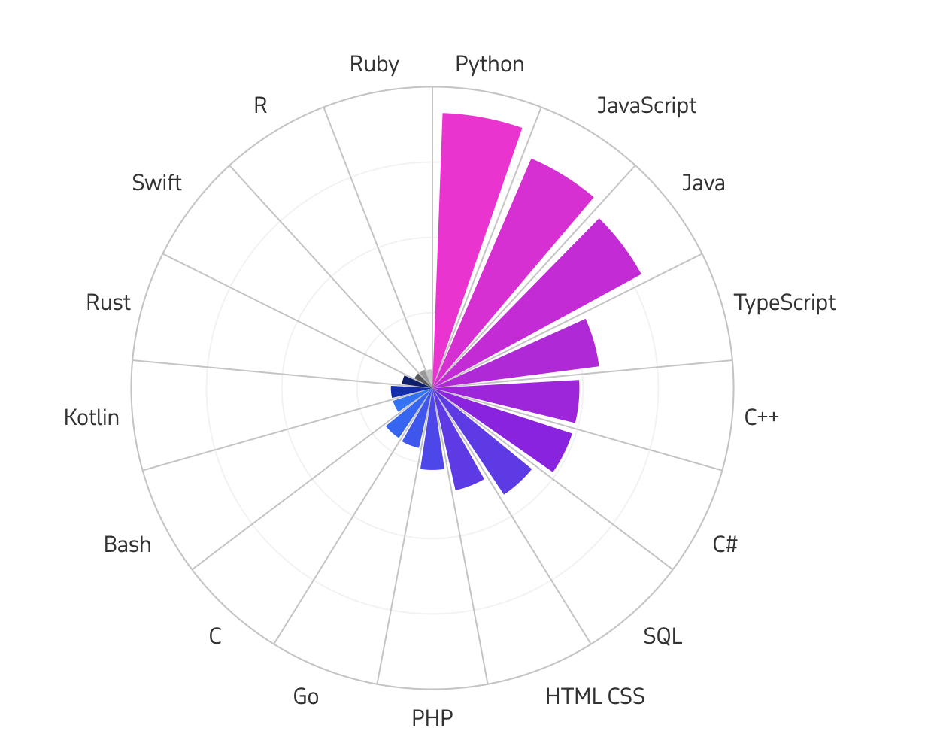
Why Use Python
What is this course?
Easy to learn
Python’s syntax is close to plain English
Dominates the AI and ML ecosystem
Most major AI frameworks use Python as their primary interface
Excellent data science libraries
Used in both research and industry
According to TIOBE, Python is the most popular programming language holding a 22.61% share in January 2026.

Slide 8
Environment Setup
1
Install Anaconda
Download from Anaconda website (https://www.anaconda.com/download)
2
Download VS Code
search `visual studio code download` in Google (https://code.visualstudio.com/)
3
Create folder for this class
4
Open VS code, open folder and open terminal

Slide 9
Environment Setup
5
Create a new virtual environment
conda create -n myenv python
6
Activate new environment
conda activate myenv
7
Installs the IPython kernel
conda install ipykernel
8
Create your first ipynb file

Slide 10
Environment Setup
6
Download Lecture 1 folder from Google Drive
https://drive.google.com/drive/folders/1VIRmD0k-_eMySS3ZJTh2loJVaF6onveb?usp=drive_link
6
Save the L01 folder into the folder you created for this class
conda activate myenv
7
Check that the folder exists in vs code
8
Open the L01_intro_to_ipynb.ipynb file

Slide 11

What's Next
Class 2
More on Python fundamentals
Class 3
Python practice
Class 4 & 5
Data visualization with pyplot, matplotlib & seaborn
Class 6
Object Oriented Programing

