Slide 1
practice
Guess the Number

Slide 2
01 · Rules of the Game

Slide 3
Game Rules
Rules
The computer chooses a secret number between 1 and 100.
The player’s goal is to to guess the secret number in as few attempts as possible.
The player will enter a guess between 1 and 100 each turn.
After each guess, the game will give feedback:
“Too high!” → Your guess is above the secret number.
“Too low!” → Your guess is below the secret number.
Each guess counts as one attempt.
The game keeps track of how many attempts you’ve made.
You win when you correctly guess the secret number.
If you reach 10 or more attempts, the game reveals the correct number and ends.
The game stops when:
You guess correctly, OR
The attempt limit condition is triggered.

Slide 4
02 · Game Coding Structure

Slide 5
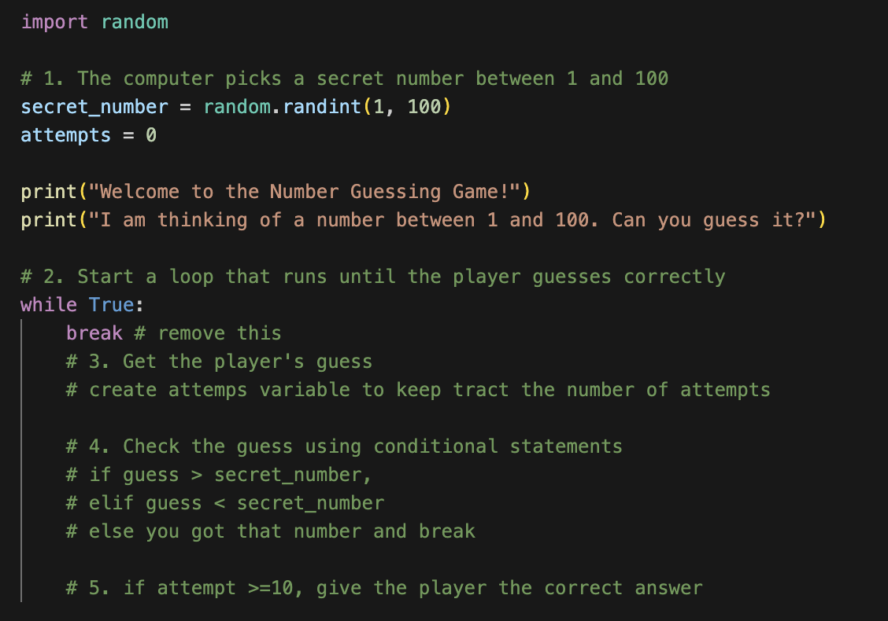
Coding Structure
Cell 1

Slide 6
03 · Code

Slide 7
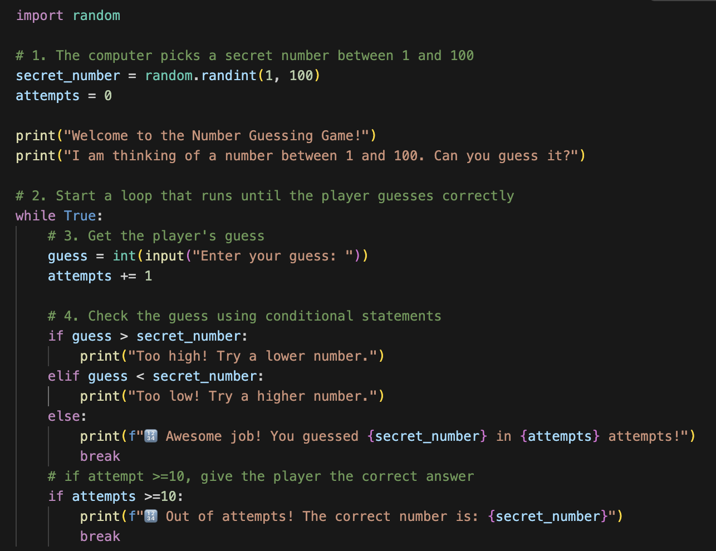
Game Rules
steps

Slide 8
Finished! 🥳

