Slide 1
practice
Hangman Game

Slide 2
01 · Rules of the Game

Slide 3
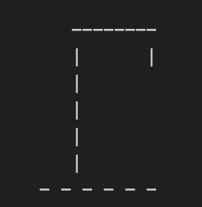
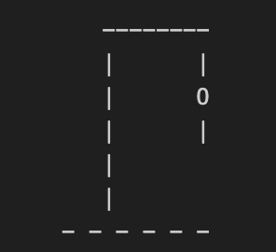
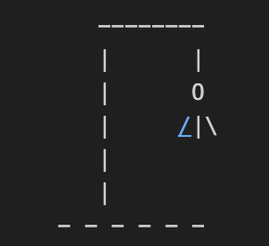
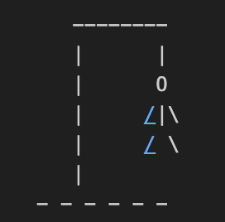
Game Rules
Rules
Image
The Objective: Guess the hidden word, letter by letter, before the drawing of the hangman is complete.
The Secret Word: The computer randomly selects a word and displays it as a row of blanks (_ _ _ _ _), with each blank representing a letter
Guessing:
You guess one letter at a time
If the letter is in the word, the blanks are filled in with that letter
If the letter is not in the word, you lose a life, and one part of the hangman stick-figure is drawn
If guess a word we guessed before, print You already guessed it

Slide 4
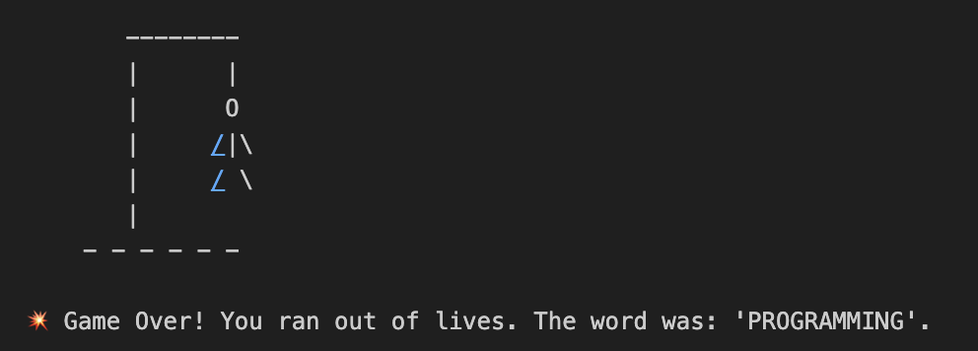
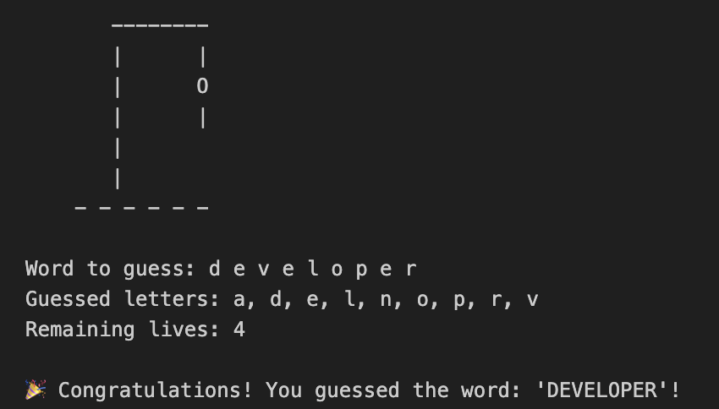
Game Rules
Rules
Image
Winning: You win if you guess all the correct letters and reveal the full word before running out of turns
Losing: You lose if you make 6 incorrect guesses. At that point, the hangman is fully drawn and the game is over

Slide 5
02 · Game Coding Structure

Slide 6
Coding Structure
Cell 1
Cell 2
In cell 1, there is a HANGMAN_STAGES list, containing the ASCII art of each stage of hangman
In cell2, create the play_hangman() function
Create world pool
Randomly choose a word
Game state variables
Create a set keeping tract of the guessed letters
Create an int keeping tract of the number of wrong letters guessed
Max number of possible wrong letters guessed
Main game loop (while/else)
Clear the output
Display the current stage, the hidden words (ex: n_gh_)
Get player input
Check if it is already guessed, is correct or false
Check if the player won
If the wrong letter guessed is larger than the max number possible wrong letters, the player losses

Slide 7
03 · Start Coding

Slide 8
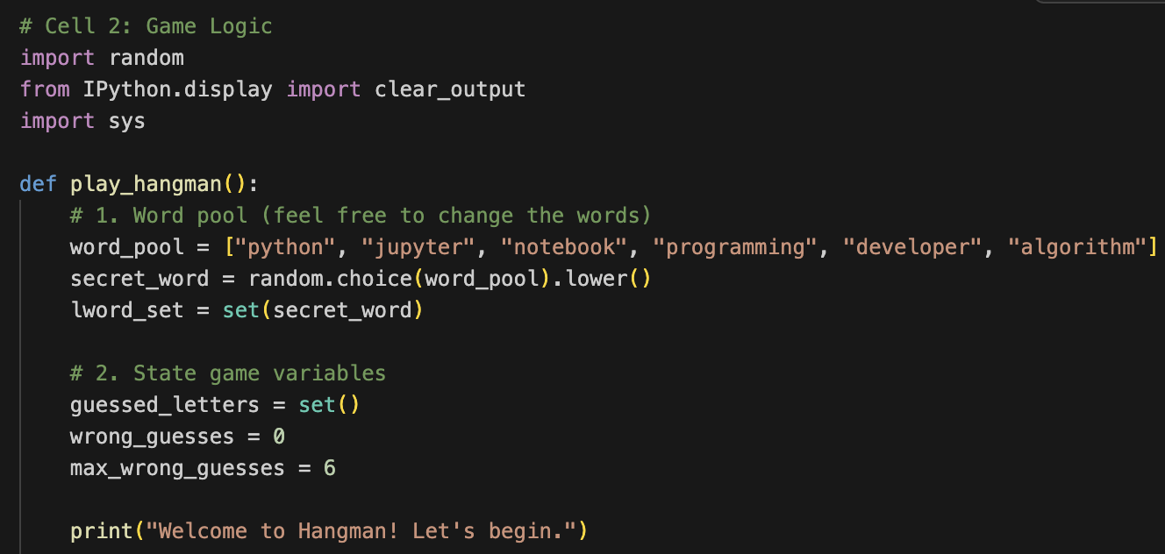
Game Rules
steps
Import libraries
Define the play_hangman() function
Define a word pool and randomly select a word
State game variables and greet
(inside play_hangman() function)

Slide 9
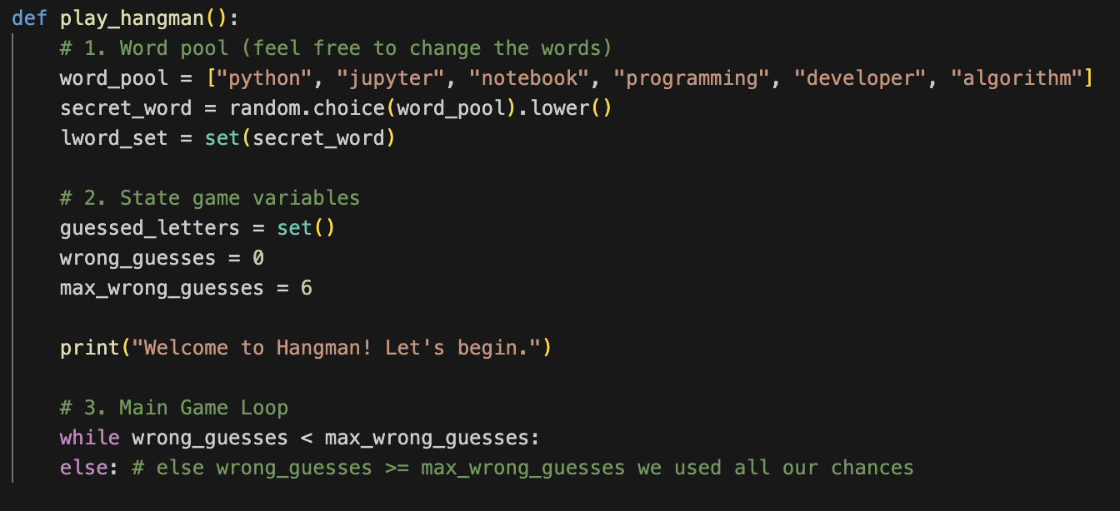
Game Rules
steps
The Main Game Loop

Slide 10
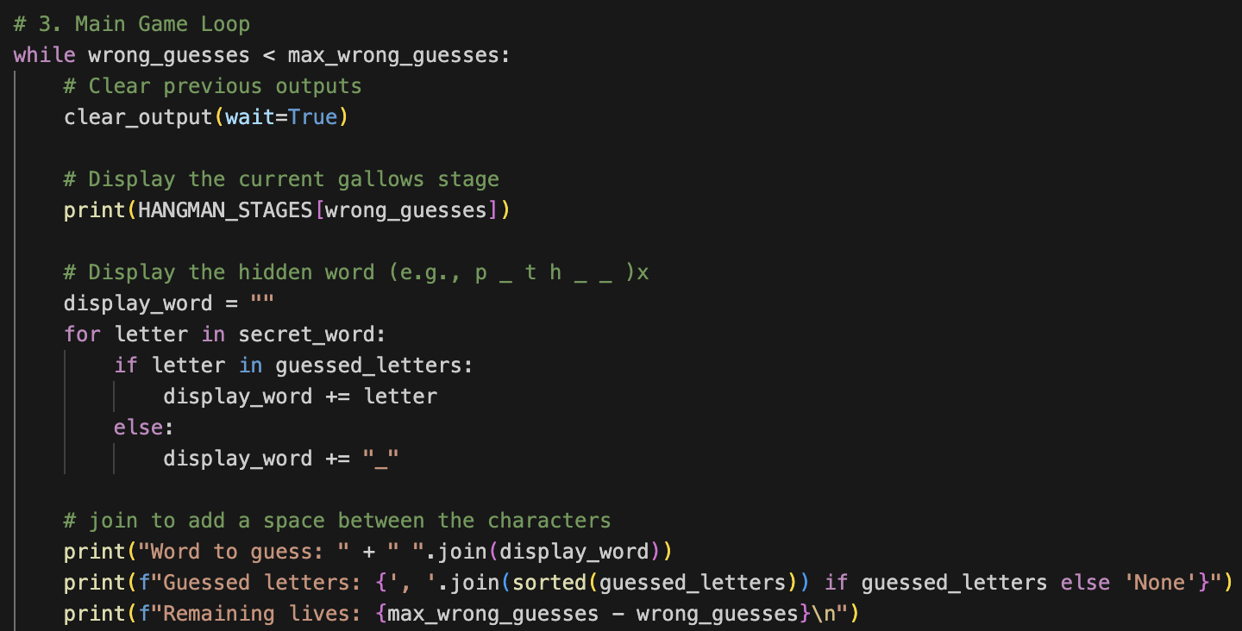
Game Rules
steps
Inside while …
Clear previous outputs
Display the gallows
Display the word so far
Display the current progress

Slide 11
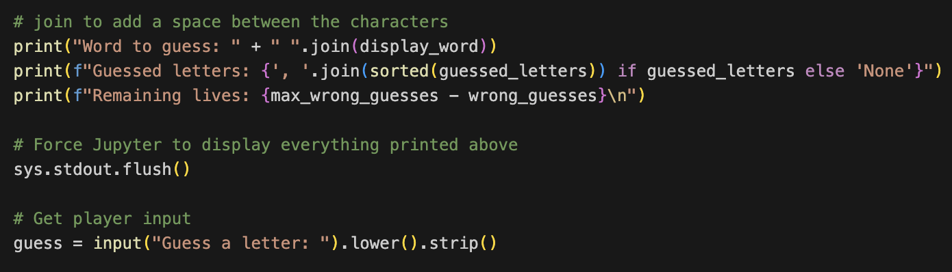
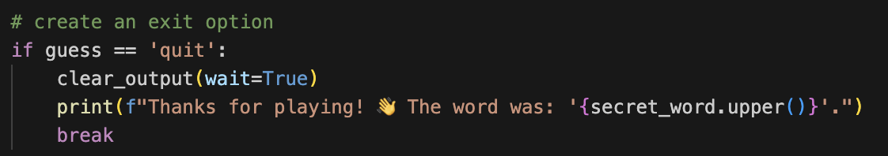
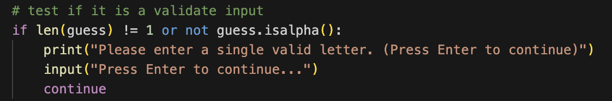
Game Rules
steps
Still inside the while loop, after outputting the current progress
Force Jupyter to display everything
Get player input
Make an exist from the game
Test if the input is a valid letter

Slide 12
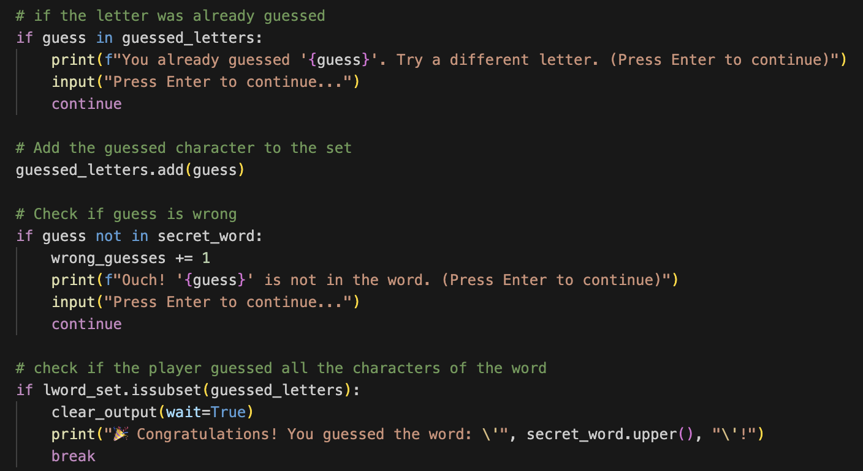
Game Rules
steps
Still inside the while loop, after testing if it is a valid input
Test if the input was already guessed
Add the guessed character to the set
Check if the guess is wrong
Check if the player guessed all the characters – you won!!

Slide 13
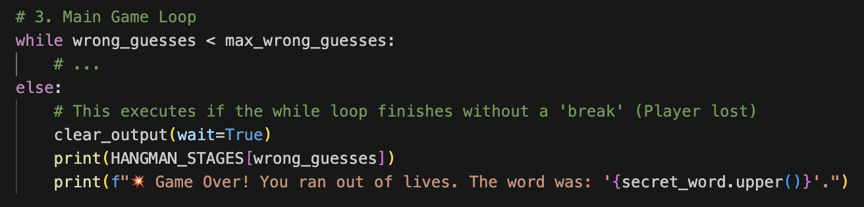
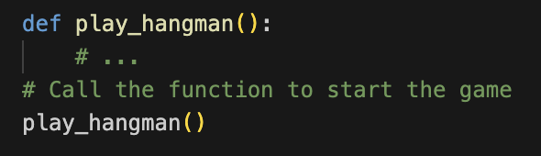
Game Rules
steps
How if wrong guesses >= max wrong guesses
Outside of while loop, inside the corresponding else
End the game – you lost :(
Outside of the play_hangman() function,
Call it to test the game

Slide 14
Finished! 🥳

