Slide 1
Capstone Project - The Battle of Neighborhoods
Yihan Zhao
April 3rd, 2019

Slide 2
Introduction
Starting from the California gold rush which brought over twenty thousand Chinese immigrants to the United States, Chinese restaurants were spread all over to America's east coast, such as New York City, and west coast, San Fransisco. People like to use the term "melt pot" to describe the culture of New York City. With its diverse culture, we want to examine a good location to open a Chinese restaurant in Manhattan, which has a strong Chinese demographic.

Slide 3
Data
To find the best location to open a Chinese restaurant, I will use New York City data that contains the latitude and longitude of all Chinese restaurants in Manhattan. The data is public available: https://cocl.us/new_york_dataset.
To have more information on each Chinese restaurants, I will use the Foursquare API.

Slide 4
Methodology
Collect Inspection Data
Explore and Understand Data
Data preparation and preprocessing
Modeling

Slide 5
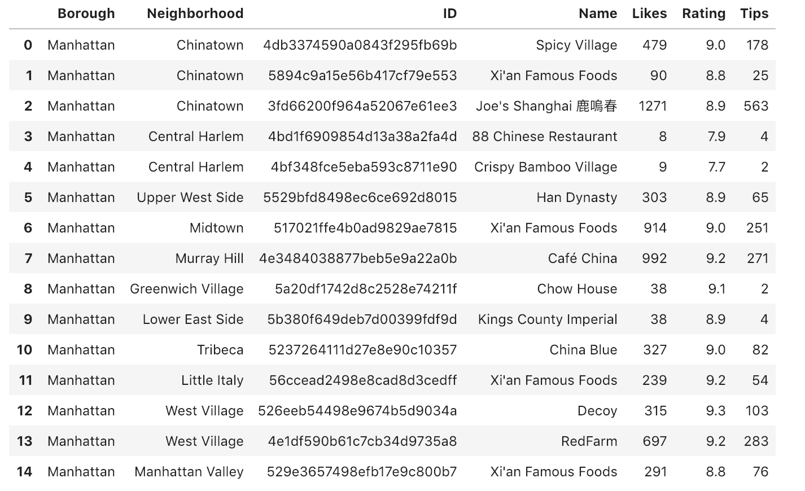
Results (Continued)
All Chinese Restaurants in Manhattan

Slide 6
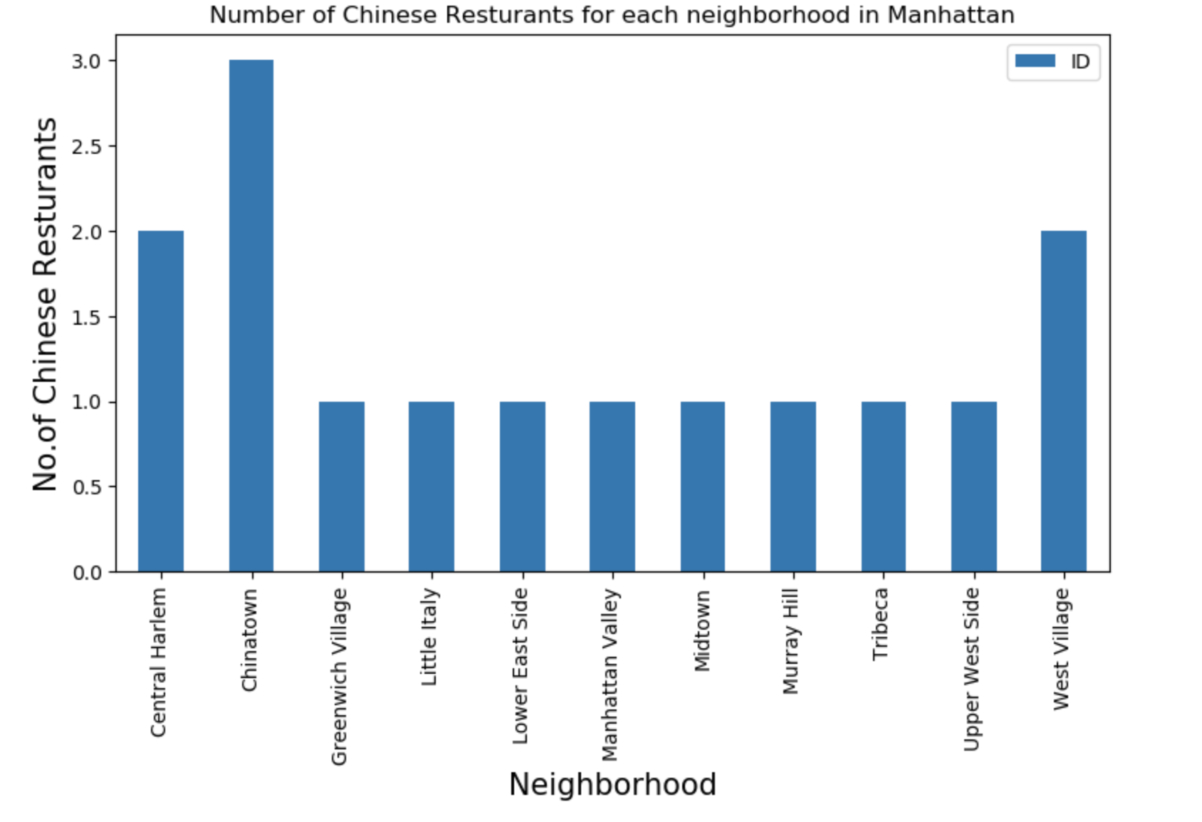
Results (Continued)
Number of Chinese Restaurants in each Manhattan Neighborhood

Slide 7
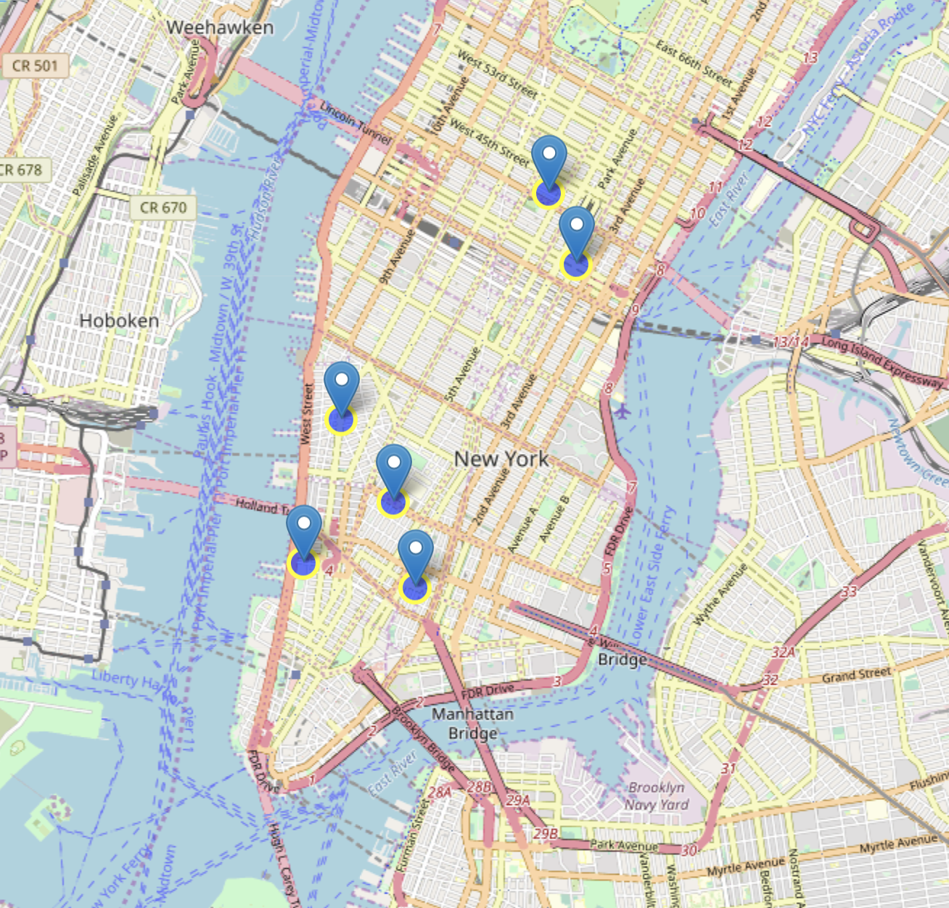
Results
View Chinese Restaurants with rating higher than 9.0

Slide 8
Discussion and Conclusion
West Village is the neighborhood that has the average maximum rating of 9.25 for Chinese restaurants. Joe's Shanghai has the highest likes and tips in the neighborhood of Chinatown with total likes of 1271 and total tips of 563. Joe's Shanghai is the type of Shanghai cuisine. Since there is no similar Shanghai cuisine in West Village, we can consider open one there.

