Slide 1
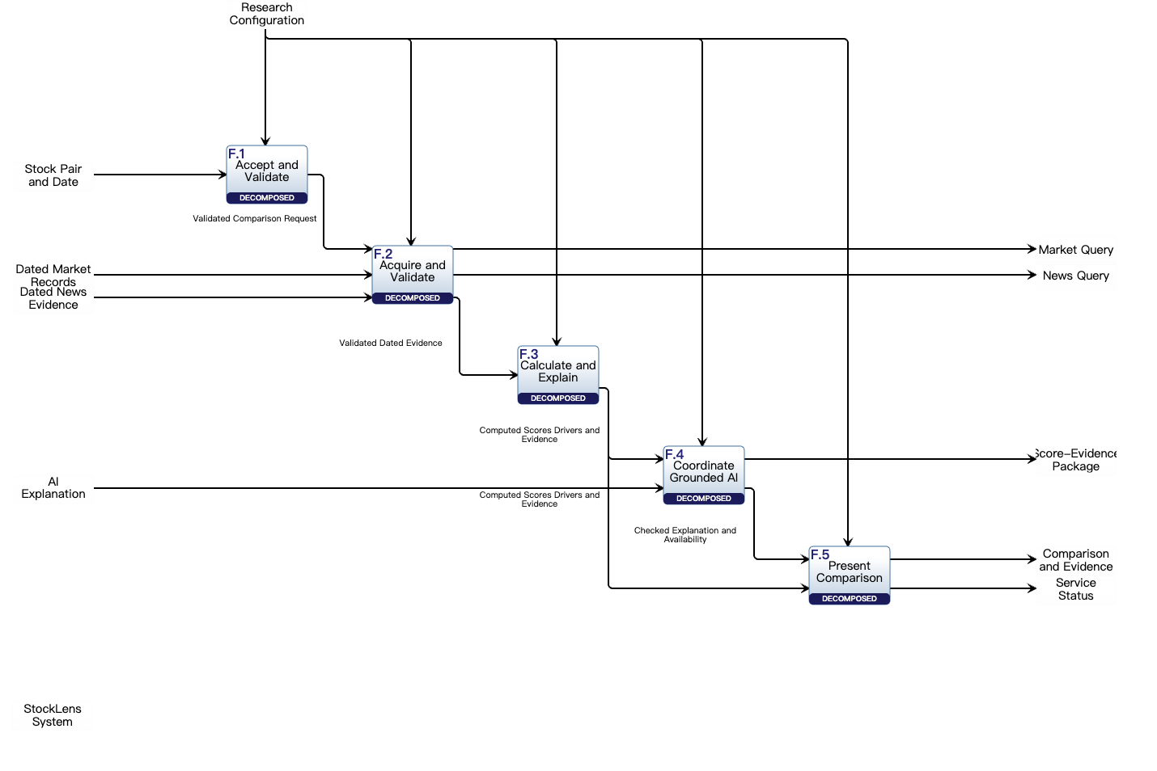
UC.1 direct trace through the saved first-level IDEF0
Blue: inherited exchanges Green: first-level internal flows Gray: configuration / maintenance context
0 Research Configuration controls F.1–F.5
1 Pair and date
1.1 Validated request
3 Market query
4 Dated market records
2 News query
5 Dated news evidence
5.1 Validated dated evidence
5.2 Computed score record
6 Score-evidence package
7 AI explanation text
7.1 Checked explanation
8 Comparison and evidence
5.3 Same record to display
9 Service status (context)
Native model: project 659, F.0 264782; F.1–F.5 269034–269038. Mechanisms are intentionally not allocated at this level.
Notes:
Source: https://cloud.innoslate.com/cornell/p/659/diagrams/idef0/264782 . The base is an unchanged native PNG export. Editable numbered and colored connectors are PowerPoint annotations implementing Lab Manual 6.2.1. Numbers 1–8 are the selected research trace; 0 and 9 document inherited configuration and maintenance context. Internal steps 1.1, 5.1, 5.2, 5.3 and 7.1 correspond to the verified IF.01–IF.04 relations. IF.03 has two receiving functions.

Slide 2
Numbered sequence at the first-level functional abstraction
Logical function lifelines refine UC.1; they do not allocate physical mechanisms
User
F.1
Request
F.2
Evidence
News
Provider
Market
Provider
F.3
Ranking
F.4
AI check
AI Model
Service
F.5
Display
System
Maintainer
0 IO.10 Research Configuration — control on F.1–F.5
1 Stock pair and date
1.1 IF.01 validated request
2 IO.04 news query
3 IO.03 market query
4 IO.07 dated market records
5 IO.08 dated news evidence
5.1 IF.02 validated evidence
5.2 IF.03 computed record
5.3 IF.03 same record to display
6 IO.05 score-evidence package
7 IO.09 AI explanation
7.1 IF.04 checked explanation / availability
8 IO.02 comparison and evidence
9 IO.06 Service status
End: UC.1.8 user inspects the already displayed drivers and citations; no additional request is invented.
Gray exchanges 0 and 9 are maintained control/status context. Blue and green exchanges form the nominal user trace.
Notes:
Derived sequence annotation based on saved UC.1 action/sequence entities 185145 and native first-level IDEF0 264782. Each label is unique. The query branches may execute concurrently; numbered order is one legal linearization. Internal IF.03 branches 5.2 and 5.3 carry the same authoritative computed record; the AI result cannot change that record. No physical allocation is implied by logical function lifelines.

