Slide 1
Crypto Sentiment Analysis
Yi Hao Tan
CS 410

Slide 3
Objective
Scrape Bitcoin submissions / comments from Reddit
Perform Bitcoin sentiment analysis
Evaluate Bitcoin sentiment analysis model

Slide 4

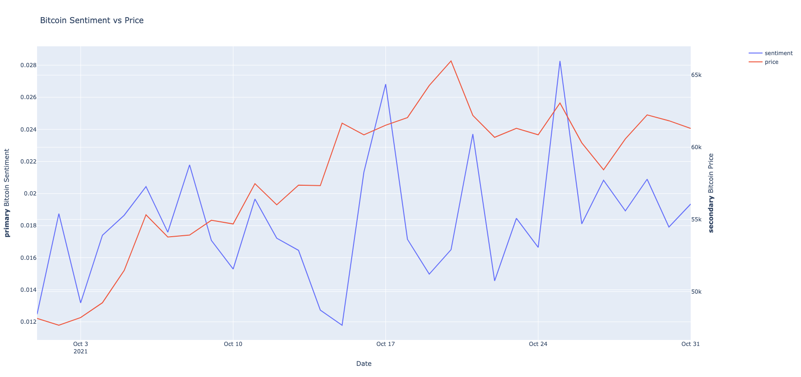

Architecture
Scrape submissions / comments data from Bitcoin subreddit
Preprocess data, compute sentiment score and plot visualization
Scrapper
Sentiment Analyzer
Write data to text files
Read data from text files

Slide 5
Scraper
Utilize both Pushshift and PRAW to scrape Reddit submissions and comments
The chosen subreddit for analysis is r/Bitcoin
The date range is between 2021-10-01 and 2021-10-31
The max number of comments used per submission is 10
The scraped data is written to text files (31 in total)

Slide 6
Sentiment Analyzer
Consume the comments / submissions data from the text files
Preprocess data such as removal of stopwords, tokenization and stemming etc
Compute sentiment score via Vader
Improve sentiment model by adding new keywords such as {‘moon’:1.0}
Plot bitcoin sentiment vs price via Plotly

Slide 7
Demo
git clone https://github.com/yihaotan/CourseProject.git
pip install -r requirements.txt
cd src
python3 sentiment_analyzer.py

Slide 8
Evaluation
Notes:
There are some peaks that coincide with the price trend line, telling us that the model is pretty accurate. The higher the sentiment score, the more a positive outlook that buyers have on bitcoin, driving demand and driving the price higher. The overall trend line for the month is positive, which is consistent with the trend line for the price as well.

Slide 9
Evaluation (Cont)
https://alternative.me/crypto/fear-and-greed-index/

Slide 10
Conclusion
Sentiment analysis is hard
Requires a lot of tweaking
Scrape more data and analyze the data over a longer time period

