Slide 1
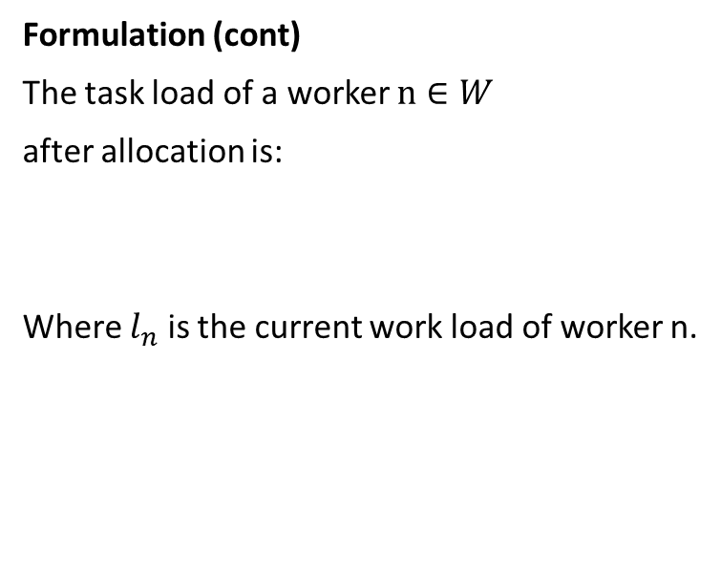
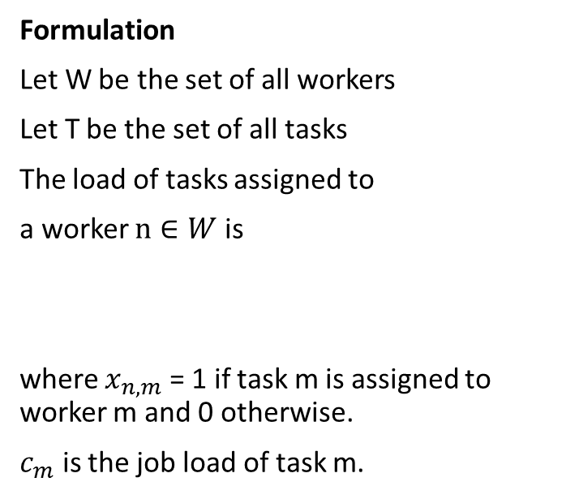

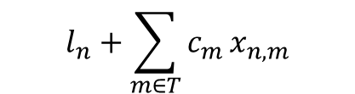
Task allocation
Aim
Balance the work load of workers during task allocation
Formulation (cont)
The task load of a worker $n∈W$
after allocation is:
Where $l_{n}$ is the current work load of worker n.
$$l_{n}+\sum_{m∈T}{c_{m}}x_{n,m}$$
Formulation
Let W be the set of all workers
Let T be the set of all tasks
The load of tasks assigned to
a worker $n∈W$ is
where $x_{n,m}$ = 1 if task m is assigned to worker m and 0 otherwise.
$c_{m}$ is the job load of task m.
$$\sum_{m∈T}{c_{m}}x_{n,m}$$

Slide 2

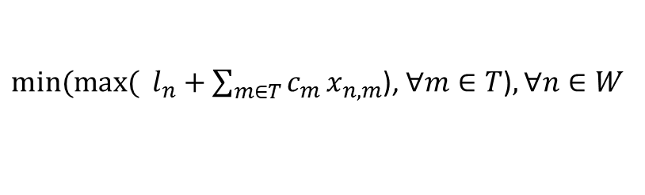
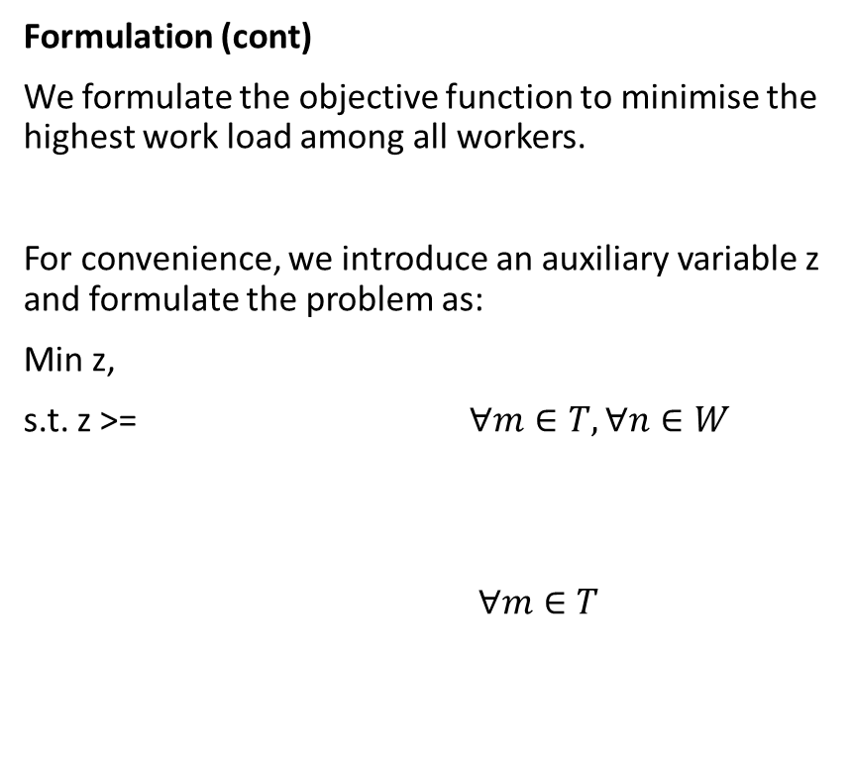
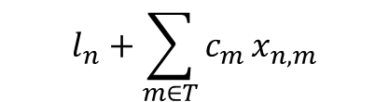
Task allocation
Formulation (cont)
We formulate the objective function to minimise the highest work load among all workers.
For convenience, we introduce an auxiliary variable z and formulate the problem as:
Min z,
s.t. z >= $∀m∈T,∀n∈W$
$∀m∈T$
${min⁡(max⁡( l}_{n}+\sum_{m∈T}{c_{m}}x_{n,m}$), $∀m∈T$)$,∀n∈W$
$$l_{n}+\sum_{m∈T}{c_{m}}x_{n,m}$$
(Guarantee that workload of all worker smaller than z)
$$\sum_{n∈W}{x_{n,m}=1}$$
(Guarantee all tasks assigned to 1 worker)

Slide 3
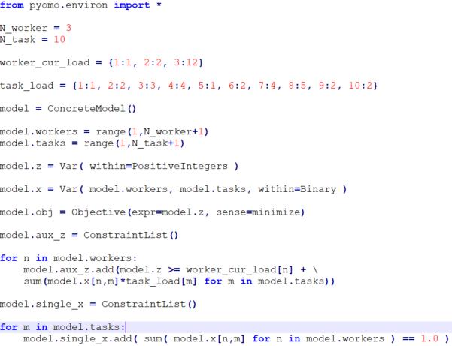
Code
Task_allocation.py pyomo solve task_allocation.py --solver=glpk
Predefined workload for each worker
Predefined load for each task
objective
constraints

Slide 4

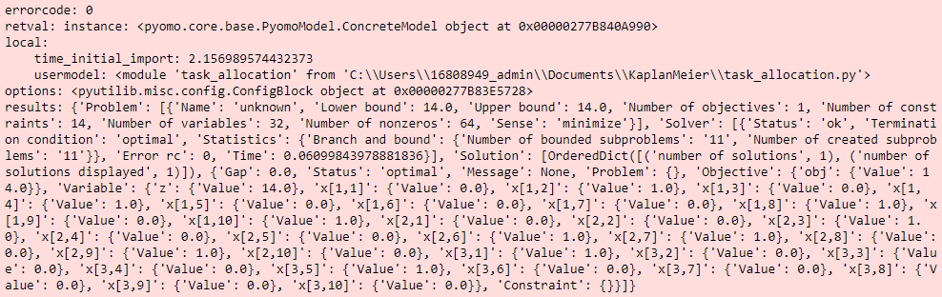
Example
Output:
Current work load
allocated work load
Worker 1
2
4
8
10
Worker 2
3
6
7
9
Worker 3
5
1

Slide 5



Task allocation (with task types and competencies)
Formulation (cont)
$s_{n,a}$ is the competency of worker n on task type a
If work n is competent at task type a, $s_{n,a}$ = 1,
else $s_{n,a}$ = 0.
To ensure that all tasks assigned to 1 worker with the right competency, we add another constraint:
$$\sum_{n∈W}{{s_{n,a}x}_{n,m}=1}$$
$$∀m∈T$$

Slide 6
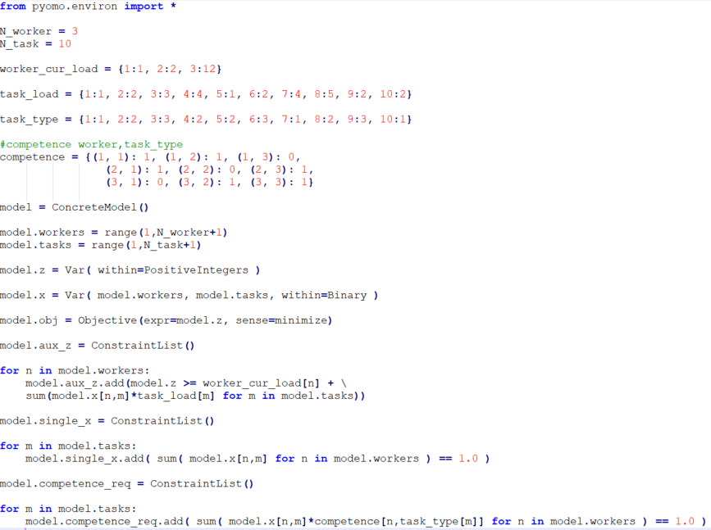
Code (with task types and competencies)
Task_allocation_r1.py pyomo solve task_allocation_r1.py --solver=glpk
Task type
Define competency of worker
New constraints to ensure that all tasks assigned to worker with competency

Slide 7
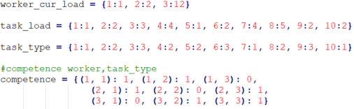
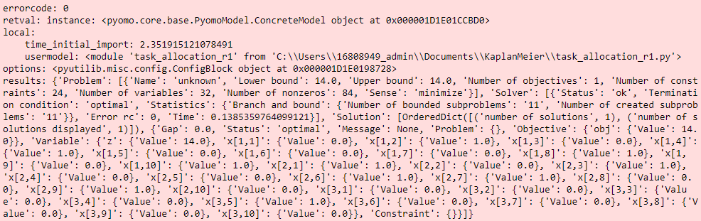
Example (with task types and competencies)
Output:
competence
1
3
2
3
1
2
Current work load
allocated work load (type 1,2,3)
Worker 1
2
4
8
10
Worker 2
1
3
6
7
9
Worker 3
5

