Slide 1

Elma
ELMA: Early-Exit Offloading for Embedded Question Answering Applications
Capstone Design
Dec 15, 2021
Group: 3
Instructor: Prof. An Zou
Sponsor: UM-SJTU Joint Institute
Group Member: Yihua Liu, Shuocheng Chen, Yiming Ju

Slide 2



Team Members
Yihua Liu
Shuocheng Chen
Yiming Ju

Slide 3
Overview
Introduction
Design Specifications
Concept Generation & Selection
Design Description
Implementation & Validation
Discussion & Conclusion

Slide 4
Elma
1. Introduction

Slide 5



Introduction
NLP
Embedded System
16000 words / s
0.2 s
Large computation
High performance
Cloud
Notes:
NLP has a wide use in our daily life, like text classification, auto correct, question answering. The most famous one is siri. Actually a small voice recognition device keeps turning on. And once detect the user’s voice, it will convert the user’s command into an audio packet. Then the packets are sent to the data center and analyze with 16000 words / s. And then it is sent to database of iOS and reply the answer within 0.2s.
You can see that NLP task needs large computation so that it can have a high performance. However you know our cell phone absolutely cannot have the same ability as the cloud. To achieve a high performance without large computation locally, we propose this idea of offloading. It’s to let some critical computation do locally at the terminal.

Slide 6
Elma
2. Design Specifications

Slide 7
Design Specifications
Customers Requirements
Functionality
Question answering on embedded systems
Similar accuracy
Efficiency
Network latency
Faster prediction
Security
Personal sensitive data
A safer method
Cost
Need network connection
Work without network
Notes:
Functionality it is required to complete the task of question answering on embedded systems.
Efficiency Since the data needs to be transferred between terminal and the cloud. There exists network latency. As a user, a faster prediction is better.
Security personal sensitive data should be protected when it is computed on the cloud. So we need a safer method.
Finally now the realization needs network connection. It’s better to work without network.

Slide 8
Design Specifications
Engineering Specifications
Functionality
Train on the cloud and predict locally
Offloading
Efficiency
The whole model for prediction is large
Early exit
Security
Encryption and decryption consume resources
Simplify
Cost
Storage and computation on the cloud
Work remotely
Notes:
Finally the cost of computation is much larger than the cost on the cloud. It will have a greater and lower-price storage and computation on the cloud. So the general train process should be processed remotely.

Slide 9
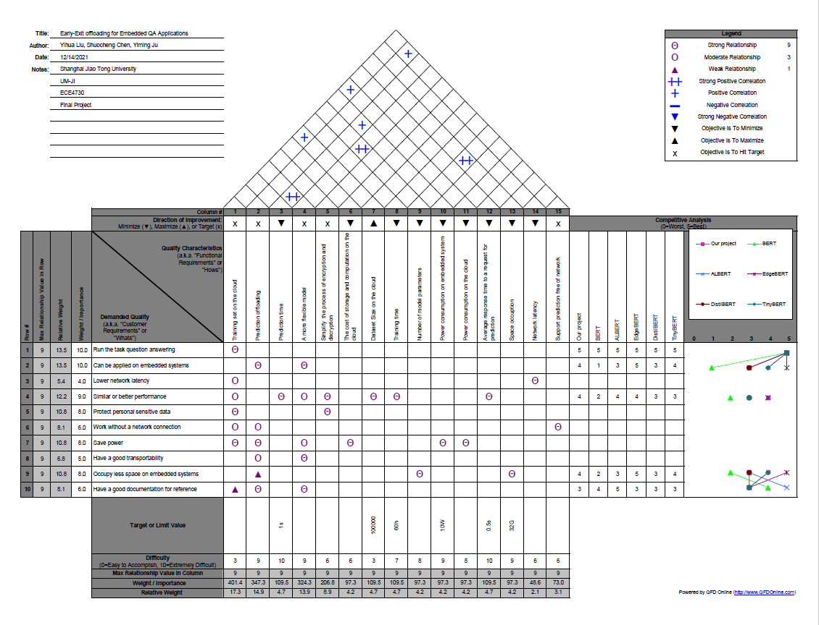
Design Specifications
Notes:
Quality Function Deployment. Here is the demand quality, the same as the customer requirements. And here is quality characteristics required in engineering specifications. These columns are the weights of the tasks we considered in our project. The higher means more important. This area is the relationship between demand quality and engineering specifications. Here is the correlations between functional requirements. Last is the difficulty level we evaluate for each task.

Slide 10
Elma
3. Concept Generation & Selection

Slide 11
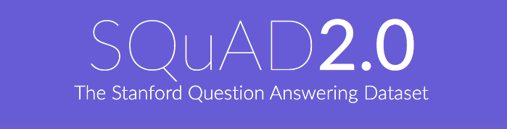

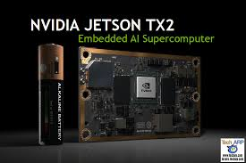
Concept Generation & Selection
Dataset selection
Environment Selection
Develop Kit Selection
Notes:
SQuAD2.0: a dataset contains unsolvable questions
Cuda: an architecture for GPU parallel computing => processing data faster.
It’s more consistency with this environment.

Slide 12
Concept Generation & Selection
BERT vs. ALBERT Tensorflow vs. PyTorch
Criterion | Weight(%) | BERT |  |  |  | ALBERT
 |  | Tensorflow |  | PyTorch |  | Tensorflow |  | PyTorch
 |  | Score | Rating | Score | Rating | Score | Rating | Score | Rating
Performance | 0.35 | 8 | 2.8 | 8 | 2.8 | 9 | 3.15 | 9 | 3.15
Space occupation | 0.35 | 4 | 1.4 | 4 | 1.4 | 7 | 2.45 | 7 | 2.45
Flexibility | 0.2 | 3 | 0.6 | 8 | 1.6 | 3 | 0.6 | 8 | 1.6
Derivative | 0.1 | 7 | 0.7 | 5 | 0.5 | 7 | 0.7 | 5 | 0.5
Total |  |  | 5.5 |  | 6.3 |  | 6.9 |  | 7.7
ALBERT + Pytorch

Slide 13
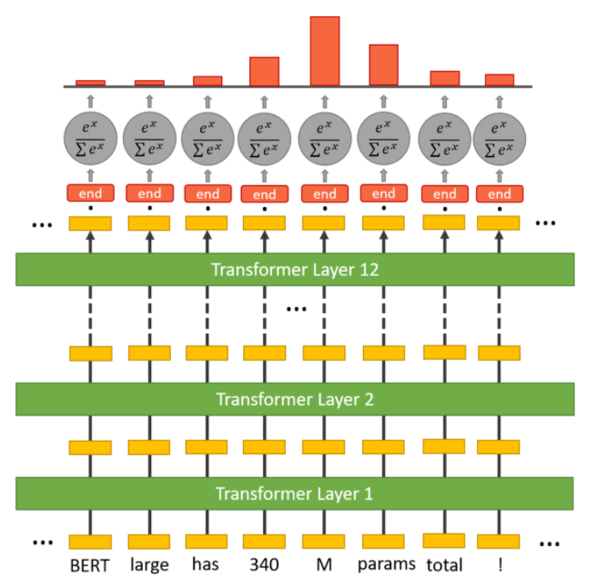
Concept Generation & Selection
ALBERT
Parameter Sharing
Save memory space
Embedding Factorization
Better performance
Sentence Order Prediction
Notes:
Here is an illustration for albert model. Each yellow blocks at the bottom are the inputs. They will go through twelve transformers and finally a classification layer. Finally for example this one will be the final answer. And there are three advantages of albert over bert.

Slide 14
Elma
4. Design Description

Slide 15
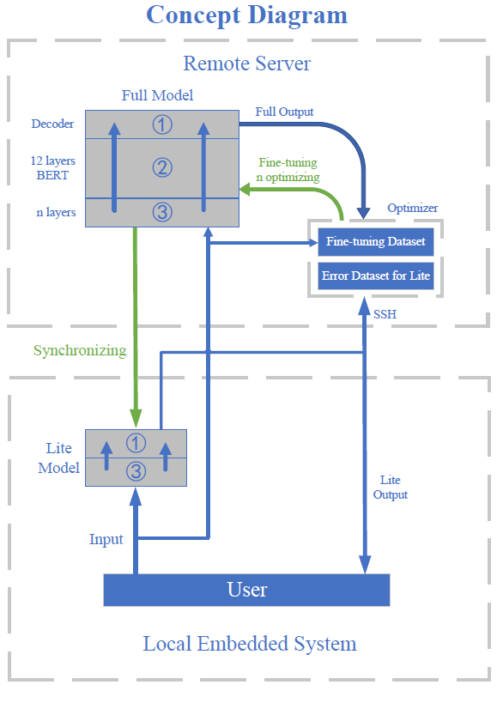
Design Description
Remote Server： Full model
Embedded System: Lite model

Slide 16
Design Description
Remote Server： Full model
12 layers ALBERT
Optimizer
Fine-tuning

Slide 17
Design Description
Embedded System: Lite model
Early-Exit
Synchronization
Notes:
The lite model is on the embedded system, which is implemented by applying the early exiting optimization to the full model. The result of the first few layer would be used as the final result, so it doesnt need to go through the rest layers. This saves lots of computational resources.The lite model is synchronized once the full model is fine-tuned to the error dataset.

Slide 18
Early Exit
Input: x_{n}(transformer output),E_{T}(threshold of entropy)
Output: z_{N}(output of last transformer) or unsolvable
For n = 1…N do
z_{n} = f_{exit}(x_{n})
y_{n} = softmax(z_{n})
e_{n} = entropy(y_{n})
if e < E_{T} then
return argmax(y_{n})
End if
End for
If the question is solvable
return z_{N}
Else
return unsolvable question to the server

Slide 19
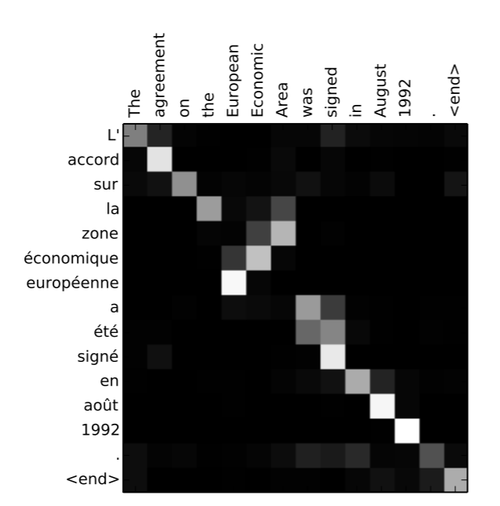
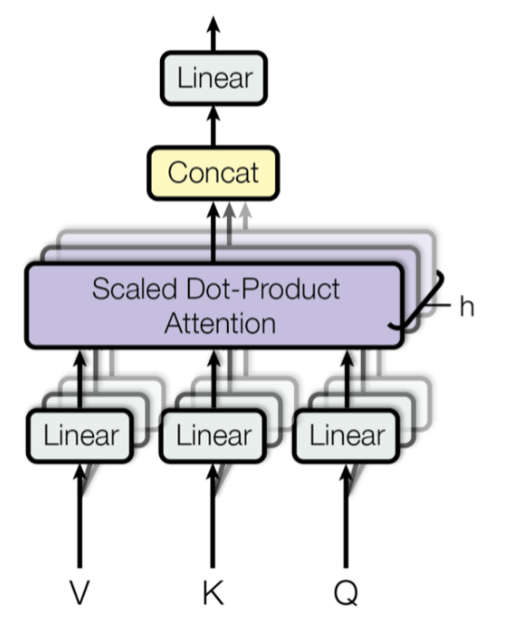
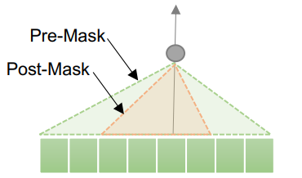
Adaptive Attention
Attention Mechanism
Multi-Head Attention
Adaptive Attention Span

Slide 20
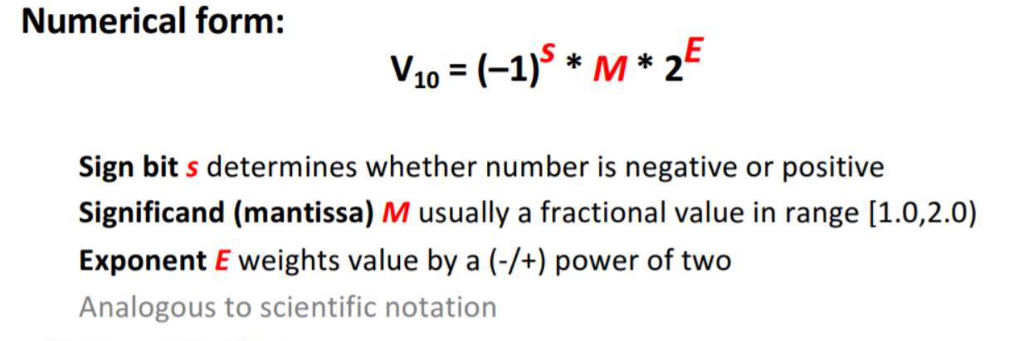
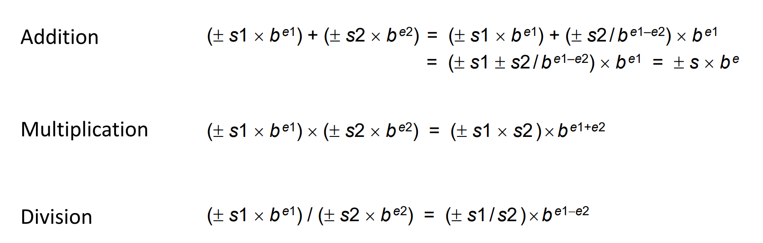
Fp16 Quantization
Floating Point defined by IEEE 754

Slide 21
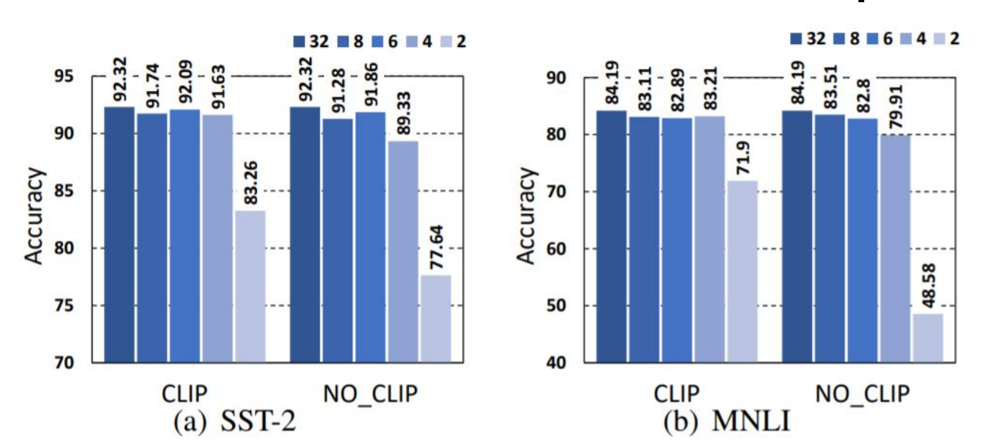
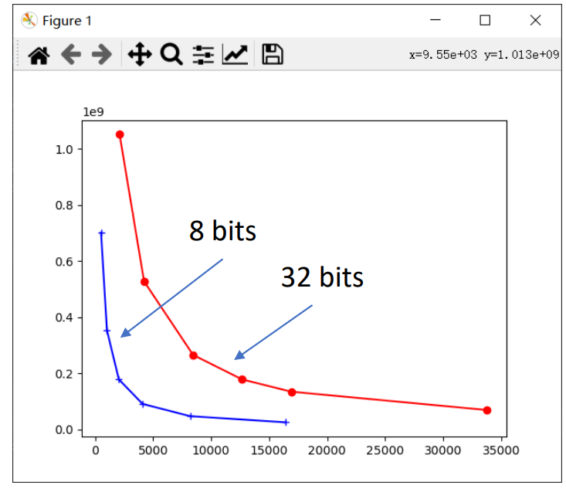
Fp16 Quantization

Slide 22
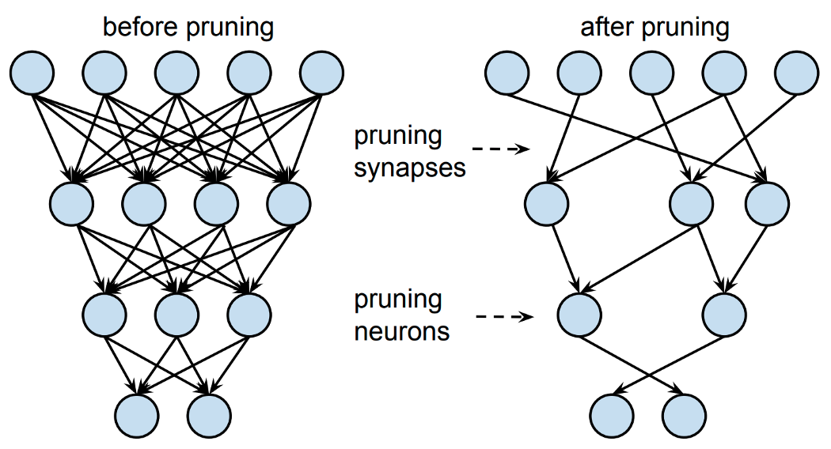
Network Pruning
Method:
Movement Pruning
Magnitude Pruning
Notes:
Movement Pruning is pruning during training. Those neurons with weights going to zero would be pruned during training. Magnitude pruning is pruning after training. The neurons with smallest weights are pruned. Both methods are tested, the results shows that they saves a lot of computational resources with only minimal influence on final accuracy.

Slide 23
Elma
5. Implementation & Validation

Slide 24
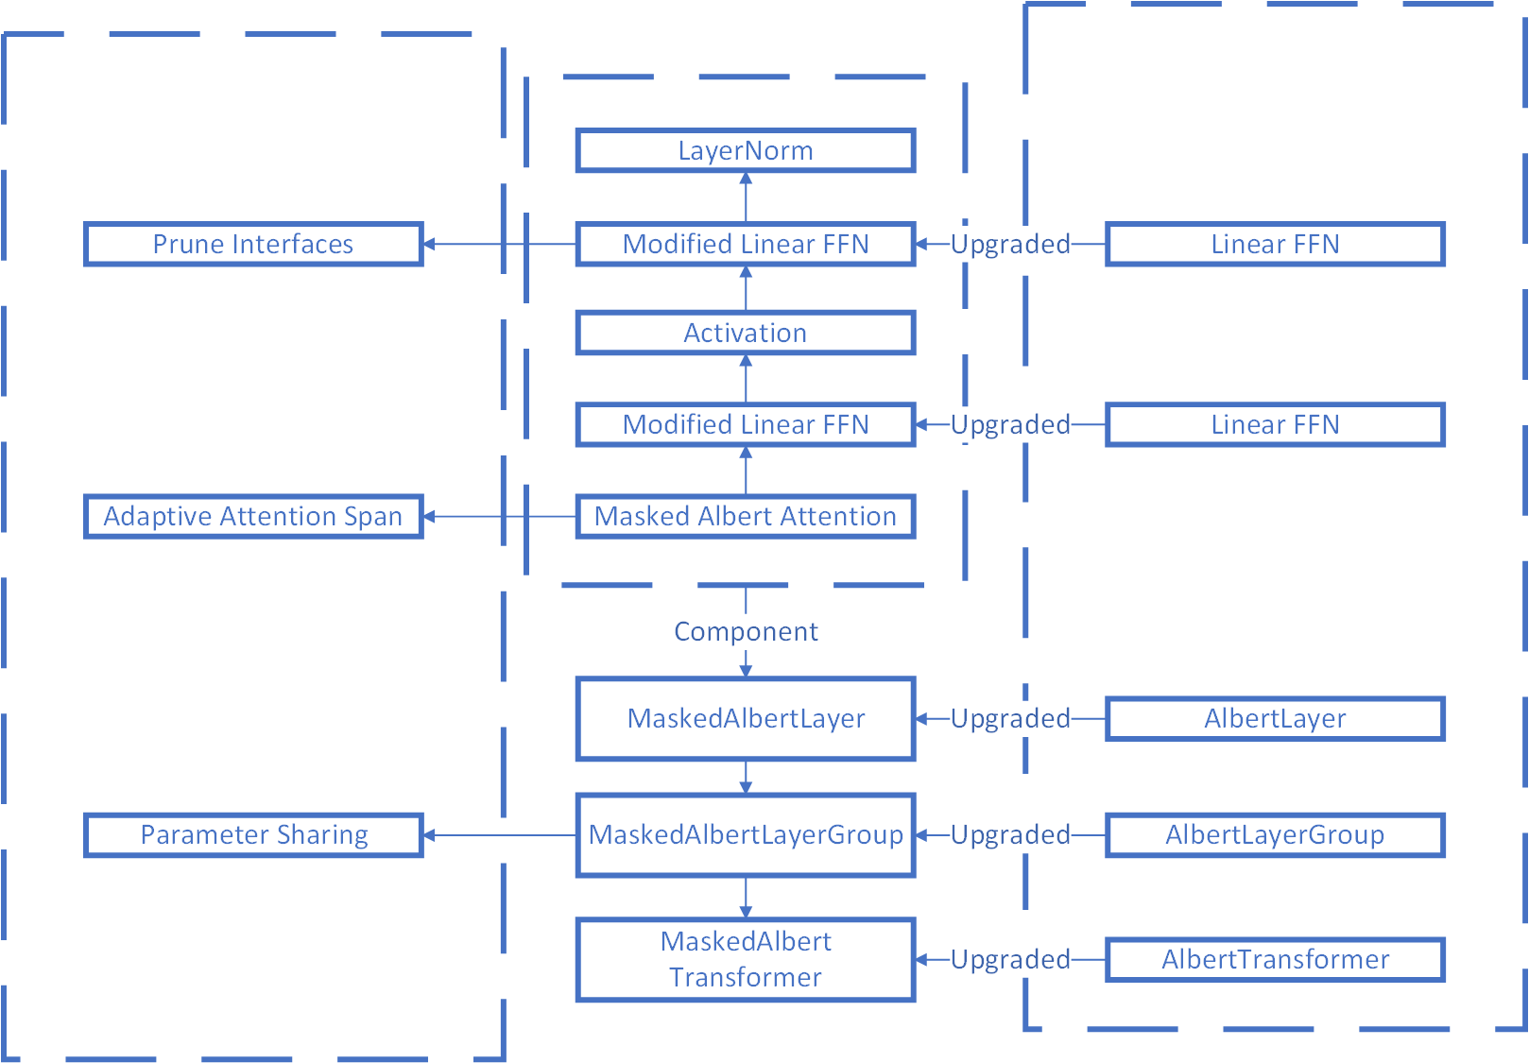
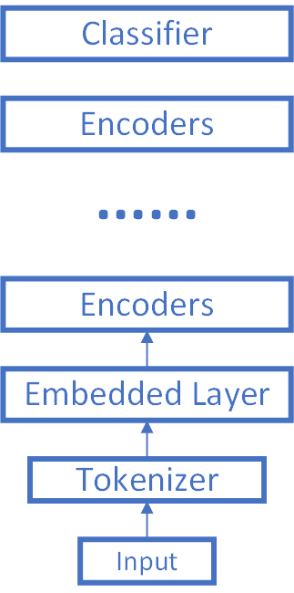
Implementation

Slide 25
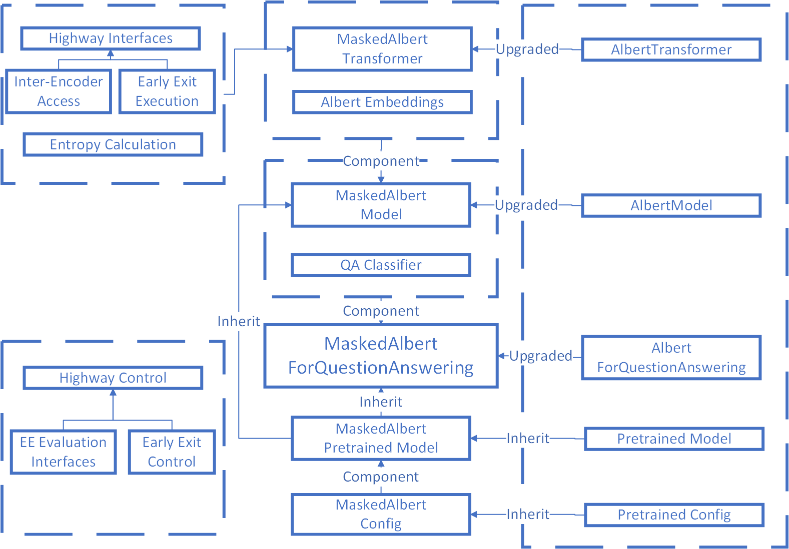
Implementation

Slide 26
Implementation
FP16
if fp16:
with amp.scale_loss(loss, optimizer) as scaled_loss: scaled_loss.backward()
else:
loss.backward()
mask = MagnitudeBinarizer.apply(inputs=tensor, threshold=threshold)
pruned_model[name] = tensor * mask
Magnitude Prune

Slide 27
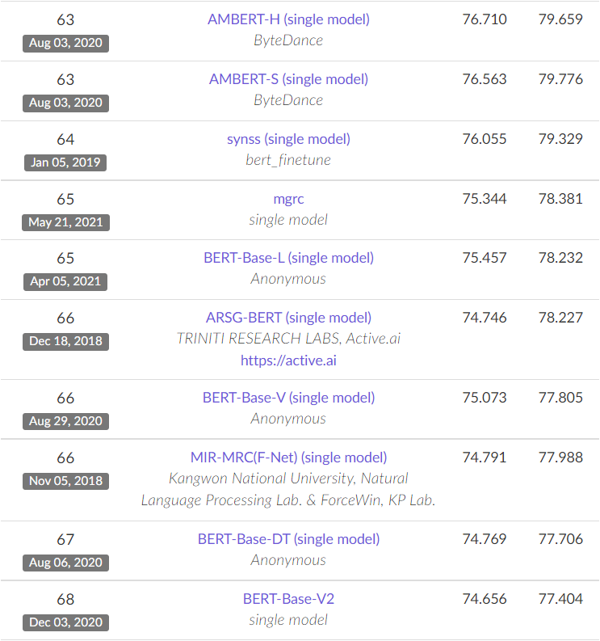
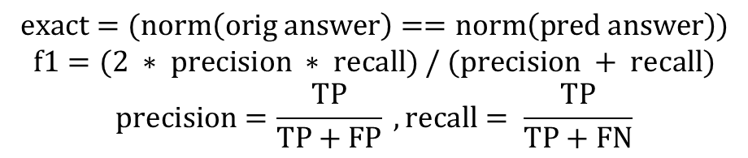
Validation
$$exact=(norm\left(orig answer\right)==norm\left(pred answer\right))$$
$$f1=(2 ∗ precision ∗ recall) / (precision + recall)$$
$$precision=\frac{TP}{TP+FP} ,recall= \frac{TP}{TP+FN}$$
Metrics | Values
HasAns_exact | 65.72199730094466
HasAns_f1 | 71.02531166019085
HasAns_total | 5928
NoAns_exact | 84.44070647603027
NoAns_f1 | 84.44070647603027
NoAns_total | 5945
exact | 75.09475280047165
f1 | 77.74261328405724
Total | 11873

Slide 28
Elma
6. Discussion & Conclusion

Slide 29
Discussion
Functionality
Encryption: Localized encryption
C Program
Unencrypted
Encrypted
Synchronization: Network communication automation
Bash script
Manually
Automatically
Notes:
Synchronization: The server will transfer the trained model to embedded system

Slide 30
Discussion
Optimization
Distillation rate
Choice of entropy
Introduce a true error dataset
Parameter sharing within each of the layer groups
1
2
3
4
5
6
7
8
9
10
11
12
Group 1
Group 2
Group 3
Notes:
It is intuitive that different words in a sentence have different importance when we are trying to interpret it. In this sentence, ‘The agreement on the European Economic Area was signed in August 1992.” We can see that words with more information have more weights, “agreement, European economic area” etc. The attention masks are trained during the training process, and it gives weights to different words. The albert model we used have 12 such attention layer to boost its accuracy, but it also consumes a lot of resources. We use this adaptive attention span introduced by EdgeBERT to change the situation. The Adaptive Span determines if the word on a specific location goes through the attention layer, if it is not included in the attention span, the calculation of the word in this specific position would be omitted without worsening the final result.

Slide 31
Conclusion
Efficiency
Security
Early-exit
Cost
Locality
Cloud
Offloading
Notes:
In conclusion, recall previously we evaluate four requirements and specifications: functionality, efficiency, security, and cost. We have realized the functionality, and efficiency is improved by early-exit, security is provided by offloading, costs are reduced by cloud computing – we don’t need to deploy huge computation resources locally

Slide 32
Elma
Thanks!
ELMA: Early-Exit Offloading for Embedded Question Answering Applications
Group: 3
Instructor: Prof. An Zou
Sponsor: UM-SJTU Joint Institute
Group Member: Yihua Liu, Shuocheng Chen, Yiming Ju

