Slide 1

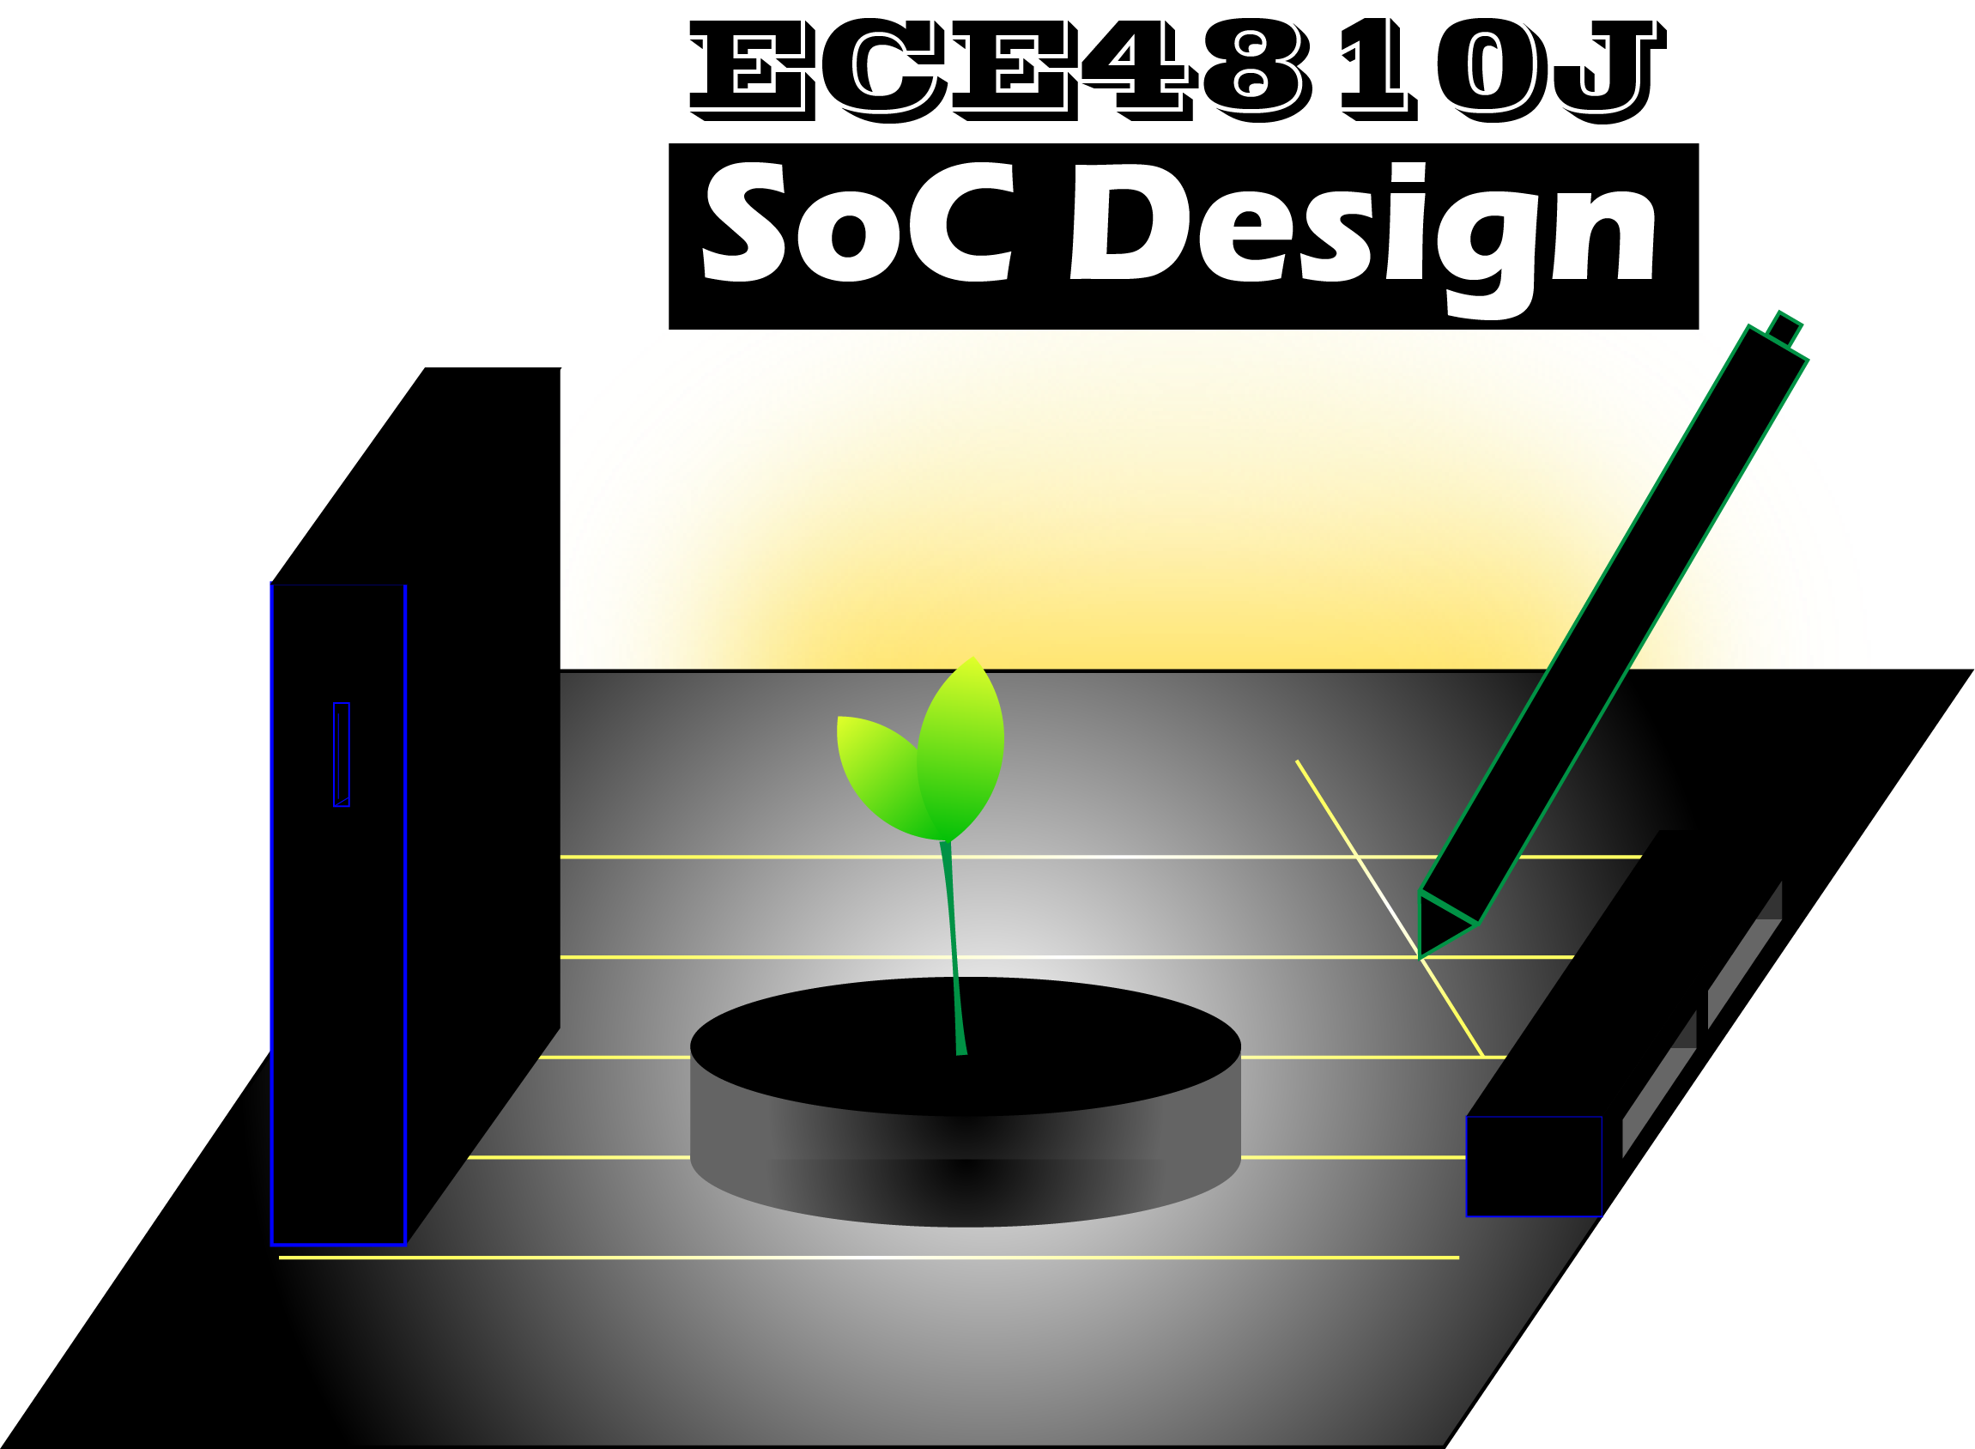
Lab #1
Introduction to Zynq & Xilinx Vitis
ECE4810J System-on-Chip Design
Yihua Liu
UM-SJTU Joint Institute
ayka_tsuzuki@sjtu.edu.cn
Sept 19, 2022

Slide 2
Overview
Overview
Arty-Z7
Zynq
Tool Command Language (TCL)
Xilinx Software Command Tool (XSCT)
Xgpio
Xilinx Vitis
Reference

Slide 3
Overview
Lab 1: Xilinx Vitis on ZYNQ FPGA
Lab 2: Xilinx Vitis HLS & PYNQ on ZYNQ FPGA
Lab 3: Xilinx Vitis HLS Optimization on ZYNQ FPGA
Lab 4: ASIC Design Flow I
Lab 5: ASIC Design Flow II
Lab 6: ASIC Design Flow III
Reminder: Active involvement in projects & labs, including Piazza and lab attendance, will be counted into Participation grades

Slide 4
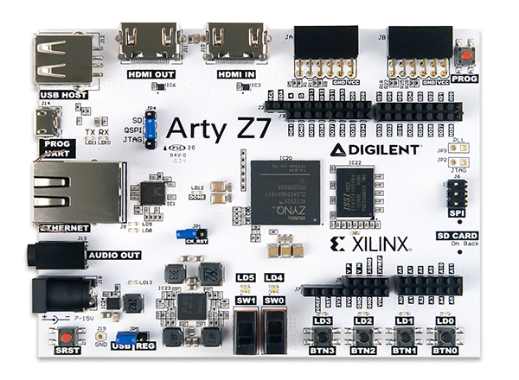
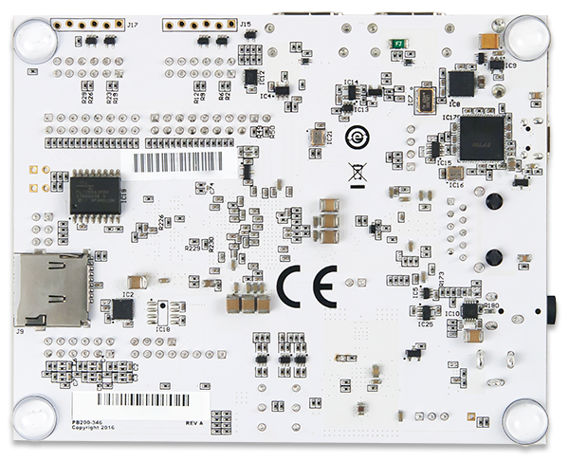
Arty-Z7
Switch
Low Voltage Translator
Low Voltage Translator
USB 2.0
Transceiver
CMOS
Oscillator
CMOS
Oscillator
Serial NOR Flash
ZYNQ
DDR3
SDIO Port
Expander
Auth Chip
8-SOIC
LDO Regulator
SwitchingVoltage Regulator

Slide 5
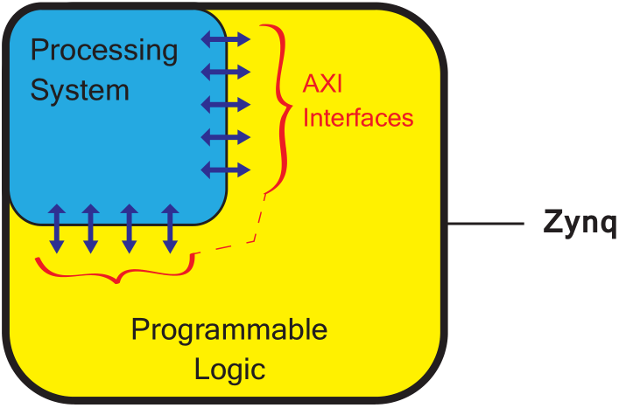
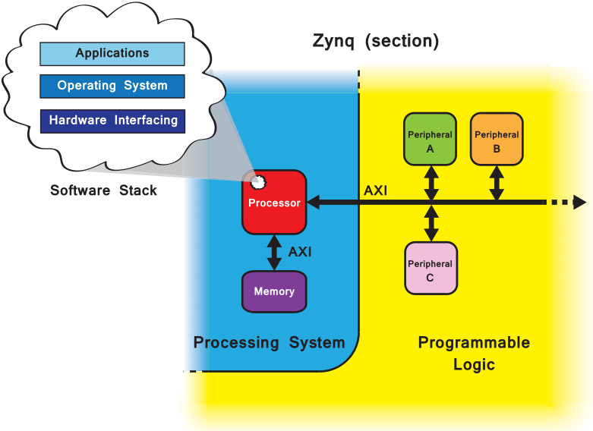
Zynq
Zynq comprises two main parts: a Processing System (PS) formed around a dual-core ARM Cortex-A9 processor, and Programmable Logic (PL), which is equivalent to that of an FPGA. It also features integrated memory, a variety of peripherals, and high-speed communications interfaces. The PL section is ideal for implementing high-speed logic, arithmetic and data flow subsystems, while the PS supports software routines and/or operating systems. Links between the PL and PS are made using industry standard Advanced eXtensible Interface (AXI) connections.
Fig 1. A simplified model of the Zynq architecture

Slide 6
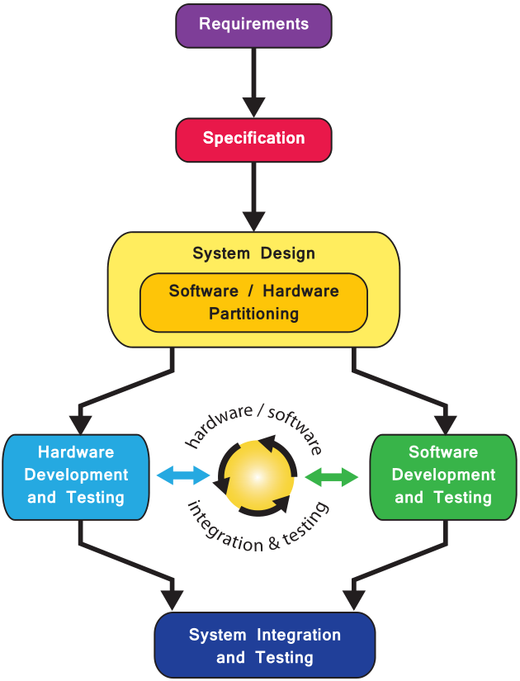
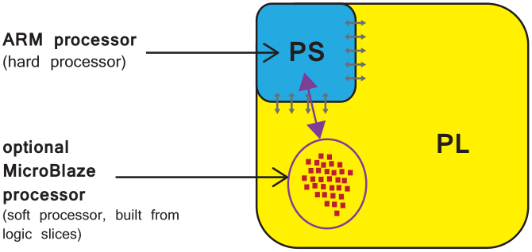
Zynq
Fig 2. A basic model of the design flow for Zynq SoC
Design Reuse:
Intellectual Property (IP) functional blocks — corresponding to the peripheral components seen in Fig. 1, can be sources in different ways.
Fig 3. Locations of hard (ARM Cortex-A9) and soft (MicroBlaze) processors on a Zynq device

Slide 7
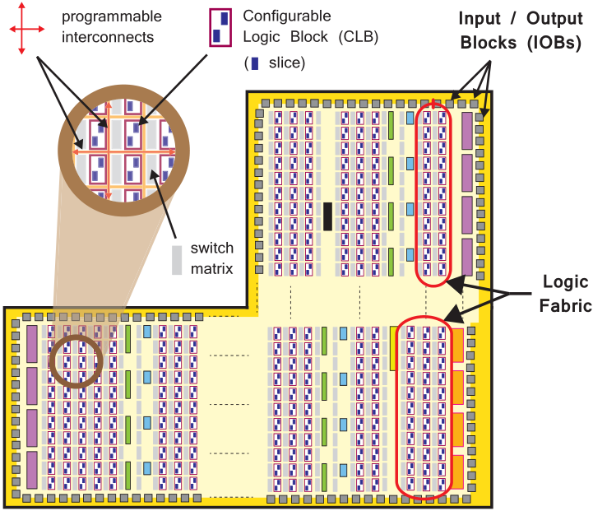
Zynq
Features of PL:
Configurable Logic Block (CLB)
Slice
(6-input) Lookup Table (LUT) 53200
Flip-flop (FF) 106400
Switch Matrix
Carry logic
Input / Output Blocks (IOBs)
DSP48E1: high-speed arithmetic 220
Block RAMs (BRAMs): can implement RAM, ROM, and FIFO buffers 280
GPIO / SelectIO: HP 200 / HS 0
GTX Transceivers: comm interface blocks
XADC, Clocks, and JTAG for debug
Fig 4. The logic fabric and its constituent elements
XADC block
PCI
Express
block
Clock tiles
Block RAM
GTX transceivers

Slide 8
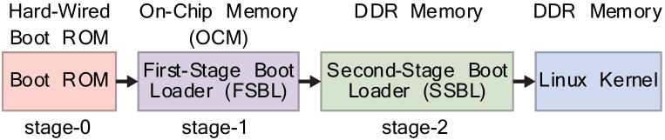
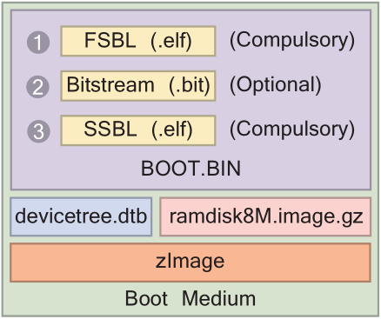
Zynq
IP-XACT:
The IP-XACT standard is an eXtensible Markup Language (XML) schema for
documenting IP using metadata, developed by the SPIRIT Consortium, now managed by Accellera Systems Initiative.
First-Stage Bootloader (FSBL):
The FSBL is a section of code contained in the MBR (Master Boot Record)
Possible boot sources:
NAND Flash, NOR Flash, QSPI Flash, SD Card, JTAG
The FSBL is loaded into the OCM (On-Chip Memory)
by the boot ROM after the initial boot period.
BootGen: a standalone app to generate bootable images
Fig 5. Zynq Linux boot process
Fig 6. Required files for Zynq Linux boot medium

Slide 9
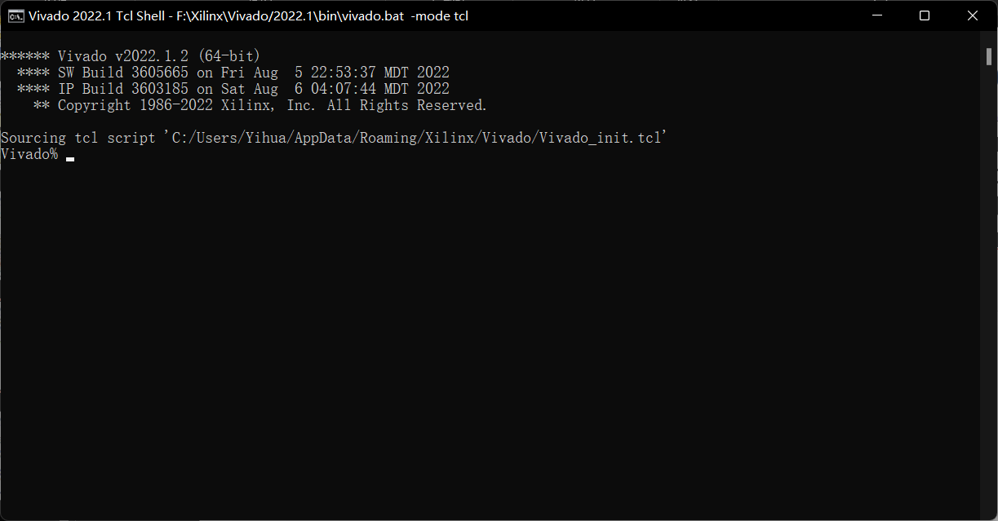
Tcl
Tcl (pronounced “tickle”) is a high-level, general-purpose, interpreted, dynamic programming language created in 1988. The popular combination of Tcl with the Tk extension is referred to as Tcl/Tk and enables building a GUI natively in Tcl. Tcl/Tk is included in the standard Python installation in the form of Tkinter.
Tclsh is bundled in some distributions of Windows/MacOS/Linux; if not, install ActiveTcl.
You will use Tcl in Vivado 2022.1 Tcl
Shell most of the time.
Please read and play
Reduced Tcl Tutorial All-in-One.pdf
on Canvas Files->Reading Materials
->Literatures up to Chapter String

Slide 10
XSCT
connect -host localhost -port 3121
connect -url tcp:localhost:3121
Connect to hw_server/TCF agent on host localhost and port 3121
disconnect <channel-id> Disconnect from specified channel
targets List all targets
targets -set -filter {name =~ "MicroBlaze*"} -index 0
Set current target to target with name starting with "MicroBlaze" and which is on the first JTAG device
rrd usr r8 Read register r8 in group usr
rwr usr r8 0x0 Write 0x0 to register r8 in group usr
state : return state stop: suspend stp: step into nxt: step over con: resume
openhw/closehw Open/Close a hardware design from Vivado
getws/setws Get/Set Vitis workspace
importprojects <path> Import projects to workspace
app: build, clean, config, create, list, remove, report, switch

Slide 11
XGpio
You may use the following functions of xgpio.h in Lab #1:
int XGpio_Initialize (XGpio *InstancePtr, u16 DeviceId)
Initialize the XGpio instance provided by the caller based on the given DeviceID.
XGpio_Config * XGpio_LookupConfig (u16 DeviceId)
Lookup the device configuration based on the unique device ID.
int XGpio_CfgInitialize (XGpio *InstancePtr, XGpio_Config *Config, UINTPTR EffectiveAddr)
Initialize the XGpio instance provided by the caller based on the given configuration data.
void XGpio_SetDataDirection (XGpio *InstancePtr, unsigned Channel, u32 DirectionMask)
Set the input/output direction of all discrete signals for the specified GPIO channel.
u32 XGpio_DiscreteRead (XGpio *InstancePtr, unsigned Channel)
Read state of discretes for the specified GPIO channel.
void XGpio_DiscreteWrite (XGpio *InstancePtr, unsigned Channel, u32 Mask)
Write to discretes register for the specified GPIO channel.

Slide 12
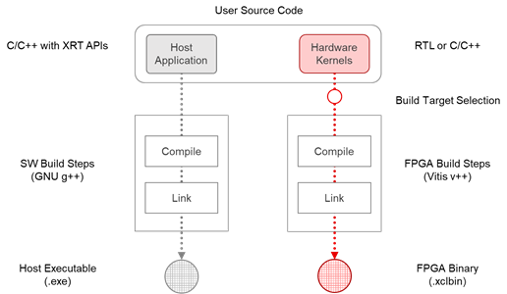
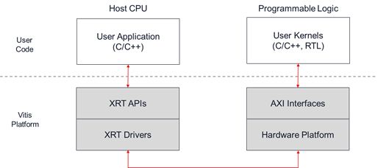
Xilinx Vitis
Fig 7. Vitis Build Process
Vitis Build Targets:
Software Emulation (Linux only): v++ -t sw_emu Kernel code compiled to run on the host processor
Hardware Emulation (Linux only): v++ -t hw_emu Kernel code compiled into RTL run in simulator
ERROR: [v++ 82-987] Sorry, emulation flows are not yet supported on this operating system.
Hardware: v++ -t hw Kernel code compiled into RTL implemented on FPGA
XRT: Xilinx Runtime library

Slide 13
Reference
Arty Z7 - Digilent Reference
Arty Z7 Reference Manual - Digilent Reference
The Zynq Book: Embedded Processing with the ARM® Cortex®-A9 on the Xilinx® Zynq®-7000 All Programmable SoC
UG1400 Vitis Unified Software Platform Documentation: Embedded Software Development (v2022.1)
gpio: xgpio.h File Reference (xilinx.github.io)
System Design with HDL Code Generation from MATLAB and Simulink - MATLAB & Simulink (mathworks.com)
Basic HDL Code Generation and FPGA Synthesis from MATLAB - MATLAB & Simulink (mathworks.com)
Generate HDL Code from Simulink Model - MATLAB & Simulink (mathworks.com)
Using the Zynq SoC Processing System — Embedded Design Tutorials 2022.1 documentation (xilinx.github.io)

