Slide 1

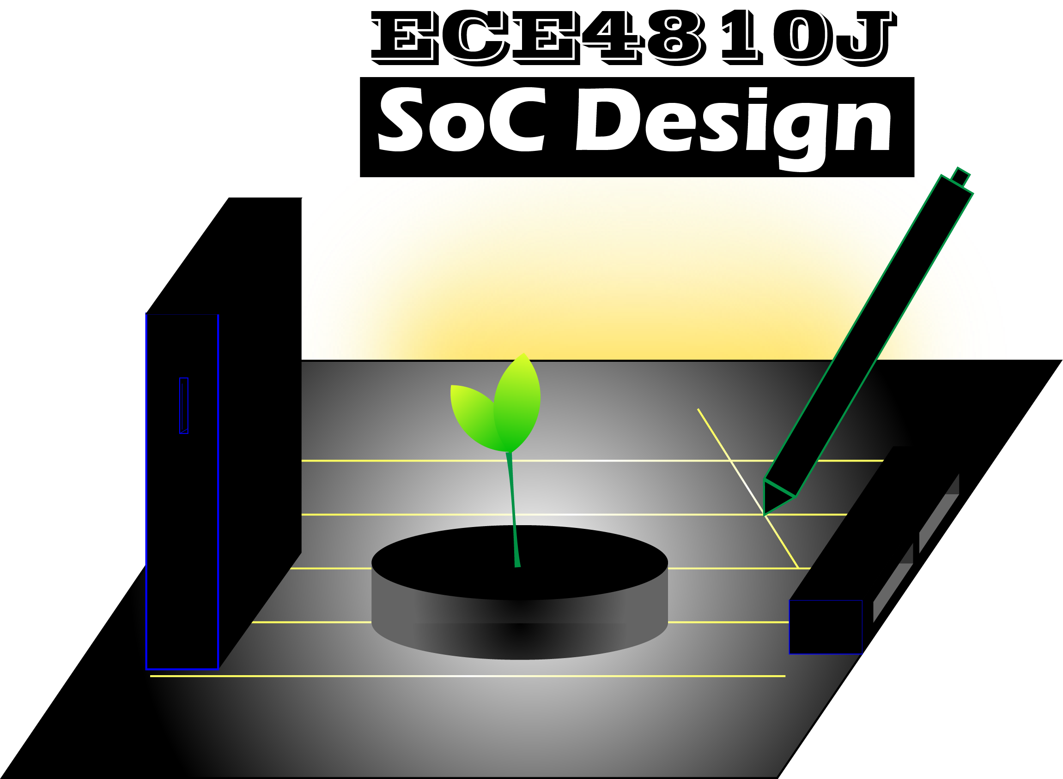
Lab #2
Introduction to Vitis HLS & PYNQ
ECE4810J System-on-Chip Design
Yihua Liu
UM-SJTU Joint Institute
ayka_tsuzuki@sjtu.edu.cn
Sept 26, 2022

Slide 2
Overview
Overview
Verilog 2005 Revisited
SystemVerilog 2017
Synthesis Isn’t for Granted
Pipelined Multiplication
Reference

Slide 3
Verilog 2005 Revisited
Structural Model
Dataflow Model/Description
Behavioral Model/Description
module VrInhibit(in, invin, out);
input in, invin;
output out;
wire notinvin;
not U1(notinvin, invin);
and U2(out, in, notinvin);
endmodule
module Vrprimed(N, F);
input [3:0] N;
output F;
assign F = N[3] ?
(N[0] & (N[1]^N[2])) :
(N[0] | (~N[2]&N[1]));
endmodule
module Vrbytecase(A, B, C,
sel, Z);
input [7:0] A, B, C;
input [1:0] sel;
output reg [7:0] Z;
always @ (*)
case
2'd0: Z = A;
2'd1: Z = B;
2'd2: Z = C;
2'd3: Z = 8'b0;
default: Z = 8'bx;
endcase
endmodule
Verilog built-in gates:
and xor bufif0
nand xnor bufif1
or buf notif0
nor not notif1
Continuous-assignment statements:
assign net-name = expression;
assign net-name[bit-index] = expression;
assign net-name[msb:lsb] = expression;
assign net-concatenation = expression;
Instance statements:
component-name instance-identifier(expr,…);
component-name instance-identifier( .port-name(expr),…);
Procedural statements: assignment, begin-end blocks, if, case, while, and repeat
Synthesis

Slide 4
Verilog 2005 Revisited
Verilog signals: nets and variables
Nets: a wire in a physical circuit and provides connectivity between modules and other elements in a Verilog structural model
wire, tri, triand, trior, tri0, tr1, trireg, wand, wor, supply0, supply1, uwire
Variables: store values during a Verilog model’s execution and need not have physical significance in a circuit.
reg, integer, real, realtime, time
Nets vs. variables: a variable’s value can be changed only by procedural code within a module; it cannot be changed from outside. Procedural code can assign values only to variables, not nets.
Signed arithmetic: signed
reg signed [15:0] A, output reg signed [15:0] T
Signed operations are used only if all of an expression’s operands are signed
4’sb1101 + 1’b1 = 14, (4’sb1101 << 1) + 1 = -3
Type-casting functions: $signed(), $unsigned()
A reg is NOT A FLIP-FLOP

Slide 5
Verilog 2005 Revisited
An array is an ordered set of variables of the same type indexed by array index
reg identifier [start:end];
reg [msb:lsb] identifier [start:end];
integer identifier [start:end];
wire identifier [start:end];
wire [msb:lsb] identifier [start:end];
Multi-dimensional arrays
reg [7:0] mem3 [1:10] [0:255]
The lower nibble of the byte in row 5, column 7: mem3[5][7][3:0]
One-dimensional array of vectors vs. two-dimensional array of bits:
reg [7:0] mem1 [0:255] vs. reg mem2 [0:255] [7:0]
mem1[1] = 0; // Assigns 0 to the second element of mem1
mem2[1][0] = 0; // Assigns 0 to the bit referenced by indices [1][0]
mem1 = 0; // Illegal - Attempt to write to entire array
mem2[1] = 0; // Illegal - Attempt to write to elements [1:0]-[1:255]
mem2[1][1:3] = 0; // Illegal - Attempt to write to elements [1:1]-[1:3]

Slide 6
Verilog 2005 Revisited
Function | Task
execute in one simulation time unit | can contain time-controlling statements
cannot enable a task | can enable other tasks and functions
have at least one input type argument not have an output or inout type argument | can have zero or more arguments of any type
shall return a single value | shall not return a value
A function/task can be defined only within a module, i.e., its definition is local to the module.
To use in multiple modules, define it by itself in a file and use `include to include it in each module.
A useful example:
function integer clogb2;
input [31:0] value;
begin
value = value - 1;
for (clogb2 = 0; value > 0; clogb2 = clogb2 + 1)
value = value >> 1;
end
endfunction

Slide 7
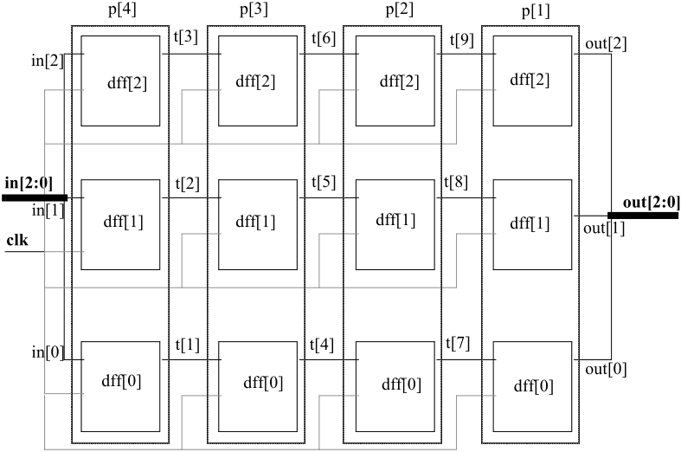
Verilog 2005 Revisited
Array of Instances
To specify an array of instances, the instance name shall be followed by the range specification [lhi:rhi], which shall represent an array of abs(lhi-rhi)+1 instances. This example demonstrates how a series of modules can be chained together.
module dffn(q, d, clk);
parameter bits = 1;
input [bits – 1:0] d;
output [bits – 1:0] q;
input clk;
DFF dff[bits - 1:0] (q, d, clk);
endmodule
module MxN_pipeline(in, out, clk);
parameter M = 3, N = 4; // N = depth
input [M - 1:0] in; // M = width
output [M - 1:0] out;
input clk;
wire [M * (N - 1):1] t;
dffn #(M) p[1:N] ({out, t}, {t, in}, clk);
endmodule

Slide 8
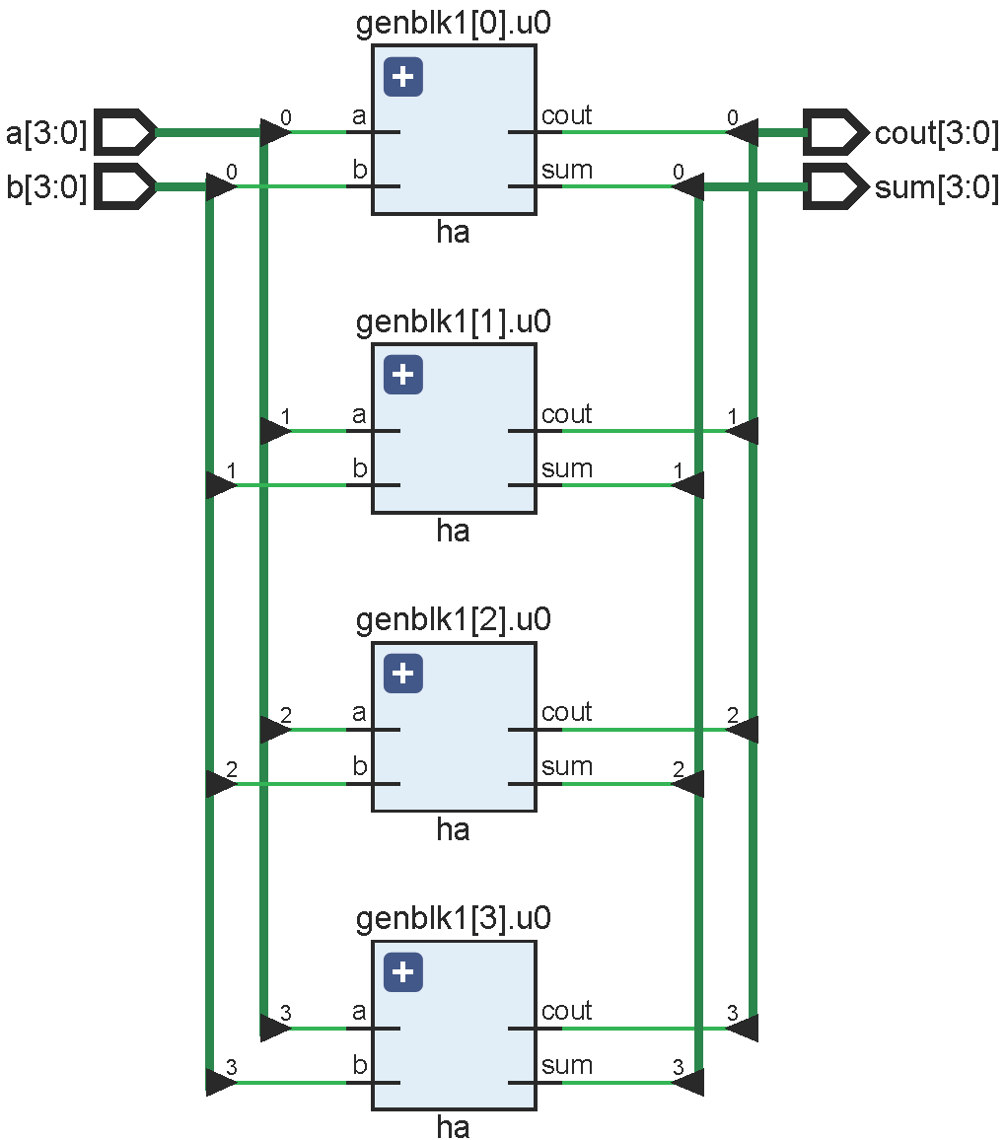
Verilog 2005 Revisited
Generate Blocks
Useful if you want to create multiple copies of a particular structure within a model
Within the block, if, case, and for statements may be used
If instances generated in iterative for loops, the loop is controlled by integer genvar
Example:
module ha(input a, b, output sum, cout);
assign sum = a ^ b;
assign cout = a & b;
endmodule // Design for a half-adder
module my_design #(parameter N = 4)
(input [N - 1:0] a, b, output [N - 1:0] sum, cout);
genvar i; // Generate a temporary loop variable
generate // Generate for loop to instantiate N times
for (i = 0; i < N; i = i + 1) begin
ha u0(a[i], b[i], sum[i], cout[i]);
end
endgenerate
endmodule // Top level design that contains N inst of ha

Slide 9
Verilog 2005 Revisited
Case Statement
Case statement with do-not-cares:
casez casex
reg [7:0] r, mask;
mask = 8'bx0x0x0x0;
casex (r ^ mask)
8'b001100xx: stat1;
8'b1100xx00: stat2;
8'b00xx0011: stat3;
8'bxx010100: stat4;
endcase
reg [7:0] ir;
casez (ir)
8'b1???????: instruction1(ir);
8'b01??????: instruction2(ir);
8'b00010???: instruction3(ir);
8'b000001??: instruction4(ir);
endcase

Slide 10
Verilog 2005 Revisited
Latch: Memory device without a clock
always_comb begin
if (cond)
next_x = y;
end
always_comb begin
next_x = x;
if (cond)
next_x = y;
end
always_comb begin
next_x = x;
if (cond)
next_x = y;
else
next_x = x;
end

Slide 11
SystemVerilog 2017
Verilog
wire
reg
always (*)
always (posedge clock)
SystemVerilog
wire / logic
logic
always_comb
always_ff @(posedge clock)
An enumerated type declares a set of integral named constants.
enum bit [3:0] {bronze='h3, silver, gold='h5} medal2;
A type name can be given so that the same type can be used in many places.
typedef enum { red, green, blue, yellow, white, black } Colors;
Colors C;

Slide 12
SystemVerilog 2017
How to prevent unintentional latches?
unique, unique0, priority
unique-if and unique0-if assert that there is no overlap in a series of if–else–if conditions, i.e., they are mutually exclusive and hence it is safe for the conditions to be evaluated in parallel.
A unique-if or unique0-if is violated if more than one condition is found true.
Doesn’t issue a violation report
module lab2_1;
int a, b, c;
initial begin
a = 50;
b = 20;
c = 40;
priority if (a < b)
$display("a<b");
else if (a < c)
$display("a<c")
end
endmodule
Issue a violation report
module lab2_1;
int a, b, c;
initial begin
a = 50;
b = 20;
c = 40;
unique if (a < b)
$display("a<b");
else if (a < c)
$display("a<c")
end
endmodule
module lab2_1;
int a, b, c;
initial begin
a = 10;
b = 20;
c = 40;
unique if (a < b)
$display("a<b");
else if (a < c)
$display("a<c")
else
$display("a>=b||a>=c")
end
endmodule
module lab2_1;
int a, b, c;
initial begin
a = 10;
b = 20;
c = 40;
unique0 if (a < b)
$display("a<b");
else if (a < c)
$display("a<c")
else
$display("a>=b||a>=c")
end
endmodule
module lab2_1;
int a, b, c;
initial begin
a = 50;
b = 20;
c = 40;
unique0 if (a < b)
$display("a<b");
else if (a < c)
$display("a<c")
end
endmodule
always_comb begin
{int2, int1, int0} = 3'b000;
unique casez (irq)
3'b1??: int2 = 1'b1;
3'b?1?: int1 = 1'b1;
3'b??1: int0 = 1'b1;
endcase
end
Warning-[RT-MTOCMUIF] More than one condition match in statement
Warning-[RT-NCMUIF] No condition matches in statement
If the keywords unique or priority are used, a violation report shall be issued if no condition matches unless there is an explicit else.

Slide 13
SystemVerilog 2017
unique, unique0, priority
A priority-if indicates that a series of if–else–if conditions shall be evaluated in the order listed.
module lab2_2;
bit [7:0] a;
initial begin
a = 0;
priority case (a)
0: $display("Fount to be 0");
0: $display("Again fount to be 0");
2: $display("Fount to be 2");
endcase
end
endmodule
ncsim > run
Found to be 0
ncsim: *W,RNQUIE: Simulation is complete.

Slide 14
Synthesis Isn’t for Granted
Vivado Design Suite User Guide Synthesis UG901 (v2022.1)
Verilog Language Support: SystemVerilog Support:
From ISE to Vivado 2021.2
Division: supported only if 2nd operand is a power of 2 or both operands are constant
Modulus: supported only if 2nd operand is a power of 2
Expression | Symbol | Status
Arithmetic | +, -, *, ** | Supported
Division | / | Supported
Modulus | % | Supported
Power | ** | Supported: No real or X or Z 2 const, 2nd non-negative 1st is 2, 2nd can be a var
Verilog Constants |  | Support Status
tri1, tr0, trireg |  | Unsupported
delay (#) |  | Ignored
`timescale |  | Ignored
$fdisplay, $finish, $fopen |  | Ignored
$fclose, $fgets |  | Not Supported
 | Construct | Status
Data type | 2-state data types | Supported
 | 4-state data types | Supported
Operators & expressions | $error | Supported only within initial blocks, only be used to evaluate constant expressions like parameters
 | $warning
 | $info
 | Increment operators | Supported
 | Decrement operators | Supported
Functions | Void functions | Supported
 | Virtual functions | Not Supported
Compiler directives |  | Supported
Generate constructs |  | Supported
Class | Instance, constructor | Supported
But, at what cost?

Slide 15
Pipelined Multiplication
Partial Products
Multiply the first n bits of the two components
Multiply the next n bits, etc.
Sum the partial products to get the answer
Example: 4-stage Pipelined Multiplication
multiplicand: 00001011 << 2
multiplier: 00000111 >> 2
partial product: 00100001
multiplicand: 00101100 << 2
multiplier: 00000001 >> 2
partial product: 00101100
+ 00100001
= 01001101

Slide 16
Pipelined Multiplication
Various choices:
Generate blocks vs. Array instantiation
Number of stages vs. Number of bits
Combinational logic vs. Sequential logic
Shift operators vs. Concatenation

Slide 17
Reference
IEEE. “1364-2005 IEEE Standard for Verilog® Hardware Description Language.”
IEEE. “1800-2017 IEEE Standard for SystemVerilog – Unified Hardware Design, Specification, and Verification Language.”
John F. Wakerly. Digital Design Principles and Practices Fifth Edition.
Haoyang Zhang. “ECE4700J Summer 2022 Computer Architecture Lab 1 Verilog: Hardware Description Language”. University of Michigan – Shanghai Jiao Tong University Joint Institute. May 18, 2022.
https://support.xilinx.com/s/question/0D52E00006hpiTjSAI/does-vivado-ise-support-division-operator-for-synthesize. July 27, 2018.
Xilinx. Vivado Design Suite User Guide Synthesis UG901 (v2022.1). June 6, 2022.
Runxi Wang and Xinfei Guo. “[Lab 1] Timing Issue of divider IP.” Sept. 21, 2022. URL: https://piazza.com/class/l7nfec1tage34/post/7.
https://support.xilinx.com/s/question/0D52E00006lLgwMSAS/vhdl-divider-inference-in-vivado-synthesis-20191. Sept. 9, 2019.

Slide 18
Reference
https://support.xilinx.com/s/question/0D52E00006hpXuGSAU/multiplication-sign-and-division-sign-can-pass-synthesis-and-implementation-in-vivado.
ChipVerify. “SystemVerilog Unique Priority Case.”
Xilinx. “PG151 Divider Generator v5.1 LogiCORE IP Product Guide.” Feb. 4, 2021.

