Slide 1

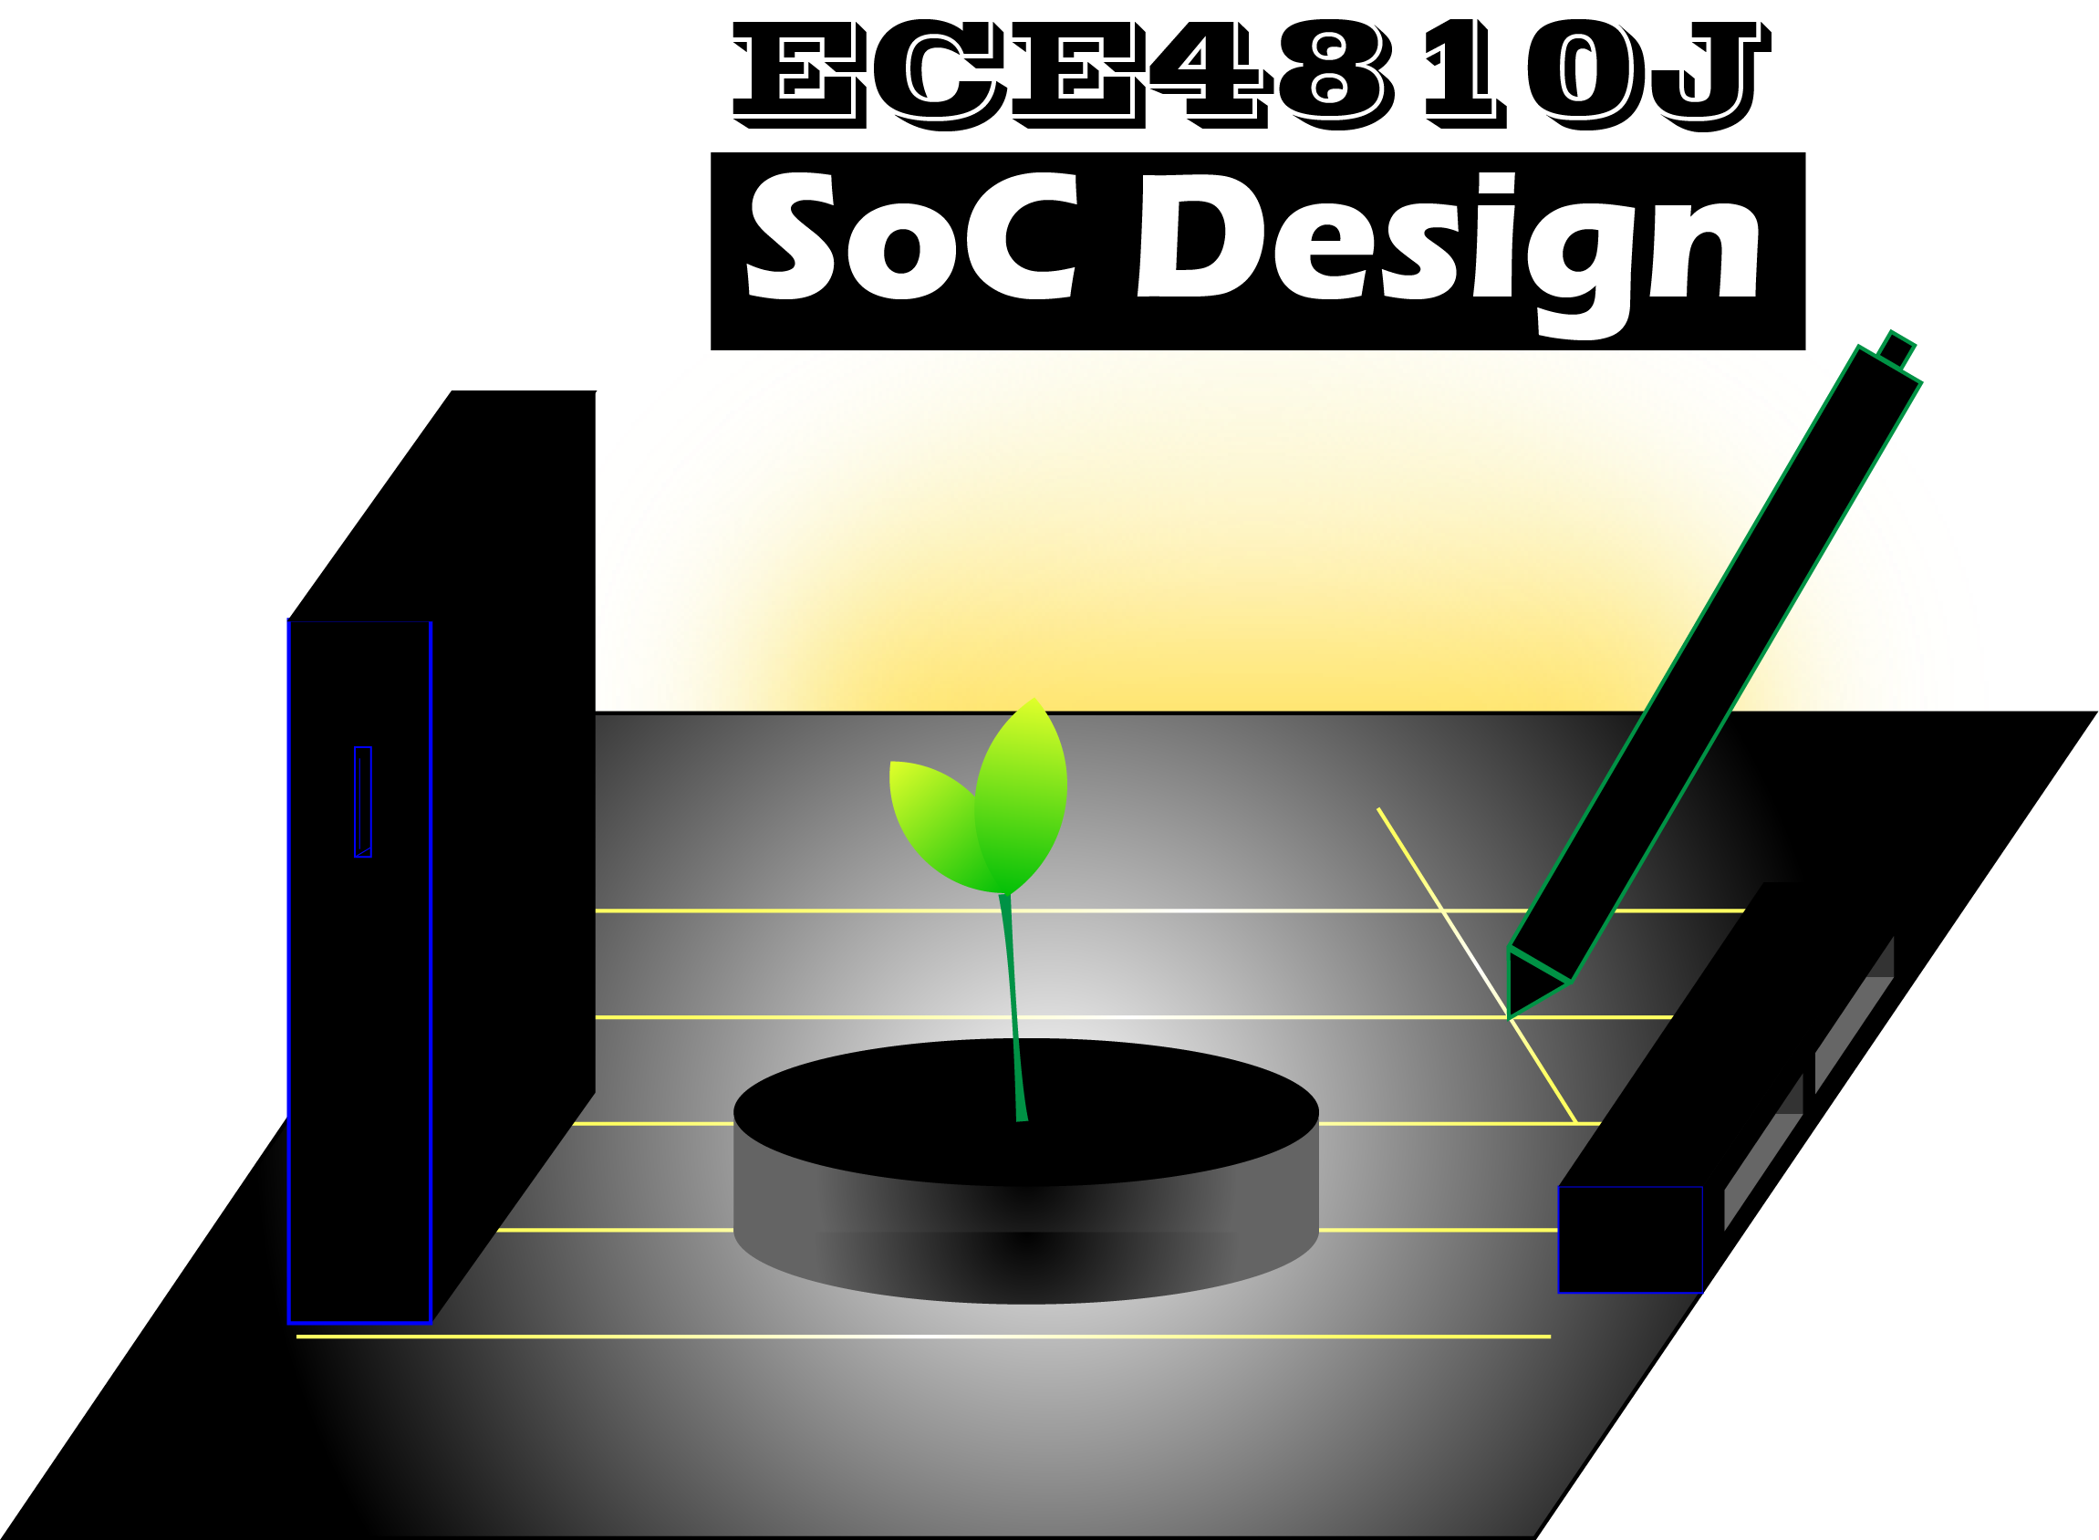
Lab #3
Applications of Vitis HLS & PYNQ
ECE4810J System-on-Chip Design
Yihua Liu
UM-SJTU Joint Institute
ayka_tsuzuki@sjtu.edu.cn
Oct. 10, 2022

Slide 2
Overview
Overview
High Level Synthesis
Reference

Slide 3
High Level Synthesis
Algorithmic HLS does several things automatically that an RTL designer does manually:
HLS analyzes and exploits the concurrency in an algorithm.
HLS inserts registers as necessary to limit critical paths and achieve a desired clock frequency.
HLS generates control logic that directs the data path.
HLS implements interfaces to connect to the rest of the system.
HLS maps data onto storage elements to balance resource usage and bandwidth.
HLS maps computation onto logic elements performing user specified and automatic optimizations to achieve the most efficient implementation.
We make the following assumptions about the input function specification:
No dynamic memory allocation (no operators like malloc(), free(), new, and delete())
Limited use of pointers-to-pointers (e.g., may not appear at the interface)
System calls are not supported (e.g., abort(), exit(), printf(), etc. They can be used in the code, e.g., in the testbench, but they are ignored (removed) during synthesis.
Limited use of other standard libraries (e.g., only common math.h functions are supported)
Limited use of function pointers and virtual functions in C++ classes (function calls must be compile-time determined by the compiler).
No recursive function calls.
The interface must be precisely defined.

Slide 4
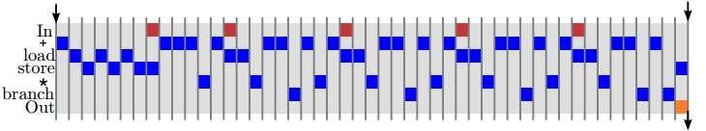
High Level Synthesis
fir:
.frame r1,0,r15 # vars= 0, regs= 0, args= 0
.mask 0x00000000
addik r3,r0,delay_line.1450
lwi r4,r3,8 # Unrolled loop to shift the delay line
swi r4,r3,12
lwi r4,r3,4
swi r4,r3,8
lwi r4,r3,0
swi r4,r3,4
swi r5,r3,0 # Store the new input sample into the delay line
addik r5,r0,4 # Initialize the loop counter
addk r8,r0,r0 # Initialize accumulator to zero
addk r4,r8,r0 # Initialize index expression to zero
$L2:
muli r3,r4,4 # Compute a byte offset into the delay_line array
addik r9,r3,delay_line.1450
lw r3,r3,r7 # Load filter tap
lwi r9,r9,0 # Load value from delay line
mul r3,r3,r9 # Filter Multiply
addk r8,r8,r3 # Filter Accumulate
addik r5,r5,-1 # update the loop counter
bneid r5,$L2
addik r4,r4,1 # branch delay slot, update index expression rtsd r15, 8
swi r8,r6,0 # branch delay slot, store the output
.end fir
#define NUM_TAPS 4
void fir(int input, int *output, int taps[NUM_TAPS]) {
static int delay_line[NUM_TAPS] = {};
int result = 0;
for (int i = NUM_TAPS - 1; i > 0; i--) {
delay_line[i] = delay_line[i - 1];
}
delay_line[0] = input;
for (int i = 0; i < NUM_TAPS; i++) {
result += delay_line[i] * taps[i];
}
*output = result;
}
A key question to understand is: “What circuit is generated from this code?”.
One possible circuit would execute the code sequentially, as would a simple RISC microprocessor.
microblazeel-xilinx-linux-gnu-gcc -01 -mno -xl -soft -mul S fir.c
Listing 1. Code for a four tap FIR filter.

Slide 5
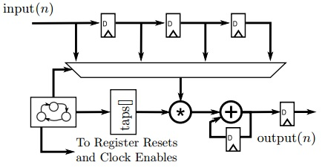
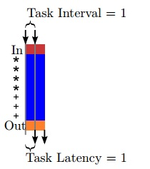
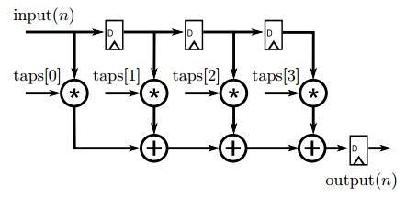
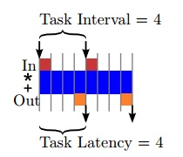
High Level Synthesis
However, the Vitis HLS tool can also generate higher performance pipelined and parallel architectures. One important class of architectures is called a function pipeline. A function pipeline architecture is derived by considering the code within the function to be entirely part of a computational data path, with little control logic. Loops and branches in the code are converted into unconditional constructs. The Vitis HLS tool can be directed to generate a function pipeline by placing the #pragma HLS pipeline directive in the body of a function.
A “one tap per clock” architecture for an FIR filter.
A “one sample per clock” architecture for an FIR filter.

Slide 6
High Level Synthesis
Arbitrary Precision Data Types Library
Language | Integer Data Type | Required Header
C++ | ap_[u]int<W> (1024 bits) Can be extended to 4K bits | #include <ap_int.h>
C++ | ap_[u]fixed<W,I,Q,O,N> | #include <ap_fixed.h>
W Word length in bits
I The number of bits used to represent the integer value
Q Quantization mode
AP_RND Rounds to plus infinity
AP_RND_ZERO Rounds to zero
AP_RND_MIN_INF Rounds to minus infinity
AP_RND_INF Rounds to infinity
AP_RND_CONV Convergent rounding
AP_TRN Truncation to minus infinity (default)
AP_TRN_ZERO Truncation to zero
O Overflow mode
AP_SAT Saturation
AP_SAT_ZERO Saturation to zero
AP_SAT_SYM Symmetrical saturation
AP_WRAP Wrap around (default)
AP_WRAP_SM Sign magnitude wrap around
N This defines the number of saturation bits in overflow wrap mode

Slide 7
High Level Synthesis
#include "cpp_ap_int_arith.h"
void cpp_ap_int_arith (din_A inA, din_B inB, din_C inC, din_D inD, dout_1 *out1, dout_2 *out2, dout_3 *out3, dout_4 *out4) {
*out1 = inA * inB;
*out2 = inB + inA;
*out3 = inC / inA;
*out4 = inD % inA;
}
The default maximum width allowed is 1024 bits. You can override this default by defining the macro AP_INT_MAX_W with a positive integer value less than or equal to 4096 before inclusion of the ap_int.h header file.
#include "types_standard.h"
void types_standard(din_A inA, din_B inB, din_C inC, din_D inD, dout_1 *out1, dout_2 *out2, dout_3 *out3, dout_4 *out4) { // Basic arithmetic operations
*out1 = inA * inB;
*out2 = inB + inA;
*out3 = inC / inA;
*out4 = inD % inA;
}
#define AP_INT_MAX_W 4096 // Must be defined before next line
#include "ap_int.h"
ap_int<4096> very_wide_var;
#ifndef _CPP_AP_INT_ARITH_H_
#define _CPP_AP_INT_ARITH_H_
#include <stdio.h>
#include "ap_int.h"
typedef ap_int<6> dinA_t;
typedef ap_int<12> dinB_t;
typedef ap_int<22> dinC_t;
typedef ap_int<33> dinD_t;
typedef ap_int<18> dout1_t;
typedef ap_uint<13> dout2_t;
typedef ap_int<22> dout3_t;
typedef ap_int<6> dout4_t;
void cpp_ap_int_arith (dinA_t inA, dinB_t inB, dinC_t inC, dinD_t inD, dout1_t *out1, dout2_t *out2, dout3_t *out3, dout4_t *out4);
#endif
#include <stdio.h>
#include <stdint.h>
#define N 9
typedef char din_A;
typedef short din_B;
typedef int din_C;
typedef long long din_D;
typedef int dout_1;
typedef unsigned char dout_2;
typedef int32_t dout_3;
typedef int64_t dout_4;
void types_standard(din_A inA, din_B inB, din_C inC, din_D inD, dout_1 *out1, dout_2 *out2, dout_3 *out3, dout_4 *out4);
One disadvantage of AP data types is that arrays are not automatically initialized with a value of 0. You must manually initialize the array if desired.
If C++ Arbitrary Precision Integer Types are synthesized, it results in a design that is functionally identical to Standard Types. To allow assignment of values wider than 64-bits, the ap_[u]int<> classes provide constructors that allow initialization from a string of arbitrary length. To avoid unexpected behavior during co-simulation, do not initialize ap_uint<N> a ={0}.
ap_uint<96> wide_var(“76543210fedcba9876543210”, 16);
wide_var = ap_int<96>(“0123456789abcdef01234567”, 16);

Slide 8
High Level Synthesis
Base FIR Architecture
Calculating Performance
#define N 11
#include "ap_int.h"
typedef int coef_t;
typedef int data_t;
typedef int acc_t; void fir(data_t *y, data_t x) {
coef_t c[N] = {53, 0, -91, 0, 313, 500, 313, 0, -91, 0, 53};
static data_t shift_reg[N];
acc_t acc;
int i; acc = 0;
Shift_Accum_Loop:
for (i = N - 1; i >= 0; i--) {
if (i == 0) {
acc += x * c[0];
shift_reg[0] = x;
} else {
shift_reg[i] = shift_reg[i - 1];
acc += shift_reg[i] * c[i];
}
}
*y = acc;
}
It is possible to specify a target frequency to the Vitis HLS tool using the create_clock tcl command. For example, the command create_clock −period 5 directs the tool to target a clock period of 5 ns and equivalently a clock frequency of 200 MHz. Vitis HLS deals with clock frequency estimates including some margin to account for the fact that there is some error in the estimate. The goal of this margin is to ensure enough timing slack in the design that the generated RTL can be successfully placed and routed. This margin can be directly controlled using the set_clock_uncertainty TCL command.
The label Shift_Accum_Loop: is not necessary. However it can be useful for debugging. The Vitis HLS tool adds these labels into the views of the code.

Slide 9
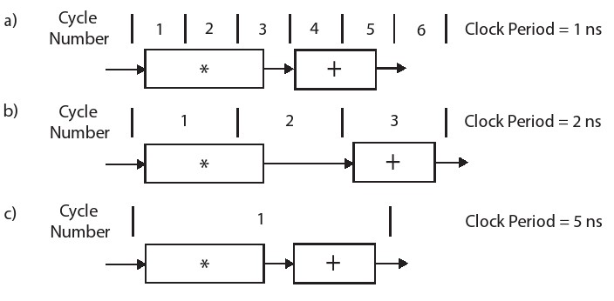
High Level Synthesis
Operation Chaining
Loop Fission
TDL:
for (i = N - 1; i > 0; i--) {
shift_reg[i] = shift_reg[i - 1];
}
shift_reg[0] = x;
acc = 0;
MAC:
for (i = N - 1; i >= 0; i--) {
acc += shift_reg[i] * c[i];
}
Tapped Delay Line
Multiply Accumulate
Loop fission alone often does not provide a more efficient hardware implementation. However, it allows each of the loops to be optimized independently, which could lead to better results than optimizing the single, original for loop.
The reverse is also true; merging two (or more) for loops into one for loop may yield the best results. This is highly dependent upon the application, which is true for most optimizations.
Code Hoisting
Shift_Accum_Loop:
for (i = N - 1; i > 0; i--) {
shift_reg[i] = shift_reg[i - 1];
acc += shift_reg[i] * c[i];
}
acc += x * c[0];
shift_reg[0] = x;
Removing the conditional statement from the for loop creates a more efficient hardware implementation.

Slide 10
High Level Synthesis
Loop Unrolling
A user can tell the Vitis HLS tool to automatically unroll the loop using the unroll directive. To automatically perform the unrolling, we should put the directive #pragma HLS unroll factor=2 into the body of the code, right after the for-loop header. By specifying the optional argument skip_exit_check in that directive, the Vitis HLS tool will not add the final for loop to check for partial iterations.
TDL:
for (i = N - 1; i > 1; i = i – 2) {
shift_reg[i] = shift_reg[i - 1];
shift_reg[i - 1] = shift_reg[i - 2];
}
if (i == 1) {
shift_reg[1] = shift_reg[0];
}
shift_reg[0] = x;
acc = 0;
MAC:
for (i = N - 1; i >= 3; i -= 4) {
acc += shift_reg[i] * c[i] +
shift_reg[i - 1] * c[i - 1] +
shift_reg[i - 2] * c[i - 2] +
shift_reg[i - 3] * c[i - 3];
} for (; i >= 0; i--) {
acc += shift_reg[i] * c[i];
}
Loop unrolling replicates the body of the loop by some number of times (called the factor). Assume that we store the shift_reg array in one BRAM that has 2 read ports and 2 write port, we can perform two read operations and two write operations from the shift_reg array in the same cycle. You can tell the Vitis HLS tool to put all the values in the shift_reg array into registers using the directive #pragma HLS array_partition variable=shift_reg complete.

Slide 11
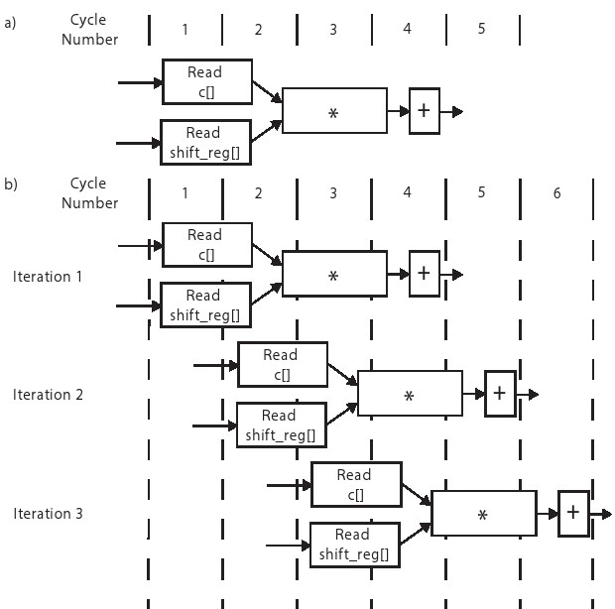
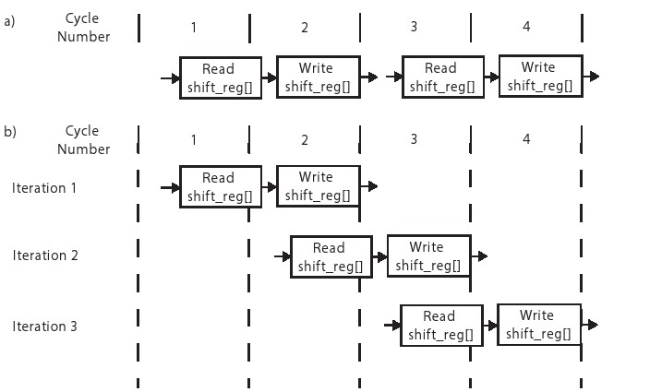
High Level Synthesis
Loop Pipelining
Loop unrolling replicates the body of the loop by some number of times (called the factor). Assume that we store the shift_reg array in one BRAM that has 2 read ports and 2 write port, we can perform two read operations and two write operations from the shift_reg array in the same cycle. You can tell the Vitis HLS tool to put all the values in the shift_reg array into registers using the directive #pragma HLS array_partition variable=shift_reg complete.
The iteration latency is the number of cycles that it takes to perform one iteration of the loop body.
Iteration latency = 44 -> 14
The loop initiation interval (II) is the number of clock cycles until the next iteration of the loop can start.
#pragma HLS pipeline II=1
#pragma HLS resource variable=shift_reg core=RAM 1P
#pragma HLS pipeline
pipeline_mac
pipeline_tdl

Slide 12
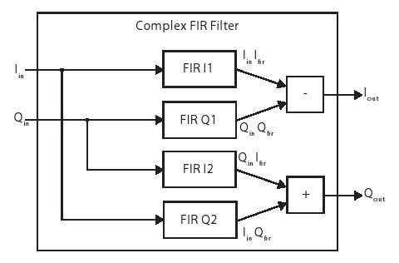

High Level Synthesis
Bitwidth Optimization
coef t c[N] = {53, 0, −91, 0, 313, 500, 313, 0, −91, 0, 53};
The maximum absolute value for any of these 11 entries is 500, which requires ⌈log2 500⌉ = 9 bits.
Since we need negative numbers, we add an additional bit. Thus, coef_t can be declared as ap_int<10>. Consider the operation a = b + c where ap_uint<10> b and ap_uint<10> c. The data type for a is ap_uint<z> where z = max(x, y) + 1.
The value the bitwidth z given the bitwidths x and y (i.e., ap_int<z> a, ap_int<x> b, ap_int<y> c) for the operation a = b ∗ c is z = x + y.
$$\left(I_{in}+jQ_{in}\right)\left(I_{fir}+jQ_{fir}\right)=\left(I_{in}I_{fir}−Q_{in}Q_{fir}\right)+j(Q_{in}I_{fir}+I_{in}Q_{fir})$$
typedef int data_t;
void firI1(data_t *y, data_t x);
void firQ1(data_t *y, data_t x);
void firI2(data_t *y, data_t x);
void firQ2(data_t *y, data_t x); void complexFIR(data_t Iin, data_t Qin, data_t *Iout, data_t *Qout) { data_t IinIfir,QinQfir,QinIfir,IinQfir; firI1(&IinIfir,Iin);
firQ1(&QinQfir,Qin);
firI2(&QinIfir,Qin);
firQ2(&IinQfir,Iin);
*Iout = IinIfir + QinQfir;
*Qout = QinIfir - IinQfir;
}
Complex FIR Filter
firI1, firQ1, firI2, and firQ2 have the exact
same code; can we call the same function 4 times?
static keyword used within the fir function for the shift_reg

Slide 13
High Level Synthesis
Bitwidth Optimization
The Vitis HLS tool does not optimize across function boundaries, i.e., each fir function synthesized independently, and treated as a black box in the complexFIR function. You can use the inline directive if you want the Vitis HLS tool to co-optimize a particular function within its parent function.
can increase the potential for benefits in performance and area
creates a large amount of code that the tool must synthesize, which may take a long time, even fail to synthesize, or may result in a non-optimal design
eliminates any overhead associated with performing the function call.
Therefore, use the inline directive carefully. Also note that the Vitis HLS tool may choose to inline functions on its own. These are typically functions with a small amount of code. You can force the tool to keep the function hierarchy by inline off. The inline directive also has a recursive argument that recursively adds the code into the parent functions from every child function.
float mul(int x, int y) {
return x ∗ y;
}
float top_function(float a, float b, float c, float d) {
return mul(a, b) + mul(c, d) + mul(b, c) + mul(a, d);
}
float inlined_top_function(float a, float b, float c, float d) {
return a ∗ b + c ∗ d + b ∗ c + a ∗ d;
}

Slide 14
Reference
Ryan Kastner, Janarbek Matai, and Stephen Neuendorffer. “Parallel Programming for FPGAs.” Sept. 6, 2022.

