Slide 1

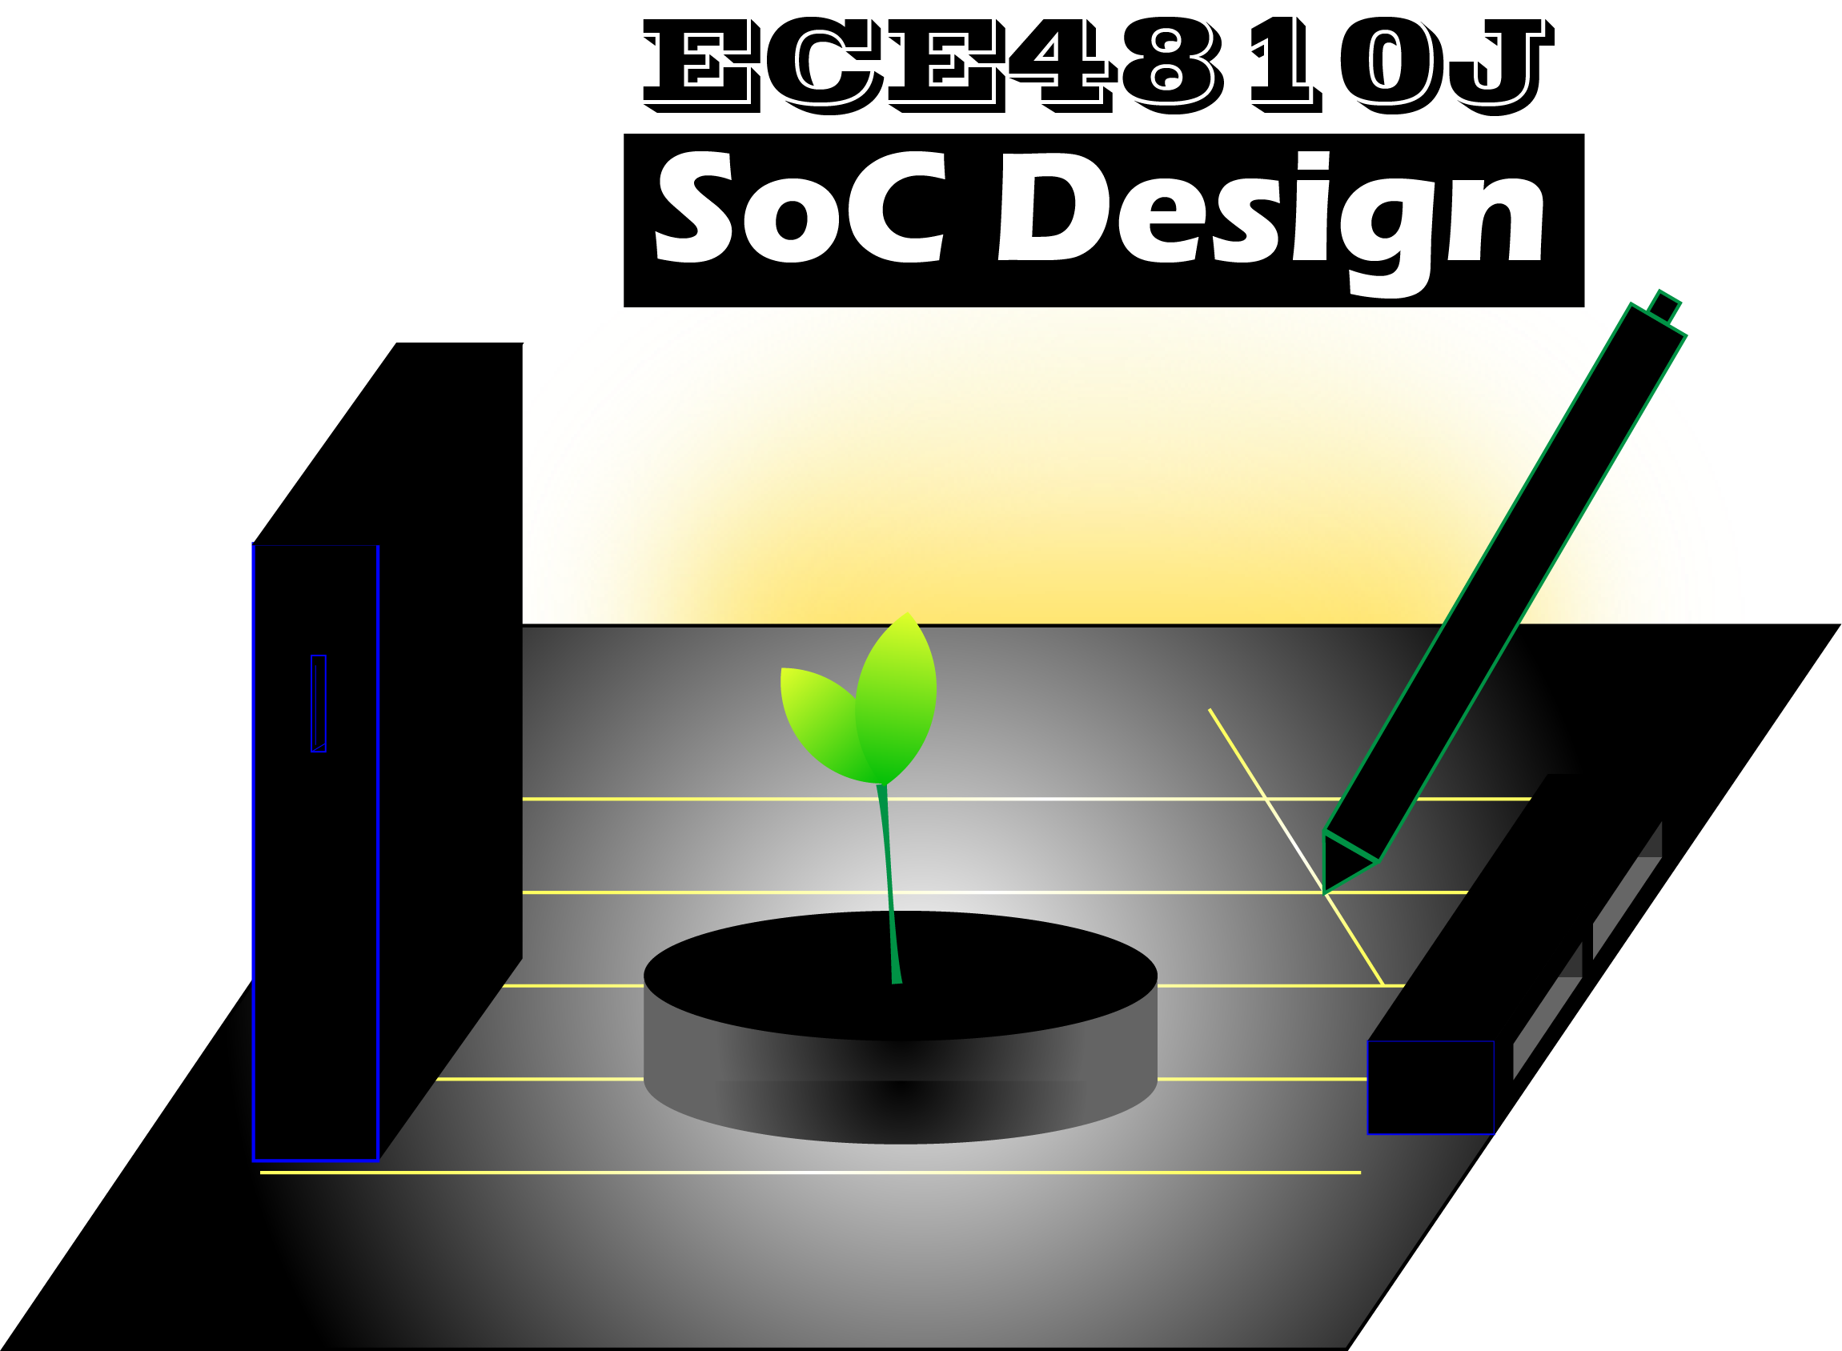
Lab #5
ASIC Backend Flow
ECE4810J System-on-Chip Design
Yihua Liu
UM-SJTU Joint Institute
ayka_tsuzuki@sjtu.edu.cn
Oct. 31, 2022

Slide 2
Overview
Overview
ASIC Flow Front-End vs Back-End
VLSI Design Methodologies
Productive MLM & VLSI Design
PyMTL3
Reference

Slide 3
ASIC Flow Front-End vs Back-End
Front-End:
Hardware modeling in HDL
Synopsys VCS for 4-State RTL Simulation
Synopsys Design Compiler for Synthesis
Synopsys VCS for Fast-Functional Gate-Level Simulation
Back-End:
Synopsys PrimeTime for Post-Synth Power Analysis
Synopsys IC Compiler/Cadence Innovus for Place-and-Route
Synopsys VCS for Back-Annotated Fast-Functional GL Simulation
Synopsys PrimeTime for STA & Performing Hold Fixing
Synopsys PrimeTime for Post-Place-and-Route Power Analysis
Problem
Solution Specification
Behavioral Representation
Functional Verification
RTL Coding
VHDL/Verilog
Verification Succeeded?
No
Yes
Back End
Synthesis
Synthesis Verification
Parasitic Extraction
STA
No
Timing OK?
No
Verification OK?
No
Verification OK?
Yes
Yes
Yes
Post-layout Verification
Place & Route
The End
Notes:
Mixed modeling

Slide 4



VLSI Design Methodologies
HDL
Hardware Description Language
HPF
Hardware Preprocessing Framework
HGF
Hardware Generation Framework
HDL (Verilog)
Mixed
(Verilog+Perl)
HDL (Verilog)
Host Language
(Scala)
HDL (Verilog)
synth
gen
synth
gen
synth
DUT
Sim
TB’
DUT
TB
DUT’
Sim
TB’
DUT
TB
DUT’
Sim
FPGA/ASIC
FPGA/ASIC
FPGA/ASIC
gen
TB’
gen
TB
Fast edit-sim-debug loop
Slower edit-sim-debug loop
Slower edit-sim-debug loop
Single language for
structural, behavioral, + TB
Multiple languages create
"semantic gap"
Single language for
structural, behavioral, + TB
Difficult to create highly
parameterized generators
Easier to create highly
parameterized generators
Easier to create highly
parameterized generators
Cannot use power of host
language for verification

Slide 5
Productive MLM & VLSI Design
Multi-Level Modeling
SystemC
VLSI Design
Chisel
HGSF
Hardware Generation and Simulation Framework
Single framework for ML
modeling & VLSI design
Host Language
(Python)
HDL (Verilog)
synth
Fast edit-sim-debug loop
DUT
Sim
TB
gen
DUT’
Sim
Single language for
structural, behavioral, + TB
FPGA/ASIC
Easy to create highly
parameterized generators
cosim
Use power of host
language for verification

Slide 6
PyMTL3 Framework
PyMTL Passes (Python)
PyMTL Domain Specific Language (Python)
PyMTL In-Memory Intermediate Representation (Python)
Simulation Pass
Simulatable Model
Test & Sim Harnesses
Translation Pass
System Verilog
Model
Elaboration
Model Instance
Analysis Pass
Analysis Output
Config
Transform Pass
New
Model

Slide 7
PyMTL/Verilog Integration
SimJIT-RTL Tool
Verilog Source
Verilator
Translation Cache
RTL/C++ Source
C Shared Library
PyMTL
RTL Model Instance
Translation
C Interface Source
LLVM/GCC
Wrapper Gen
PyMTL
CFFI Model Instance

Slide 8
PyMTL3: Levels of Abstraction
PyMTL3 hardware modeling framework can be used for functional-level modeling, verification, and simulator harnesses. Computer architects can model systems at various levels of abstraction including at the: functional-level (FL), cycle-level (CL), and register-transfer-level (RTL). Functional-Level – FL models implement the functionality but not the timing of the hardware target. FL models are useful for exploring algorithms, performing fast emulation of hardware targets, and creating golden models for verification of CL and RTL models. FL models can also be used for
building sophisticated test harnesses. FL models are usually the easiest to construct, but also the least accurate with respect to the target hardware.
Cycle-Level – CL models capture the cycle-approximate behavior of a hardware target. CL models will often augment the functional behavior with an additional timing model to track the performance of the hardware target in cycles. CL models are usually specifically designed to enable rapid design-space exploration of cycle-level performance across a range of microarchitectural design parameters. CL models attempt to strike a balance between accuracy, performance, and flexibility.
Register-Transfer-Level – RTL models are cycle-accurate, resource-accurate, and bit-accurate representations of hardware. RTL models are built for the purpose of verification and synthesis of specific hardware implementations. RTL models can be used to drive EDA toolflows for estimating area, energy, and timing. RTL models are usually the most tedious to construct, but also the most accurate with respect to the target hardware.

Slide 9
PyMTL3: Synthesizability
Keep in mind that PyMTL3 is embedded within Python, which is a fully general-purpose language. Given this, it is very easy to write PyMTL3 code that does not actually model any kind of realistic hardware. Students must be very diligent in actively deciding whether or not they are writing synthesizable RTL models or non-synthesizable code. Students must always keep in mind what hardware they are modeling and how they are modeling it!
Concurrent blocks: model hardware update_ff, update, update_once, accept non-synthesizable code only for debugging, assertions, or line tracing
Elaboration code: outside concurrent blocks, generate hardware, accept any code
read-modify-write
not currently supported
Always allowed | Allowed with Limitations | Explicitly not Allowed
Bits bitstruct | accessing Python lists | / // % ** += -= *= /= %= **= //=
& | ^ ~ + - >> << | writing signals | and or not while break continue
== != > >= < <= | writing temporary variables | def global class try except raise
reduce_and() reduce_or() reduce_xor() if else elif | reading reset signal | as is in with return yield import from del exec pass lambda finally
sext() zext() concat() | read-modify-write signal | constructing Python lists/dicts, using dicts
s.signal[n] s.signal[n:m] | * | reading/writing non-signals/clk signal
reading constvars/signals | for | writing reset signal
Must use <<= in update_ff
Must use @= in update
Must use <<= in update_ff
Must use @= in update
Use & | ~ instead
only in (sync) update_ff
not in (async) update
Can synthesize into quite a bit of logic
Instances of InPort, OutPort, or Wire
with statically known bounds

Slide 10
PyMTL3 Basics
% python
>>> from pymtl3 import *
Bits and Bitstruct Data Type
Most HDLs support four-state values (0, 1, X, Z)
PyMTL3 supports two-state values (0, 1)
Bits1, Bits2,…, Bits255
>>> str(pt1)
'3:4'
>>> pt1.x
Bits4(0x3)
>>> pt1.to_bits()
Bits8(0x34)
>>> Point.from_bits( Bits8(0x34) )
Point(Bits4(0x3),Bits4(0x4))
>>> nbits = 8
>>> PointN = mk_bitstruct( f"Point{nbits}", {
... 'x': mk_bits(nbits),
... 'y': mk_bits(nbits),
... })
...
>>> pt2 = PointN( 3, 4 )
>>> pt2
Point8(Bits8(0x03),Bits8(0x04))
>>> pt2.to_bits()
Bits16(0x0304)
>>> zext( a, 8 )
Bits8(0x0a)
>>> a = Bits8( 0xff )
>>> trunc( a, 3 )
Bits3(0x7)
>>> @bitstruct
... class Point:
... x: Bits4
... y: Bits4
...
>>> pt1 = Point(3, 4)
>>> pt1
Point(Bits4(0x3),Bits4(0x4))
>>> a = Bits32( 0xabcd0123 )
>>> a[24:32] = 0x67
>>> b = Bits32( a )
>>> a = Bits8( 0b10101100 )
>>> reduce_and(a)
Bits1(0x0)
>>> a = Bits8( 0xab )
>>> b = Bits12( 0xcde )
>>> concat( a, b )
Bits20(0xabcde)
>>> a = Bits4( 0xa )
>>> sext( a, 8 )
Bits8(0xfa)

Slide 11
Reference
University of Porto. “desing_flow_LuisGomes_v1.” Mar. 2022.
Christopher Batten. “ASIC Flow Front-End.” 2022.

