Slide 1

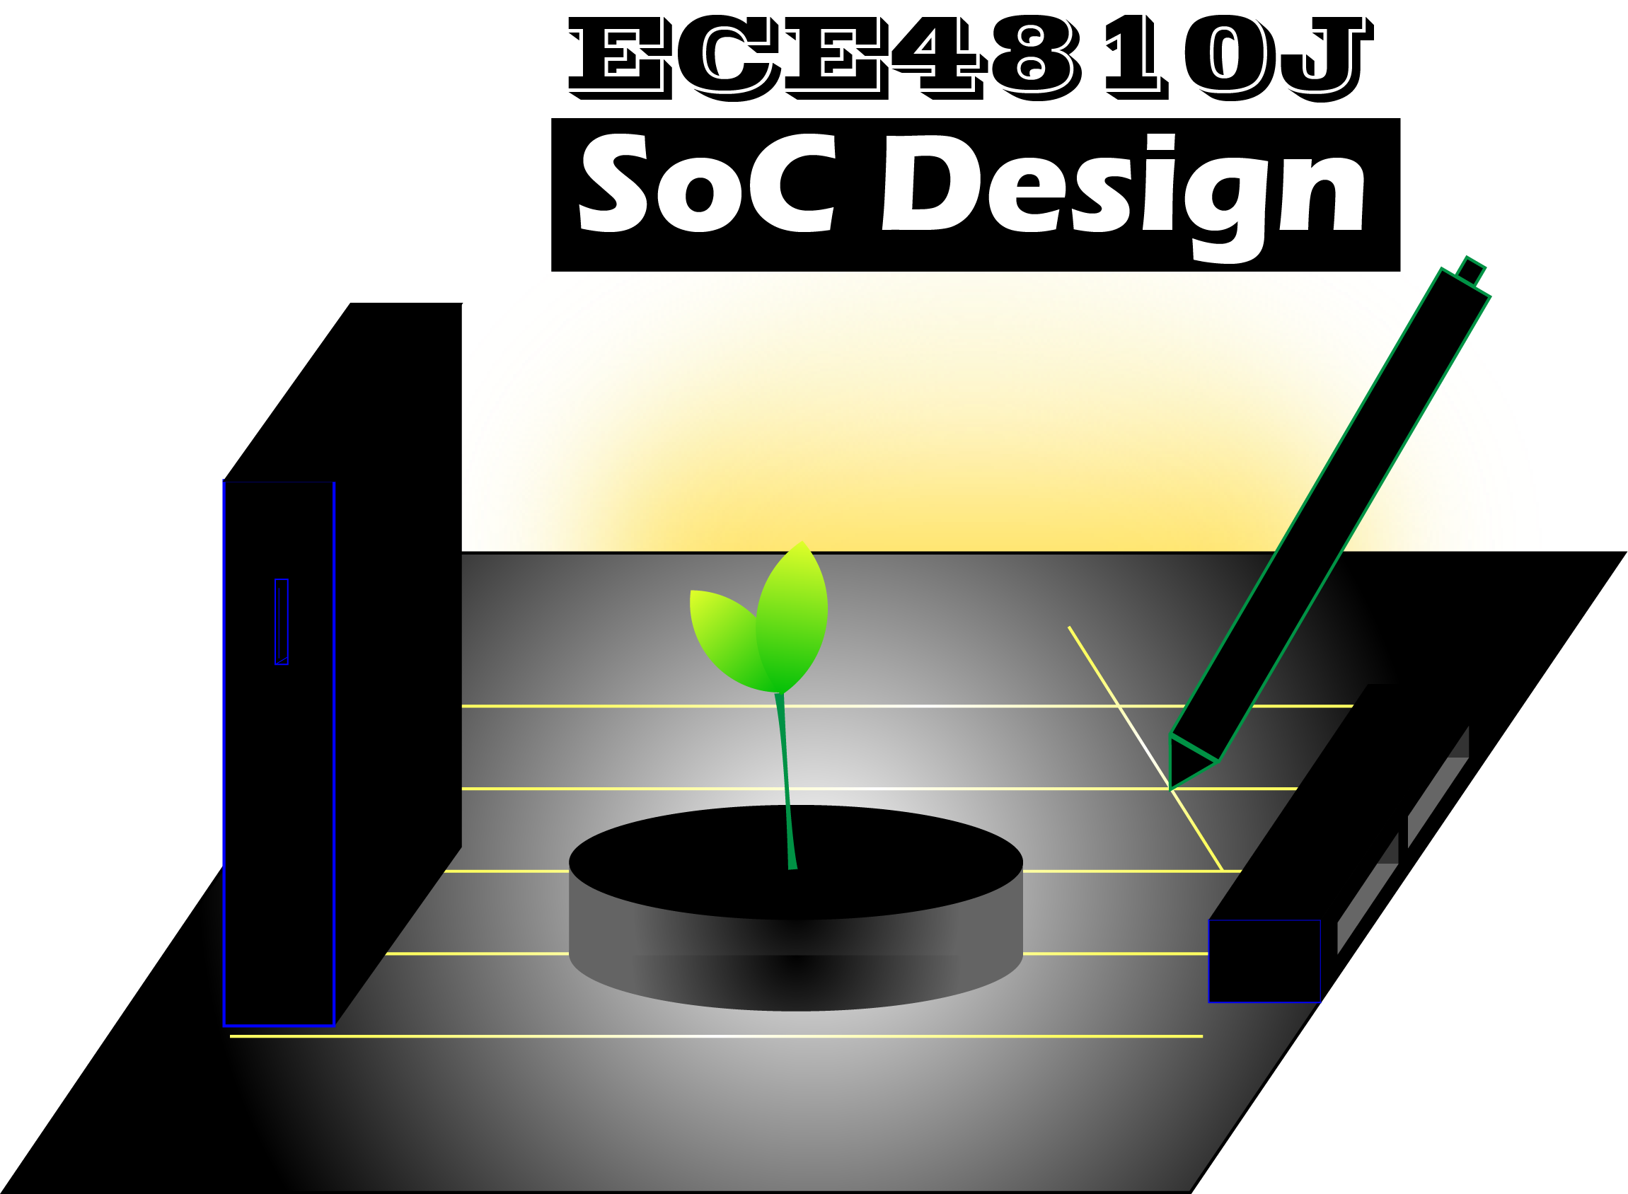
Final Project
FPGA Flow & ASIC Flow
ECE4810J System-on-Chip Design
Yihua Liu
UM-SJTU Joint Institute
ayka_tsuzuki@sjtu.edu.cn
Nov. 14, 2022

Slide 2
Overview
Overview
Schedule
Grading Policy
FPGA Flow
ASIC Flow
Reference

Slide 3
Schedule
Date | Task
Nov. 14, 2022 | Lab 6 continues (offline)
Nov. 15, 2022 | Final Project Introduction (online)
Nov. 16, 2022 | Final Project Topic Decision
Dec. 1, 2022 | Milestone Check
Dec. 8, 2022 | Presentation
Dec. 14, 2022 | Report, Deliverables, and Slides

Slide 4

Grading Policy
Milestone Check
Presentation & slides
Report & documentation
Implementation of base features
Correctness and testing
Performance optimization
Analysis
Additional features (upto 15% bonus)
Some seemingly easy topic can be difficult, vice versa

Slide 5
FPGA Flow
Vitis HLS
Verilog
SystemVerilog
SystemC
MATLAB Function
MATLAB Testbench
Simulink
C Simulation
Lab 1 Section 5
MATLAB Simulation
C Synthesis
Simulink model
C/RTL Cosimulation
HDL Coder
HLS IP Core
RTL IP Core
HDL Code
Block Design
Vivado
HDL Simulation
Cosimulation
HDL Wrapper
Synthesis
Implementation
Bitstream
Vitis
Pynq
Lab 3 Section 6
Notes:
Mixed modeling

Slide 6
ASIC Flow
PDK
Design Libraries
Design
Synthesis
Physical Implementation
Verification
Layout
Tool A
Tool B
Tool C
RTL-to-GDS Flow
Notes:
Mixed modeling

Slide 7
ASIC Flow
PyMTL3 Design
Verilog Design
Synopsys 32/28nm
Lab 5 Section 5
Synopsys 90nm
RTL Simulation
VCS
Yosys
SkyWater 130nm
Synthesis
DC/DFTC
FreePDK 45nm
Physical Implementation
Finish
Floorplan
Placement
CTS
Routing
Parasitic Extraction
Timing Signoff
ICC
OpenROAD
Innovus
Dummy Metal Fill
Verification
PT
Formality
DRC
LVS
Back-annotated Simulation
VCS
Lab 6 Section 3
GDS Layout
KLayout
Notes:
Mixed modeling

Slide 8
Reference
Austin Rovinski, Tutu Ajayi, and Christopher Batten. “OpenROAD Tutorial: Open-Source ASIC Design for Computer Architects”. Oct. 1, 2022.

