Slide 1




Fraud Detection With Unknown Features
Yi Huang
Notes:
Hi everyone. We are group 11. Our topic is what can we learn about learning and how distributed computing can be applied to faster this study.

Slide 2



Outline
Introduction
Process & Model
Results
Conclusion
Notes:
The outline of today’s presentation starts with some introduction to the problem and data then moving on to the data pipeline design. Lastly we present some results and takeaways.

Slide 3
1
Introduction

Slide 4
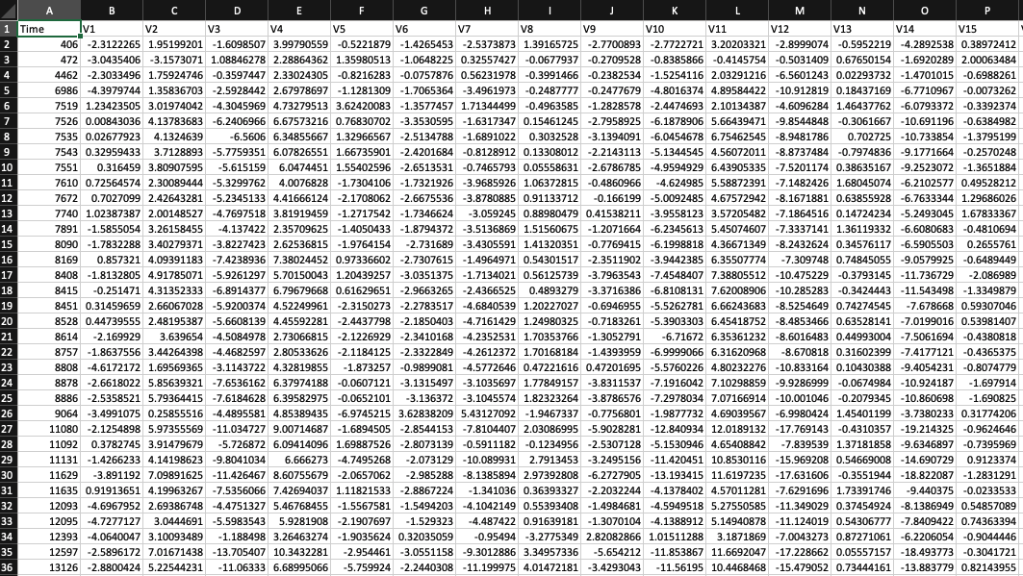
Introduction
Data
Source: https://www.kaggle.com/mlg-ulb/creditcardfraud
30
Features
3
Megabytes
5412
Rows
1
Notes:
The dataset is actually taken from a recent kaggle competition hosted by RIID Lab. According to the dataset description, this dataset is taken from an education app for students to do exercises. The dataset itself is !!extremely large!!!, it consisted of 10 columns and 100 million rows and total size is (26.3GB) over 20 gigabytes. We picked this full dataset without subsetting to gain experience handling industry-level data.

Slide 5



Introduction
Problem Statement
Fraud Detection
Unknown Features
Unbalanced Data
2
Notes:
So what are we trying to solve here?
It’s a knowledge tracing problem
We want to predict whether the student can answer the next question correctly based on the historic performance of the student
From a machine learning perspective, it’s a Time series binary classification problem
Our goal here today is to prepare for these future tasks by doing some analytics

Slide 6
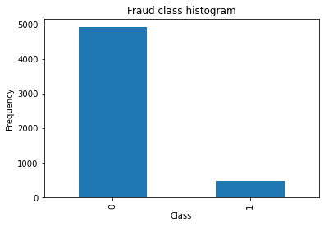
Introduction
Label
Unbalanced Data
Fraud : Non-fraud around 1:10
3
Notes:
So what are we trying to solve here?
It’s a knowledge tracing problem
We want to predict whether the student can answer the next question correctly based on the historic performance of the student
From a machine learning perspective, it’s a Time series binary classification problem
Our goal here today is to prepare for these future tasks by doing some analytics

Slide 7
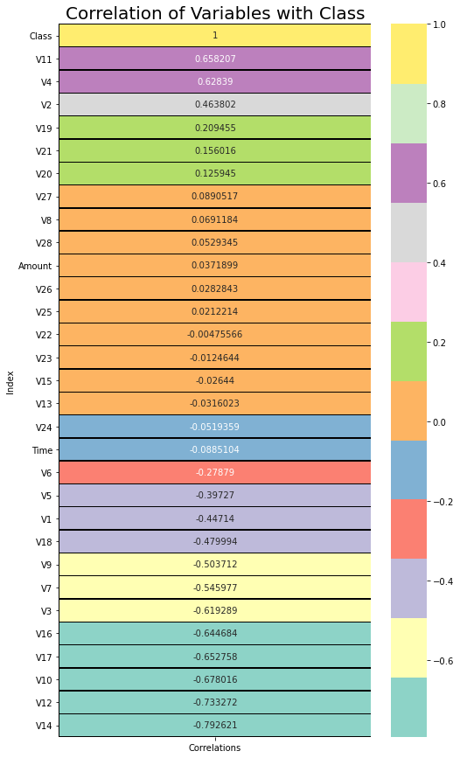
Introduction
Features
30 features, 28 unknown
Correlations with y showed
4
Notes:
So what are we trying to solve here?
It’s a knowledge tracing problem
We want to predict whether the student can answer the next question correctly based on the historic performance of the student
From a machine learning perspective, it’s a Time series binary classification problem
Our goal here today is to prepare for these future tasks by doing some analytics

Slide 8
2
Process & Model
Notes:
We now move on to the data pipeline design

Slide 9

Process & Model Pipeline
Two different models are built and compared
Feature Engineering
Model Searching
Results
Resampling
Model1
Original Data
Standard Scaler + PCA
SMOTE
Random Forest
Metrics
Model2
Log transformation
SMOTE
Gradient Boosting
5
Notes:
We first download the data in csv format from kaggle then we used bash to convert csv to json. Next we upload the json to S3 and used MongoDB M30 for sharing; the process took about a whole day. Next we sharded data into the EMR cluster; we tried three different kinds of clusters and compared the performance. Last but not least, we performed some pyspark operations to improve processing efficiency and eventually made some visualization and eda.

Slide 10
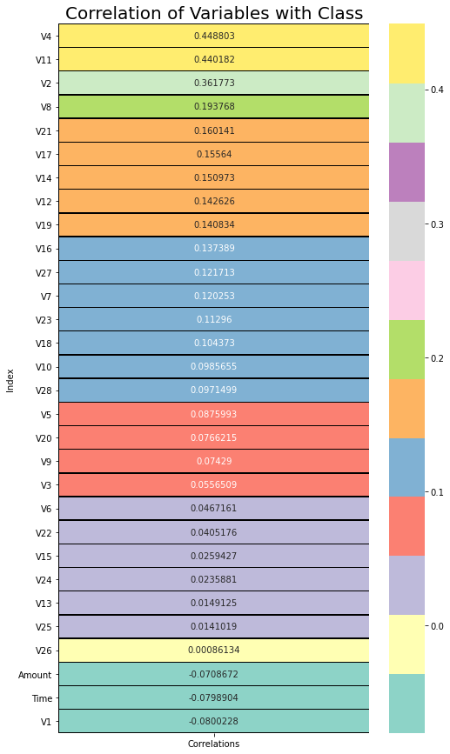
Process & Model Pipeline
Log Transformation
Apply log transform with all features
Correlations increased columns are selected to perform column transformation in the pipeline
Log
transform
6
Notes:
So what are we trying to solve here?
It’s a knowledge tracing problem
We want to predict whether the student can answer the next question correctly based on the historic performance of the student
From a machine learning perspective, it’s a Time series binary classification problem
Our goal here today is to prepare for these future tasks by doing some analytics

Slide 11
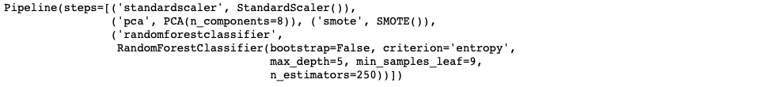
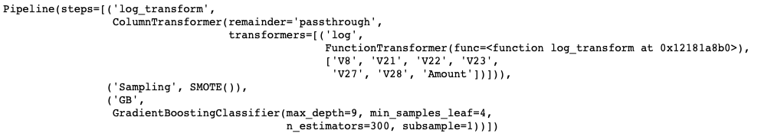
Process & Model Pipeline
Randomized Search CV model results
Model 1
Model 2
7
Notes:
So what are we trying to solve here?
It’s a knowledge tracing problem
We want to predict whether the student can answer the next question correctly based on the historic performance of the student
From a machine learning perspective, it’s a Time series binary classification problem
Our goal here today is to prepare for these future tasks by doing some analytics

Slide 12
3
Results
Notes:
Next, we present our results according to our analytics goals.

Slide 13
Results
 | Model1 (RF) | Model2 (GB)
Balanced Accuracy | 0.932 | 0.942
F1 Score | 0.909 | 0.921
Precision | 0.955 | 0.956
Recall | 0.867 | 0.888
Model 1 vs Model 2
Model 2’s performance is slightly better than model 1
8
Notes:
For the question regarding the relationship between average responding time versus the correctness rate, we made a scatter plot.
We filtered out some of the data that the were skipped as well as some missing data, and after that the dataset still contains ninety eight million rows.
We grouped them by user_id and took the 200,000 data points
We found that there is no obvious relationship between the two features, but Higher responding time will tend to get 50% correctness rate

Slide 14
4
Conclusion
Notes:
Lastly, we want to share with you some of the take aways

Slide 15
Conclusion
Model
Feature Selection + GradientBoosting model is slightly better than the PCA + RandomFrorest model.
PCA might reduces the information model can get from the data.
GradientBoosting algorithm might be better than the RandomForest.
Business
Fraud detection problem, we care the recall of the model, which means that how many fraud cases can be found from the model.
Dealing with encrypted and unknown features.
9
Notes:
Sometimes expensive machines are cost efficient, we need to find a good trade-off between processing time and machine cost/hr.
After experimenting with the execution time in local with/without Spark. Spark shows its ability to process huge data set at speed. In contrast, Pandas crushes the machine :( as shown below
To save more time when loading the data from S3 to MongoDB, we need to use more shards
Try to use better cluster instance for huge dataset, such as r5.xlarge, etc. (Although we don’t have time to compare the exact time reduction for the same code on different instances) It actually does make a significant difference.
I will hand it over to Siwei for some additional comparisons(if time allows)

Slide 16
Next steps
Limitations
Models are quite simple
Need more feature engineering
No experiment control for model comparison
Next Steps
Deeper feature engineering: more transformation, combining features, add new features from original one
More complex model: Ensamble model, Stacked model
10
Notes:
Sometimes expensive machines are cost efficient, we need to find a good trade-off between processing time and machine cost/hr.
After experimenting with the execution time in local with/without Spark. Spark shows its ability to process huge data set at speed. In contrast, Pandas crushes the machine :( as shown below
To save more time when loading the data from S3 to MongoDB, we need to use more shards
Try to use better cluster instance for huge dataset, such as r5.xlarge, etc. (Although we don’t have time to compare the exact time reduction for the same code on different instances) It actually does make a significant difference.
I will hand it over to Siwei for some additional comparisons(if time allows)

