Slide 1
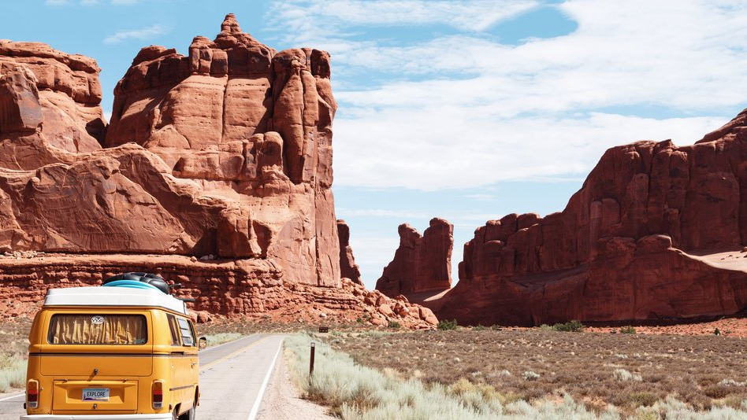
Tourist attraction system
Group MemberS : Fong EUGENE d200273c Lim YI CHENG d200231c Lim Yi Hui d200230c

Slide 2
Objectives
Convenient for users to find the tourist attraction and homestay in Johor.
Saving user’s time by using this simple and easy to use tourist attraction system.

Slide 3
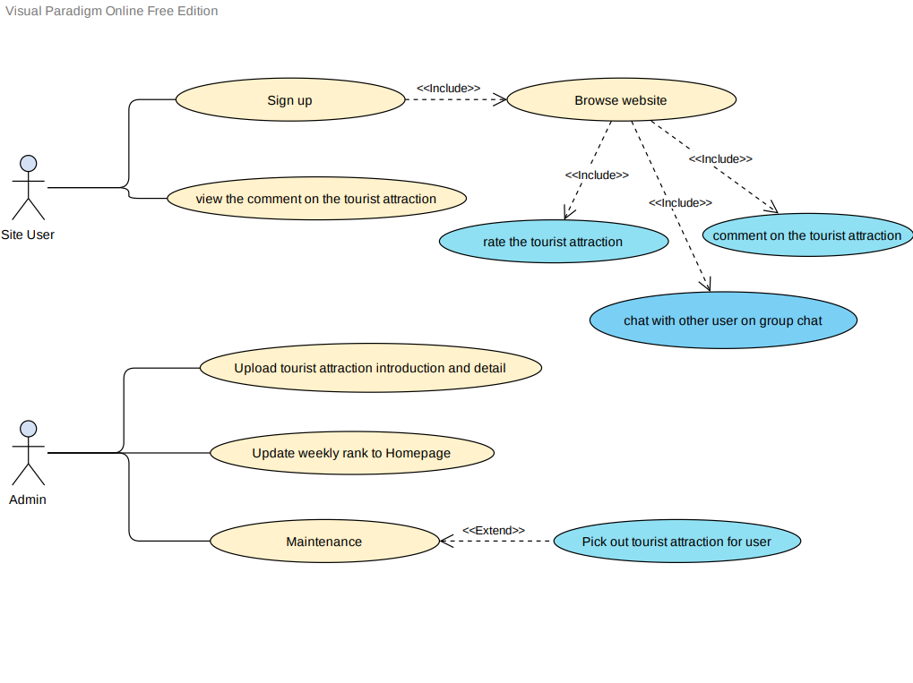
Use Case Diagram

Slide 4
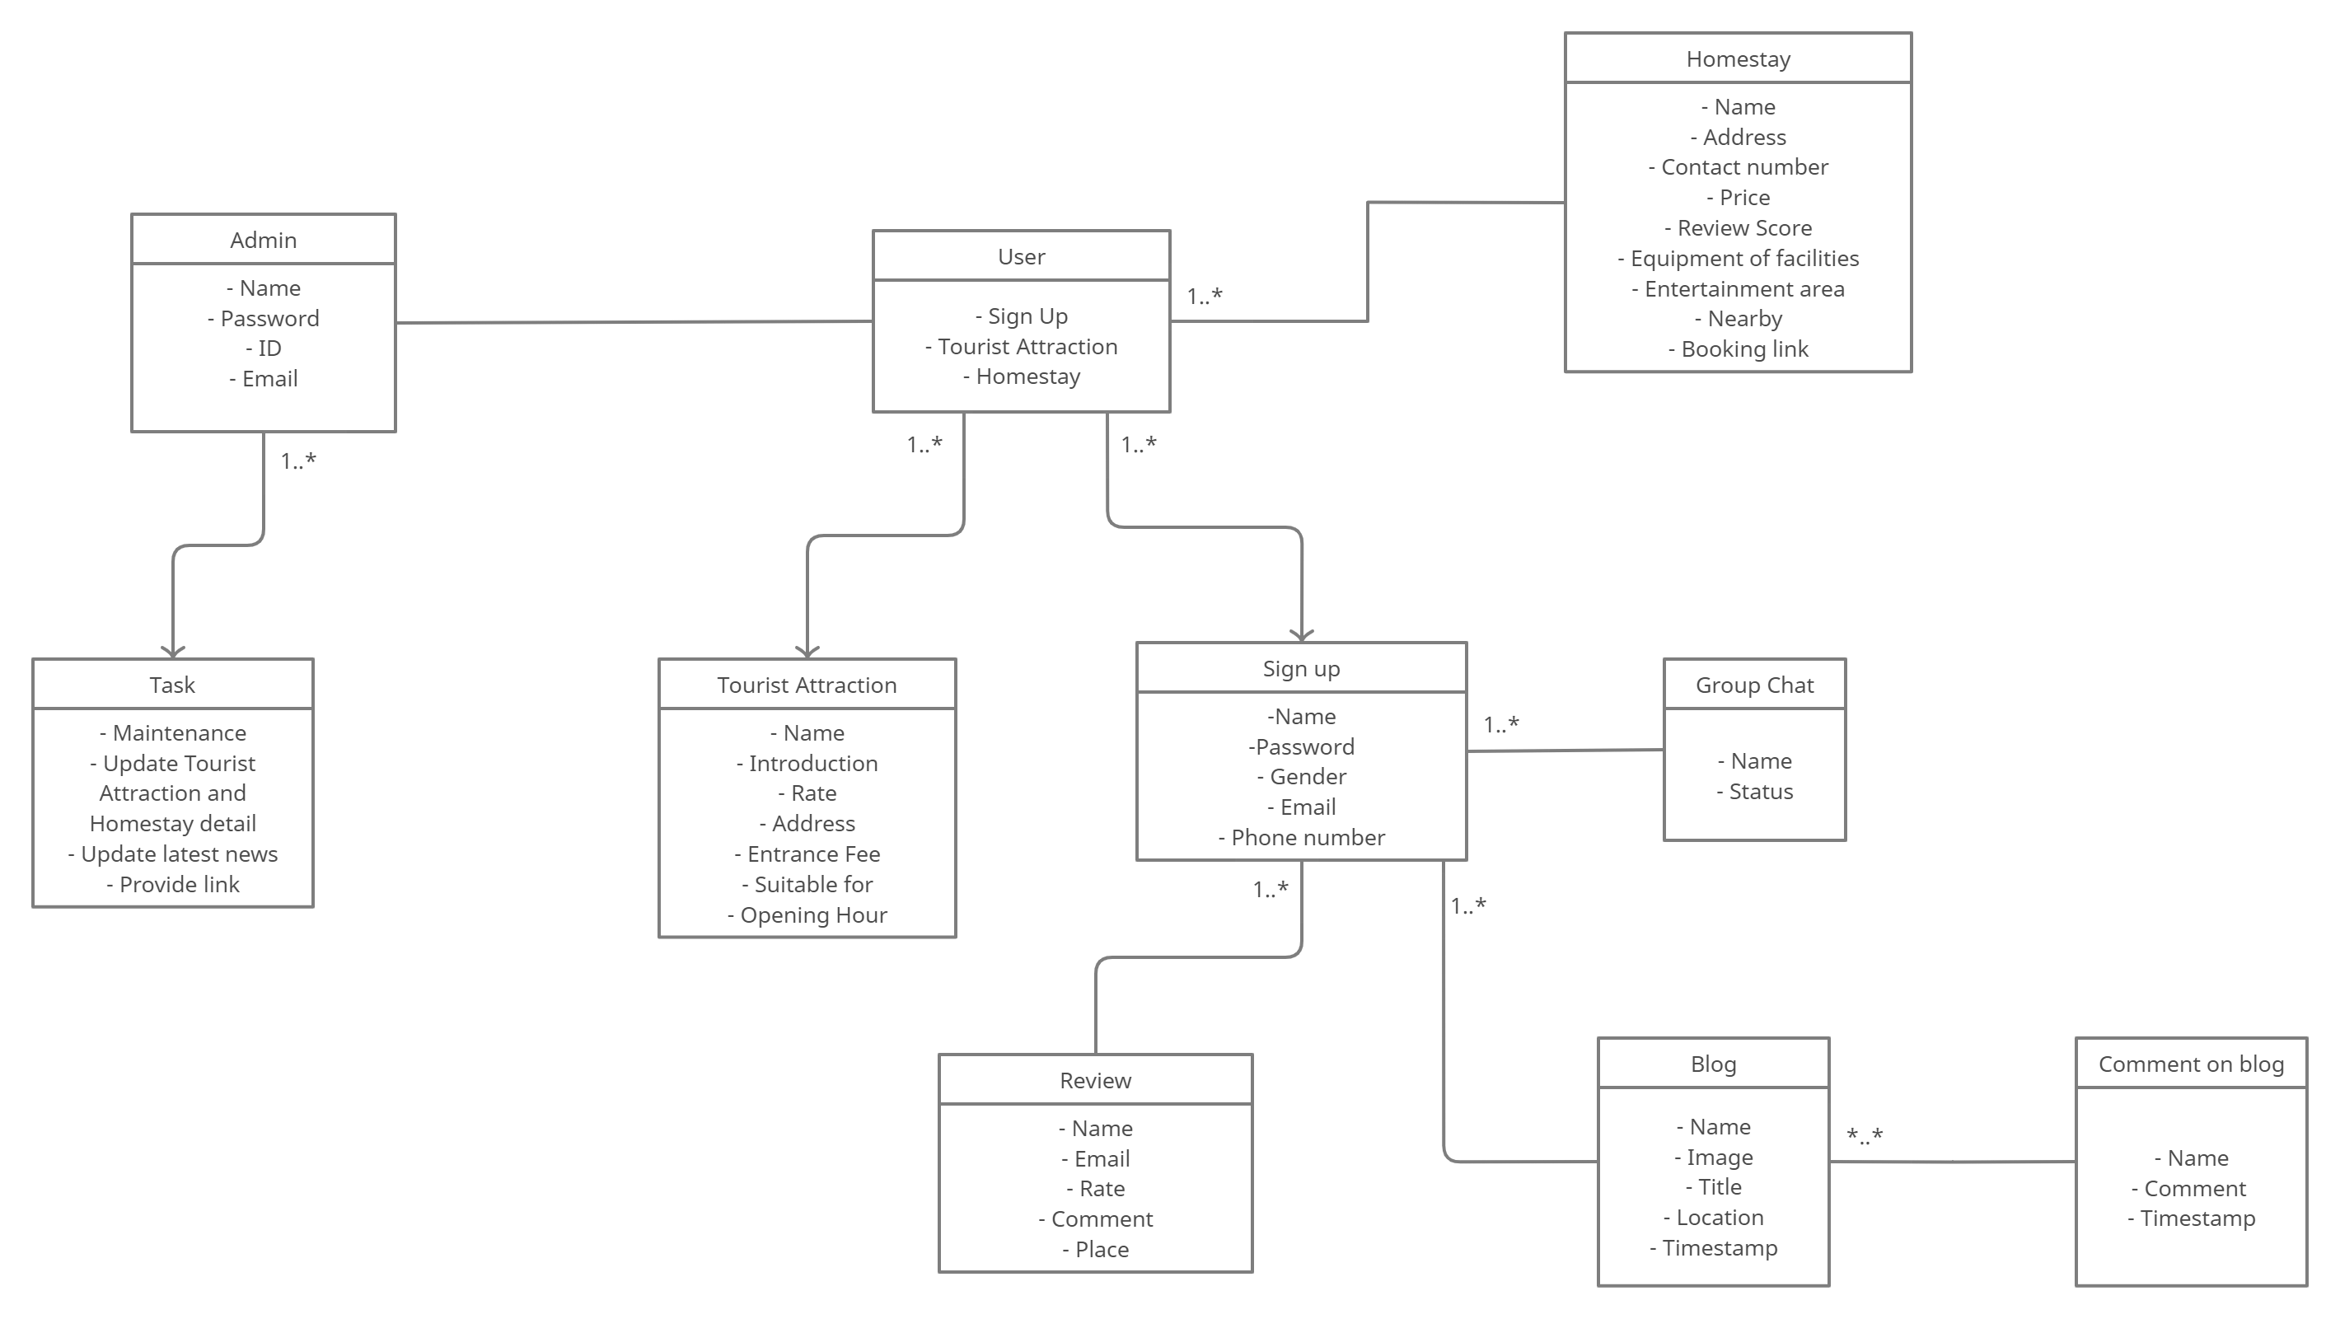
ER Diagram

Slide 5
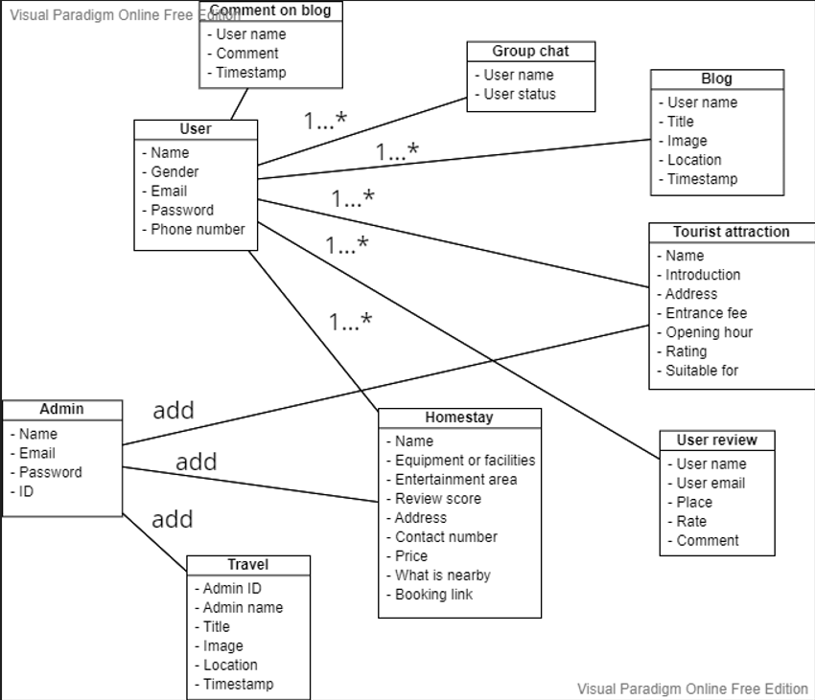
Class Diagram

Slide 6
Prototype

Slide 7
Database

Slide 8
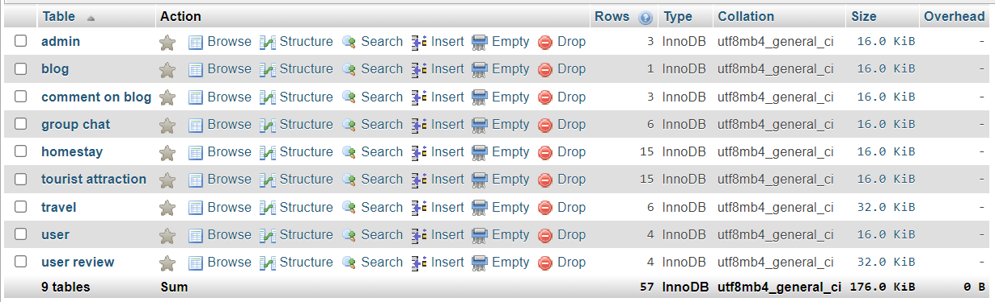
Database Tables

Slide 9
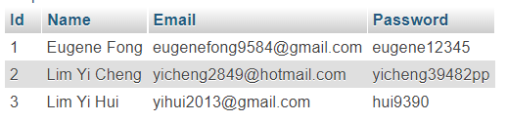
Admin

Slide 10
Blog

Slide 11
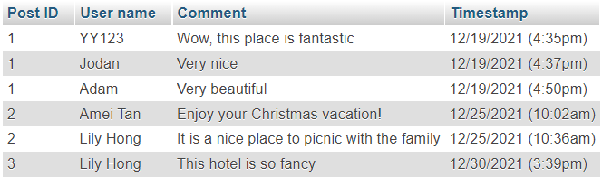
Comment On Blog

Slide 12
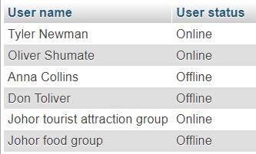
Group Chat

Slide 13
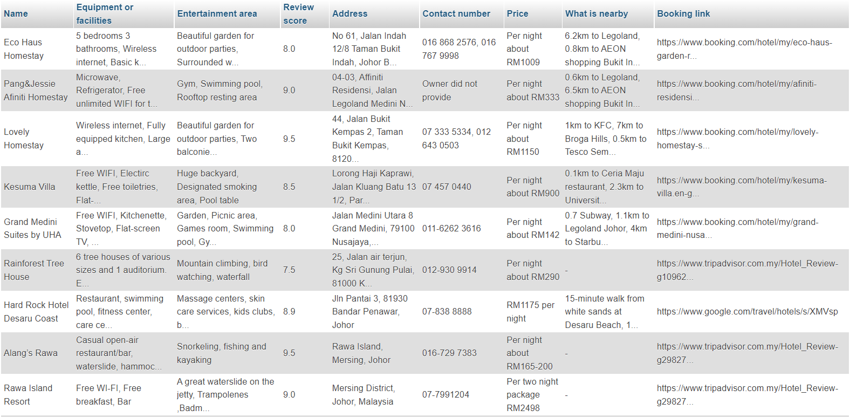
Homestay

Slide 14
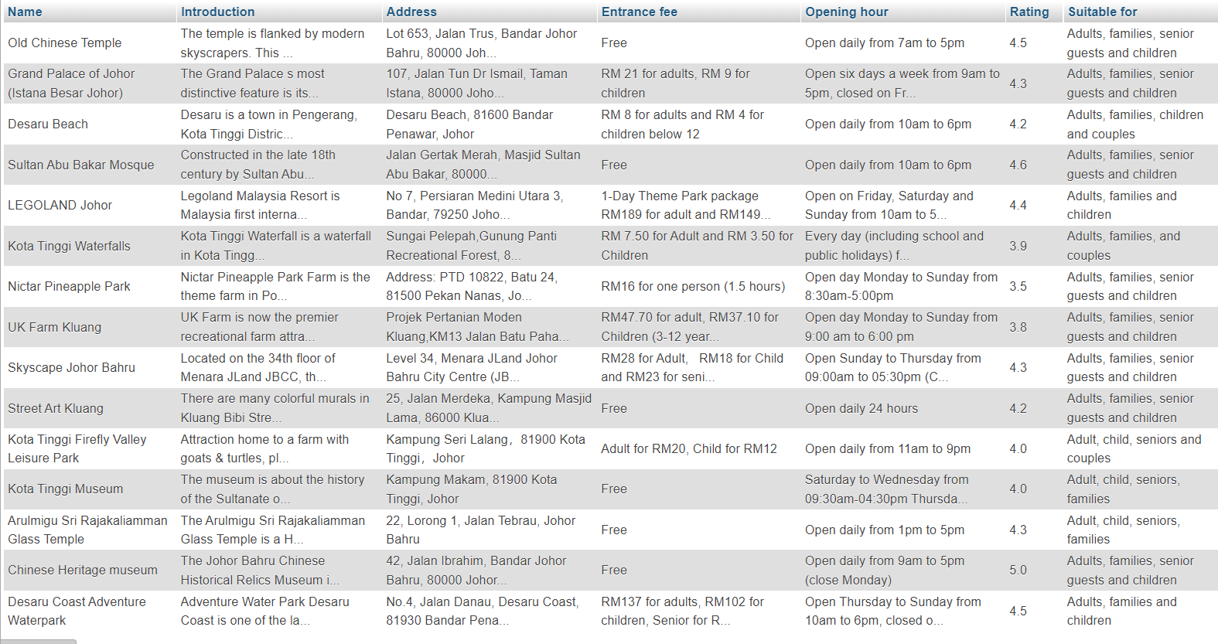
Tourist Attraction

Slide 15
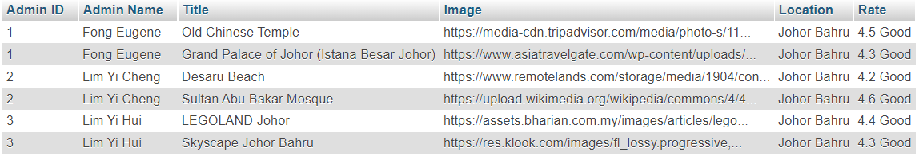
Travel Page

Slide 16
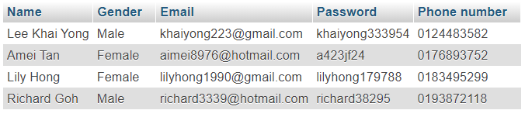
User

Slide 17
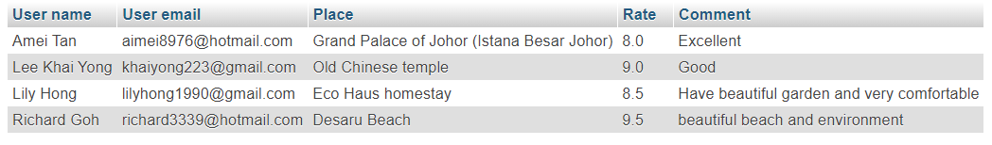
User Review

Slide 18



Select

Slide 19
Insert

Slide 20

Update

Slide 21

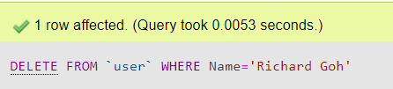
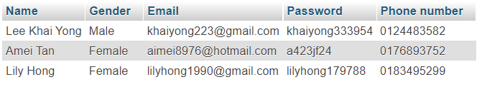
Delete

Slide 22
Conclusion
Interface is easy to understand and use for everyone
As a reference for user before they visit
Saving user time from searching the information that either false or incomplete

Slide 23
Future Works
We will combine the prototype with the database and make a physical website
Do some improvement to increase user's experience

Slide 24

THE END
Thanks you for listening

